Slide 1

Right to work checks
Refresher sessions for Divisional / Department staff
HR Staff Compliance Team
Information current as of 19 February 2024

Slide 2
Key reminders
Why right to work checks are essential – legal risk
College process - which teams / departments are responsible for checks
Types of right to work checks undertaken by hiring department
Key steps of right to work check (manual or online)
Unacceptable evidence types
Documenting the check and where to send evidence
Notes:
Questions at the end of slides

Slide 3
Key weblinks
Right to work guidance:
https://www.imperial.ac.uk/human-resources/compliance-and-immigration/immigration/right-to-work/
https://www.gov.uk/government/publications/right-to-work-checks-employers-guide
Right to work checklist:
https://www.imperial.ac.uk/media/imperial-college/administration-and-support-services/hr/public/policies/immigration-asylum-and-nationality-act-2006/Imperial-Right-to-Work-Checklist-Department-vs-1.docx
Online right to work check links:
https://www.gov.uk/prove-right-to-work
https://www.gov.uk/view-right-to-work

Slide 4
Prevention of illegal working - responsibilities
UKVI expect sponsors to demonstrate a commitment to ensuring prevention of illegal work and have appropriate processes. This is checked during sponsorship licence audits.
RTW checks for all College staff, not just those on sponsored visas, as any breach would demonstrate weakness in process/systems:
The College has a legal obligation to prevent illegal working. If we were to employ an individual who did not have the legal right to undertake the work offered this could result in:
    A Civil Penalty = a maximum £60,000 fine per illegal worker
    (If knowingly = a maximum 2-year prison sentence + unlimited fine)
Significant impact upon College sponsorship licences to recruit international staff (and students) & damage to reputation
A compliant RTW check, undertaken before work start, evidenced correctly, provides the College with a ‘statutory excuse’ against a civil penalty. This is our ‘insurance’ against the above risks.

Slide 5
Right to work / UK visa status held by individual
Individual should state their UK Immigration / right to work status on their application form saved as part of a candidate pack
If their current immigration/RTW status is not clear, this can be asked by the hiring department on interview date or following a verbal employment offer.
    It should be made clear that any check/questions on RTW status is so that we can proceed any new hire / contract request efficiently – i.e. if individual cannot yet evidence their RTW this will not impact on the recruitment decision
If the individual doesn’t yet hold any UK Immigration status, please ask them to provide a copy of their current passport and confirm any relevant information about previous UK immigration statuses held.
  There is no point in completing a RTW check at this stage or completing a right to work checklist, as the checklist is to document when the check is fully completed.

Slide 6
Right to work checks – HR Staff Compliance Team
Employees – where check responsibility sits with HR Staff Compliance Team
All ‘time-limited’ visa holders (i.e. has an expiry date – but not including EUSS)
Any individual with a current UK Immigration (visa) application in process
Any individual who does not currently hold a UK visa
Sending time-limited visa/EUSS pre-settled status expiry reminders and completing follow up RTW checks during employment
For the above, please gather any relevant information and submit with new hire request to HR Recruitment / Staff Hub team processing contract offer.
RTW Check will be conducted following the offer, and before work start – confirmed by a ‘conditions met’ email addendum to conditional contract

Slide 7
Right to work checks – Hiring department
Employees – where checking responsibility sits with hiring department
UK nationals (In person check only)
Irish nationals (in person check only)
Indefinite leave to remain / settlement / no time limit (Non-EUSS)
  usually an Online check,
  However some may have an endorsement in a current passport, and it would be an in-person manual document check required for these
EUSS settled status Indefinite Leave to Remain (Online check only)
EUSS pre-settled status (Online check only)
Frontier Worker Permit check (Online check only)

Slide 8
Right to work checks – Other
Employees – Overseas work - International Mobility Team conduct all checks for any work to be conducted from overseas for new or current employees. They will liaise with Staff Compliance Team where individual also has a UK immigration status, and also needs a RTW in the UK check or follow up check.
Sponsored Researchers – Staff compliance team responsible for all new T5 sponsored researcher, or follow up check
Casual workers – all pre-engagement and follow up checks done by CWT
Casual work team process Visiting/honorary associations but are not responsible for any pre-engagement ID/status checks or ATAS cert checks, this falls with the hosting department
Visitors/Honorary Researchers/Academic Visitors – Hosting Dept responsible for any status / ID check and any pre-start ATAS certificate check, where applicable
Permitted Paid Engagements – pre-engagement ID checks untaken by CWT if to be paid through casual payroll, or if invoice is to be paid through Accounts Payable, this would be undertaken by the hosting department.

Slide 9
Types of RTW check – where department conducts the check
UK and Irish nationals (manual in-person check)
Where the evidence is a UK/Irish Passport, or UK birth certificate along with other evidence (payslip with NI number etc) this must be original evidence and checked in person with the individual present.
  It is not acceptable since October 2022 to conduct manual document checks/ photo verification online via video-call, this must be an in person check without exception.
Indefinite leave to remain (manual in-person check)
Where the individual has a settlement/Indefinite leave status endorsed in a current passport (not on BRP card or viewable as Online check) or on an Immigration Status Document this again must be the original document checked in person.
  Where the individual has settlement/indefinite leave status endorsed in an expired passport, this is not accepted evidence. The Staff Compliance Team will advise the individual to get documents updated and to undertake the check.

Slide 10
Types of RTW check – where department conducts the check
Manual, in-person document check evidence types/combinations:
A passport (current or expired) showing the holder is a British citizen or a citizen of the UK and Colonies having the right of abode in the UK.
A passport or passport card (in either case, whether current or expired) showing that the holder is an Irish citizen.
A document issued by the Bailiwick of Jersey, the Bailiwick of Guernsey or the Isle of Man, which has been verified as valid by the Home Office Employer Checking Service, showing that the holder has been granted unlimited leave to enter or remain under Appendix EU(J) to the Jersey Immigration Rules, Appendix EU to the Immigration (Bailiwick of Guernsey) Rules 2008 or Appendix EU to the Isle of Man Immigration Rules.
A current passport endorsed to show that the holder is exempt from immigration control, is allowed to stay indefinitely in the UK, has the right of abode in the UK, or has no time limit on their stay in the UK.
A current Immigration Status Document issued by the Home Office to the holder with an endorsement indicating that the named person is allowed to stay indefinitely in the UK, or has no time limit on their stay in the UK, together with an official document giving the person’s permanent National Insurance number and their name issued by a government agency or a previous employer.
A birth or adoption certificate issued in the UK, together with an official document giving the person’s permanent National Insurance number and their name issued by a government agency or a previous employer. Includes a full birth certificate issued by a UK diplomatic mission (British Embassy or British High Commission.
A birth or adoption certificate issued in the Channel Islands, the Isle of Man or Ireland, together with an official document giving the person’s permanent National Insurance number and their name issued by a government agency or a previous employer.
A certificate of registration or naturalisation as a British citizen, together with an official document giving the person’s permanent National Insurance number and their name issued by a government agency or a previous employer.

Slide 11
Types of RTW check – where department conducts the check
Online checks for:
EUSS settled status
EUSS pre-settled status
Indefinite leave to remain / Settlement – Biometric residence permit/card holders
Frontier worker permit holders
All these checks are conducted via using a share code on the Home Office online RTW check portal. We cannot accept letter confirming status or BRP card.
Photo verification can be conducted in person or over a MS Teams video call
Obtaining the share code is not the completed check, where one of the above statuses, the hiring dept must use the online portal and download the check result pdf and verify photo likeness themselves.

Slide 12
Online checks
Guidance on conducting the online check and examples of the result types is online here: https://www.imperial.ac.uk/media/imperial-college/administration-and-support-services/hr/public/policies/immigration-asylum-and-nationality-act-2006/Online-RTW-checks-guidance-for-departments-October-2022-update.pdf
Candidate/employee raises a share code online and provides this for the department to check their status, alongside their date of birth. The code is only valid for a fixed number of days
The department can check the individual’s status via https://www.gov.uk/view-right-to-work using the share code and the employee’s date of birth.
  On the online form - for the question ‘What is your company name’, enter: 'Imperial College London’.
You can view the person’s immigration status and picture online and download as a pdf.
You must perform a video call with the individual or see them in-person whilst the online check result/pdf is on screen to verify their photo likeness.
Record the completed check on a RTW Checklist, and snip/paste the pdf result in full onto the evidence section of the checklist.
If any technical issue with the Online Check portal, or on the result, please let HR know

Slide 13
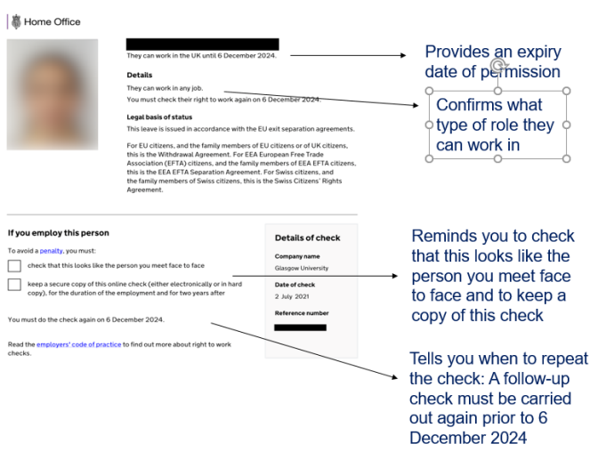
Online checks – e.g. EUSS pre-settled status

Slide 14
Undertaking and evidencing the RTW check
Pre-employment RTW checks must be undertaken before work or induction is started and time of the check recorded.
  Ideally, wherever possible – undertake the RTW check on the interview day and submit evidence with the new hire documents to HR Hub team processing contract*
  Where RTW check has not been conducted at interview, where possible undertake this before work start date and send evidence to HR Hub team processing contract
  Where RTW check is a manual in person document check and not possible to conduct before the work start date, this must be scheduled as Task 1, Day 1, before any other induction activity is carried out.
Once check is completed - Send the RTW evidence on a completed RTW Checklist to the HR Hub team to add to the file promptly so that they can update HR Information system and update individual and hiring department as the RTW contract condition as being met.
  In future, please include a copy of confirmation of ‘RTW check/conditions met’ sent from a HR team along with the new starter checklist and employment contract when sending to payroll.
*If an individual doesn’t yet hold a suitable right to work status for the work being offered at time of interview, you should not complete a RTW Checklist, this will be done by HR once the correct status is held and check is completed.

Slide 15
Documents / evidence - reminders:
Expired UK/Irish passports are acceptable as RTW evidence
Where a settlement / Indefinite leave visa status is held as an endorsement in the passport, this must be endorsed in a current valid passport to be acceptable evidence
Where settlement / Indefinite leave visa status is on an Immigration Status Document this requires National Insurance number evidence too.
EU passports or National ID cards are not accepted RTW evidence
Biometric Residence Permits are not accepted RTW evidence
British National Overseas (e.g. Hong Kong national) travel document looks a lot like a British passport but is not acceptable evidence of right to work – would need Online check
UK Driving licence is not accepted evidence
It is not acceptable to use a result from an Online RTW/Immigration status check that we haven’t accessed with share code and saved ourselves.

Slide 16
Documenting the RTW check
Check the evidence is on the list of permitted evidence and looks genuine
  If the evidence/Online check result appears to show any status other than British/Irish national, Indefinite leave, EUSS or Frontier worker permit status – refer to HR to complete the check following the conditional contract
Check the status is current and valid
Check any photograph likeness on evidence matches the individual
Record when the check was completed, who conducted the check and whether Online RTW check, or a Manual in-person check
Use the current version of the RTW Checklist to record this and use this to record the scan/photo/screengrab of the evidence/online status that has been checked. Please delete any locally saved copies and use the link when needed.

Slide 17
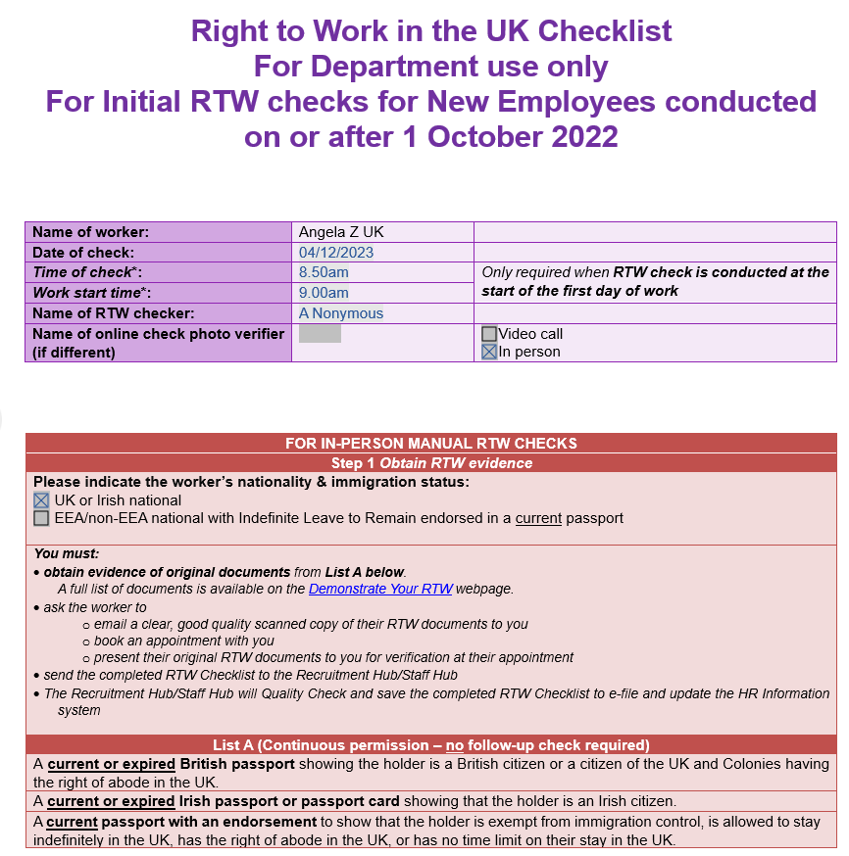
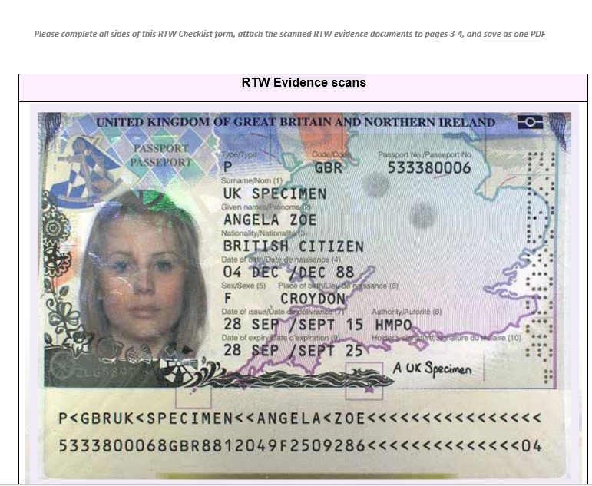
Using the RTW Checklist

Slide 18


Questions..

