Slide 1
Room Booking
User Guide
May 2018 – V.01

Slide 2
Contents
Introduction to the new Room Booking System | 3
Using Outlook: Make a booking Amend / Cancel a booking | 6
Using Planon Make a booking Amend / Cancel a booking | 12
Using the Advance Room Search & Report (ICLIS) | 25
Etiquette for Using College Shared Space | 28
Appendix 1 – How to Add the “Room Bookings” Gadget | 35
Appendix 2 – Room Booking and Room Use Etiquette | 37

Slide 3
Introduction to the new Room Booking System

Slide 4


What is the new Room Booking system?
The College is introducing a new system, Planon, for booking meeting rooms. This system enables self-service bookings and is also integrated with Microsoft Outlook. For more details about the system roll-out, please visit the Room Booking Implementation Project website. Using Outlook or Planon has different advantages:
Quickly book or request familiar rooms, from your department’s group.
Manage the whole meeting from one appointment e.g. invitees, attachments.
Easily create and manage a series of recurring bookings.
Use search functionality, including location, capacity and room facilities, to find and book suitable meeting rooms.
View a list of your upcoming room bookings (including those made in Outlook).
Use the ‘ICLIS’ gadget to search for teaching rooms, view their availability and find contact details.

Slide 5
Types of Rooms
One of the goals of introducing a new room booking system is to facilitate better sharing of space across the College. However, recognising the complexities of the estate and its varied uses, rooms can have the following properties:
All staff with a College ID and login will be able to book these rooms directly.
Open to all staff
Staff, whose department has put a shared room in the system, will be able to book other department’s rooms that have also shared.
Shared
Staff will be able to request these rooms, which are approved or rejected by a departmental moderator.
Moderated
Restricted
Only staff in the restricted department(s) will be able to book these rooms.

Slide 6
Room Booking Using Outlook

Slide 7
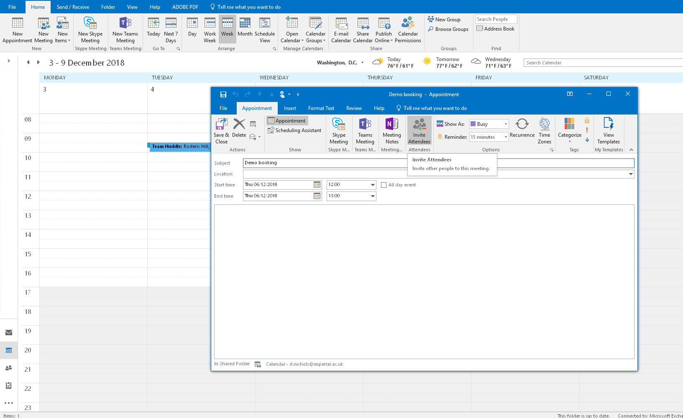
Outlook: Make a Booking
Open your Calendar and create a “New Appointment”. This will open a new window.
In the “Appointment” tab select “Invite Attendees”.

Slide 8
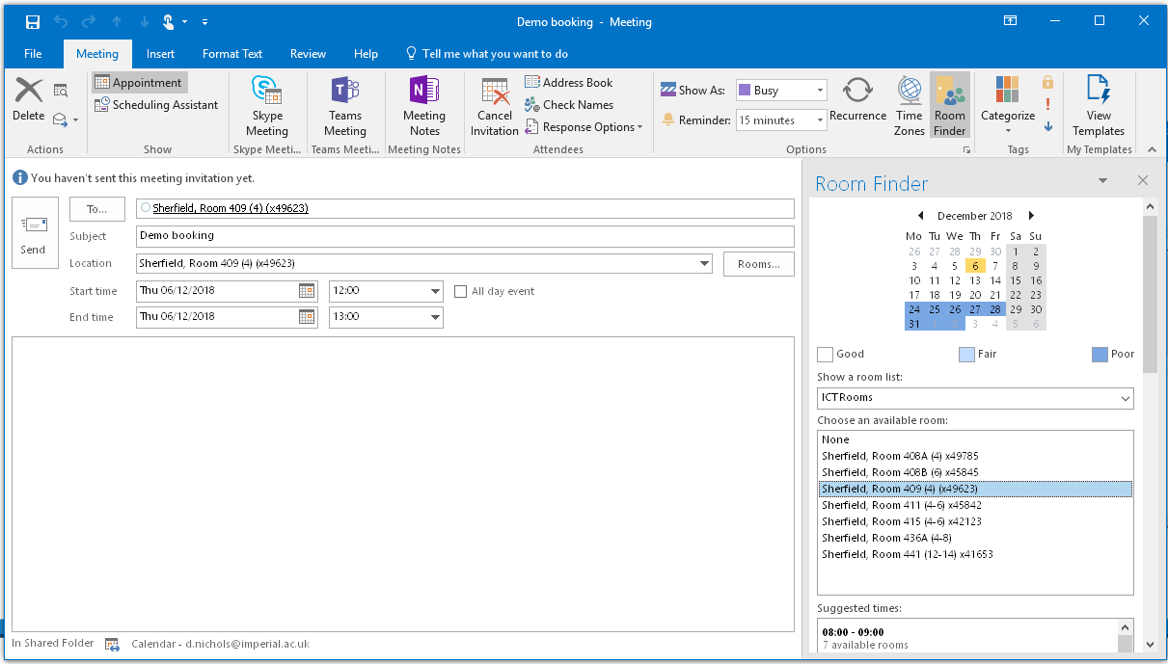
Outlook: Make a Booking
Click on the “Room Finder” in the top ribbon.
Select the list of rooms you are interested in booking. It is advised you only select the list for your department, or the “Shared Rooms” list, as you may not have permission to book others. To search for new rooms, it’s recommended that you use Planon.
Once you have selected a list of rooms, it will show which rooms are available and below, a list of suggested times for when the most rooms are available.

Slide 9
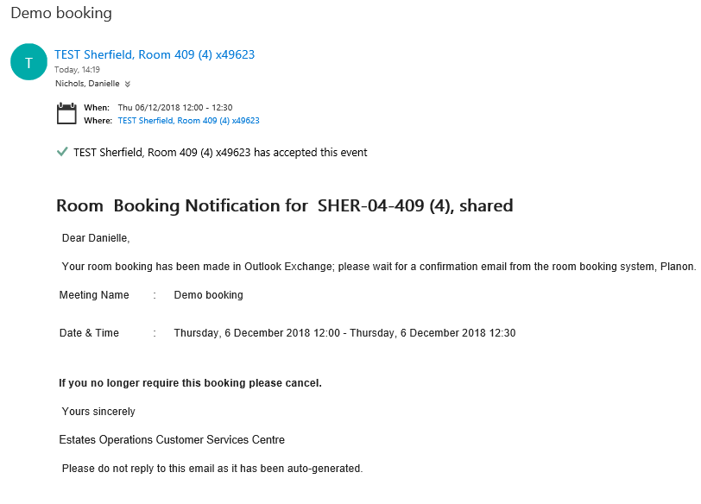
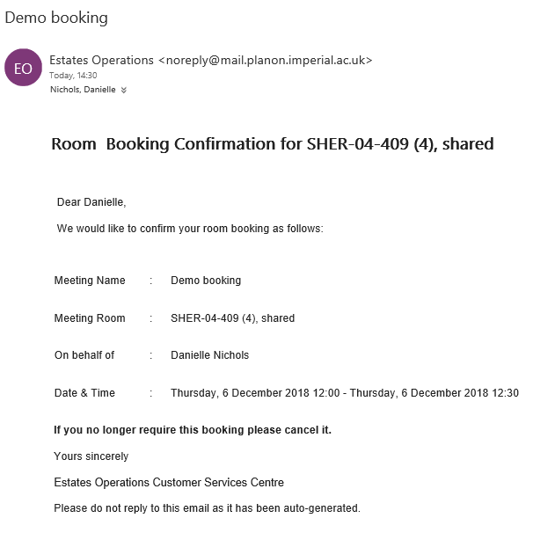
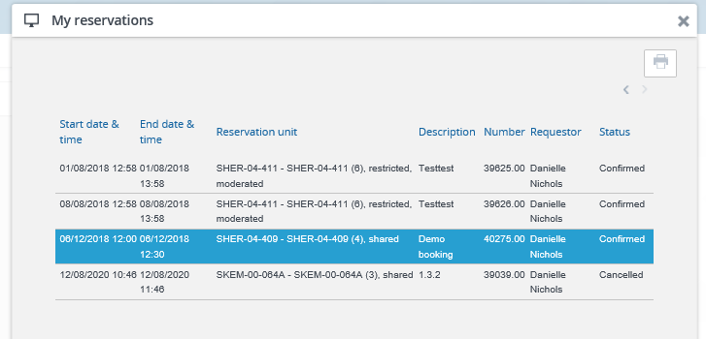
Outlook: Make a Booking
7a)
7b)
Invite any other attendees and add any other information or attachments to the appointment, and then click “Send”.
You will receive two or three emails:
A confirmation email from Outlook Exchange that the room is free.
A confirmation email from Planon that the booking has been made in the system. Your booking is not confirmed until you receive this second email.
If the room you have requested is moderated, you will also need to wait for a confirmation email from the moderator.
You can easily check the status of all upcoming bookings in “My Bookings” when you log in to Planon.
8)

Slide 10
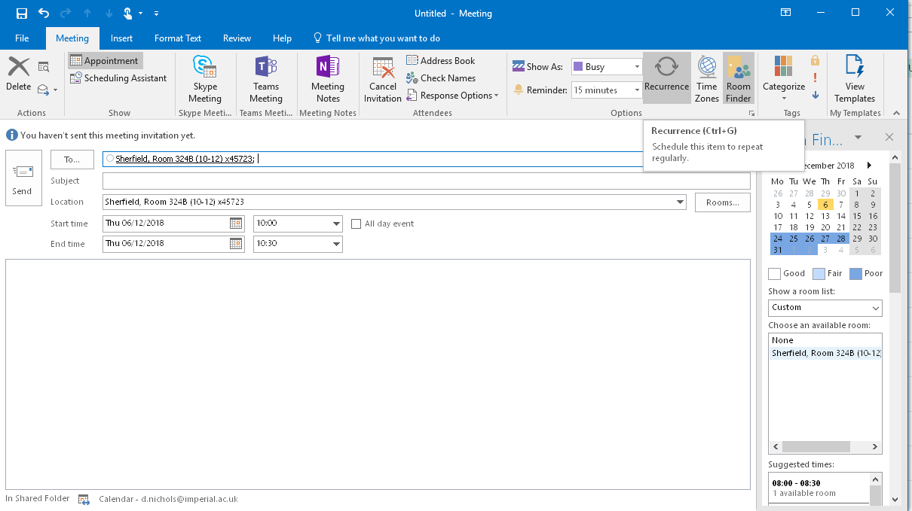
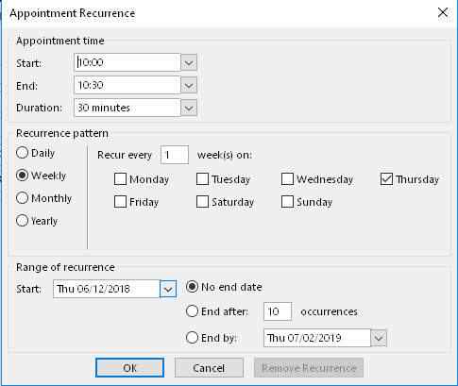
Outlook: Make a Booking (recurring)
To create a series of recurring bookings, create the first appointment and select the room to be booked (see page 7).
Click the “Recurrence” button to open a new window.
Select the preferred recurrence and send the appointment. You will receive email notifications from Outlook and Planon.
If one of the occurrences is not viable, then the whole series will be rejected.

Slide 11
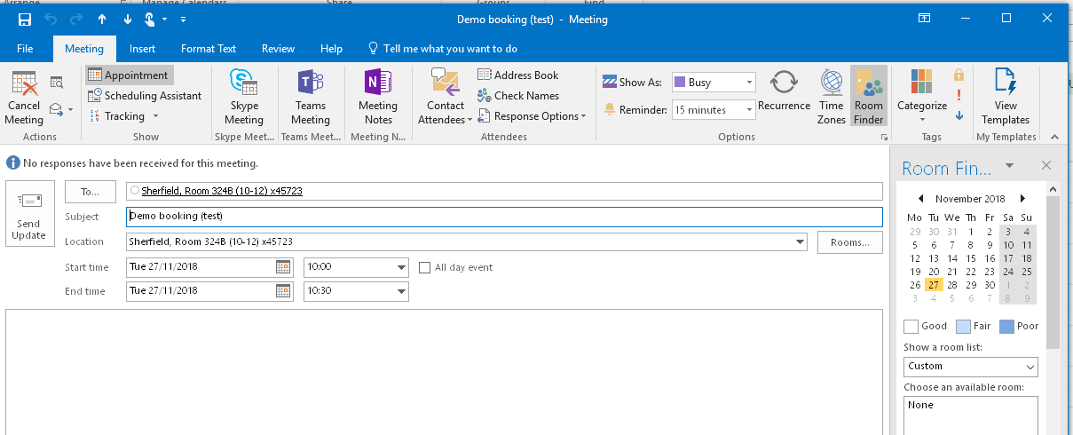
Amend or Cancel a Booking
To amend a booking, select the appointment in your calendar and adjust the time, date or location. Click “Send Update”. You will need to wait for confirmation emails from Outlook and Planon for the amended booking.
To cancel a booking, select the appointment in your calendar and click “Cancel Meeting”. This will automatically remove your booking from Planon too.

Slide 12
Room Booking Using Planon

Slide 13
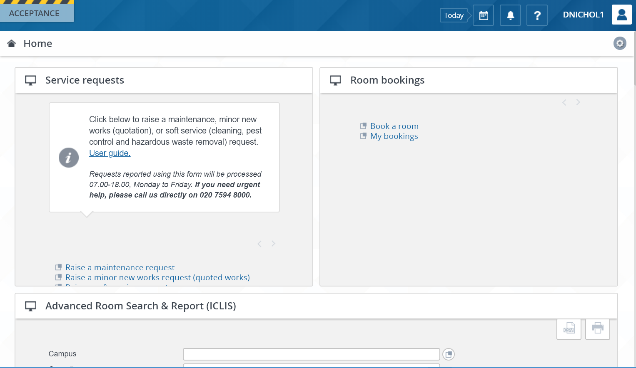
Planon: Make a Booking
Navigate to Planon and log in using your usual user name and password.
Go to the gadget called “Room Bookings” and click “Book a Room” to enter the wizard. If you cannot see this gadget, see Appendix 1 for instructions on how to add it.

Slide 14
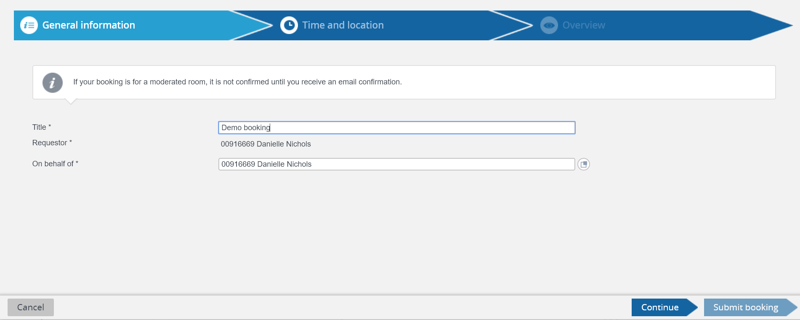
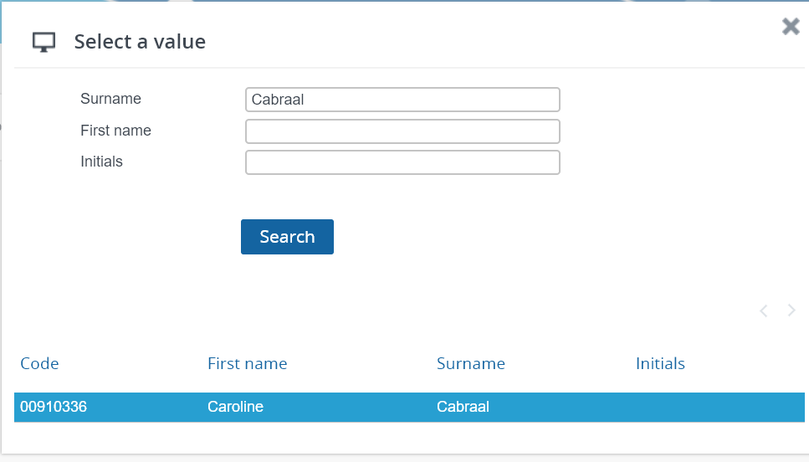
Planon: Make a Booking
The Room Booking Wizard will guide you through all the steps to make a room booking. On the first page, give the booking a title. This will be visible in “My Bookings” in Planon and the confirmation appointment that is sent to your email.
The “On behalf of” field will default to yourself. However, you can make bookings on behalf of colleagues. At the end of the “On behalf of” row, click the pop up button. Search for the colleague you’d like to book on behalf of and select their name.
Click “Continue”

Slide 15
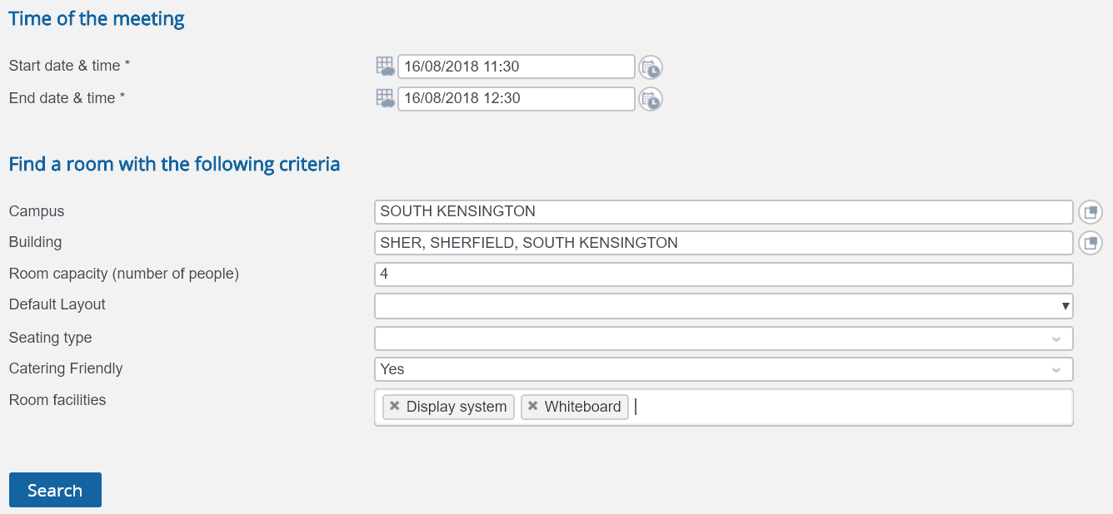
Planon: Make a Booking
The next page offers the opportunity to search for rooms based on a range of criteria.
The date & time of the meeting are the only compulsory criteria
You can start writing in these fields and they will prepopulate. Or click on the button at the end of the row to see all the options.
If a “Room capacity” is entered, search results will only show rooms of that size, or above.
“Room facilities” contains a drop-down list of items in a room. As many of these as required can be selected.
Selecting “Yes” will only return rooms where catering is allowed.
Once all the required criteria have been selected, click “Search”. The results will appear below.

Slide 16
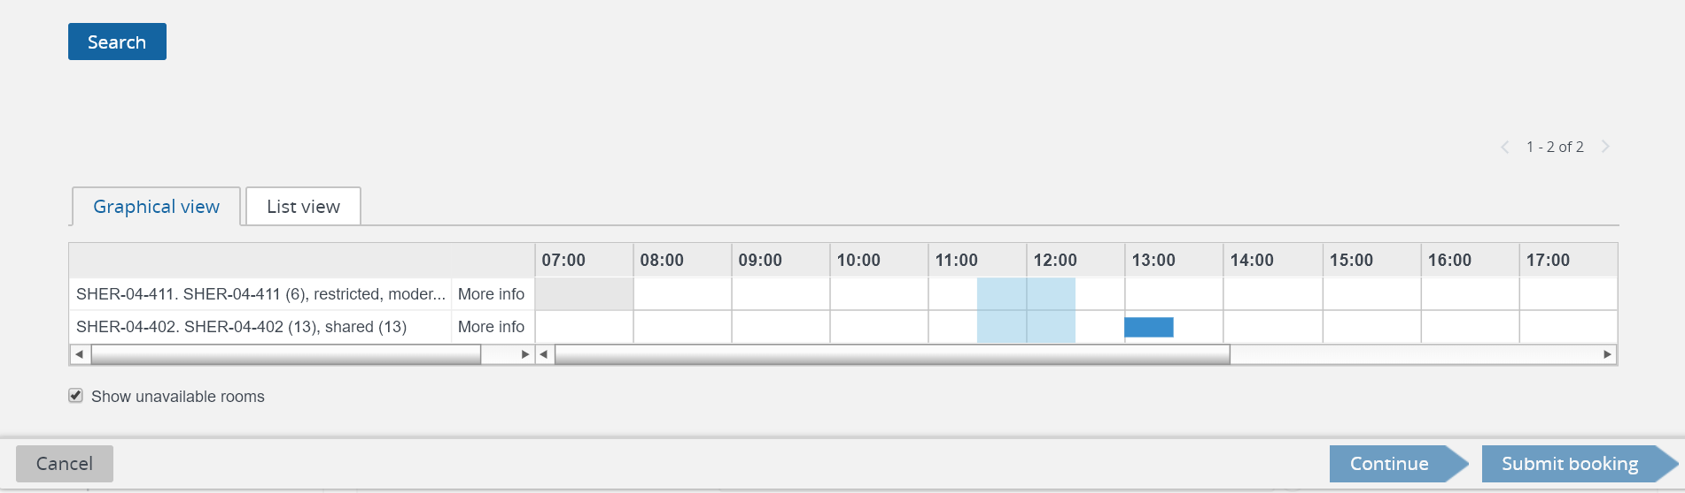
Planon: Make a Booking
Existing booking
The search results will return a list of rooms that meet your criteria. You can also tick the box to “Show unavailable rooms”, if there is flexibility about what time the meeting can be held. All existing bookings in the room on that day will show up in the planner as blue blocks.
The room name will inform you of its capacity in its default layout, and whether the room is moderated or not.

Slide 17
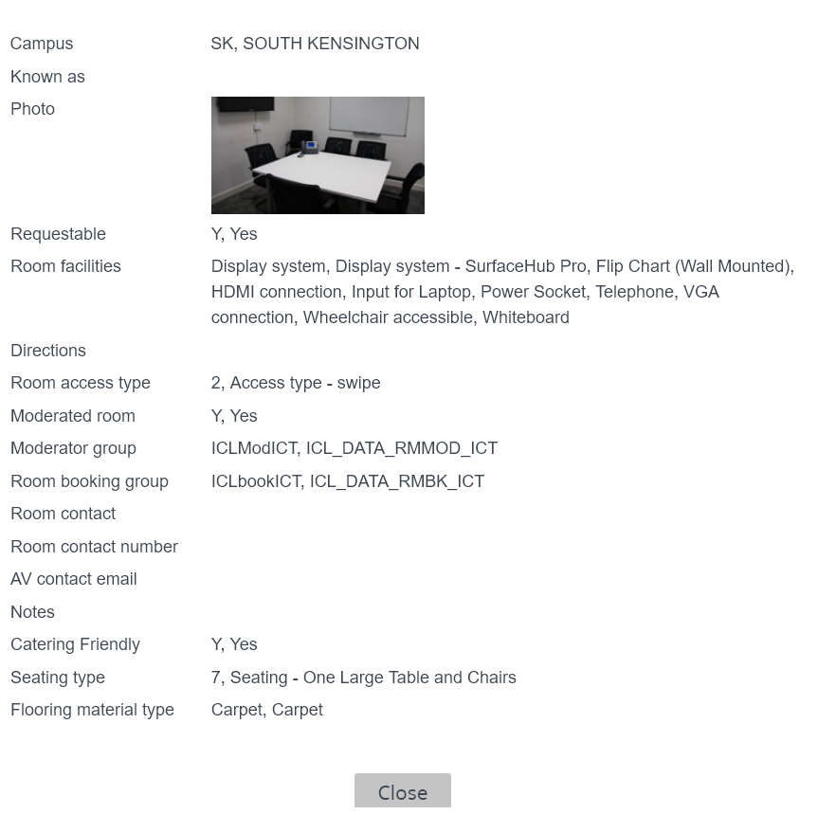
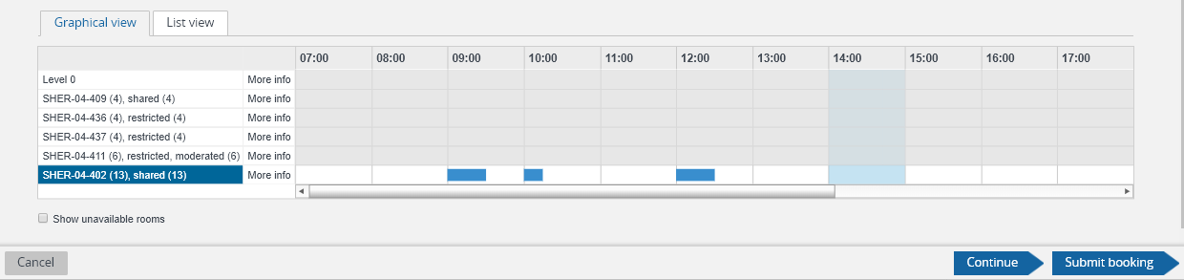
Planon: Make a Booking
It is recommended that you also click on the ‘More info’ link next to the room name, which will bring up a new window.
This will give you a photo of the room, details of all facilities in the room and helpful information such as directions to the room and the type of access controls in place.
Once you have decided which room you would like, click on it to highlight in blue, and then either click “Continue” or “Submit booking”, both of which take you to the final screen.

Slide 18
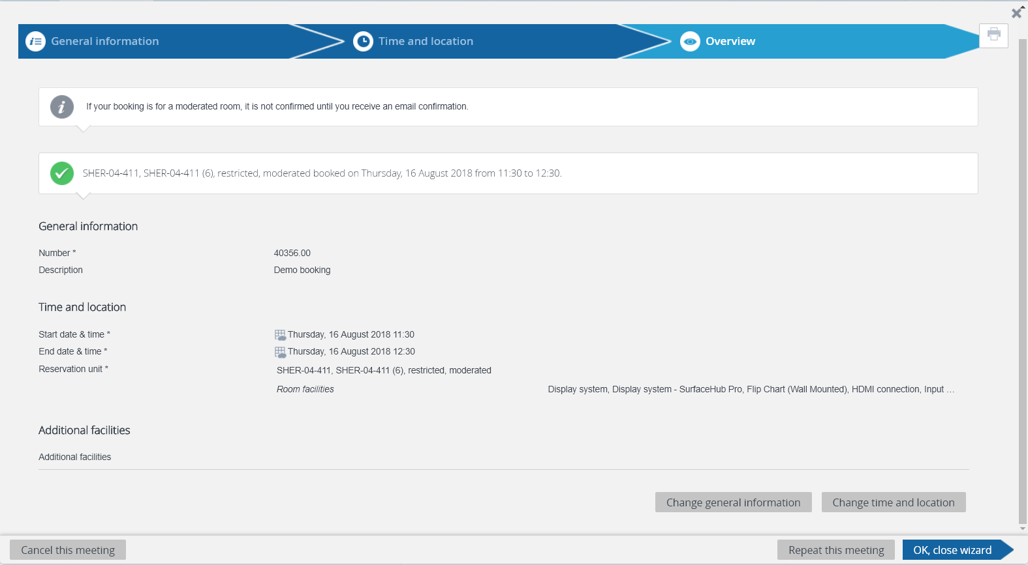
Planon: Make a Booking
The final screen is a summary of your booking. Remember, if it is a request for a moderated room, you will need to wait for email confirmation from the room’s moderator.
If you would like to change the title of your booking, you can click on the “Change general information button”. If you would like to amend the time or room, click on the “Change time and location” button. Both of these will take you back into the wizard.

Slide 19
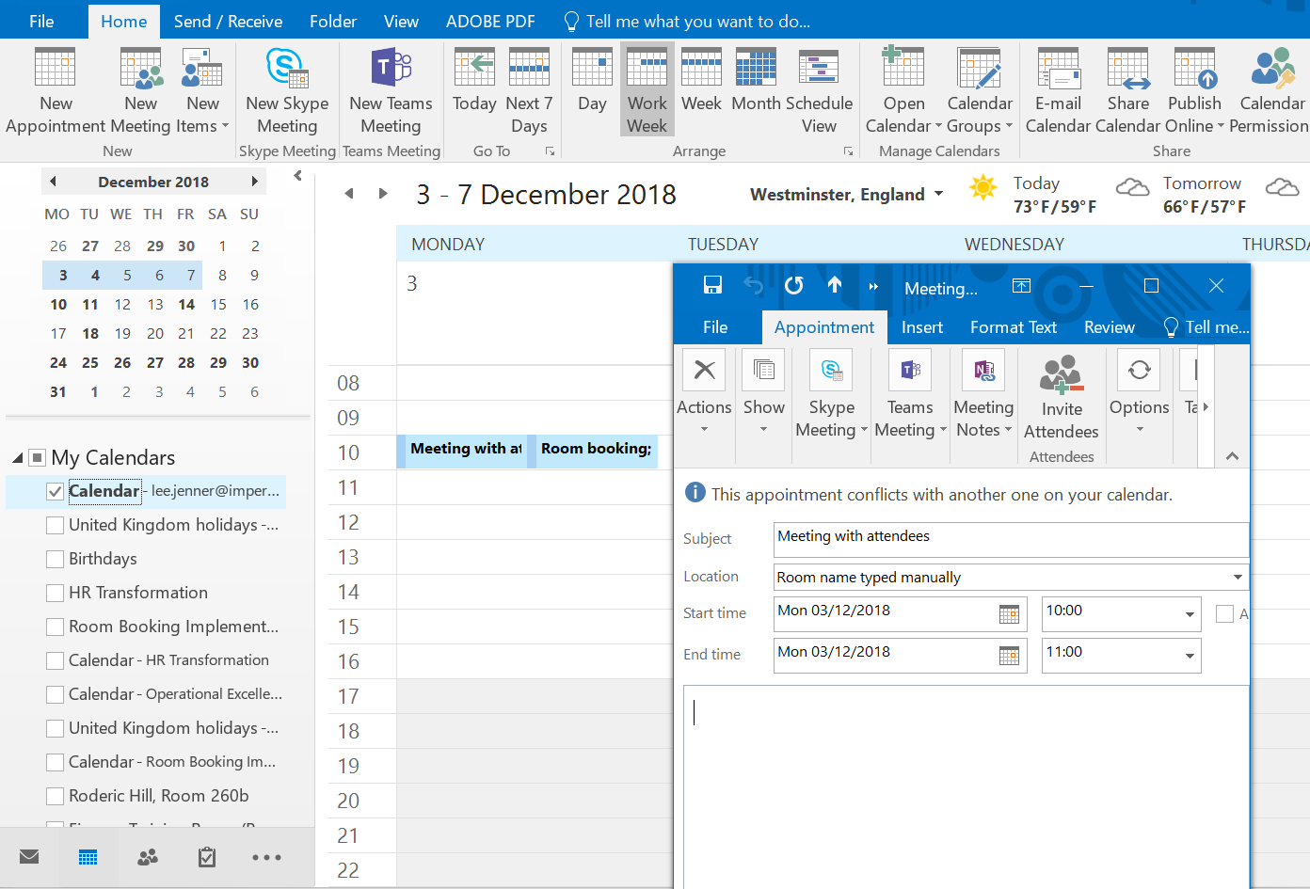
Planon: Make a Booking
Planon will send an appointment to your Outlook, which is added to your calendar if you accept it. If you decline the appointment, you will still have the booking, but it won’t show up in your calendar.
This appointment is a room booking only. Create a separate appointment in Outlook to invite attendees and type the room name in the location field. Do not invite the room to that appointment as it is already booked.

Slide 20
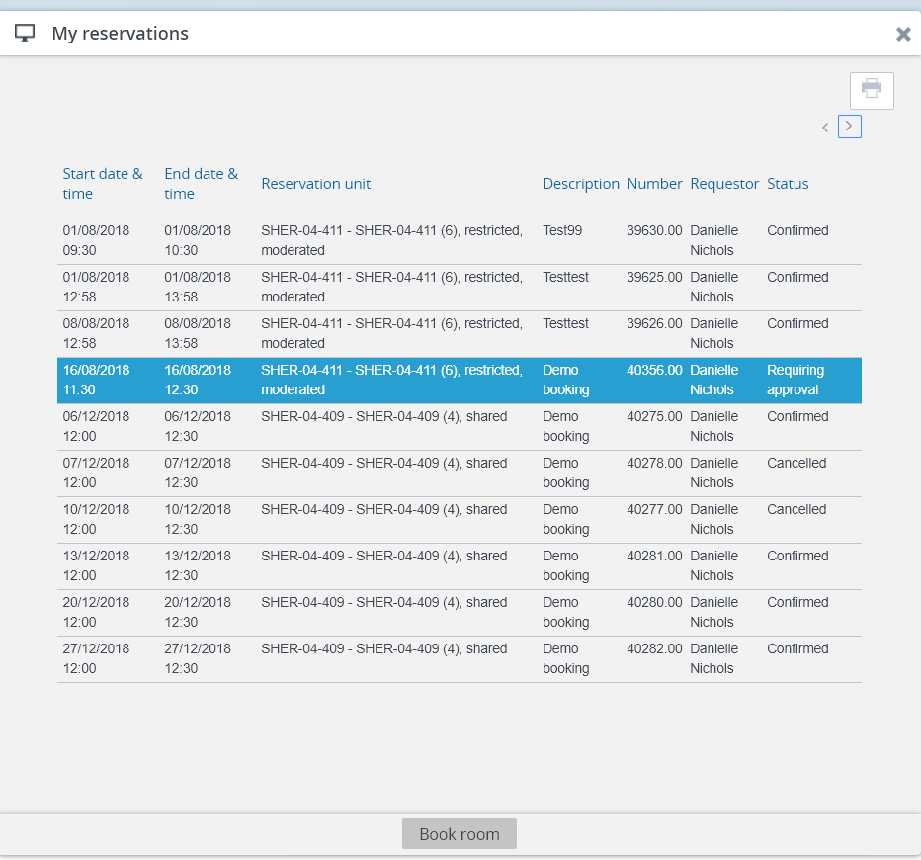
Planon: Make a Booking
All upcoming bookings can be viewed in Planon. In the “Room Booking” gadget on the home page, click on “My Bookings”. Depending on how many upcoming bookings you have, you may need to use the arrows at the top to scroll through them all. You also have the option to print the list of your bookings.
By looking at the “Status” column, you can see whether your booking is Confirmed, Cancelled, or Requiring approval from the room’s moderator.
Bookings will stay here until the date has passed, at which point they will be archived. You can still see these in your Outlook calendar, if you accepted the invitation from Planon.

Slide 21
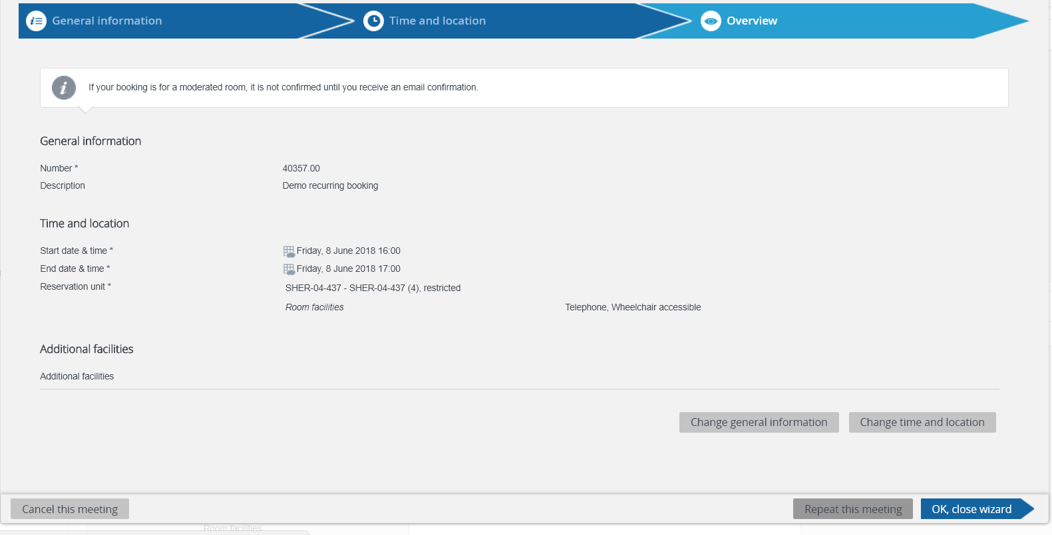
Planon: Make a Booking (repeated)
Planon does not create a series of linked, recurring, bookings, like in Outlook. Rather, you can repeat an existing booking over a desired period in a set pattern. Each of these repetitions is treated as an individual booking and has to be amended or cancelled as such.
To repeat a booking, navigate to “My Bookings” on the homepage and select the meeting you would like to repeat. This will take you into the Room Booking wizard.
Click on the “Repeat this meeting” button on the bottom right on the screen.

Slide 22
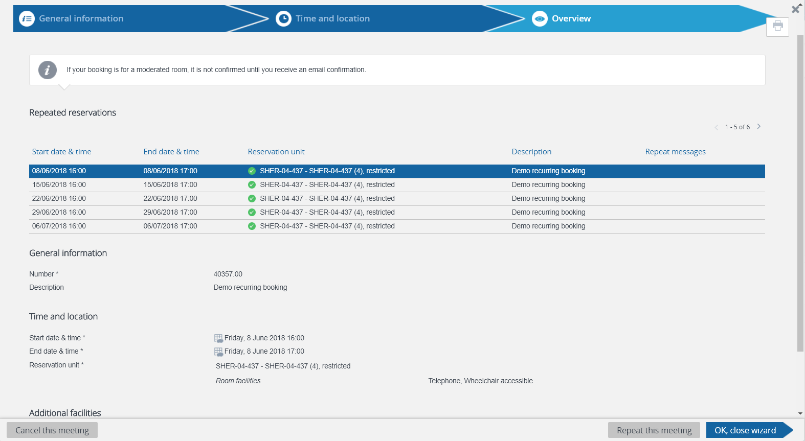
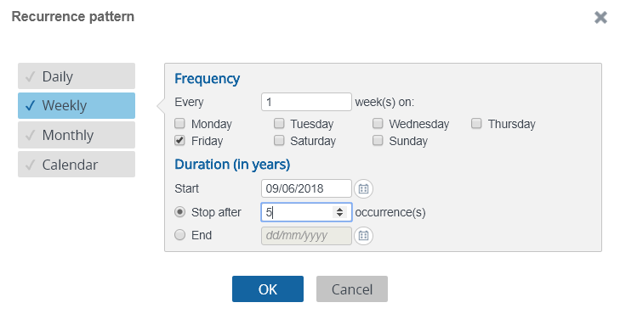
Planon: Make a Booking (repeated)
In the pop-up window, select the frequency of each appointment and then “OK”.
In the Overview screen, all of the bookings will be listed. If they have a green tick next to them, they have been accepted.

Slide 23
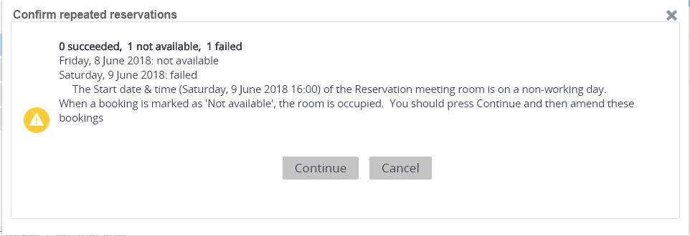
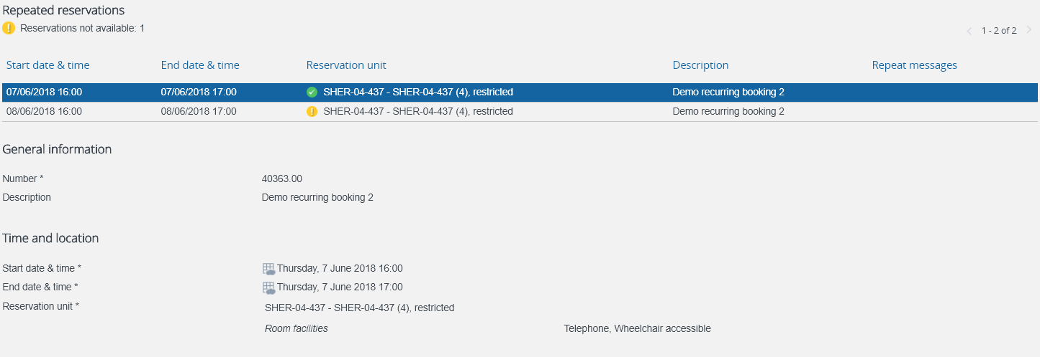
Planon: Make a Booking (repeated)
If you try and make a repeated booking when the room is already booked, it will generate a message saying how many of the requests were accepted, or are not available. Click “Continue”.
Where any bookings have a yellow exclamation mark next to them, you should click on the booking and then “Change time and location”. This will take you back into the Room Booking Wizard, where you can either change the room, or the time, so the booking no longer clashes.
All repeated meetings will be shown in “My Bookings”.

Slide 24
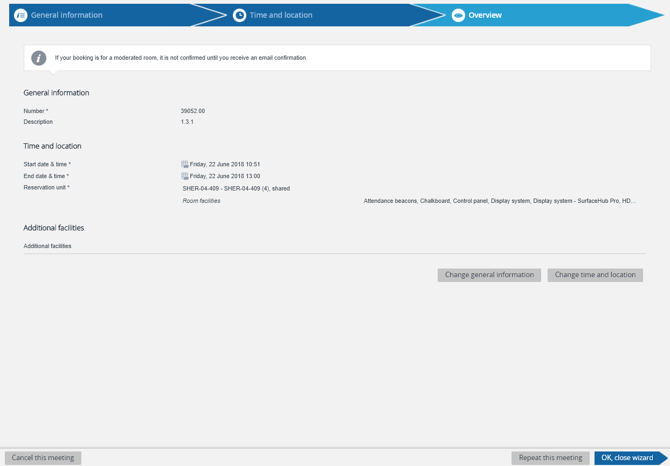
Planon: Amend or Cancel a Booking
Navigate to “My Bookings” on the homepage, which will bring up a list of all upcoming bookings.
Double click on the booking you would like to amend or cancel, which will take you into the Room Booking wizard.
Select “Change time and location” to amend your booking or “Cancel this meeting” to cancel it.

Slide 25
Advance Room Search & Report (ICLIS)

Slide 26
What is ICLIS?
ICLIS stands for “Imperial College Location Inventory System”. This was originally a stand-alone system, which was built to act as the single-source-of truth for information on bookable rooms.
This data is now being moved into Planon, in a phased manner, starting with meeting rooms and later, teaching rooms.
All staff with a College ID will be able to use a gadget in Planon called “Advance Room Search & Report (ICLIS)”, which allows detailed searches of this room data based on a range of criteria. Contact information for requesting to use these rooms is provided, and for teaching rooms, it will also provide a link to the room’s Celcat calendar to see availability.
Room data will be kept up-to-date by Super Users, a small group of people in each department, who have training in the back-office of Planon.

Slide 27
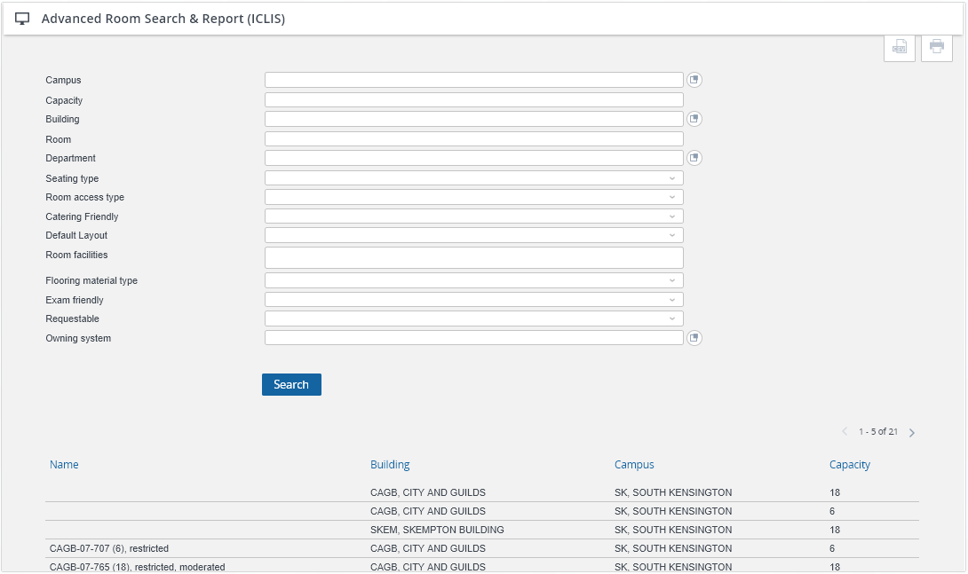
How to use ICLIS
On the Planon homepage, you will find the “Advance Room Search & Report (ICLIS)” gadget. If this is not on your homepage, see the Appendix in this guide for instructions on how to add a gadget.

Slide 28
Using Shared Space – Etiquette

Slide 29
Room Booking and Use Etiquette
As College members share space more frequently, it is very important that when using a space outside of your usual department, that a common set of room booking and use guidelines are followed.
The full Room Booking and Room Use etiquette guidelines can be found in Appendix 2, and the key messages can be found on the following pages.

Slide 30
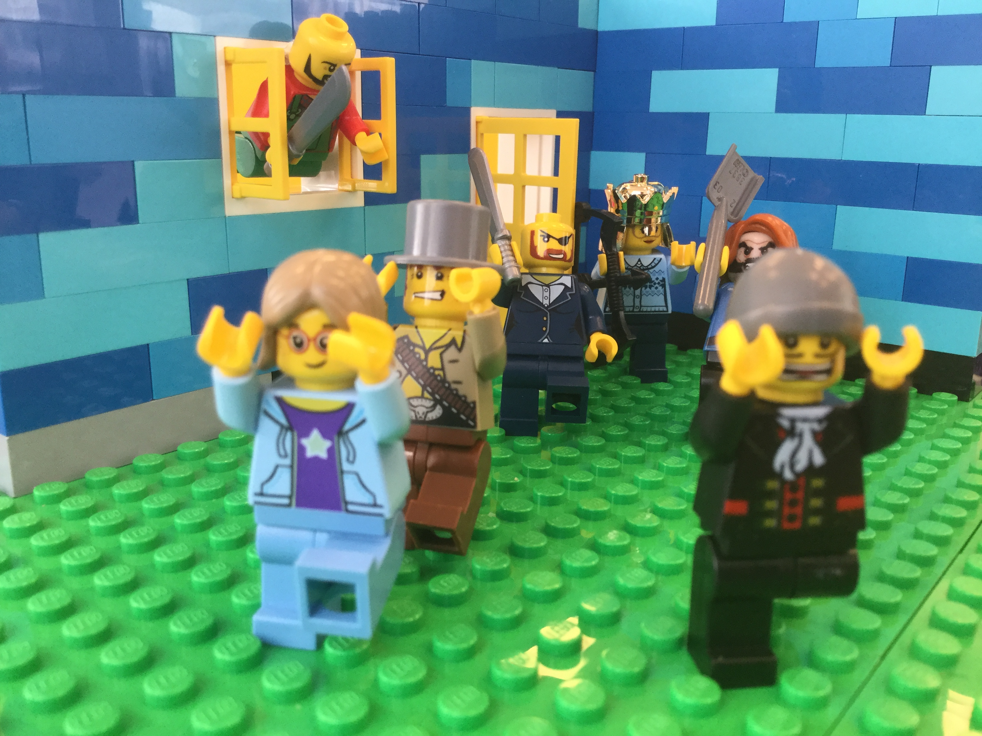
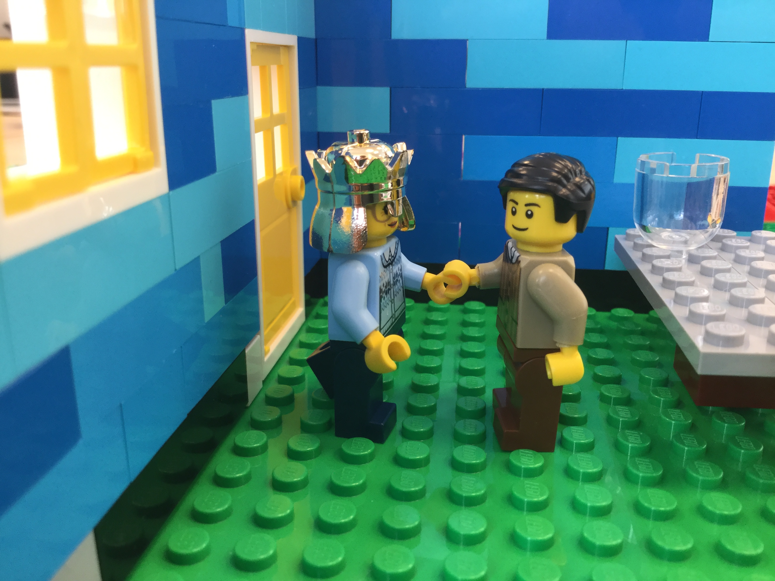
Room booking etiquette
Don’t…
I’M THE HEAD OF X! MY ROOM! OUT!
Do…
Any chance we could use this room, my good fellow?
Sorry…but I know of a room you could use in…
…“Bump” someone else’s booking: everyone’s meetings are equally important.
If you want to use a room that is already booked, contact the meeting organiser to discuss options.

Slide 31
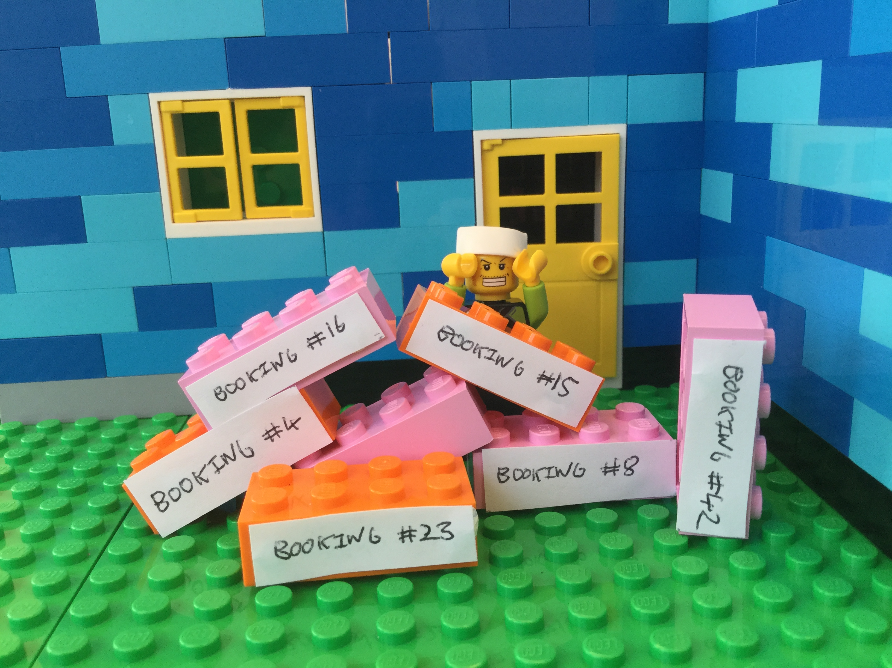
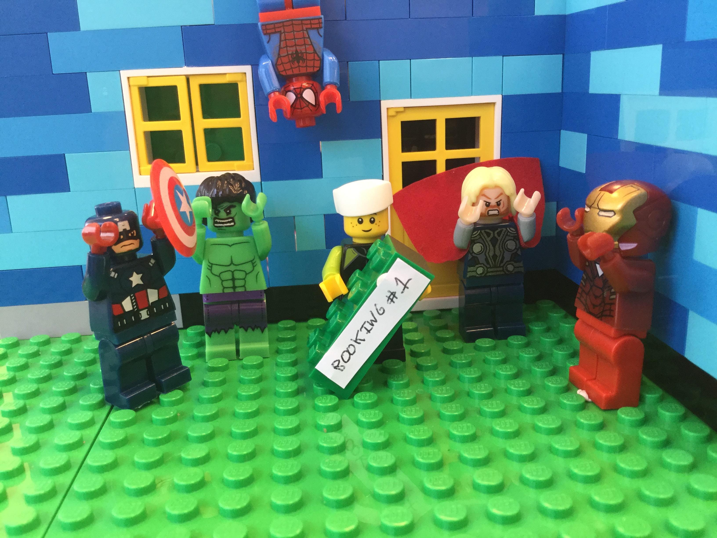
Room booking etiquette
Don’t…
Do…
B-b-but I might need them later!?!
I only kept the booking I need!
I Er…yay?
Why are we here?!
…keep bookings that are no longer required.
…cancel bookings that are no longer needed.

Slide 32
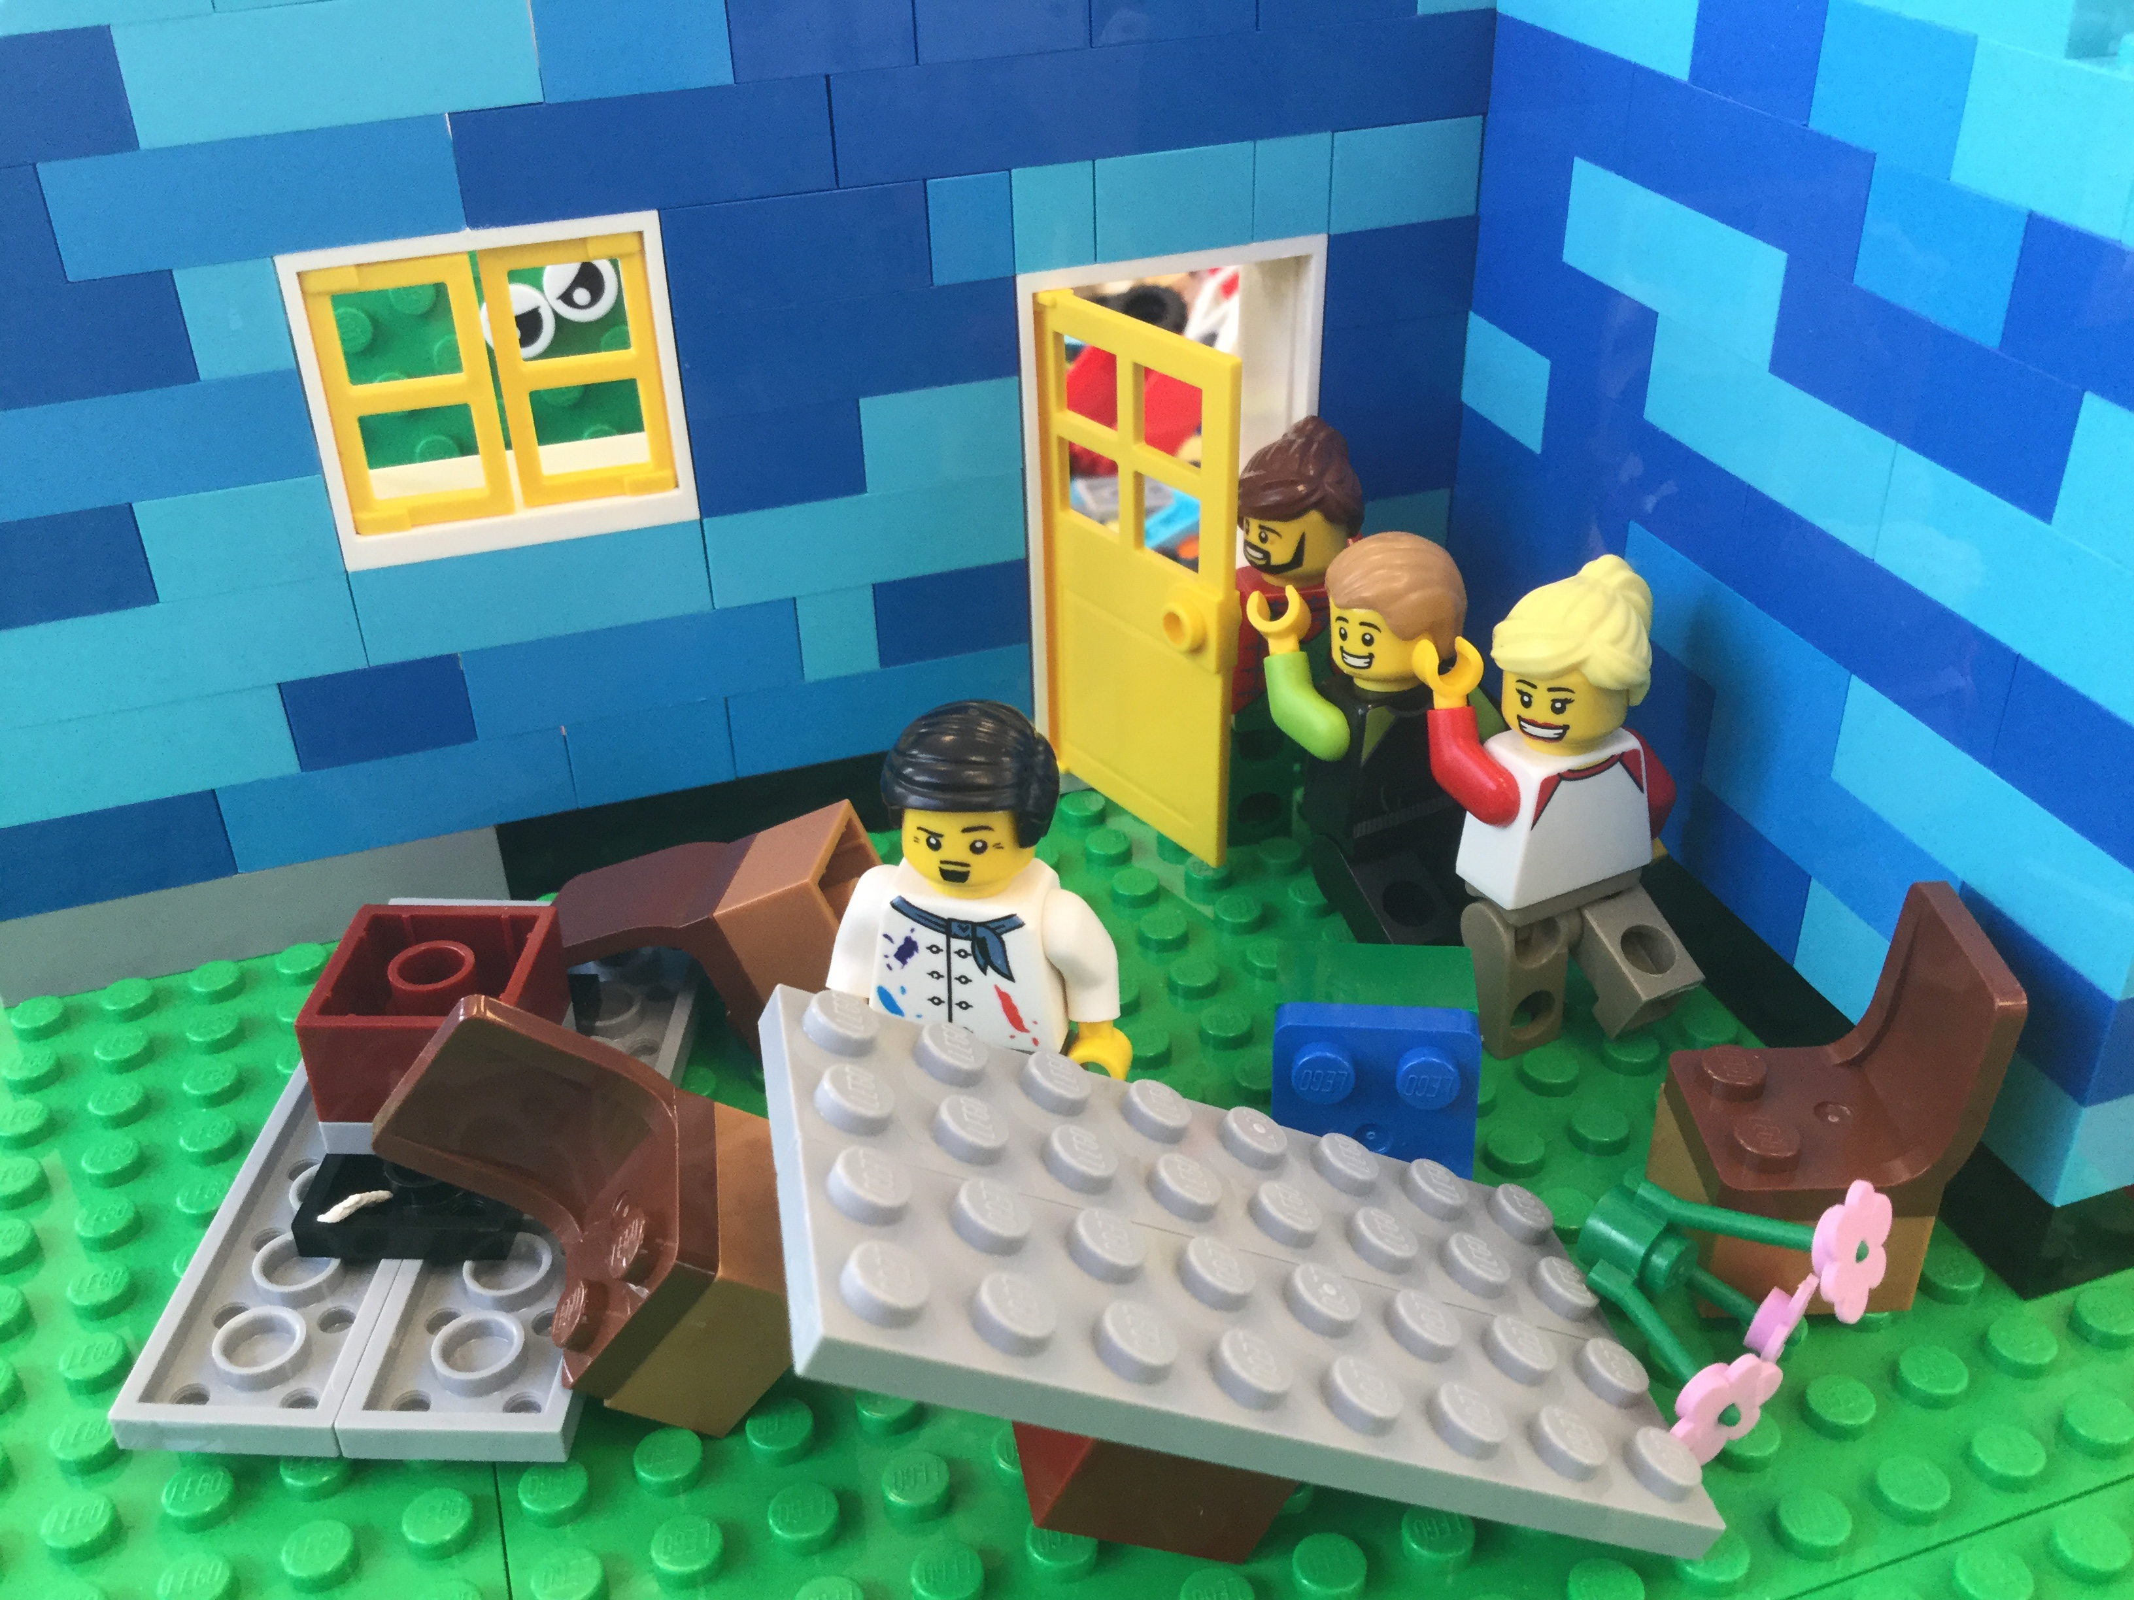
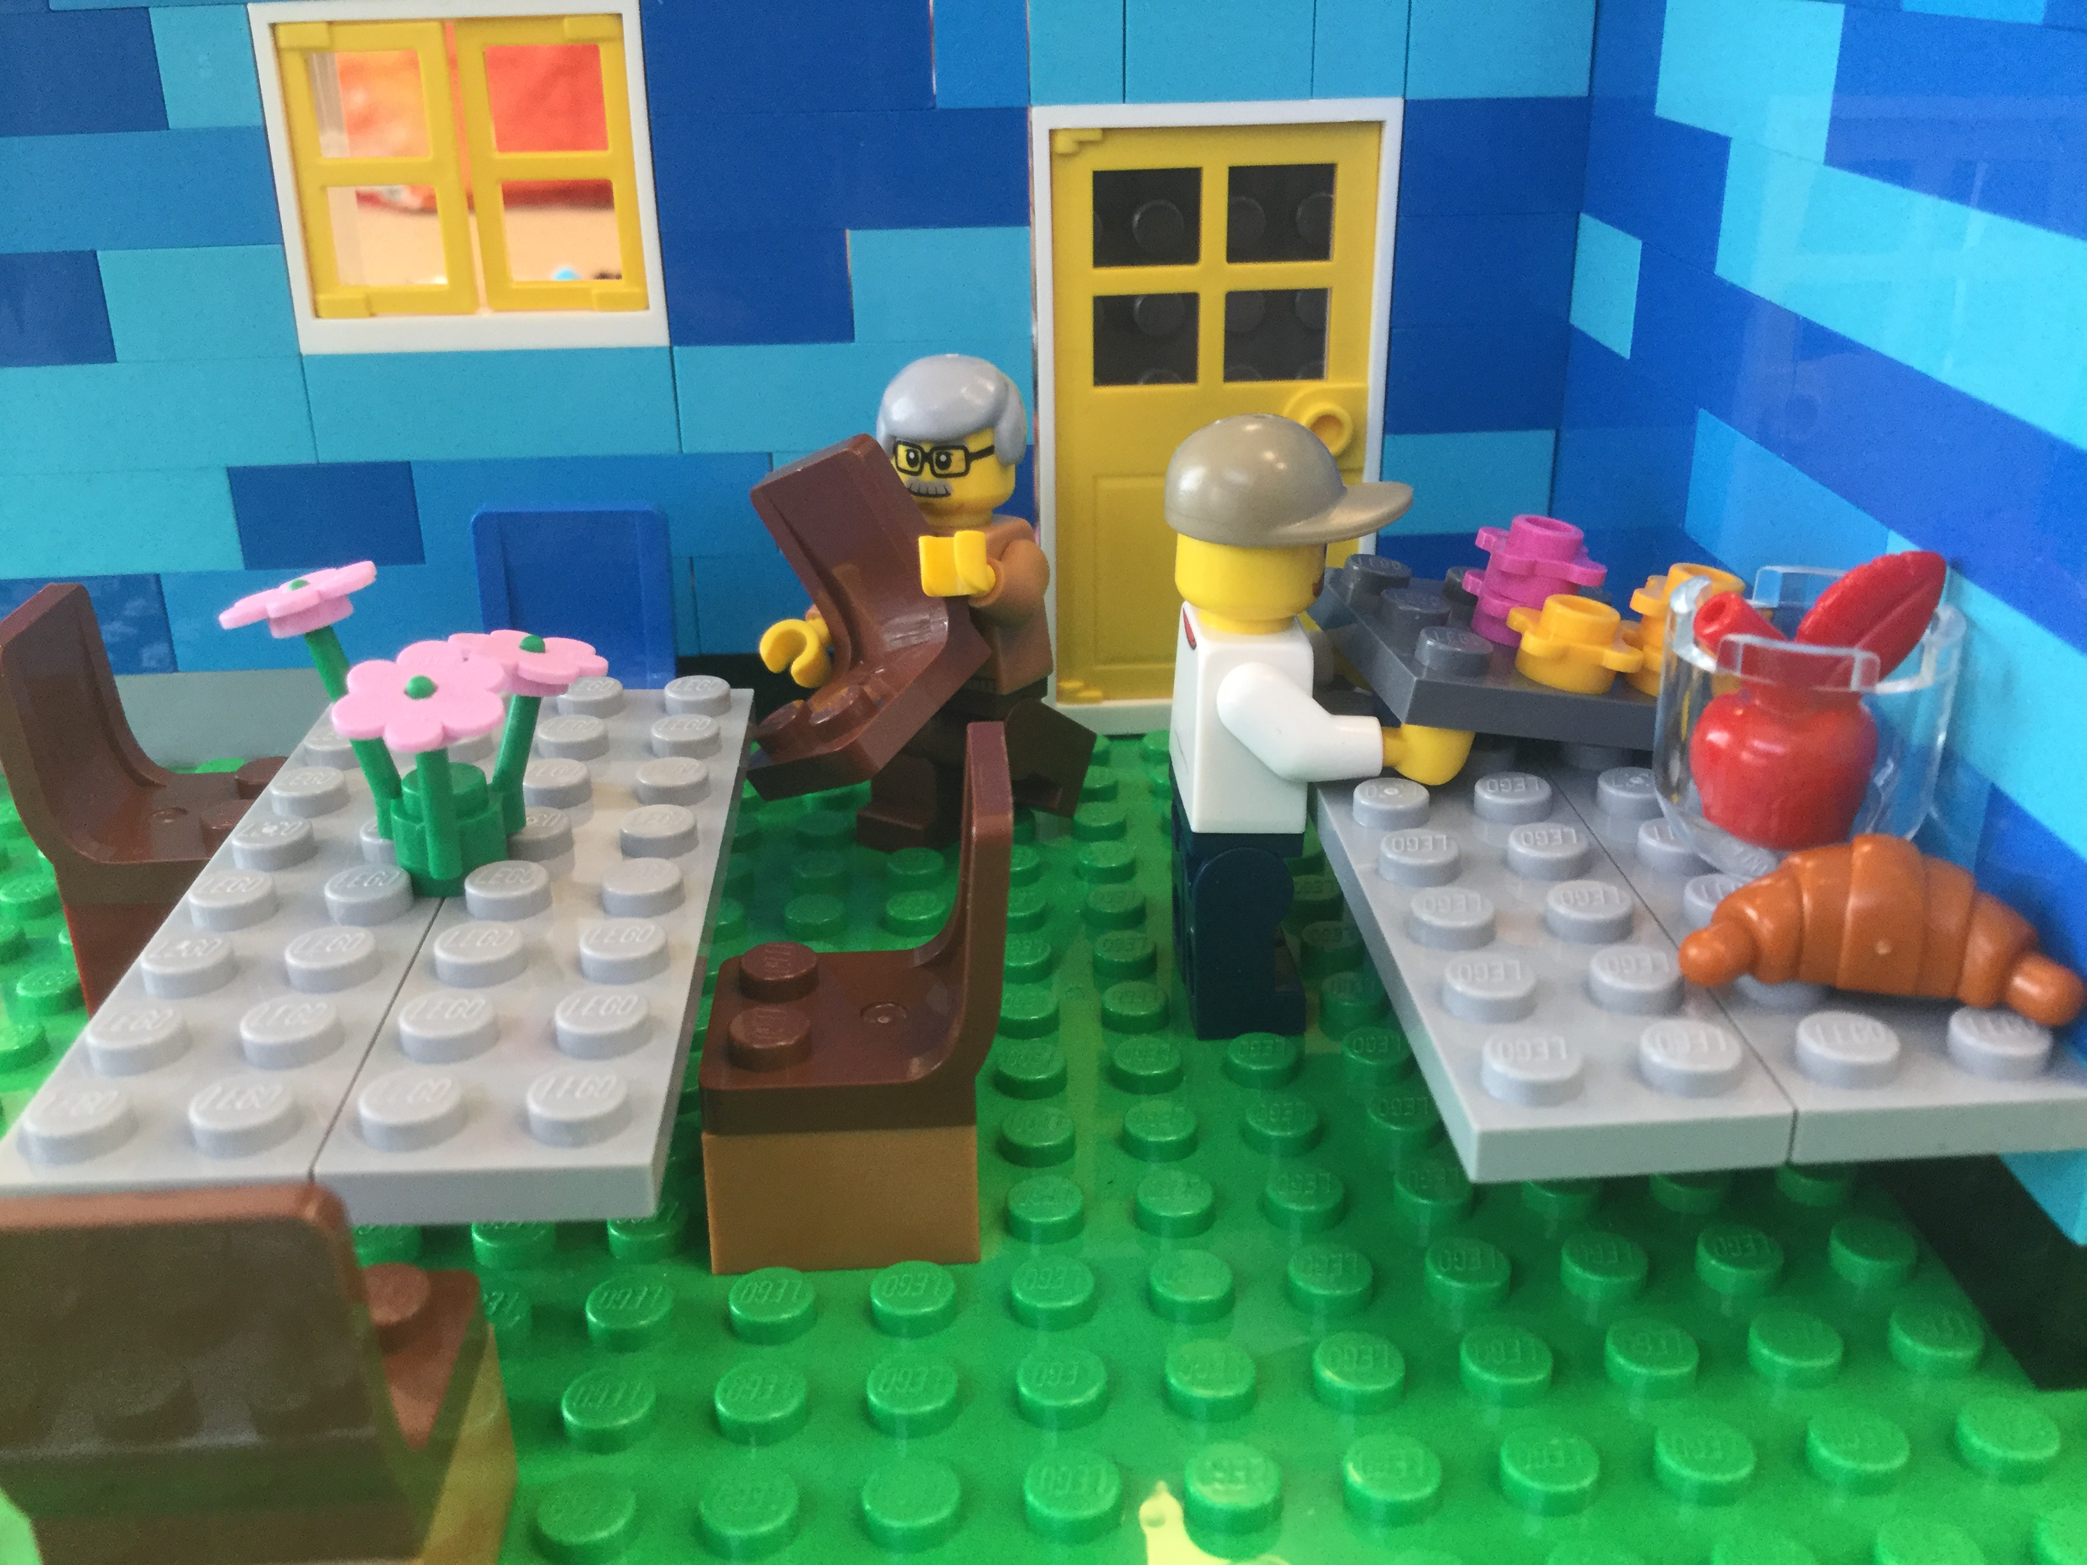
Room use etiquette
Don’t…
Do…
Sorry-we-overran-places-to-go-people-to-see-byeeee!
…
…overrun your meeting and not leave time to tidy any catering or put the room back in it’s default layout
…move plates/mugs etc to one area to make it easier for catering staff to collect them, and reset the room.

Slide 33
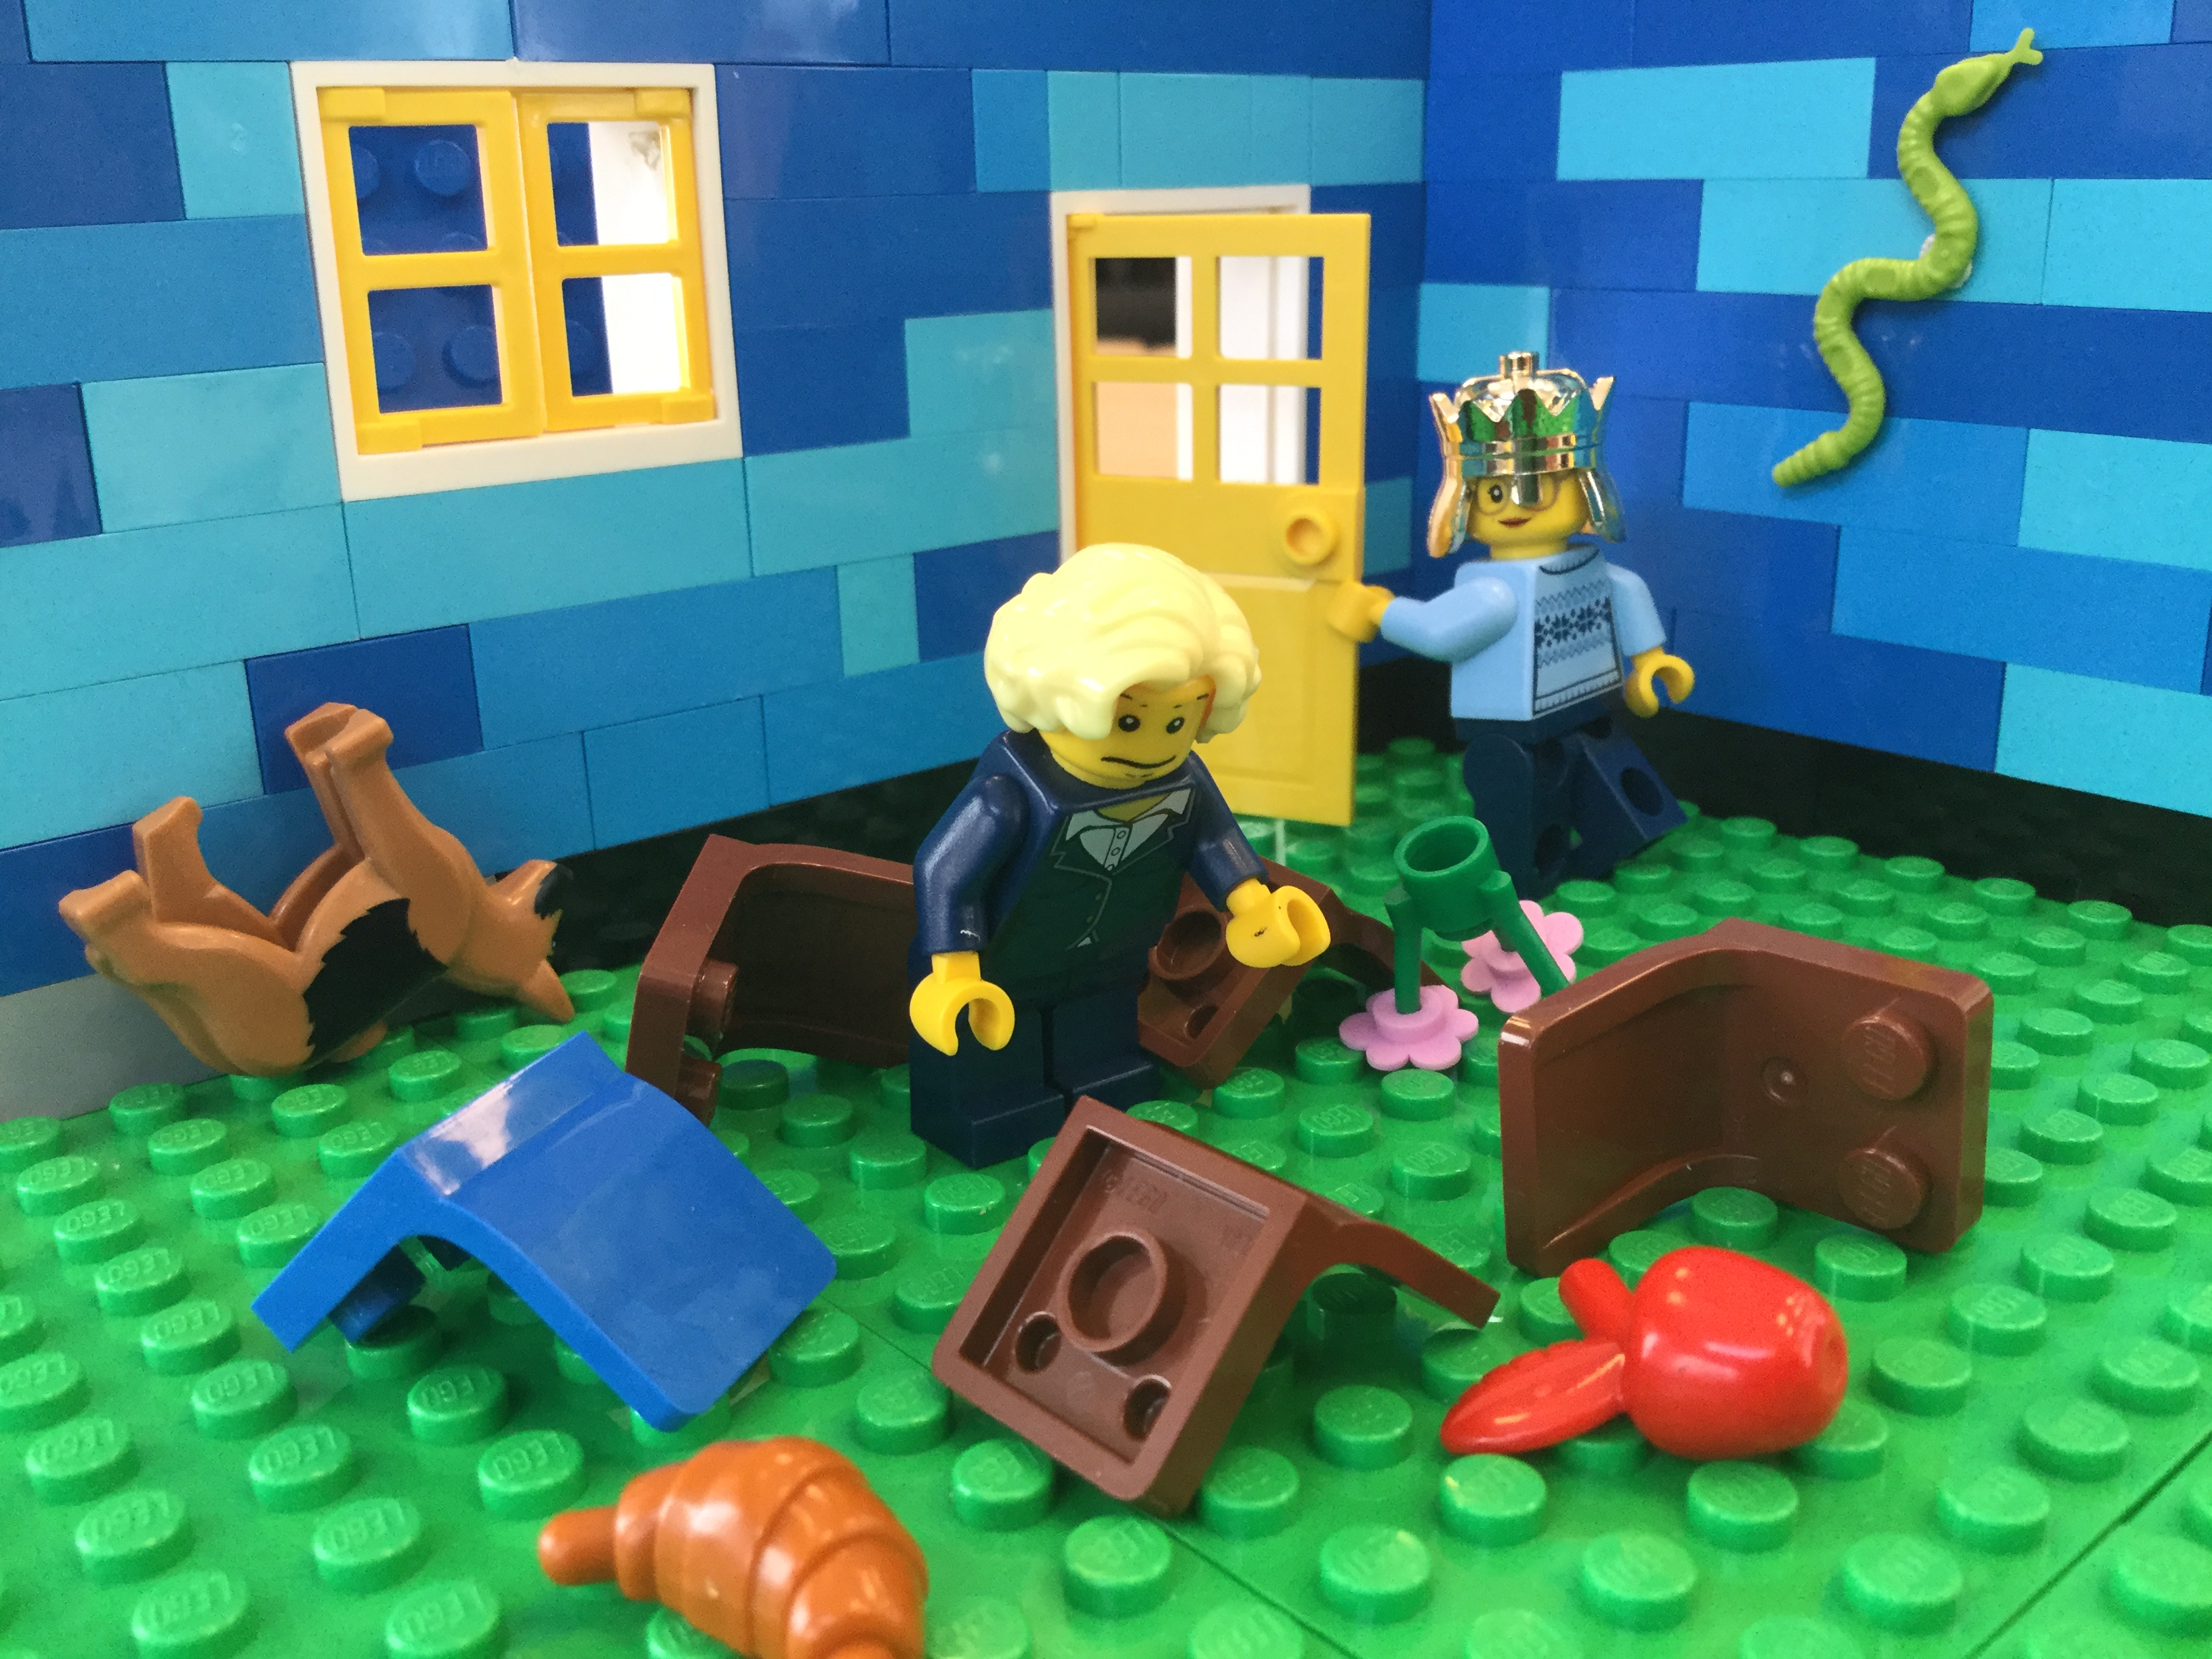
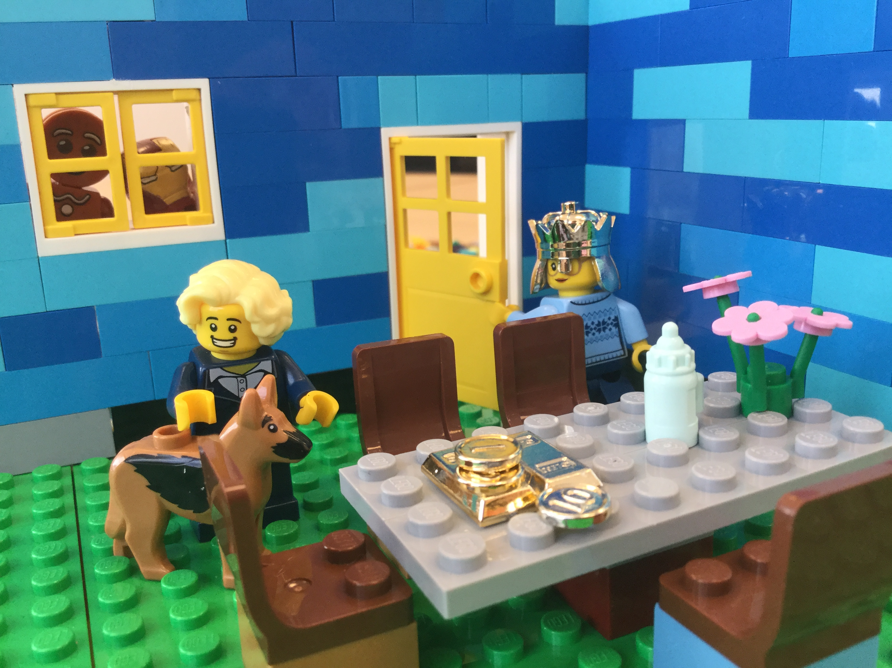
Room use etiquette
Don’t…
Do…
We found it like this, we can leave it like this, right?!
I’ve left your bonus on the table…
It’s the dream meeting room!
Er…
…host a meeting and leave the room in a state you wouldn’t expect to find it in.
…take responsibility for ensuring the room is how you would wish to find it.

Slide 34
Appendices

Slide 35
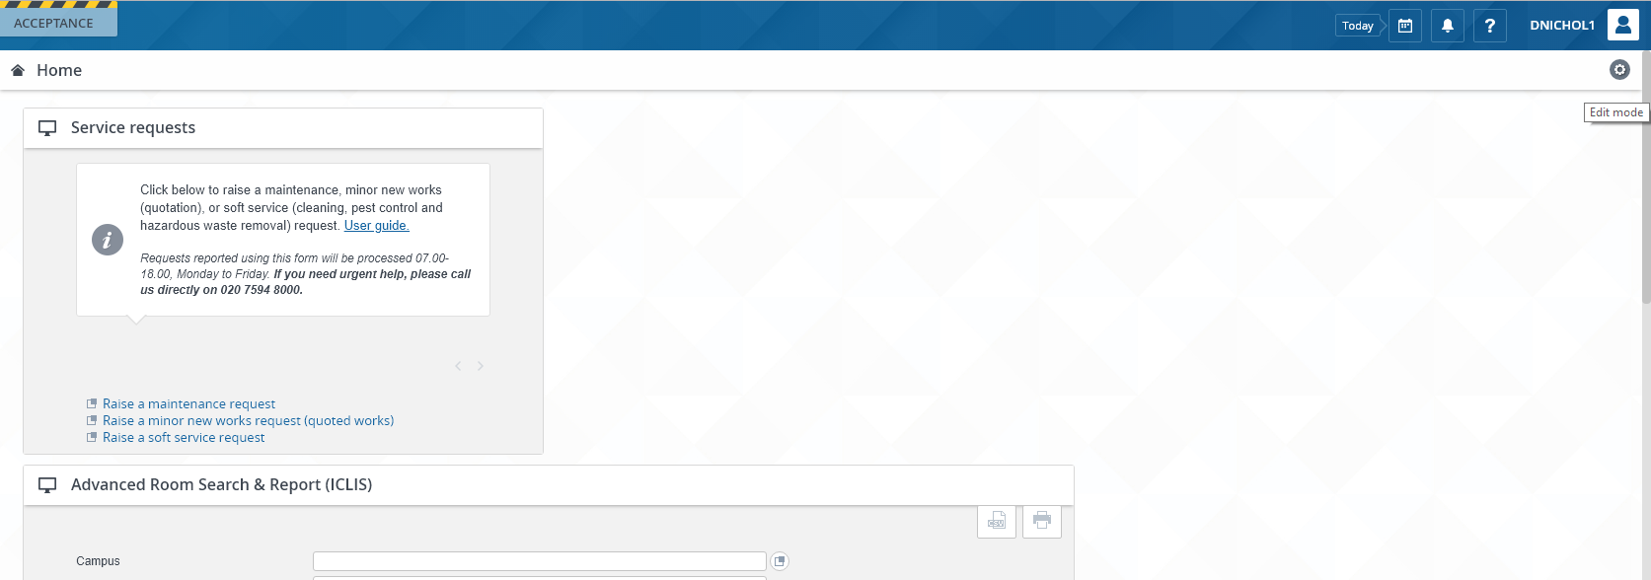
Appendix 1 – Add the Room Booking Gadget
Click the “Edit mode” cog in the top right-corner of Planon.

Slide 36
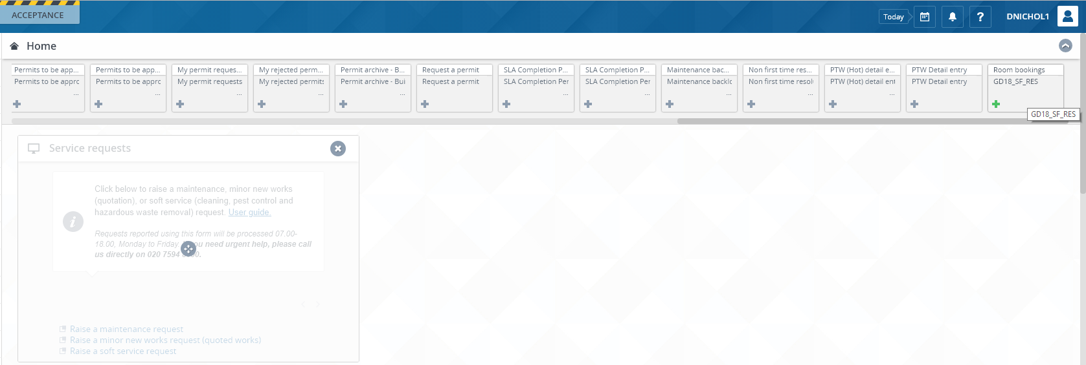
Appendix 1 – Add the Room Booking Gadget
Select the “Room bookings” gadget. Gadgets can be re-ordered on the homepage by dragging and dropping, while in this mode. Close the window by clicking on the arrow in the top-right corner.

Slide 37
Appendix 2 – Room Booking Etiquette
Bookings should not be “bumped”. To use a room that is already booked, contact the meeting organiser to discuss options.
Cancel bookings that are no longer required, as soon as possible.
Meetings will generally finish 5 minutes before the room booking.
Plan to finish the meeting with time to replace furniture to the default layout and tidy any catering. Book extra time following the meeting if necessary.
Choose a suitable room by checking the room information. Some rooms are suitable for quiet meetings only which excludes conference or Skype calls. Some rooms are not suitable for catering.
A booked room will be considered free, and may be used by others, if it has not been occupied 15 minutes after the start of the booking.
In the event of an apparent double booking, check the Planon calendar.

Slide 38
Appendix 2 – Room Use Etiquette
Meetings will generally finish 5 minutes before the room booking.
Plan to finish the meeting with time to replace furniture to the default layout and tidy any catering. Book extra time following the meeting if necessary.
Catering:
College Delivered catering: Please move plates/mugs etc. to one area before leaving to make it easier for Catering staff to collect them.
Externally sourced catering: Please remove all remains of external catering from the room before leaving. Clean and replace anything borrowed from local kitchens.
The meeting host will take responsibility to ensure the room is left as they would wish to find it.
Keep noise levels to a minimum in consideration of people working and studying nearby, before, during and after the meeting.
Please bring your own stationery and consumables (e.g. pens, flipchart paper) and take them with you when you leave.
If you need help during the meeting, use the contact details in the room or on the website.
Report all faults, whether they impact your meeting or not. Contact details are in the room and on the website.
In the event of an apparent double booking, check the Planon calendar.

