Slide 1
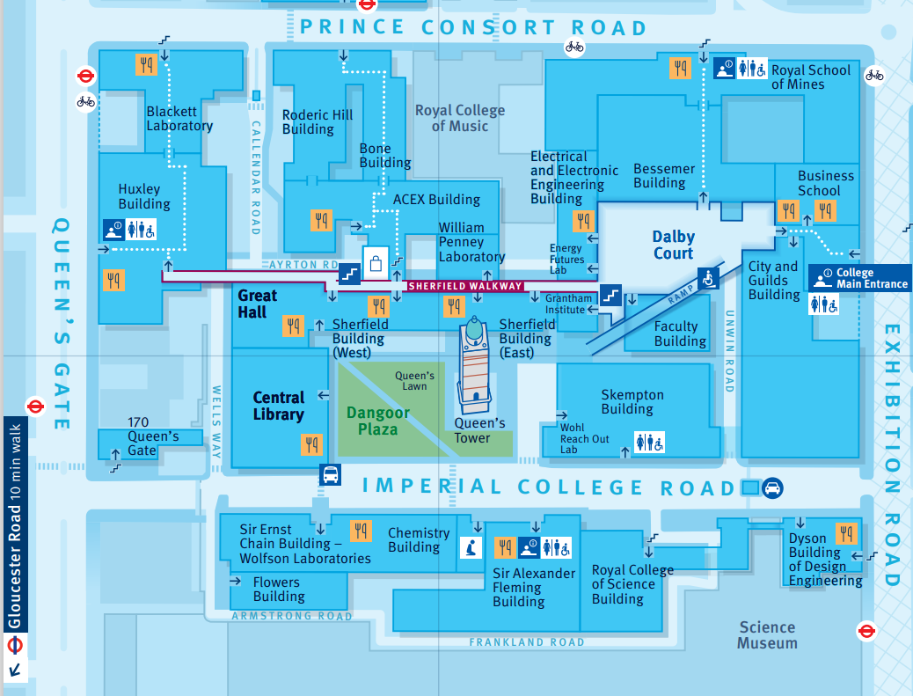
How to get to Change and Operational Improvement Office?
Change and Operational Improvement is located on the 4th Floor Roderic Hill Building, Office 420-421.

Slide 2
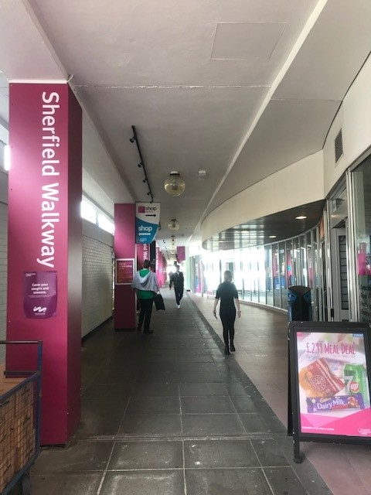
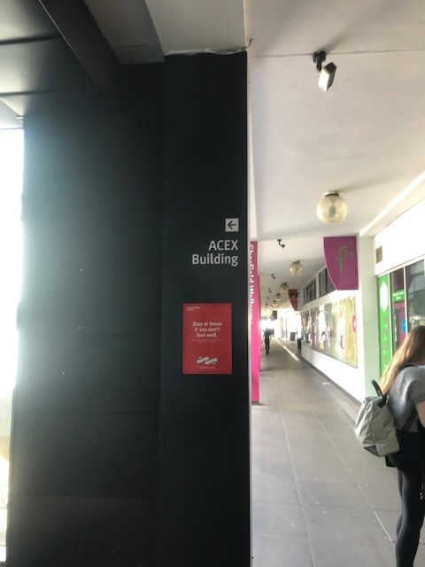
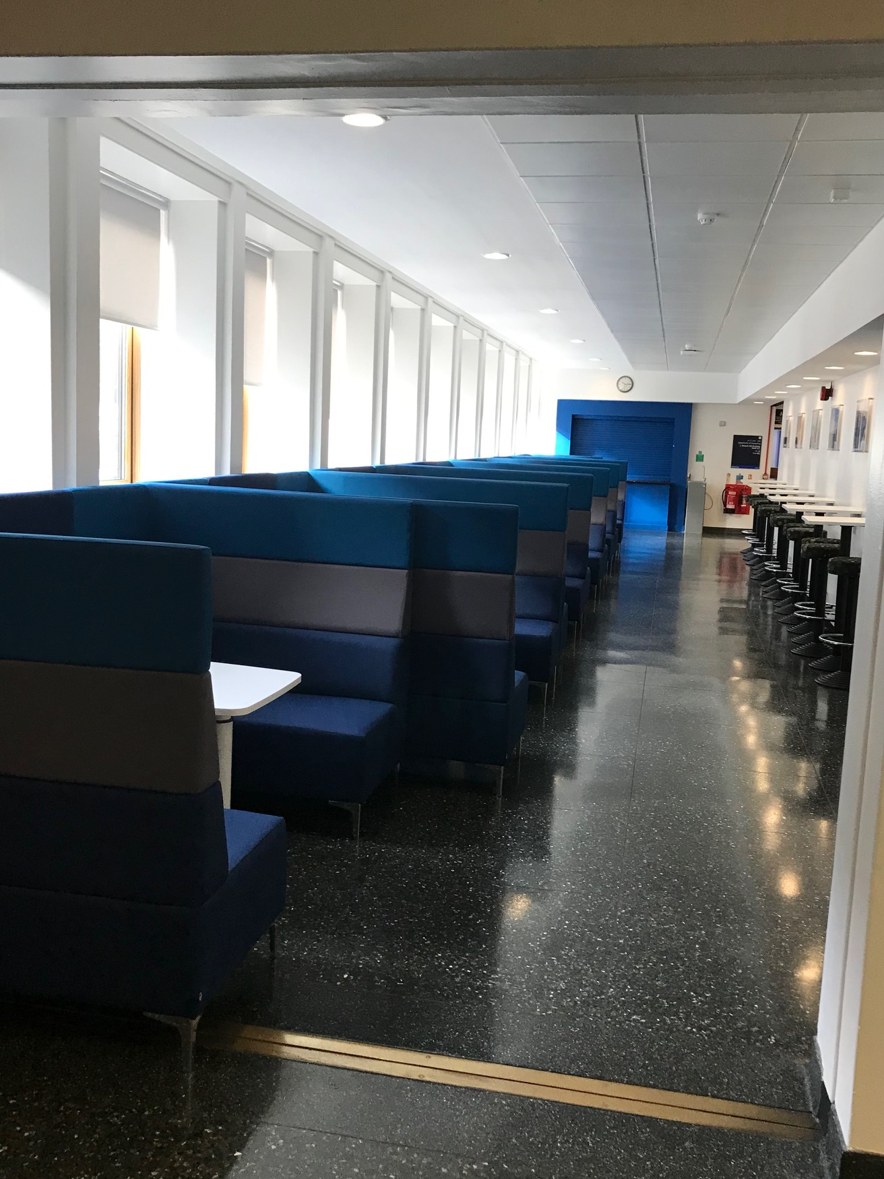
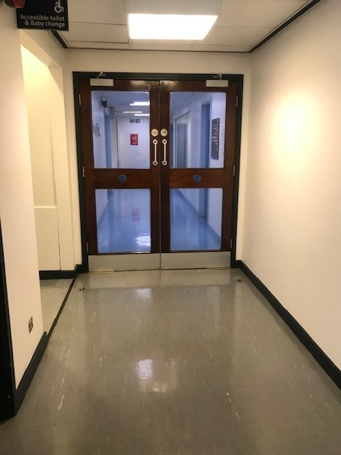
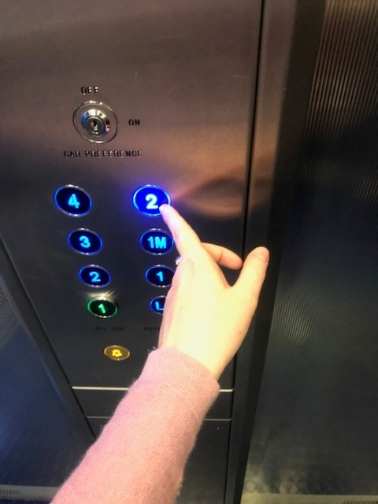





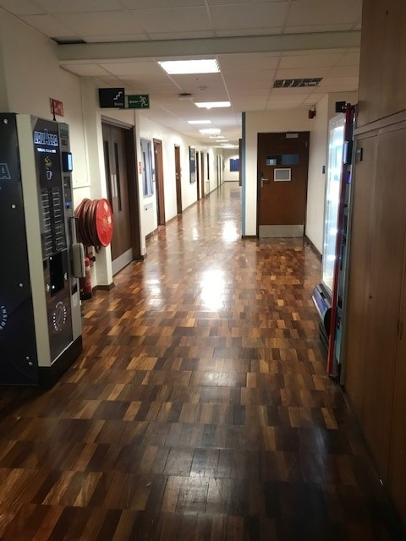


From Sherfield Walkway
On the Sherfield Walkway, go towards the ACE Extension entrance (Chemical Engineering) opposite the SCR and head up the stairs towards the Carbon Capture Plant.
Turn left around the entrance to the 2S01 staircase and head down the corridor past the blue study seating, towards the green café with a big “Computing” sign on the wall.
Continue past the big wall mural of Aeronautics through the double doors, and follow the corridor bearing right.
Summon the lift – you’re going up.
You need to press the “2” in the
top right of the console, (yes we are level 4 but the college lifts have not been updated yet).
The lift doors will open on the opposite side to
which you entered.
The Change and OI offices
(rooms 4.20, 4.21) are on the left.

