Slide 1
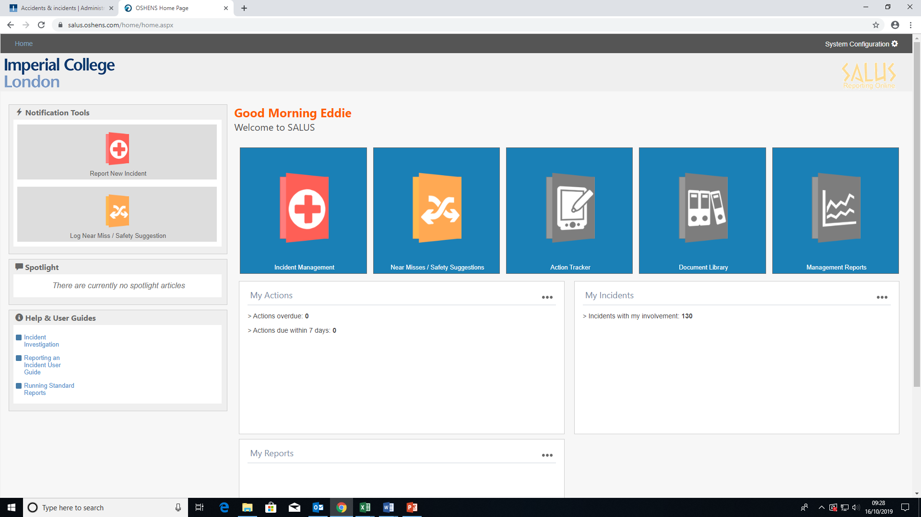
Select the “Report New Incident” tab in the top right hand side of the page

Slide 2
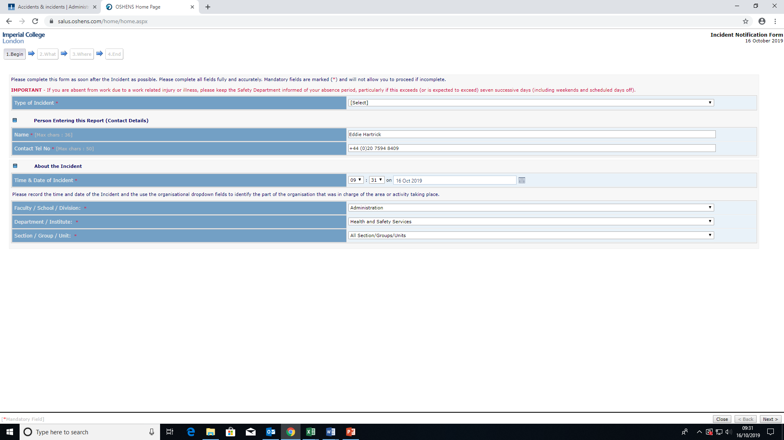
Fields marked with a red * are compulsory and must be completed

Slide 3

The highlighted field is for the Faculty/Department who has overall responsibility for investigating the incident, and resolving any problems. If you aren’t sure, just use you own department, it can be changed later by safety personnel.

Slide 4
The top dropdown is for the type of incident that has happened. To determine the category, please see the flow chart on the next slide – this example uses “Work Related Injury” but the other categories will be similar

Slide 5
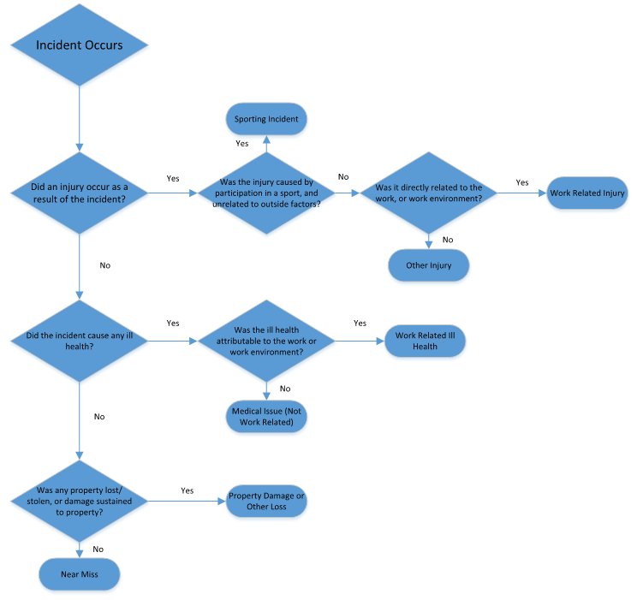

Slide 6
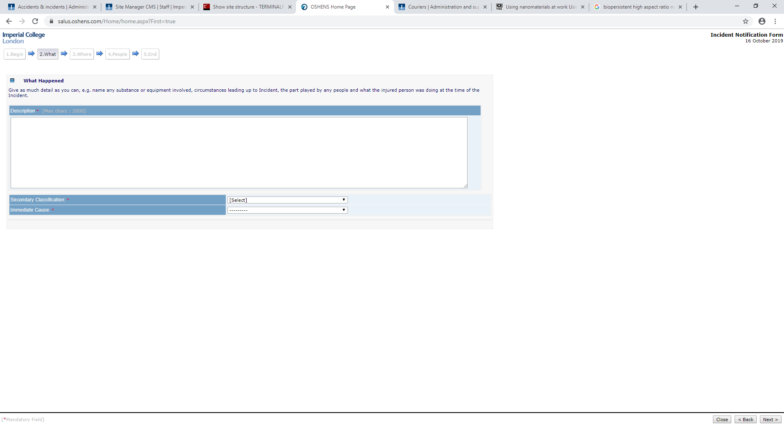
Next add a description of the incident, and select the most appropriate immediate cause from the drop down. You can also add a secondary classification if you wish. When describing the incident, please avoid using any personal information, unless completely necessary. The names of the affected persons an be added in a later field – an injured person can be referred to as “IP”.

Slide 7
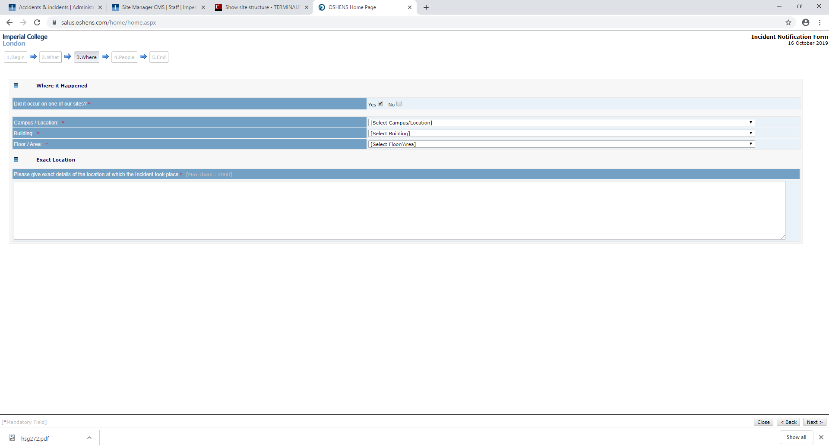
In this section, add the location using the dropdowns, then add a brief description of exactly where the incident took place.

Slide 8
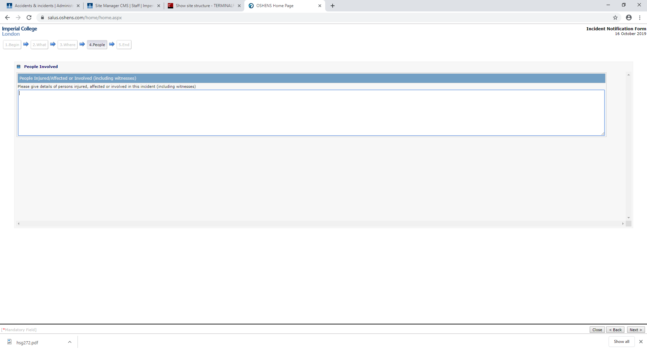
This is where you can add details of the people involved. This section is not on the email alert, so only people with database access will be able to see it.

Slide 9
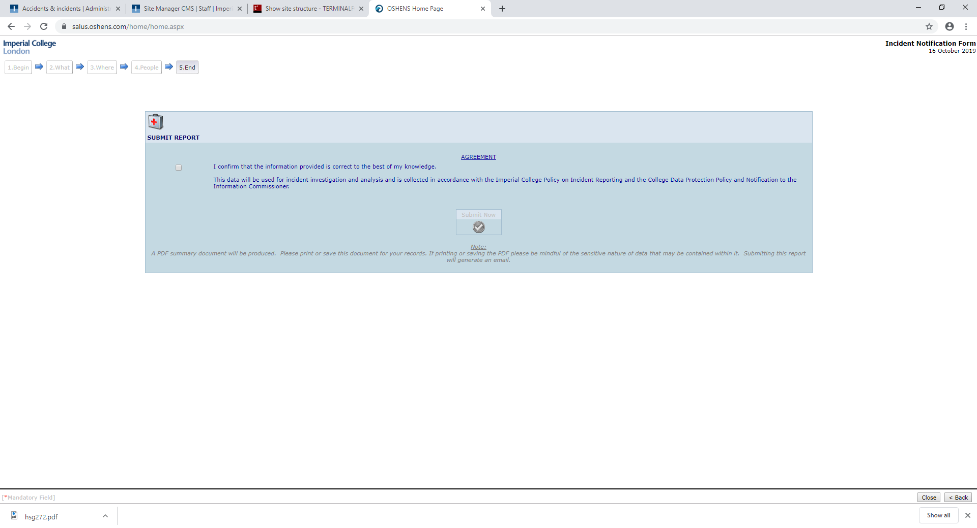
To submit the report, first check the box on the left hand side.

Slide 10
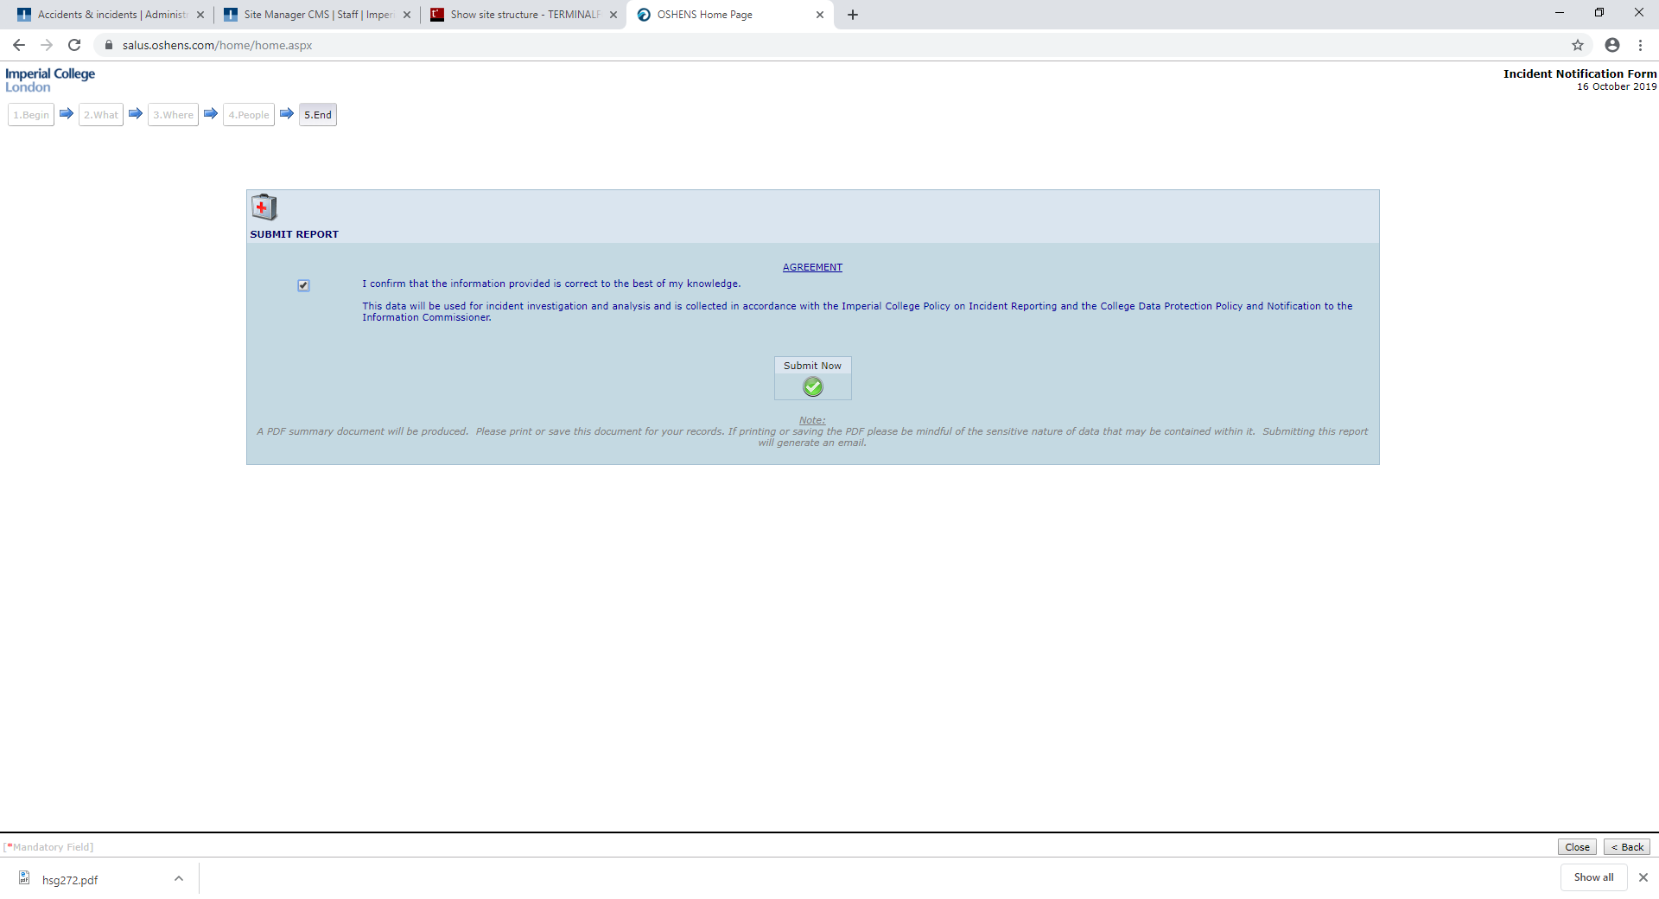
Then click on the green tick in the centre.

Slide 11
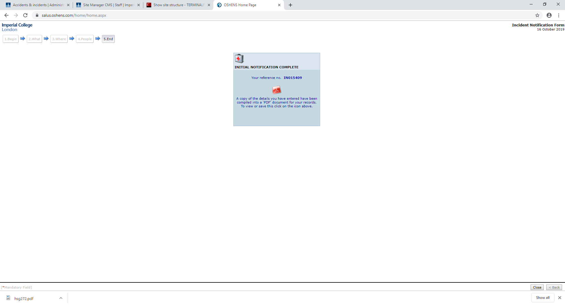
Finally, this page enables you to download a pdf copy of the report you submitted – just click the pdf logo.

