Slide 1
Examination Timetabling User Group (ETUG)
13 July 2022

Slide 2
Welcome
Minutes from the last meeting
Action Tracker
Matters Arising

Slide 3
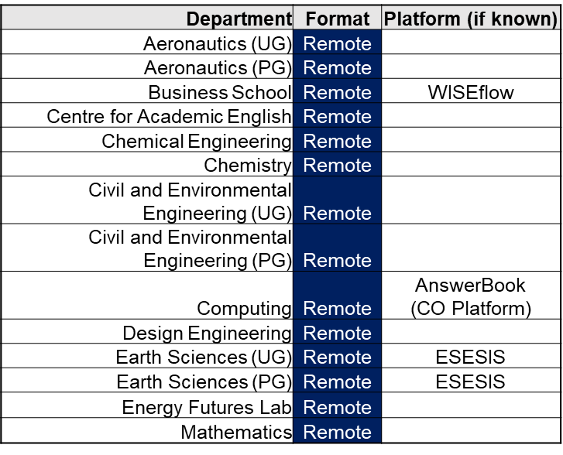
Summer 2022 – Feedback
Remote exams
Preparation
Running exams
Exam platform
Submission
Exam integrity
Student feedback

Slide 4
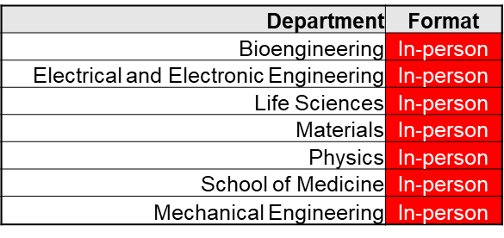
Summer 2022 – Feedback
In-person exams
Preparation
Exam spaces (inc Great Hall/QTR)
Safety/attendance
Invigilation
AEA students
Student feedback

Slide 5
Academic Year 2022/23
Great Hall/QTR bookings
Exam format – Remote or in-person?
Increased student cohorts, impact on space
2022 | 2022 | 2023 | 2023
December | Wed 7th to Fri 16th | January | Tues 3rd to Fri 13th
 |  | March | Mon 13th to Fri 24th
 |  | Summer | Mon 24th April to Fri 30th June

Slide 6
Exam Formats 2022/23
Department | Format
Aeronautics (UG) | Remote
Aeronautics (PG) | Remote
Business School | Remote
CPELQ Centre for Academic English | Remote
Chemical Engineering | Remote
Chemistry | Remote
Civil and Environmental Engineering (UG) | Remote
Civil and Environmental Engineering (PG) | Remote
CLCC Centre for Languages, Culture and Communication | Remote
Computing | Remote
Dyson School of Design Engineering | Remote
Earth Sciences (UG) | Remote
Earth Sciences (PG) | Remote
IMSE Imperial and the Institute for Molecular Science and Engineering | Remote
NQEFL Energy Futures Lab | Remote
Mathematics | Remote
Department | Format
Bioengineering | In-person
Electrical and Electronic Engineering | In-person
Life Sciences | In-person
Materials | In-person
Mechanical Engineering | In-person
Physics (UG) | In-person
Physics (PG) | In-person
School of Medicine | In-person

Slide 7
2022/23 – Rooming timeline
Dec 2022
Jan 2023
Exam requirements
Early Aug
Draft allocations
September
March 2023
Exam requirements
Late Oct
Draft allocations
November
Summer 2023
Exam requirements
Early Dec
Draft allocations
January
Rooming workshop
Early Feb
Finalise Celcat
October
Finalise Celcat
December
Finalise Celcat
March
GH/QTR & dept space allocations
AEA rooming requests

Slide 8
Digital Assessment Group
Proctoring
Facilitator chosen to help College find common definitions, cross-College agreement on assessment types, discuss balance between in-person and remote assessment
3 workshops - now seeking faculty reps to ensure appropriate College representation
Workshop dates planned over Summer (July)
WISEflow Exam Software
Further WISEflow developments currently paused following Ed Tech consensus
Alternative platforms list being collated by group to explore
Peer Assessment Project
Platform testing has now been completed by faculties
Preferred vendor to be disclosed by each faculty shortly
Exam Lockdown Solutions (College PC rooms)
ICT commence work with EUC to deliver a solution for Oct 22 (in time for Dec 22 exams)

Slide 9
Policy
Exam Timetabling Policy 2022/23
Review underway (PL/HS)
Updates include:
– Definitions (College Main Exam Periods, Remote Assessment)
– Roles & Responsibilities (CTSO/Depts)
– Exam requirements submission
– General document language, form etc
Feedback
Revised version to be shared via ETUG

Slide 10
2022/23 ETUG meetings
Late Oct 2022
Late Feb 2023
Early April 2023
July 2023
Placeholder meeting invites to be circulated shortly

