Slide 1
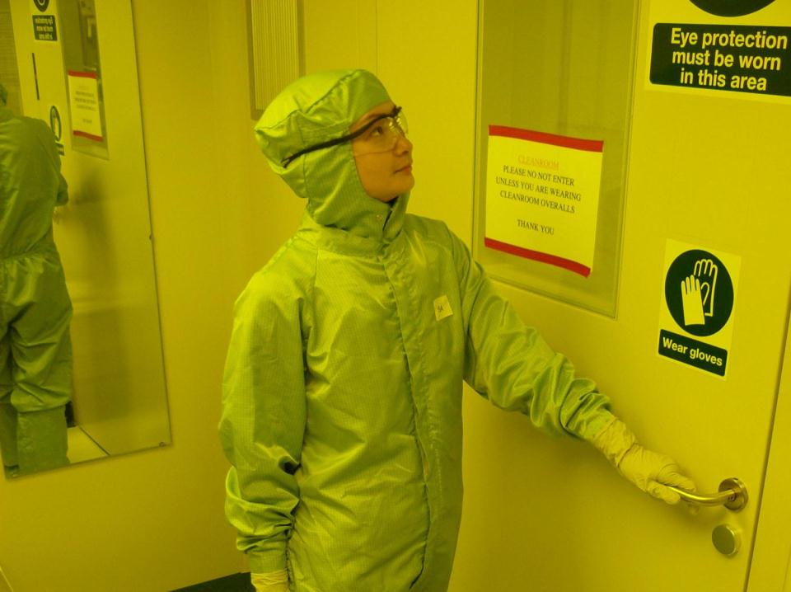
COSHH for clean room users Julia Cotton College Safety Auditor
November 2014

Slide 2
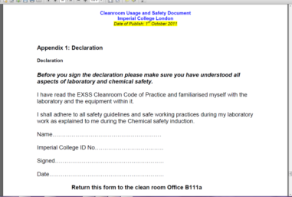
Why have this training?
Clean room code of practice - COSHH
What happens in the clean room
Risk increasing factors
Types of control measures
Failure or ineffective control measures
Failure or ineffective emergency procedures
Importance of compliance
Rescinding of access
Notes:
Clean room code of practice – Establish how many have read and understood this cover to cover?
Training should put this into perspective, and make it relevant.
One of its main requirements is that you provide COSHH risk assessments. Establish how many have done these before or had training – or know what one is.
Why make COSHH assessments? Lot of users, wide range of skills, many different toxic and carcinogenic chemicals. So need to understand how to control risks from these –and what to do if it all goes wrong. So this training is about teaching you how to control substances hazardous to your health – and your colleagues. It will also train you how to complete the legally required COSHH risk assessment – if you become employers, or line managers in UK and Europe, you MUST know how to do this.
In order to make a risk assessment, you need to understand the hazards and risks associated with your chemicals and your processes - AND others going on in same room
What are risk increasing factors? lone work, illness, lack of training, lack of caring, different departments = different standards
What are the controls? LEV, gloves, overall, safety specs, why is a mask not a good control measure?
What happens if they fail – fail to raw risk? Slow and fast accidents. How could they fail? Do they worked properly (not properly specified - gloves, fan, filter), not commissioned, not maintained, not used correctly, power or mechanical failure. How do you know if they were ineffective or failed completely? What do you need to do if they fail
Emergency - fire first aid, spillage outside containment, failure of a control
Why is compliance important?
Why your access may be rescinded - clean room code of practice

Slide 3
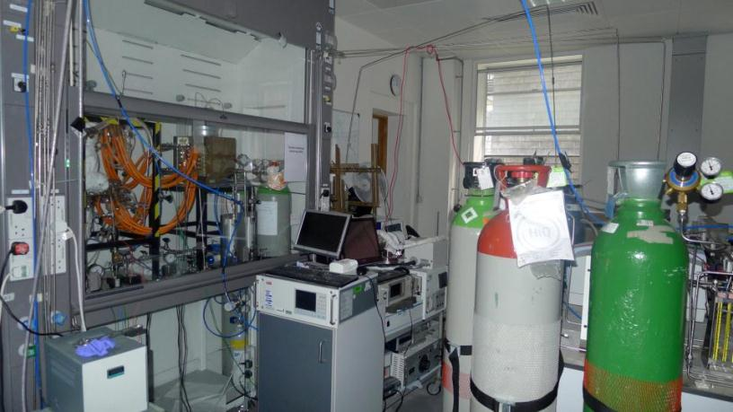
Chemical Engineering 20th October 2012
Notes:
Chemical Engineering lab, October 2012.

Slide 4
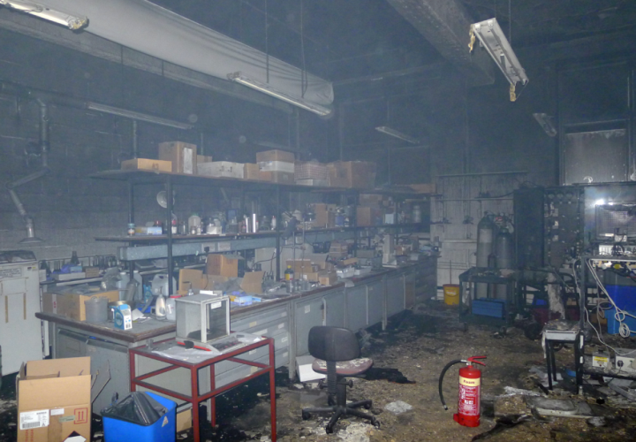
When did this happen? Who might have been in the room?
Notes:
Chemical Engineering Lab, down the corridor from the earlier one. A general view of the entire lab – destroyed by smoke and water.

Slide 5
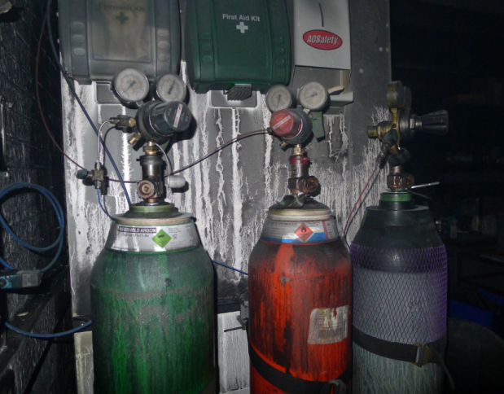
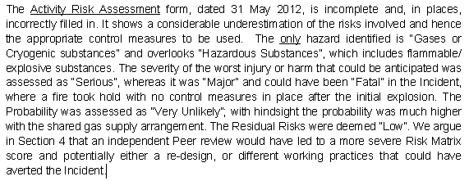
Chemical Engineering 20.25 hours 22nd October 2012
Extract from Jardine report
Notes:
The culprit. Hydrogen gas - and human error.
What time did this happen?
Who was in the room – a student.
Earlier in the day, perhaps it may have been you.
What was the route cause of what went wrong here?
3rd year PhD student conducted the risk assessment.
Not formally trained to undertake risk assessments or to change hydrogen cylinders.
The point here is that there are many labs like this and many people like this at the College.
And there are lots of near misses and a few minor accidents.
There are relatively few major accidents. But, the results may be very severe.

Slide 6
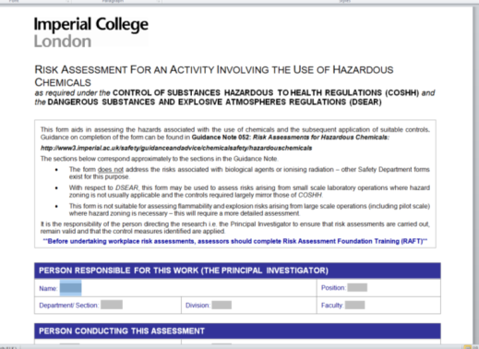
Outcomes of today’s session
Define a substance hazardous to health
Prevent yourselves and others from being exposed to hazardous chemicals
Interpret a manufacturer’s safety data sheet
Apply this to your COSHH assessment
Know the limits of control measures
Apply emergency procedures
Notes:
Define a substance hazardous to health
Prevent yourselves and others from being exposed to hazardous chemicals
Interpret a manufacturer’s safety data sheet
Apply this to your COSHH assessment
Know the limits of control measures
Apply emergency procedures

Slide 7
What happens in the Clean Room?
Why is a COSHH risk assessment needed?
Chemicals provided
Chemicals you and others supply
Storage of stocks and waste chemicals
Use wet benches and laminar flows
Computing equipment
What could go wrong?
Slow and fast accidents
Notes:
What chemicals do you take into it? What are you doing? Transporting chemicals, aliquotting them, using them, and transferring to waste containers.
What are you trying to do? Etching plastic, silicone? Coating wafers by spraying, spin-coating and electro-deposition? Creating aerosols, using solvents, highly flammable solvents and carcinogens.
What chemicals are already in there, and what chemicals are other people using – and why is this important? Because it’s a shared area, housekeeping may be poor, and you need to know about other people’s emergency procedures?
How these chemicals harm you, your colleagues or the environment, will determine what you control measures are going to be.
But you should also consider who else may go into the room and what they may be doing there - ICT, engineers?
Do you – and everybody – know exactly what to do if something goes wrong?
What happens in the clean room? What do you bring into the clean room, what at the chemicals intended to do, and why do you need to use it in there?
What are the hazards? Aggressive and toxic solvents and acids; carcinogens.
How can they harm you?
routes of exposure
likelihood
main concern = inhalation
How would you know if you had been exposed?

Slide 8

What does COSHH mean?
Control of substances hazardous to health
UK and EU legal requirement
What type of substances does it refer to?
Why is this a legal requirement?
What do you need to do to comply?
Conduct and record a COSHH risk assessment
Ensure the controls and emergency procedures are in place and effective
Notes:
Use personal anecdote to illustrate why this is necessary.
Control of substances hazardous to health
UK and EU legal requirement since 1992
What type of substances does it refer to?
Why is this a legal requirement?
What do you need to do to comply?
Conduct and record a COSHH risk assessment
Ensure the controls and emergency procedures are in place and effective

Slide 9
Summary of stages of COSHH Risk assessment
Identify harmful substances:
Read labels and safety data sheet
Examine the task – who might be exposed and how
Complete hazard checklist and then assess the risk using the COSHH RA form
Choose the control measure; check if it works as intended
Make sure you have training in the task, using the controls and the emergency procedures if these fail
REVIEW IF THINGS CHANGE OR INCIDENT!
Source: http://www.hse.gov.uk/pubns/indg136.pdf
Notes:
Which substances are harmful?
Look at each substance
Read labels and Safety data sheet
Sections 2 and 16 of the sheet, which tell you what the dangers are;
Sections 4-8, which tell you about emergencies, storage and handling.
Think about the task
If the substance is harmful, how might workers be exposed?
Who else might be exposed by:
breathing in gases, fumes, mist or dust?
contact with the skin?
swallowing?
contact with the eyes?
skin puncture?
Complete the Hazard Checklist
Assess the risk-use the form
Choosing control measures
Heirarchy of controls – more detail later..
Do the control measures work as they are intended?
Control equipment
Staying in control: Checking and maintaining
Local exhaust ventilation (LEV)
Personal protective equipment (PPE)
Skills and experience of those undertaking the task
Competence, training, instruction and information –in the process, control measures and emergency procedures
REVIEW significant change / accident
Summarised from: http://www.hse.gov.uk/pubns/indg136.pdf

Slide 10
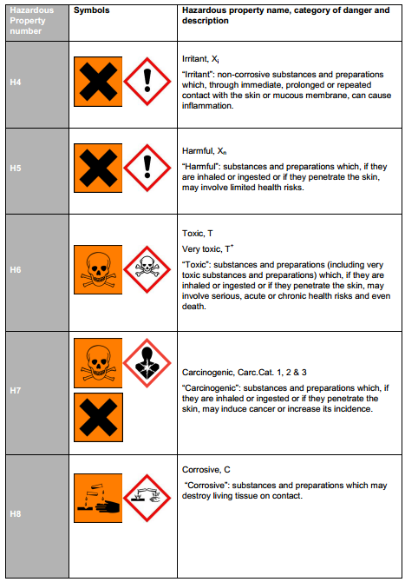
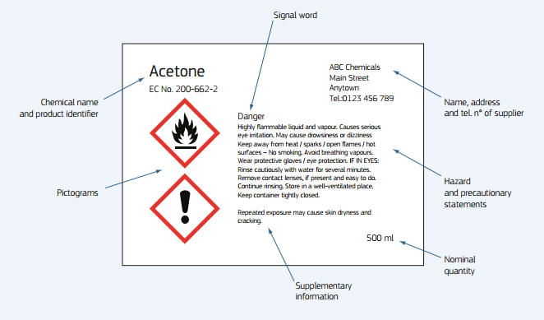

Read the label
Hazardous property numbers: H1 - H15
Read the MSDS
Notes:
R and S phrases disappearing – replaced by hazard and precaution statements – and a SIGNAL word eg DANGER
Pictograms are changing and some new ones.

Slide 11
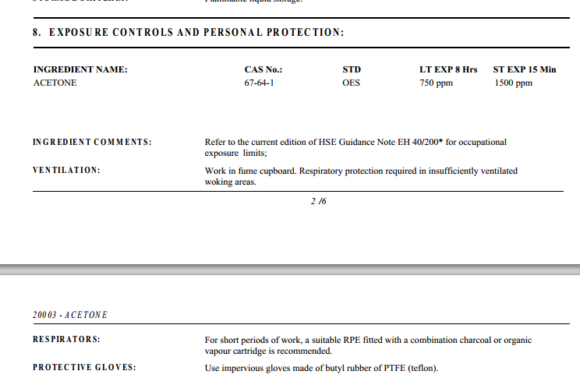
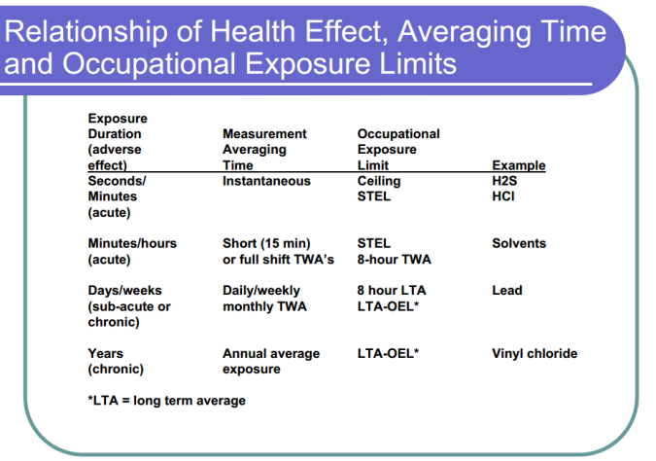
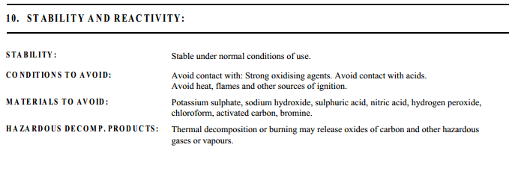
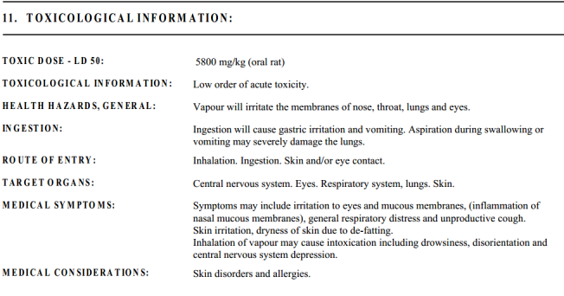
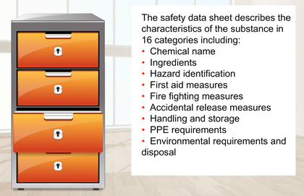
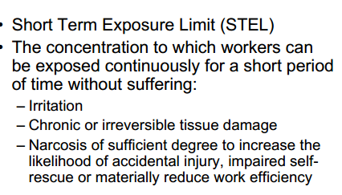
Read MSDS(s)
www.jmloveridge.com/cosh/Acetone.pdf
http://nj.gov/health/eoh/rtkweb/documents/fs/0006.pdf
Notes:
Why plural MSDS(s)?
More than one chemical, manufacturer’s give different emphasis and interpretations. May wish to consult other sources for unknown or very toxic chemicals.
Lets look at the MSDS for acetone (UK supplier), and a US state site’s info: HANDOUT MSDS
Read labels and Safety data sheet
Sections 2 and 16 of the sheet, which tell you what the dangers are;
Sections 4-8, which tell you about emergencies, storage and handling.
Explain Short term exposure limit – something with an acute effect (eg ammonia or acetone)
Providing you work in a fume hood – or a correctly used, correctly functioning wet bench, you should not be exposed.
But these values give you an indication of just how immediately harmful a substance can be by inhalation – or over a longer period.
A corrosive, fuming substance like an acid may have an immediate STEL;
For solvents, there may be a 15 minute STL – after this limit is exceeded, you may feel narcosis effects as it gets into the blood stream; then you may get CNS, kidney or liver problems. Or if exposed to a lower concentration for an averaged 8 hour period.
Some substances may have a weekly or annual exposure limit (eg heavy metals).
If you get it onto your skin as well, your exposure will obviously be increased.
What about the effects of daily, very low exposure for a year, or 10 years?
I am using acetone as an example because I know you use it .. . But why is acetone unlikely to be a problem for you?
Answer: use small quantities, using a squeeze dispenser, using the wetbench in operator protection mode (no laminar flow)
Look at section 10: because you use a lot of other chemicals, you should know about chemical incompatibilities (mixing acetone with an acid); it also gives off toxic fumes.
Section 11: “low order of acute toxicity” –still nasty but need a fair amount if you are a rat (research done on animals, not humans).
Route of entry –very important as a clue as to the control measures needed.
Who can tell me what sort of gloves are needed for open, wet work with acetone?
Is Wikipedia a good source of reliable information?

Slide 12
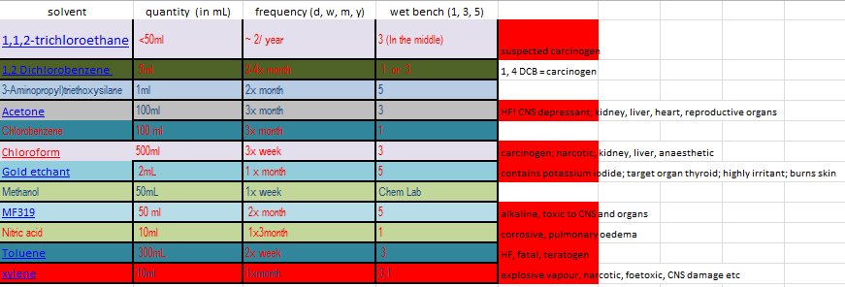
Some nasties in the cleanroom

Slide 13


What, How, When, Who?
Is it a hazardous chemical
How does it get into the body
How much is needed to cause harm
Immediate and long term effects and their symptoms
Other substances it reacts with – and any by-products
Storing stocks and wastes, using, transporting
Frequency and duration of the task
Who else might be exposed
Notes:
Is it a hazardous chemical – check the label!
How does it get into the body (route of exposure)
You also need to consider how much is needed to cause harm, and immediate and long term effects.
You and anyone else who may be exposed should also be aware of the immediate and long term effects of exposure, and of the symptoms of exposure, AND any adverse chemical reactions – and emergency procedures.
As soon as you know this, you will know what type of controls (and emergency procedures), are needed.
All this information is available from the MSDS (if it is a good one).
Then: What are you doing with your chemical? How in your process, might you inhale it or get it onto your skin or into your eyes, or get fumes into your eyes? Transporting into the lab, between benches and stores, could you drop or spill it? Will you generate aerosols or fumes when pipetting or aliquotting or transferring into spin coaters or waste containers
How often do you do it and for long?
Do any other people enter the clean room.

Slide 14
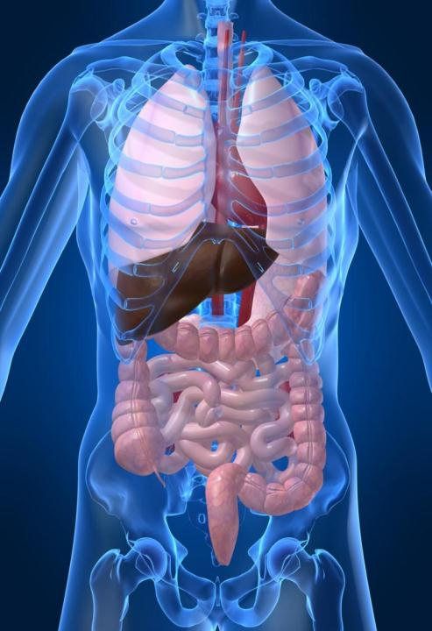


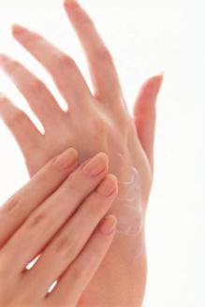
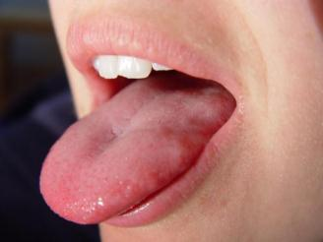
Routes of exposure
Target organs
Notes:
How do substances get into you – and your colleagues
4 routes of exposure
Question: Why do you need to know the route of exposure?
To understand what control measure(s) are needed
Question: why do you need to know what a chemical will do to you (or your colleague)?
You need to know what it might do to you in order to understand the emergency procedure

Slide 15
Examine the task: How might acetone get onto or into you in the clean room? What does this depend on?
How much are you using and how are you using it?
Is the process open or sealed?
If open, for how long?
Do you generate aerosols?
Is the air extracted effectively (local exhaust ventilation), or do you rely on respiratory protective equipment (face mask)
Will you get it on your hands – a splash or immersion?
If yes, what type of gloves are you wearing?
Could you get it onto your eyes or face?
If yes, what protection are you using?
Acetone dissolves plastic – do you wear contact lenses?
Notes:
Spend 10 minutes working together in small groups to determine this.
How much are you using and how are you using it?
Is the process open or sealed?
If open, for how long?
Do you generate aerosols?
Is the air extracted effectively (local exhaust ventilation), or do you rely on respiratory protective equipment (face mask)
Will you get it on your hands – a splash or immersion?
If yes, what type of gloves are you wearing?
Could you get it onto your eyes or face?
If yes, what protection are you using?
Acetone dissolves plastic – do you wear contact lenses?

Slide 16
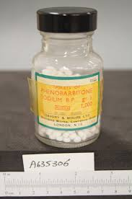

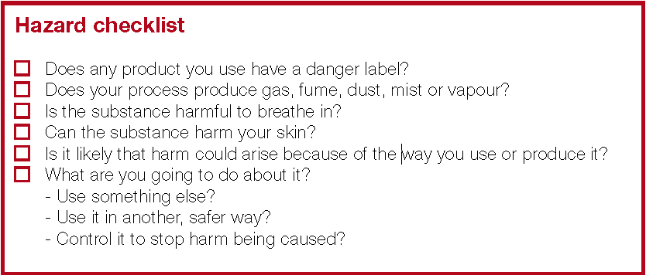
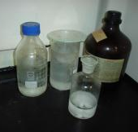
http://www.hse.gov.uk/pubns/indg136.pdf
Notes:
If none of the boxes are ticked. .. .then is the substance hazardous?
If sure, you don’t need to do a COSHH risk assessment (eg not needed for a bottle of water)
But beware of old bottles or unlabelled reagent bottles (disposal of HF by Michael Keith-Lucas and failure of fc, no eye protection and tap failed to work)

Slide 17
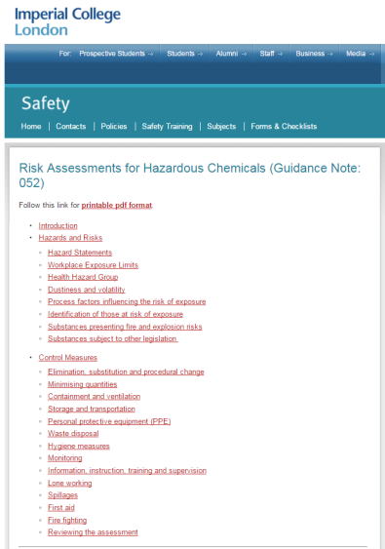
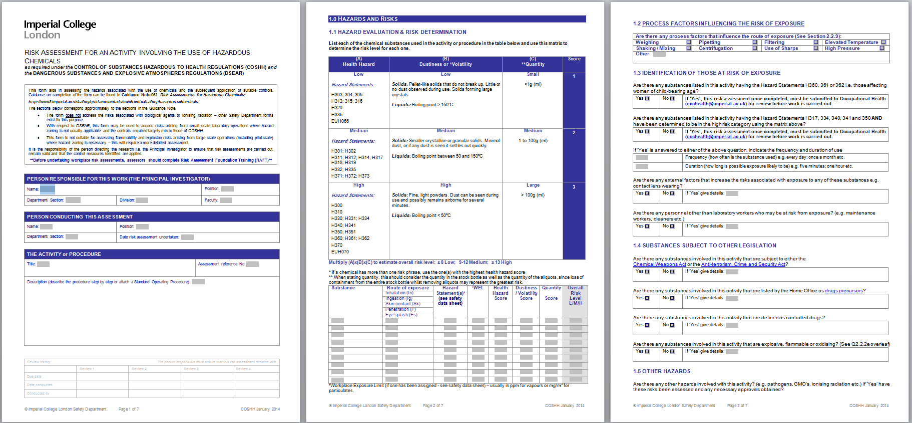
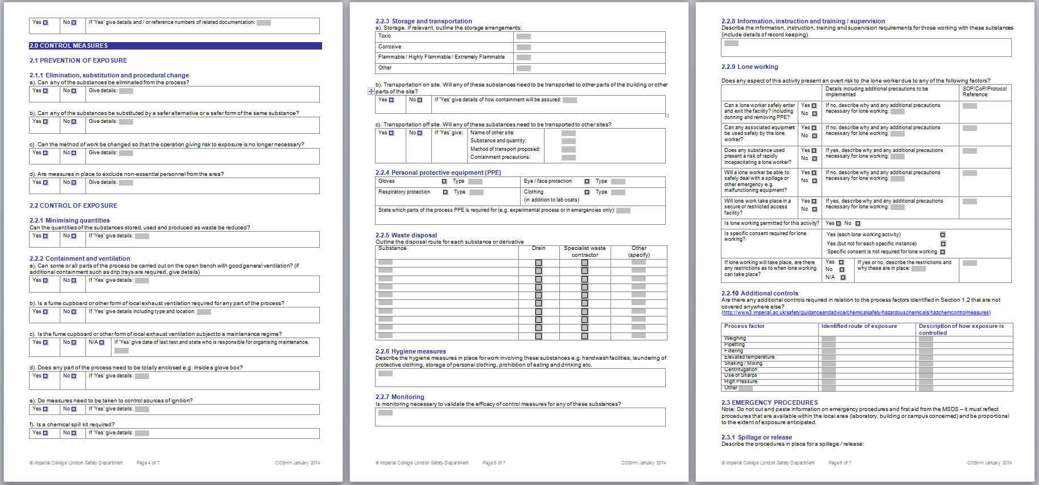
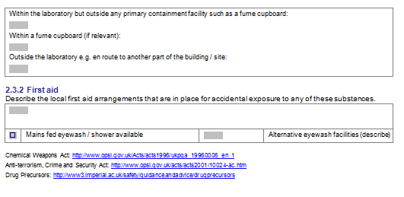
College COSHH RA form and Guidance
http://www3.imperial.ac.uk/safety/subjects/chemicalsafety
Notes:
What happens if you get your COSHH or any other risk assessment wrong?
Who should check your risk assessment?

Slide 18
Choose your controls: Hierarchy of controls
See College COSHH guidance document
Eliminate process or substance – or substitute for safer
Different form (eg liquid instead of powder)
Reduce – small amount/weaker concentration
Enclose
Control emissions at source
Keep people away
Provide PPE
Notes:
Choosing control measures
In order of priority:
1 Eliminate the use of a harmful product or substance and use a safer one.
2 Use a safer form of the product, eg paste rather than powder.
3 Change the process to emit less of the substance.
4 Enclose the process so that the product does not escape.
5 Extract emissions of the substance near the source.
6 Have as few workers in harm’s way as possible.
7 Provide personal protective equipment (PPE) such as gloves, coveralls and a
respirator. PPE must fit the wearer and they must be trained to use it correctly.
If your control measures include 5, 6 and 7, make sure they all work together.

Slide 19
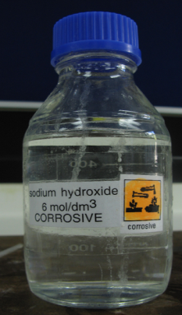
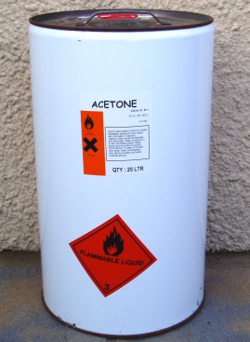
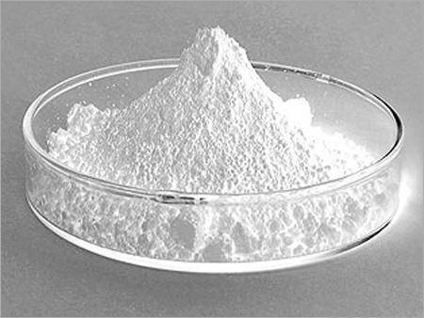
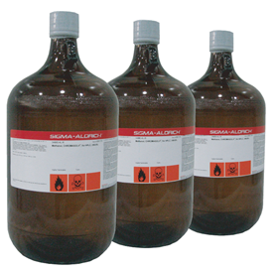
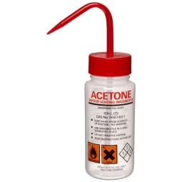
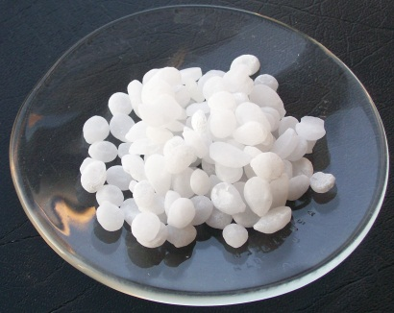
Which is safer and why?
REDUCED quantity and volume
DIFFERENT FORM

Slide 20
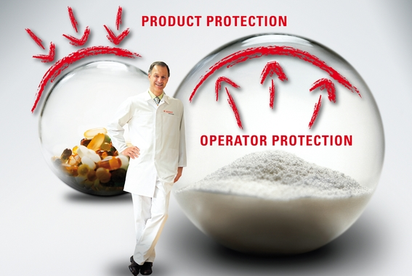
Enclosure!

Slide 21
Controlling emissions at source

Slide 22
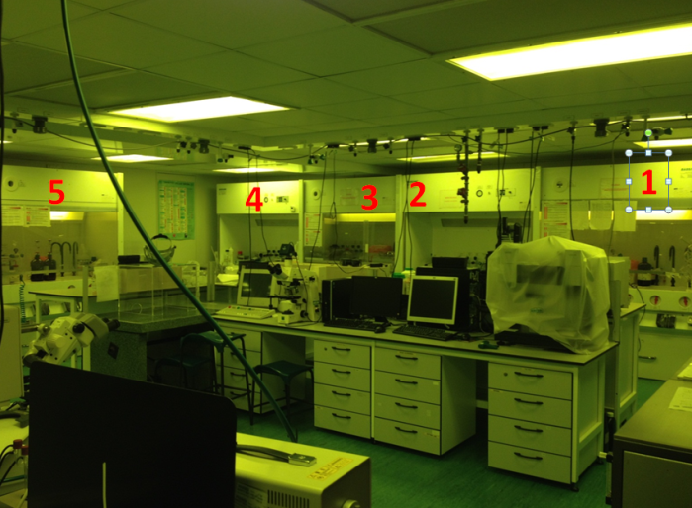
Choose the control measure . . . . . . . . . check it works as intended Which of these provides operator protection???
Wet bench
Laminar flow
Fume hood
Recirculating fume hood
Which of the above provides operator protection?
Which of the above could be used for work with HF or large volumes of other strong acids and solvents?

Slide 23
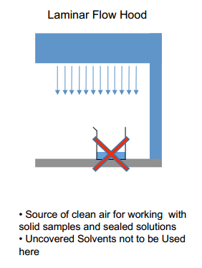
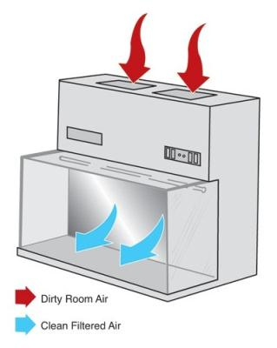
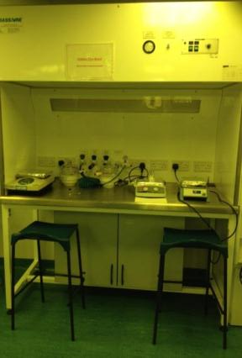
Laminar flow- only for product protection
QUESTION
Why shouldn’t uncovered solvents be used in here?
Why might this also apply to powders or other liquids?
QUESTION
How can it be “clean” air if it has passed over a solvent or a toxic dust?
QUESTION
Where is the air down-flow going?

Slide 24
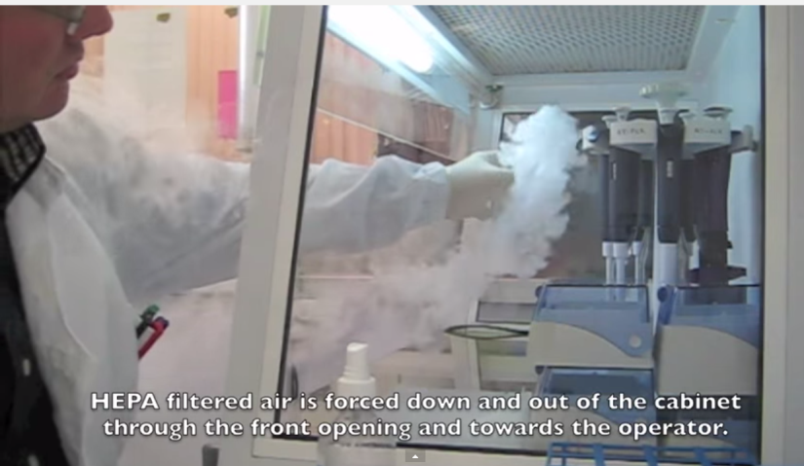
In a laminar flow, HEPA filtered air ex

Slide 25
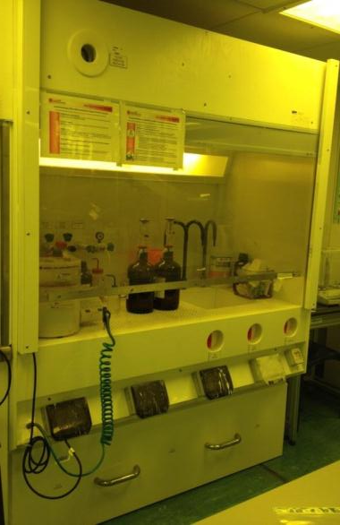
A Wet bench – is NOT a fume hood
2 x air flows:
Down flow – only for product protection)
In-flow - provides some operator protection
QUESTION:
What happens to the in-flow when you stand in front of the cabinet, put large objects inside it, or block the holes?
QUESTION:
Why does a wet bench provide only some operator protection (compared to a fume hood)?

Slide 26
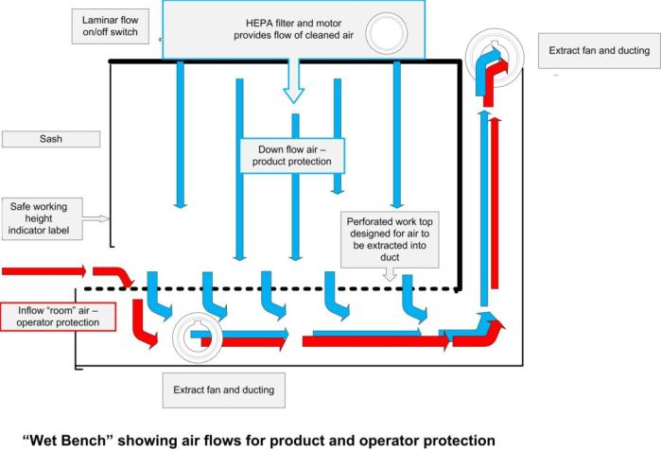
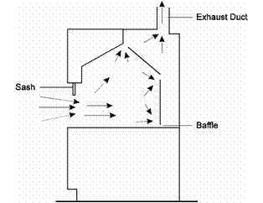
WET BENCH v Fume hood

Slide 27

Compare wet benches (for acids and solvents) with a fume hood

Slide 28
Which has better operator protection and why?
A
B

Slide 29
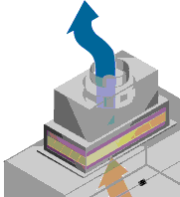
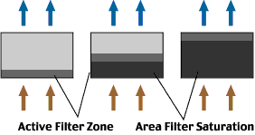
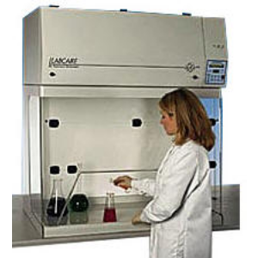
Recirculating vs ducted fume hoods
Charcoal filter - absorbs chemicals and filters particulates
Unsuitable for: very toxic substances, high volumes of contaminants, unknown or highly volatile reactions
Filters must be changed promptly if this ever this type of misuse occurs or when blocked by particulates
Toxics can pass through filter into room!
Portable - liable to siting in drafty areas – lose containment
Difficult to test containment
Maintained and tested via Department
Notes:
Avoid filter use in applications involving very toxic substances, very high volumes of contaminants, and unknown or highly volatile chemical reactions. Always make sure that filters are pr
Unsuitable for: very toxic substances, very high volumes of contaminants and unknown or highly volatile reactions
Filters must be changed promptly if this ever this type of misuse occurs or when blocked by particulates
Otherwise toxic substances will not be absorbed by the charcoal but instead pass straight through the filter into the room!!!!
omptly changed when the Threshold Limit Value (TLV) has been reached for any contaminant gases present.

Slide 30
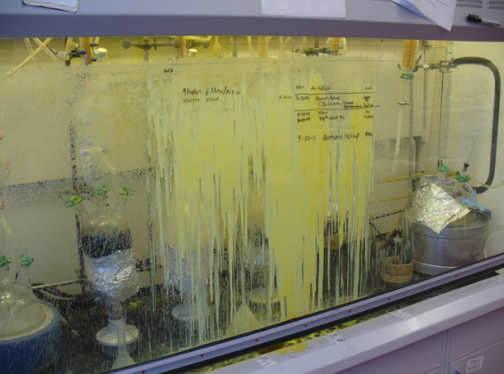
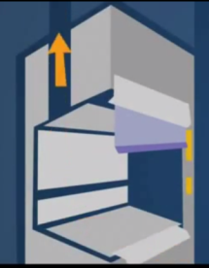
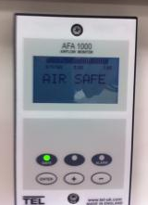
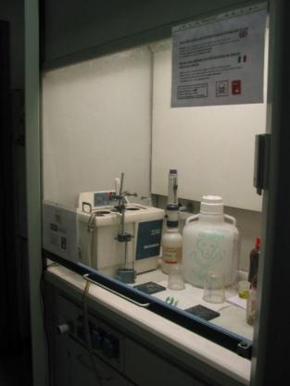
Ducted fume hood
No filter
Contaminated air ducted above building roof
Baffles/foils to ensure smooth air flow
Installed, commissioned, maintained and tested to BSEN14175 by College
Sash provides blast protection
Air flow monitor& alarm

Slide 31
All fume hoods
Have limitations
Must be carefully sited to ensure no drafts
Air flow disrupted by external and internal influences:
users, drafts, insufficient make up air
large objects, fans and heat sources within
Power or fan failure
Must be maintained and containment tested annually (look for in date label)
Users must be trained to use them, and know what to do if fan or power fails

Slide 32
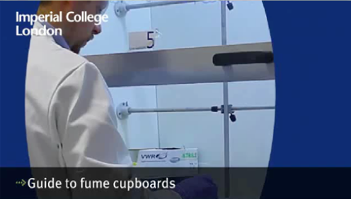
College fume hood training video

Slide 33
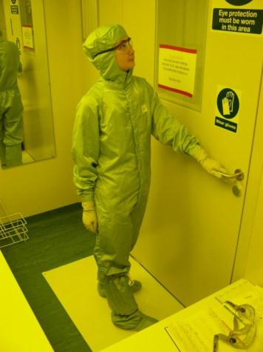


What can go wrong with Personal Protective Equipment (PPE)?
Wrong type selected
Doesn’t fit properly
Not used correctly
Contaminated before use
Damaged in use
http://www3.imperial.ac.uk/OCCHEALTH/guidanceandadvice/gloveinformationandguidance
Notes:
Who knows which are the best type of gloves to wear when working with acetone?
What goes wrong with gloves?
How could a chemical from the chemistry lab be spread into the corridor or lifts?

Slide 34
Surgical masks and respiratory protection
B
A
Who do these two masks protect and from what?

Slide 35


What might go wrong – and what would help prevent it happening?
Picture B
Picture A
Notes:
Picture A:
Knock over chlorinated waste solvent while filling it – should this go into the drain? What other chemicals might also be in the drain?
Lose power to extract fan – and therefore operator protection
The spin coater is quite close to the outside edge of the cabinet – so how effective is the in-flow?
Picture B:
Knock over and break or lose samples
Some of the chemicals are flammable – the fridge could catch fire if vapours built up
Might have unlabelled chemicals with unknown toxic properties – if the label not present or falls off.

Slide 36





Eyes!
What happens to eyes exposed to acid or alkali? What are the two Routes of Exposure through the eye?
Direct contact
Vapour penetration
Notes:
Which eye protection you choose must depend on your risk assessment.
Eye splash is common in College environment even when wearing safety glasses. Goggles are safer if you are working with Caustic or corrosive substances. Particularly if you wear contact lenses.
How long do you have to apply diphoterine eye wash – to stop eye damage?
10 seconds.
Do you know where the container is, if it is full, and if you can reach it in ten seconds (half blinded?)

Slide 37
Emergency!

Slide 38
What can go wrong?
Errors of communication! Pay attention to signs and notices!
Slow and fast accidents
Power fail when working with toxic chemical
Spill inside or outside containment
Personal contamination (eye, face or through glove or skin)
Sudden illness
Fire
Flood
Equipment breakdowns or other event
Ineffective control measures
Ineffective emergency procedures
REVIEW RISK ASSESSMENT IF INCIDENT OR SIGNIFICANT CHANGE
Notes:
Errors of communication! Pay attention to signs and notices!
Slow and fast accidents
Power fail when working with toxic chemical
Spill inside or outside containment
Personal contamination (eye, face or through glove or skin)
Sudden illness
Fire
Flood
Equipment breakdowns or other event
Ineffective control measures
Ineffective emergency procedures

Slide 39



First aid – who knows what to do?
Spillage on you (but not HF)
Neutralise immediately! But where is the diphoterine Mini Dap spray kept???
Calling Security (4444) will get you an ambulance but NOT a trained chemical first aider – so who is?
Spillage on floor?
If volatile, evacuate room or if not, immediately encircle spill to stop it spreading and smother with Trivorex powder or granules; wait for colour change to back to yellow-green; dispose as hazardous waste
Acid in eye (but NOT for HF)
Diphoterine – apply entire container in first 10 seconds, then hospital with MSDS

Slide 40
Outcomes of today’s session
Define a substance hazardous to health
Prevent yourselves and others from being exposed to hazardous chemicals
Interpret a manufacturer’s safety data sheet
Apply this to your COSHH assessment
Know the limits of control measures
Apply emergency procedures

Slide 41

Any questions?

