Slide 1
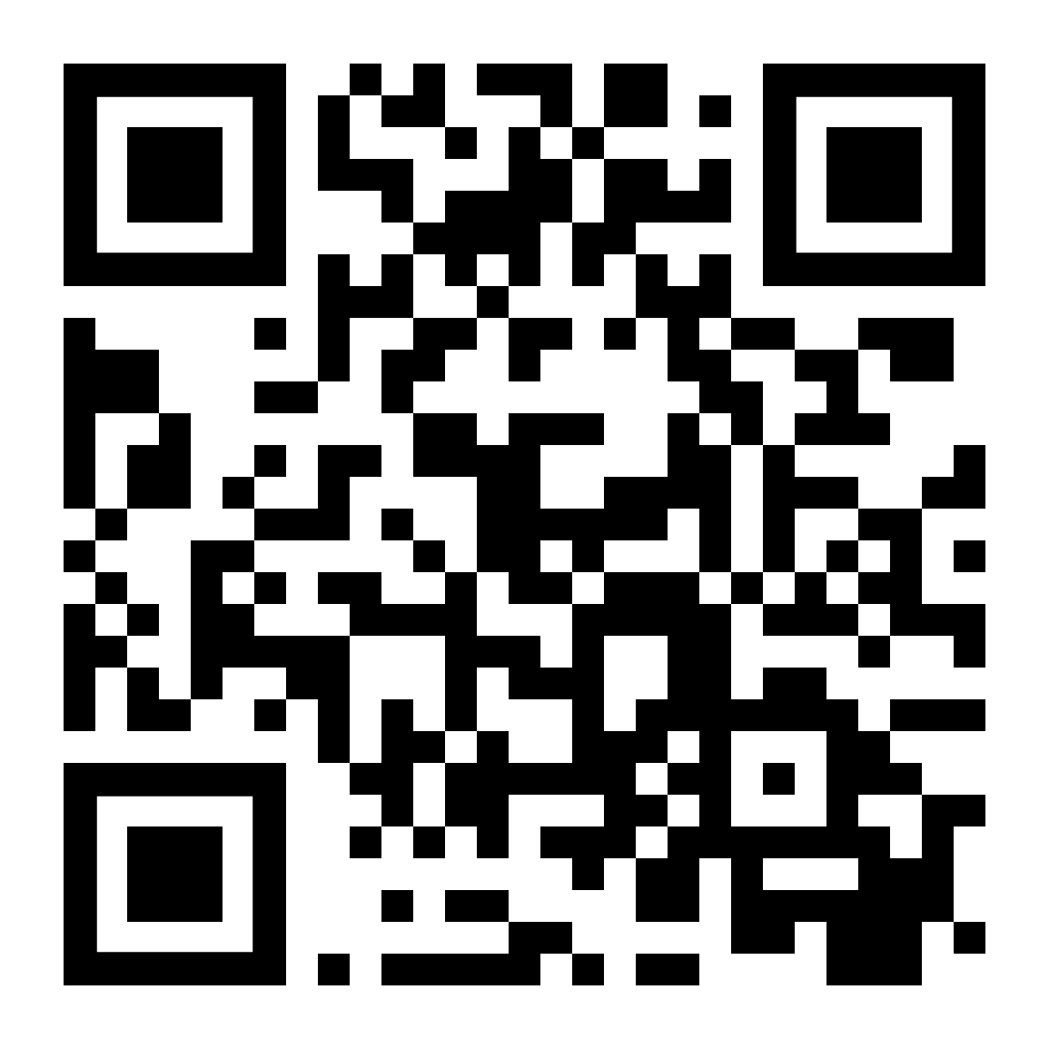
EEE PORTAL ATTENDANCE APP
Attendance Registration using EEE Portal Attendance app
Scan the QR Code or go to https://portal.ee.ic.ac.uk

Slide 2
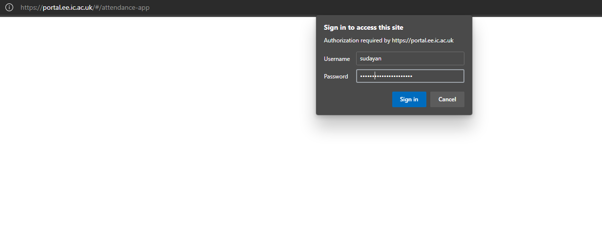
Use your Imperial credentials for login

Slide 3
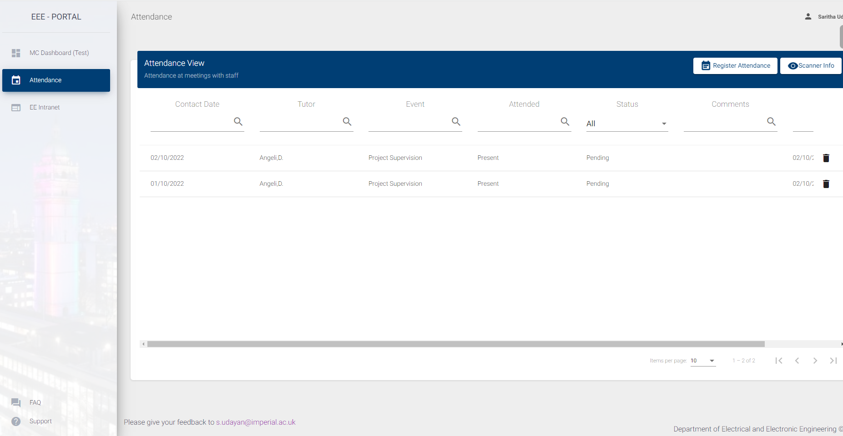
Attendance Dashboard
Click Register Attendance Button to register your attendance with the staff
Your name will be displayed here

Slide 4
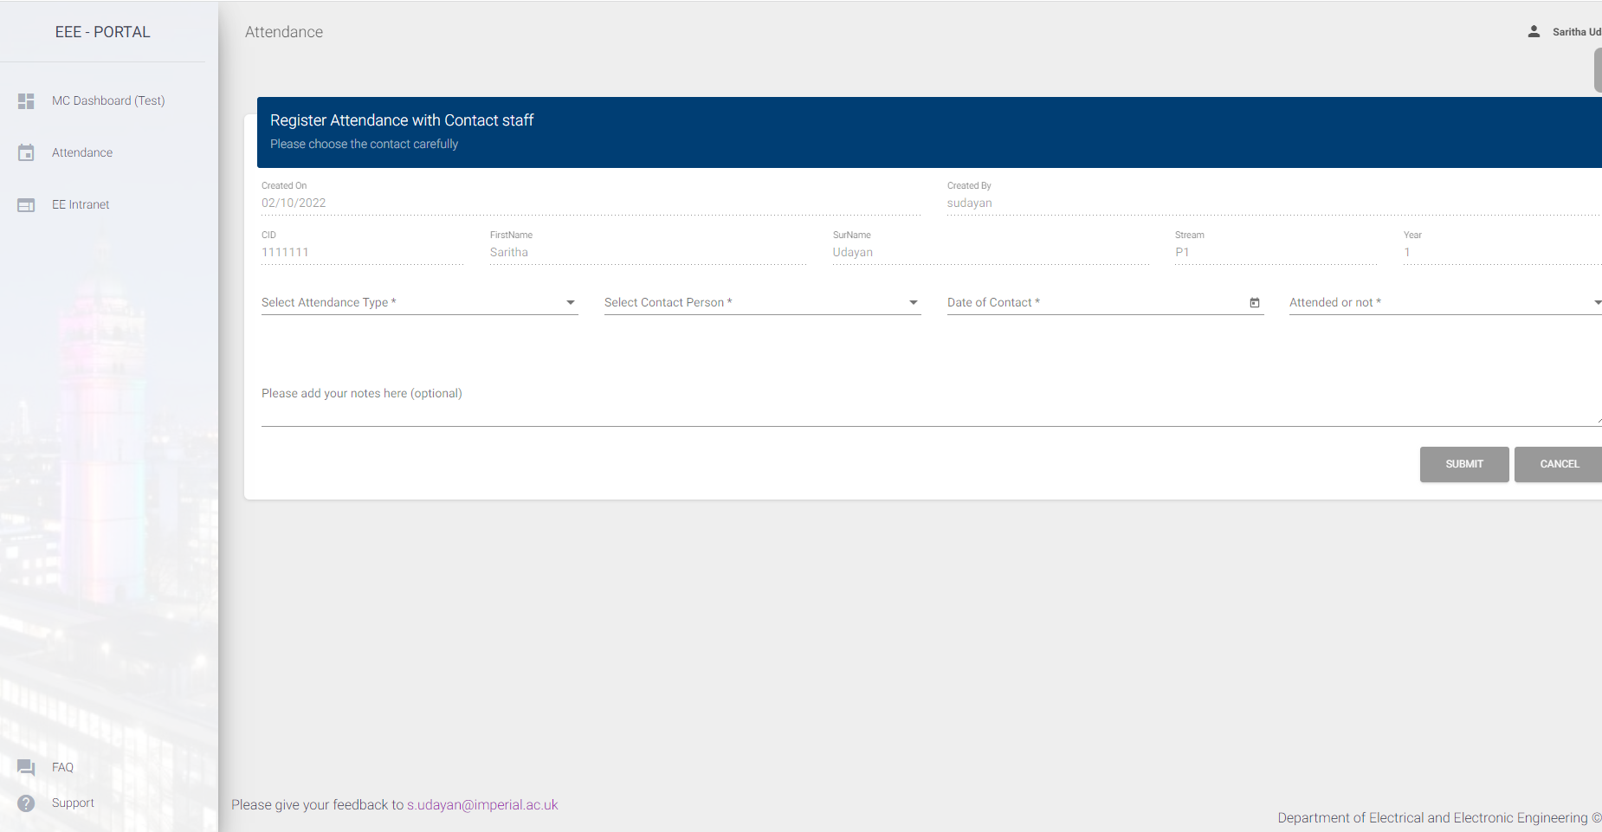
Attendance Registration
Your details will be displayed in the top 2 rows (read-only)
Please enter these 4 fields

Slide 5
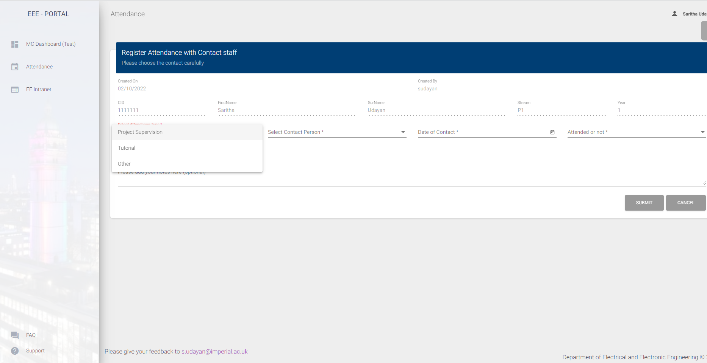

Slide 6
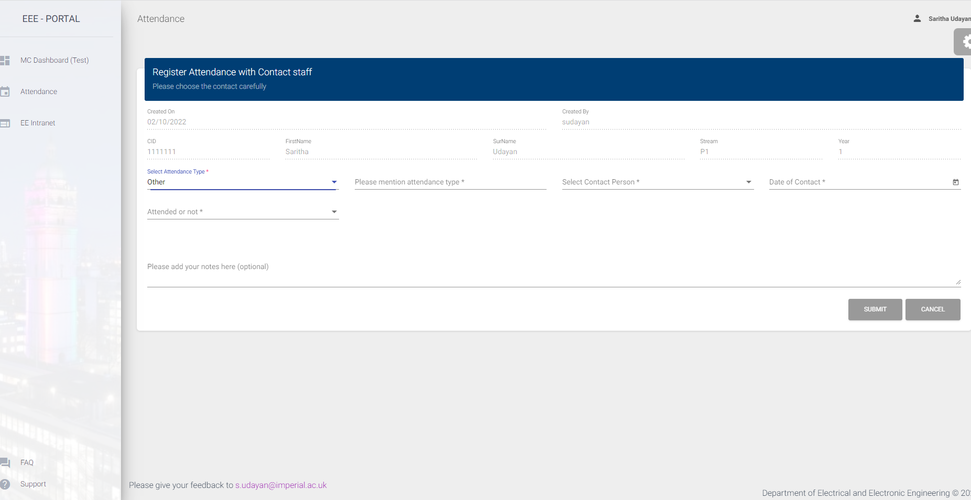
If your attendance/event is not in the list, please select Other option and describe the
event in the text

Slide 7
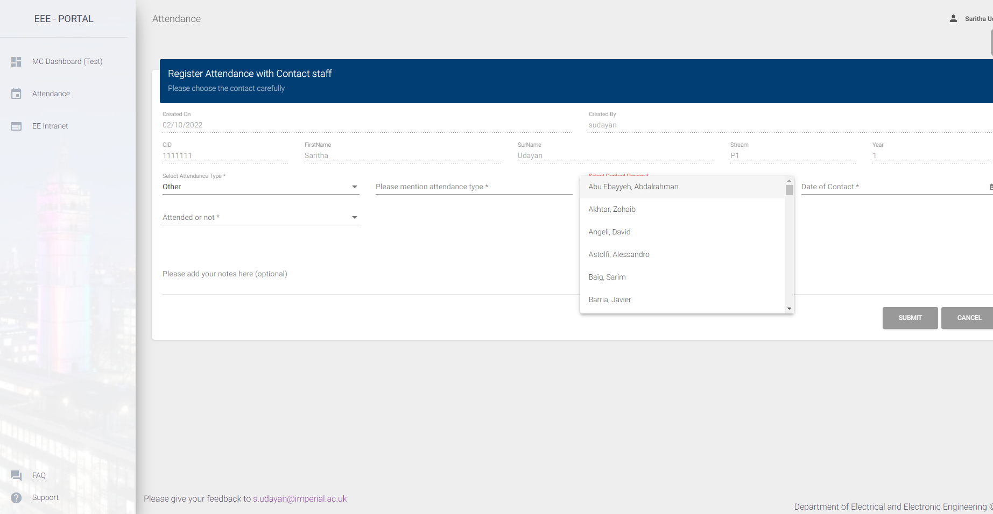
By default, the box will be prefilled with tutor or project supervisor. If not, please choose the staff name from the list .

Slide 8
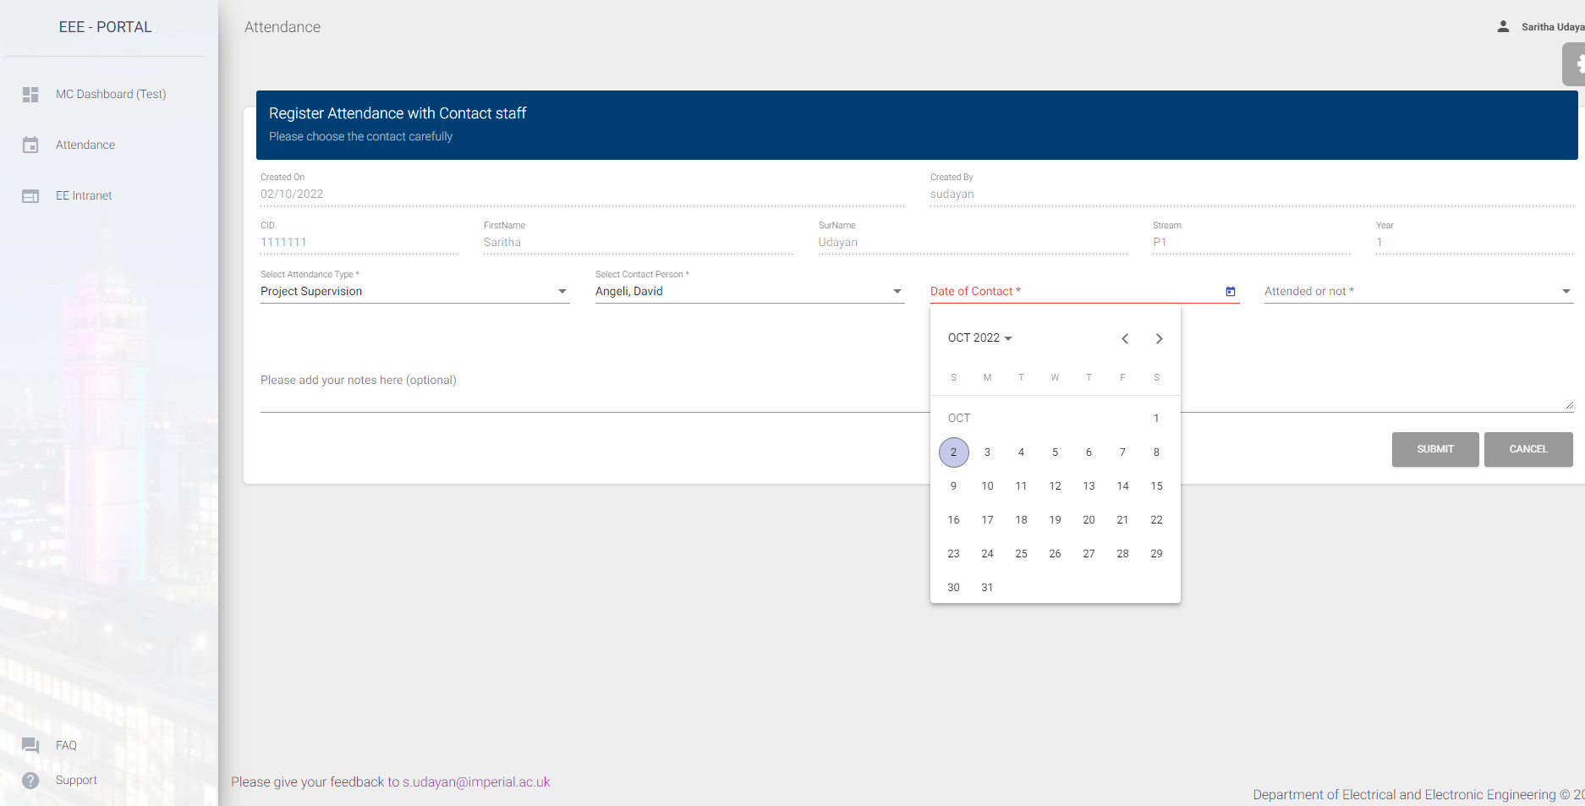
Please select the meeting date. There is a time lock of 30 days. You can only enter events of the current date & the previous 30 days

Slide 9
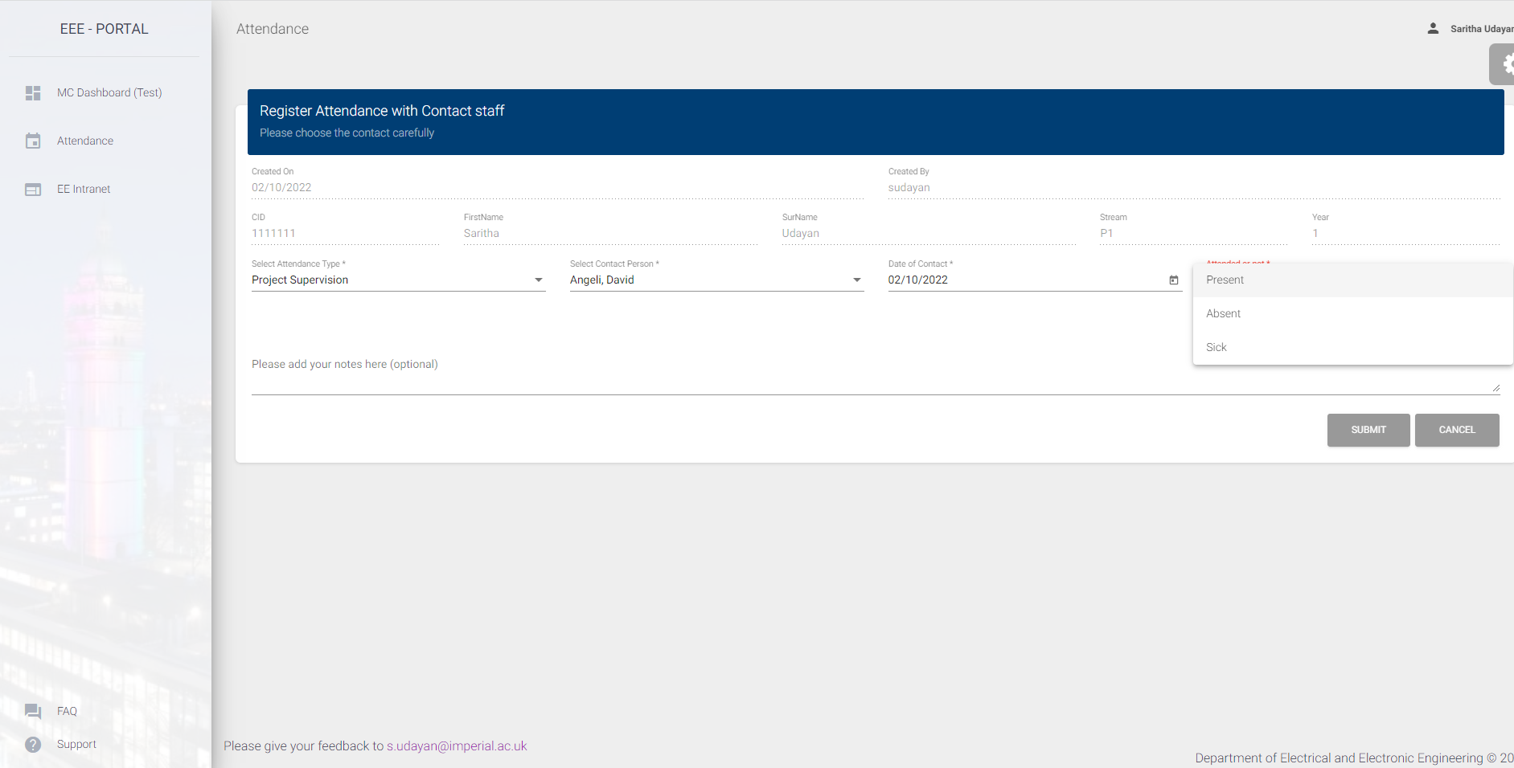
Mark your attendance. If you are choosing Sick or Absent, there is an option to enter the reason

Slide 10

You can add optional notes if you choose. Click submit to register your attendance

Slide 11
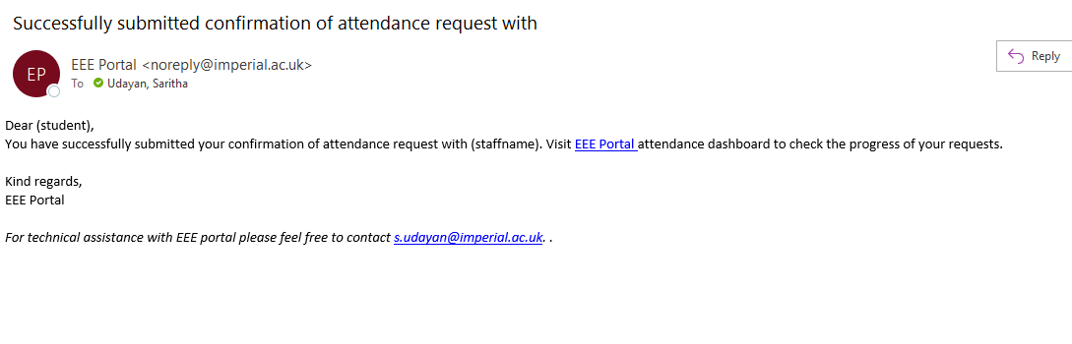
You will get an acknowledgement mail after successful registration

Slide 12
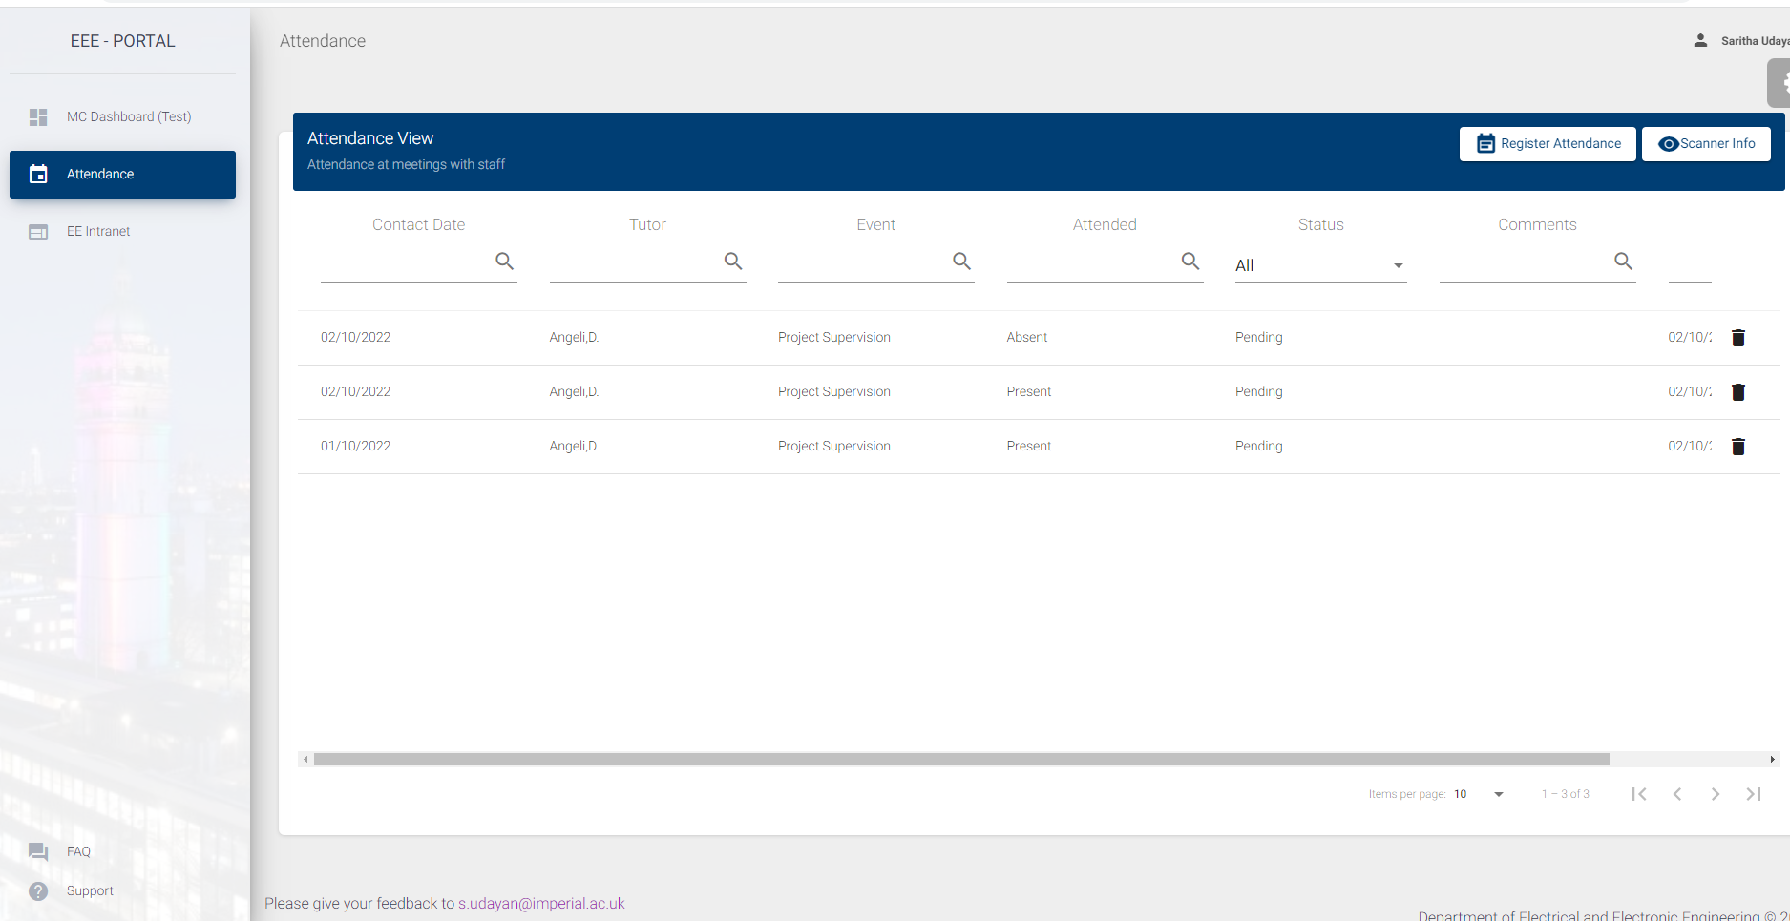
Option to delete your request to confirm attendance will be available until staff reviews it
You can view your requests in the list after registering. Sort and Filter options are available for each field.

Slide 13
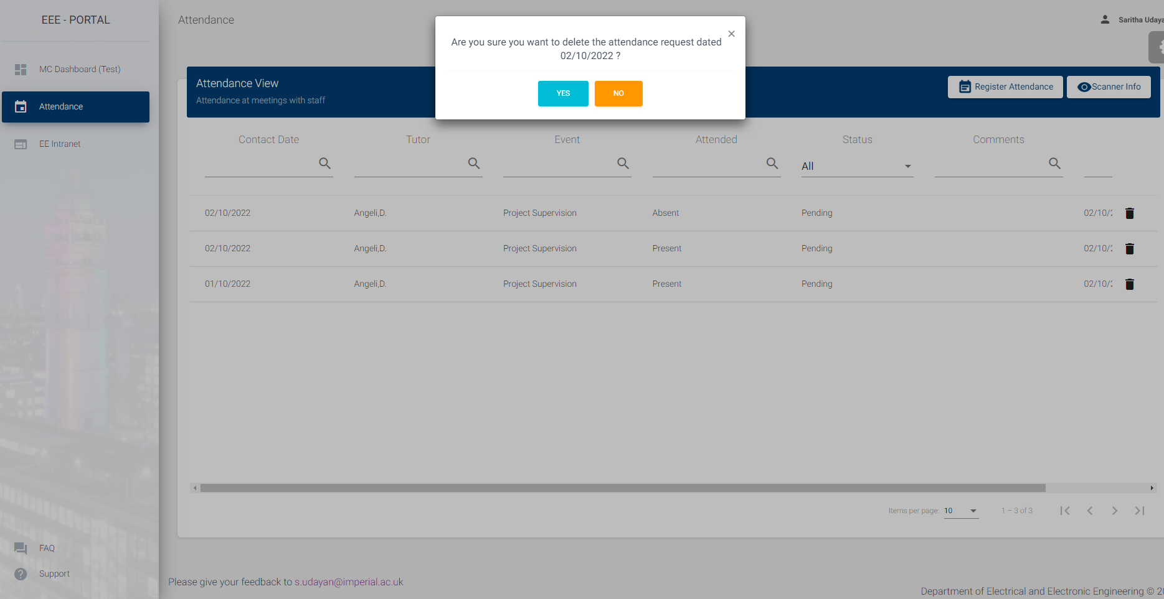

Slide 14
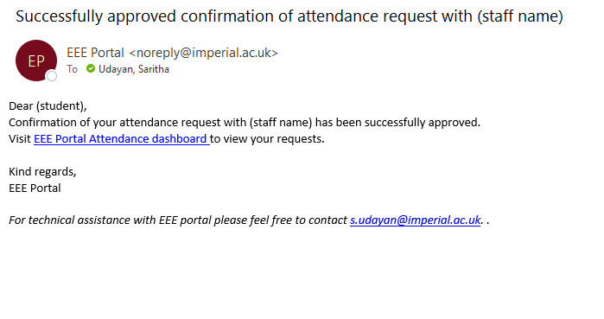
You will get an acknowledgement mail, once the staff approves your request

Slide 15
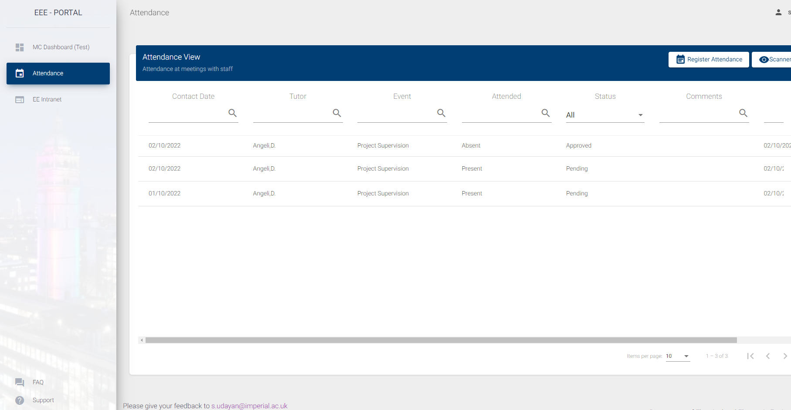
The status change will be displayed on your attendance dashboard

Slide 16
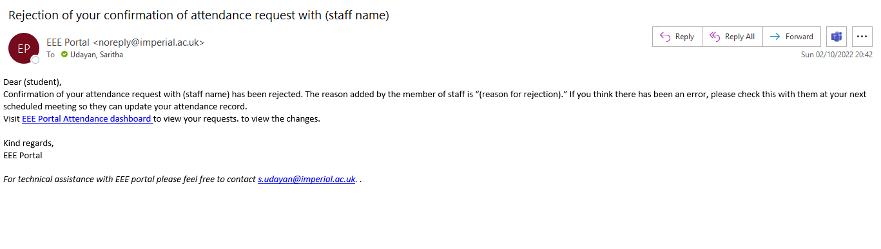
If staff rejects your attendance, then you will get an acknowledgement along with the reason of rejection.

Slide 17
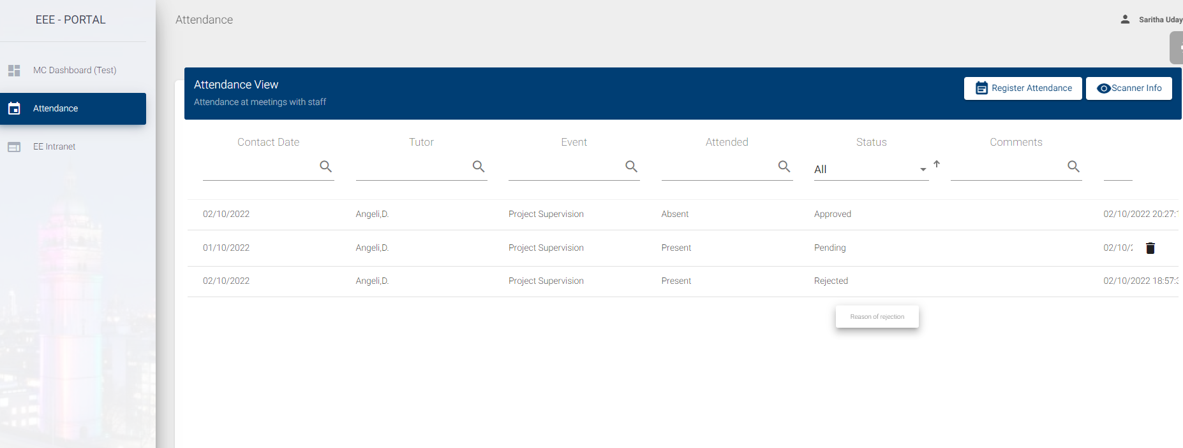
To view your card scanner info, click here
Hover to review the reason for rejection of attendance confirmation

Slide 18
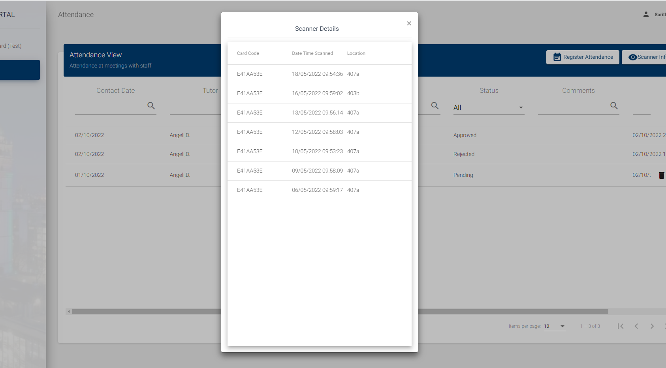

Slide 19
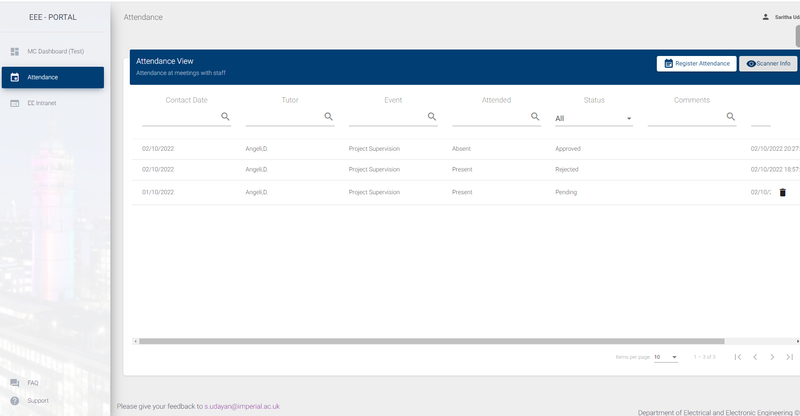
If you have any problems using the app, click Support to send an email to the address below. You can also give us your feedback about the app.

