Slide 1
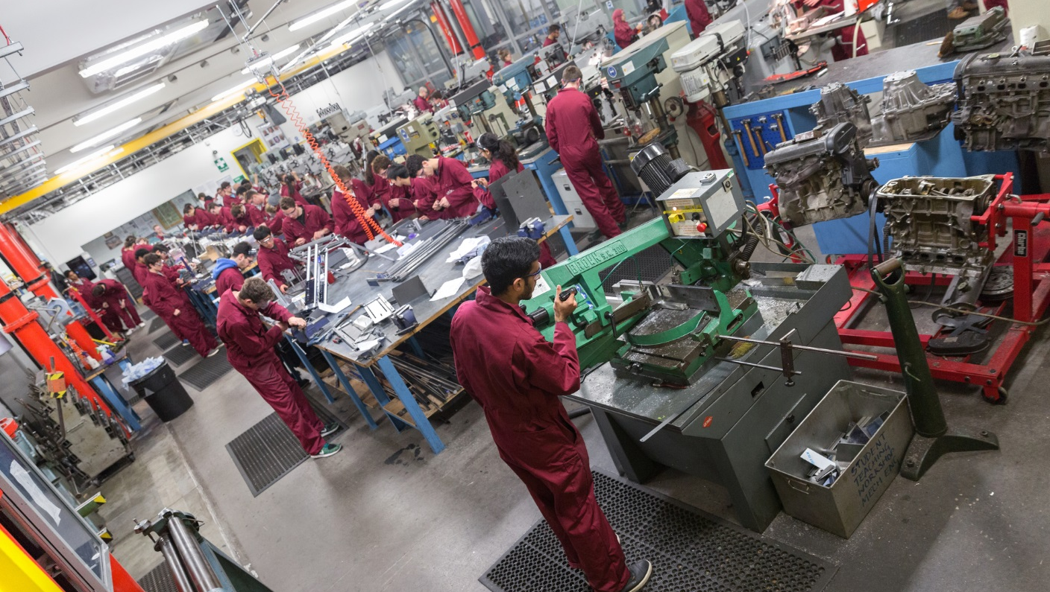

Faculty of Engineering
Strategic Plan: October 2019
Delivering excellence and impact in research, teaching and translation.

Slide 2
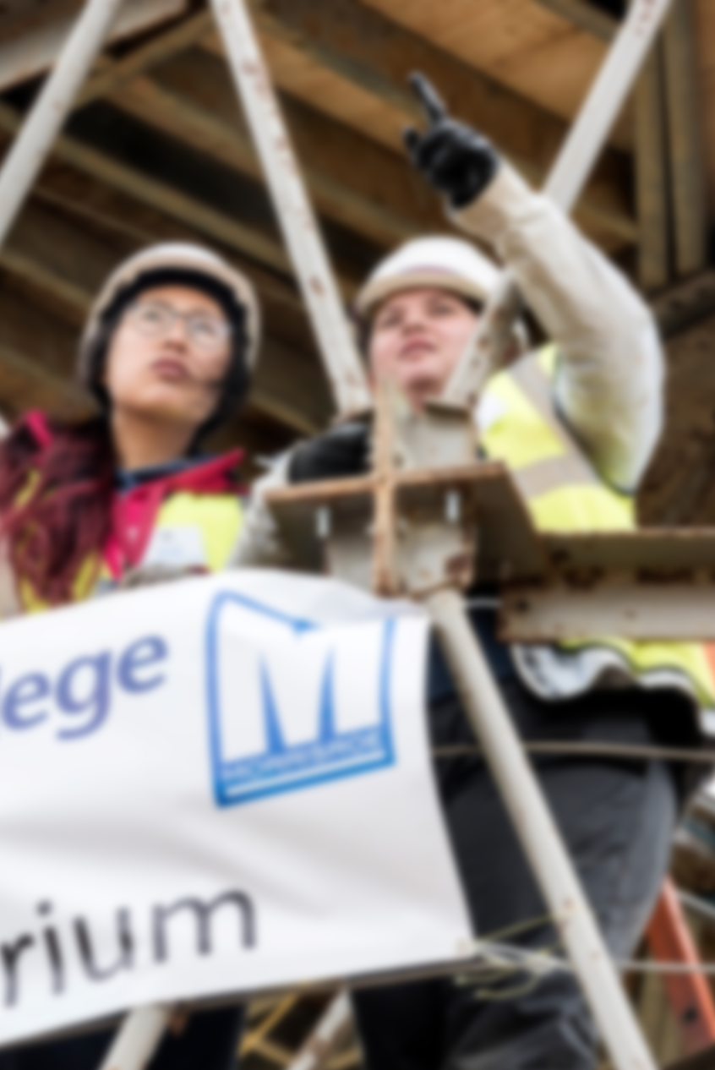
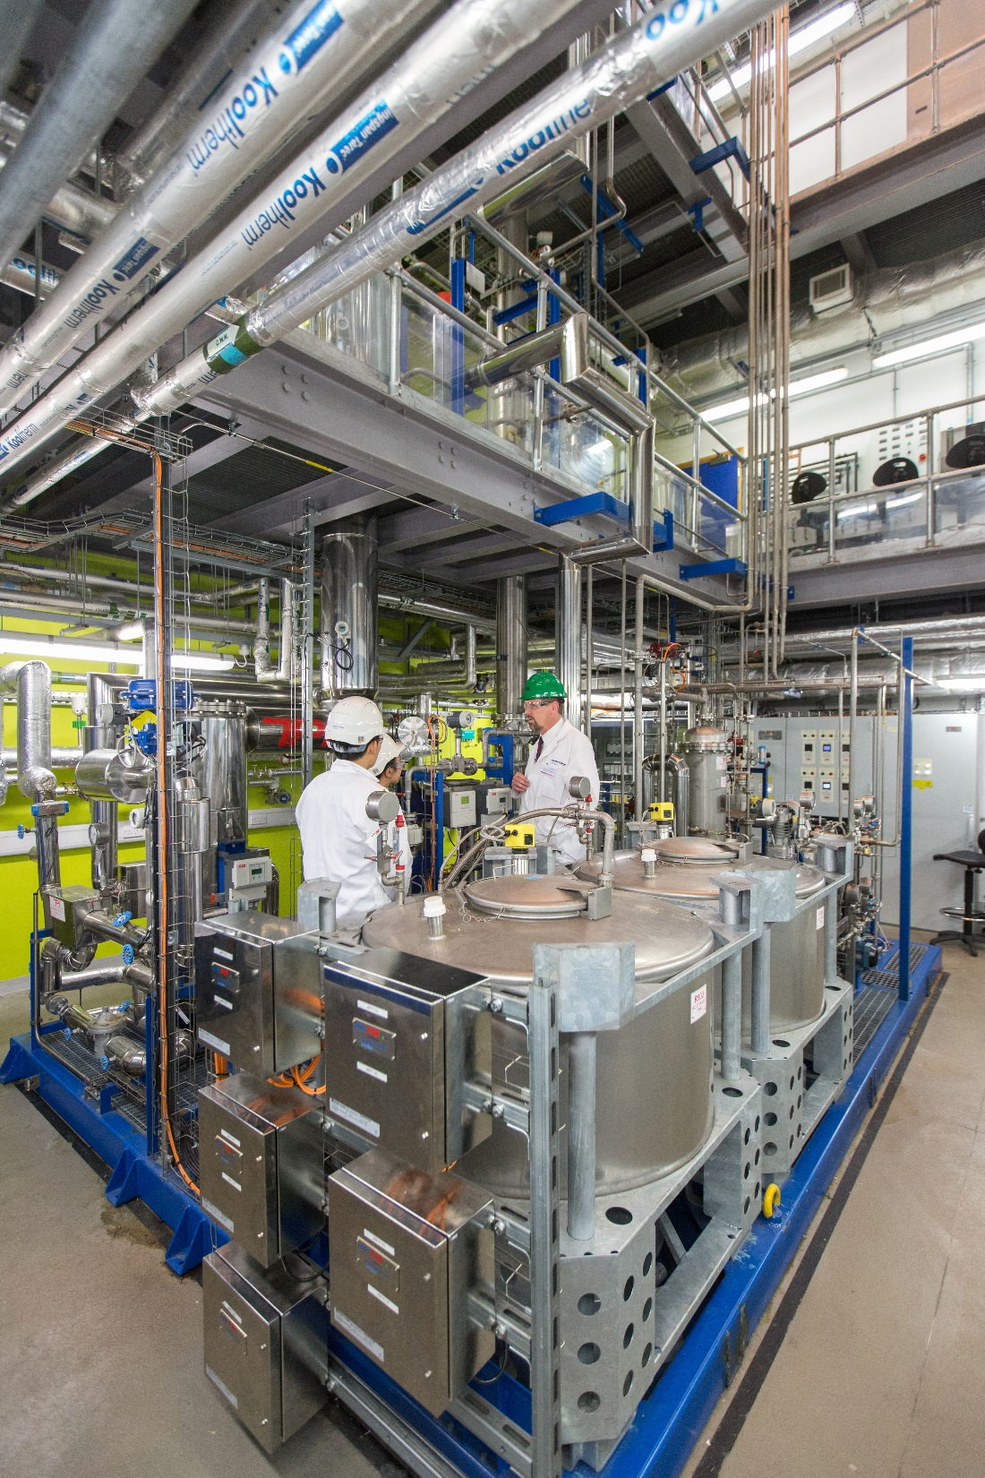
Vision
The Faculty of Engineering and its constituent departments are consistently ranked in the top ten engineering and technology schools in the world.
Our ambition over the next decade is to move to become one of the world’s top five engineering and technology schools, measured through the quality and impact of:
the education we provide;
our research;
our translation activities.

Slide 3
SWOT
Recognised as one of the world’s top engineering schools
Highly international – staff and students
Buoyant student demand from UK and overseas
Strong graduate employment
Good industry links and track record of partnership
Strong financial position
Collaborative work culture
Record on Widening Participation/Access
Cost of operations
Pay and benefits against international benchmarks
Diversity – gender, BAME and POLAR 1/2
Support for translation
Execution of major change
Lack of endowment
Scarcity of colleagues with capacity to lead major programmes
STRENGTHS
WEAKNESSES
OPPORTUNITIES
THREATS
Government Industrial Strategy and Global Challenges
Diversification of student body
Facilities at White City campus
Increasingly engaged alumni
Growing demand for PGT courses (including online)
Closer working with Faculty of Medicine
Continue to improve and celebrate Faculty culture
Retention of academic staff
Brexit – student recruitment, staff recruitment and retention
Heavy reliance on students from China
Weakness of UK industry and potential industry downturn
Cost for staff of living in/near London
Scarcity of high-quality research students
Reduced freedom to grow taught student numbers

Slide 4
Background:
Sustainable Growth
(2012-2017)
Over the period 2012-17:
Academic staff grew by 13%
Undergraduate student numbers grew by 23%
Postgraduate community has also grown, with an increase of 23% in taught postgraduates and 16% in research postgraduates
Research income grew by 22%
The Faculty in 2019:
4,700+
UG students
420+ academics
1,400+
PGT students
1,600+
PGR students

Slide 5
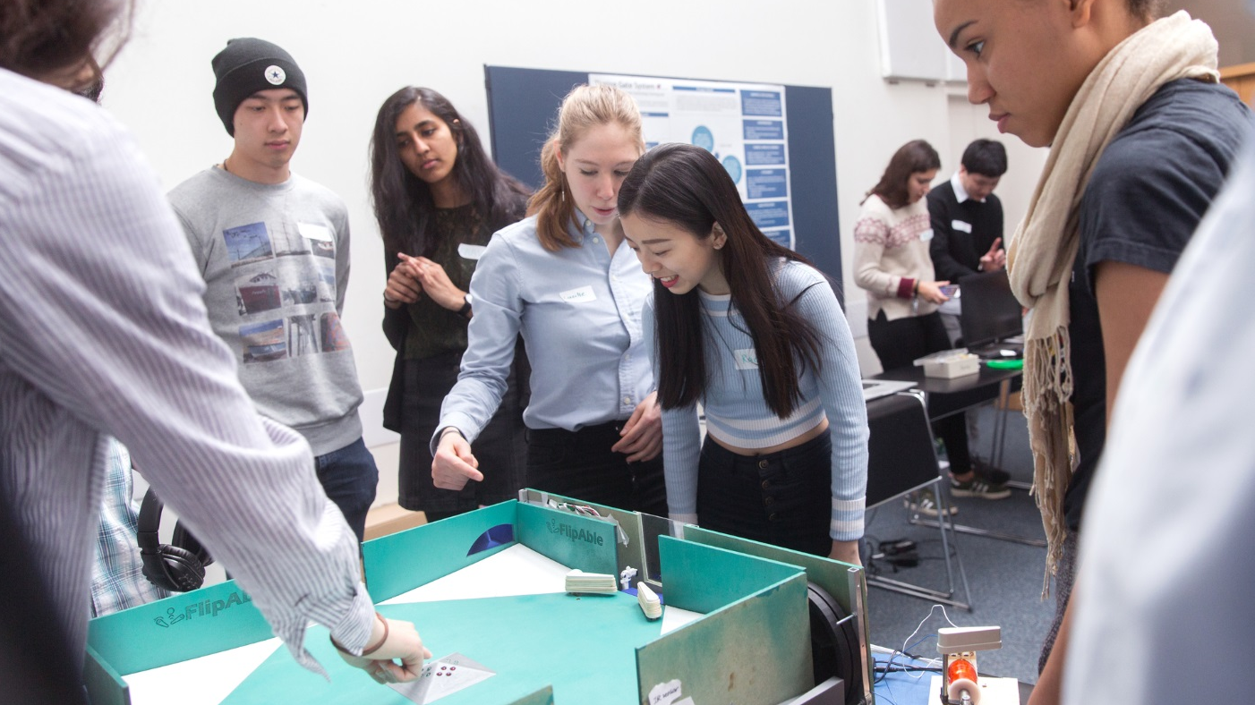



2012-2017: Strengths
Research
In REF (Research Excellence Framework) 2014, all the Departments were ranked in the top 3 in the UK for the percentage of research classed as 4* in overall quality.
We scored particularly highly in the Impact and Environment sub-profiles of the REF.
Financial position
The Faculty’s turnover has seen consistent and substantial growth (36%) over the last 6 years, and in 2017-18 the Faculty turnover stood at £286M. The turnover per FTE (all staff in the Faculty) has also seen an increase (12%) over the same period.
Translation
The majority of the research translation activities that take place through Imperial Innovations come out from Engineering.
The number of new patents filed and granted and new licencing deals per year has doubled over the period.

Slide 6
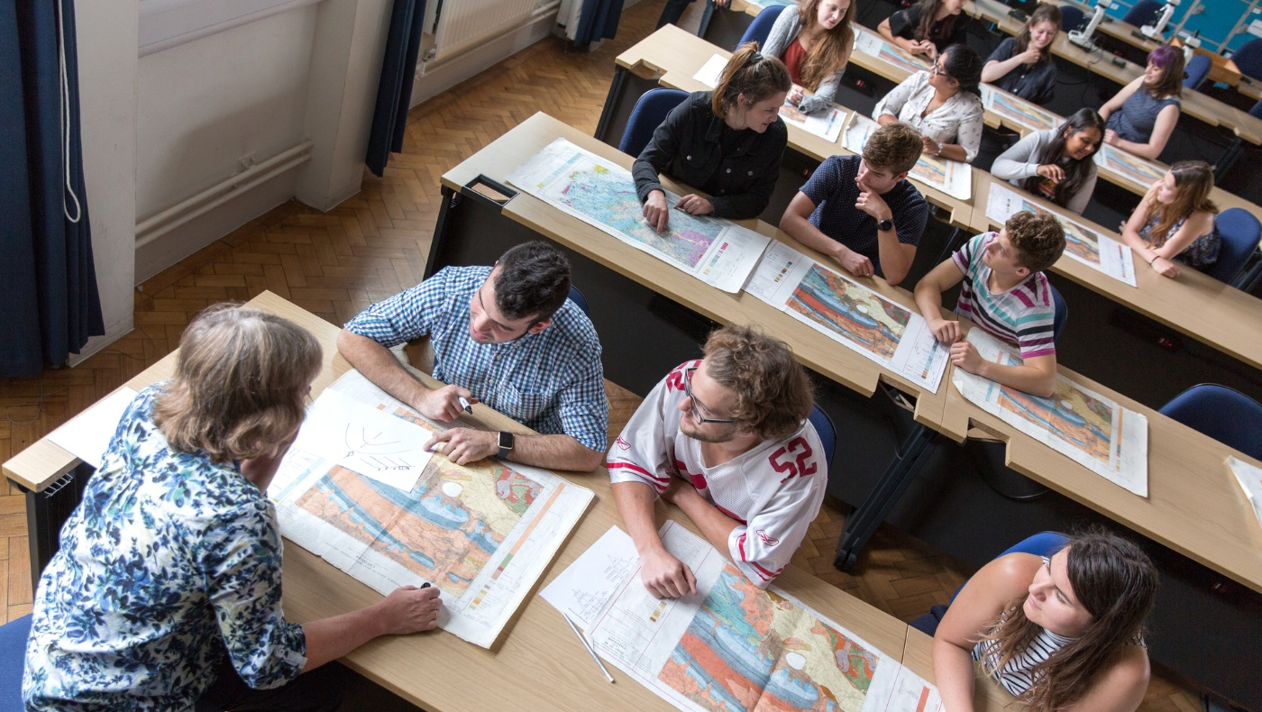


2012-2017: Weaknesses
Student satisfaction
Only 4 Departments scored in the top quartile for the majority of the questions in the annual National Student Survey in 2018.
An area that requires particular focus across the Faculty is assessment and feedback.
Diversity
Staff: In 2018, 20% of academic and research staff in the Faculty were female, 57.5% of professional services staff, and 13% of technical staff.
Students: In 2016-17, the percentage of applicants and enrolled students with Widening Participation flags were 14% and 11% respectively.
Translation
Our income from licences falls well below our UK competitors.

Slide 7
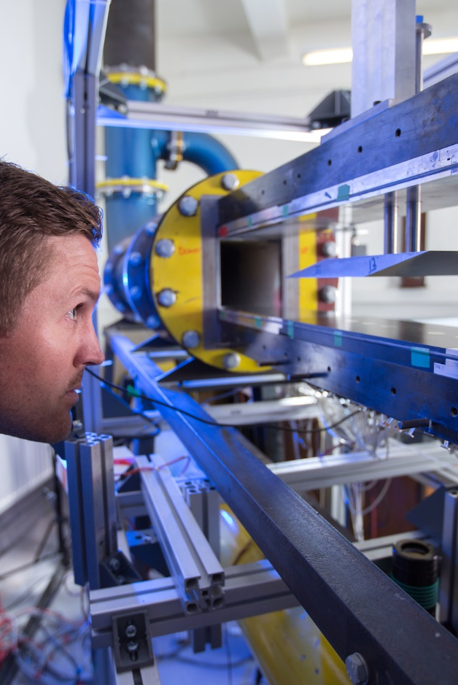
The next five years
(2018-2023)
Our emphasis over the next five period will be on continuing to improve the quality and impact of everything we do. This will be achieved through positive leadership and by empowering staff, and enabled through strong resources (finances, facilities and space). In particular continued growth will be associated with Bioengineering and the Dyson School of Design Engineering (to reach steady state), postgraduate teaching (both MSc and PhD), and research volume.
We strongly believe that the size of Departments that we currently run within the Faculty of Engineering provide an optimum balance of scale and culture. Any substantive long term growth would therefore necessitate new Departments being formed. This is not anticipated over the next five period, but is not precluded beyond that.

Slide 8
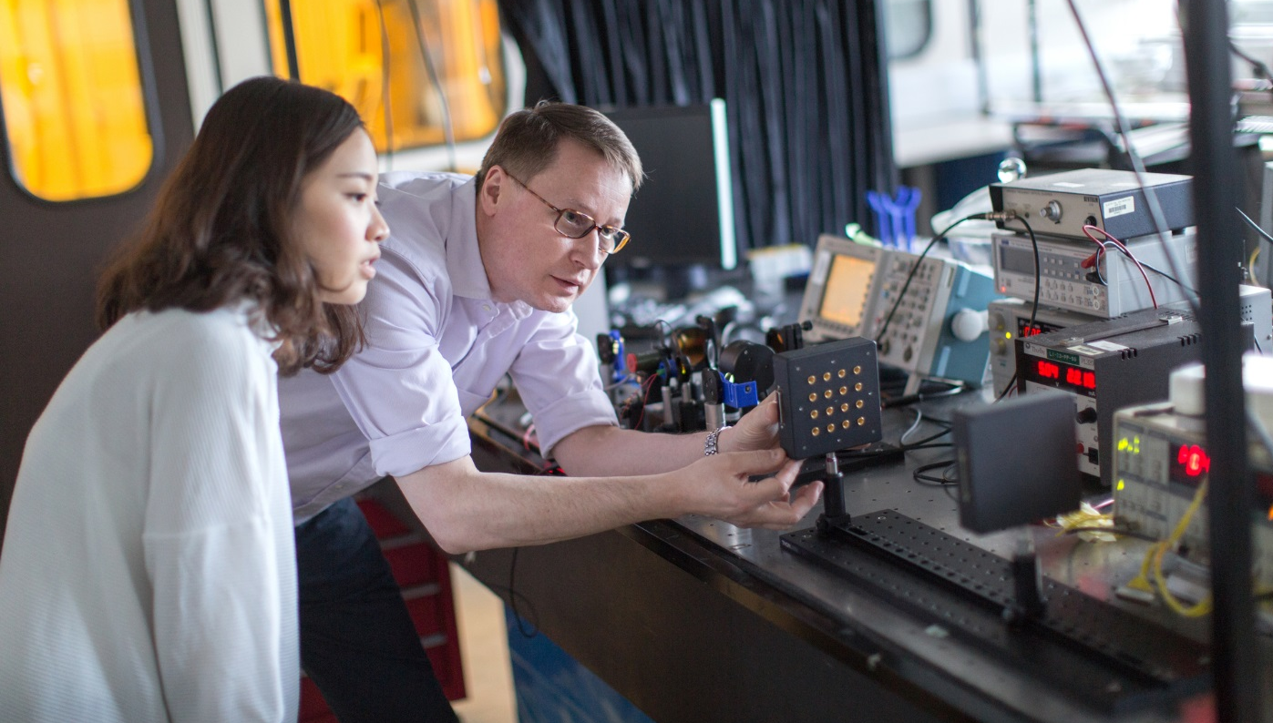
The Faculty of Engineering Strategy
People
Financial Sustainability
Education and the Student Experience
Space and Facilities
Research
Operations
Impact and Translation
Public Engagement

Slide 9
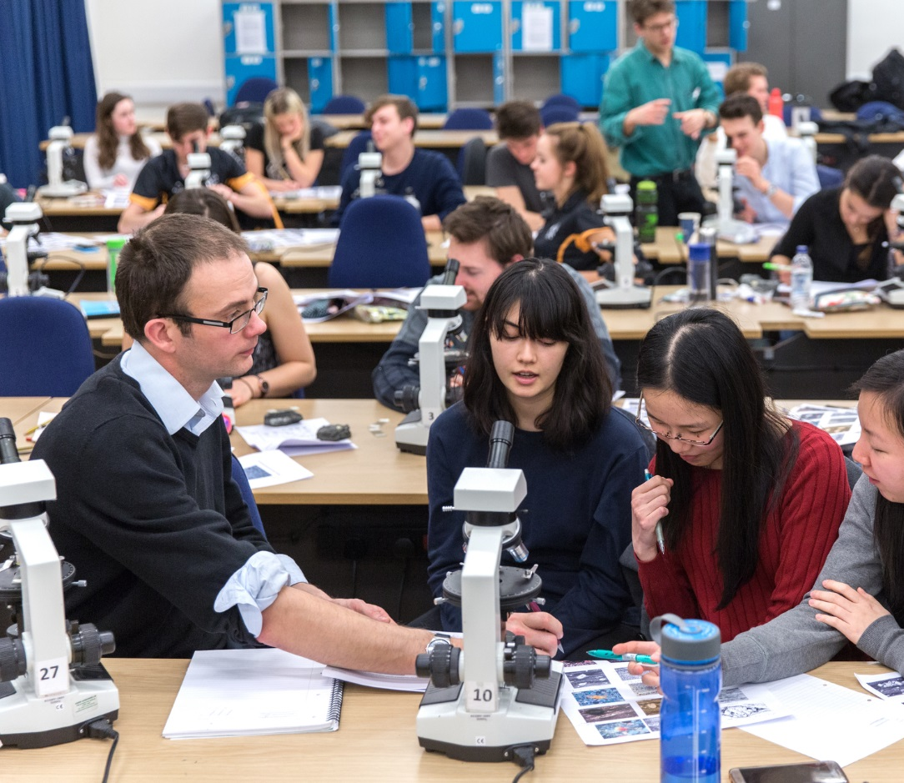
People
A major strength of the Faculty is its cohesion and positive, constructive culture that exists across and within departments, reflecting the nature of engineers as proactive problem solvers. Active collaboration between departments is characteristic of the way Engineering operates today, and is crucial to the ongoing success of the Faculty.

Slide 10
People
Diversity and inclusion
Staff wellbeing
Leadership: academic/professional
Foster an inclusive culture where everyone in our community of staff and students is treated fairly and in which diversity of experience and background is embraced
Ensure all departments meet College objective to have a minimum Bronze Athena SWAN Award
Be more transparent about diversity pay gaps and pilot and introduce practical initiatives to increase diverse representation in the Faculty, address the lack of BAME British academics and improve the working lives of us all
Continue to promote workplace wellbeing through positive mental and physical health initiatives, techniques and technologies, building on Have Your Say and Active Bystander
Support the growth of College-wide initiatives such as Mental Health First Aid
Work on providing a supportive, flexible work environment, including supporting people with caring responsibilities and encouraging everyone to work in a more agile way
Identify, develop and empower a cadre of emerging leaders:
  among our academic community with the skills and capacity to take forward the development and delivery of major research, education and societal engagement programmes;
  and among our professional services teams with the capability to take forward the development of delivery of major operational programmes
Equip our leaders and managers with appropriate training to support the people they lead

Slide 11
People
Support for all
International community
Pay, benefits, rewards and recognition
Support everyone to do their job the best they can, and continue to improve workflows and processes
Establish effective feedback mechanisms (in addition to all staff survey) so that we can listen and respond to our staff community
Provide training for all those who do PRDPs – it will be a requirement for all staff to have an annual PRDP
Promote College mentoring scheme
Celebrate and support our international community by ensuring that international staff already working at the College know that they are valued, and by recruiting the very best staff from around the world
Welcome international starters with regular events
Increase our understanding of other cultures that are significantly represented within our staff community through cross-cultural training
Be more transparent around the competitiveness of our pay and benefits package, benchmarking our offer against the world’s top schools of engineering for academic staff, and against comparable roles in London for professional services staff
Be more transparent about reward processes to demonstrate they are fair
Recognise the important contribution of our technicians and specialists and the efforts of those who volunteer within our community

Slide 12
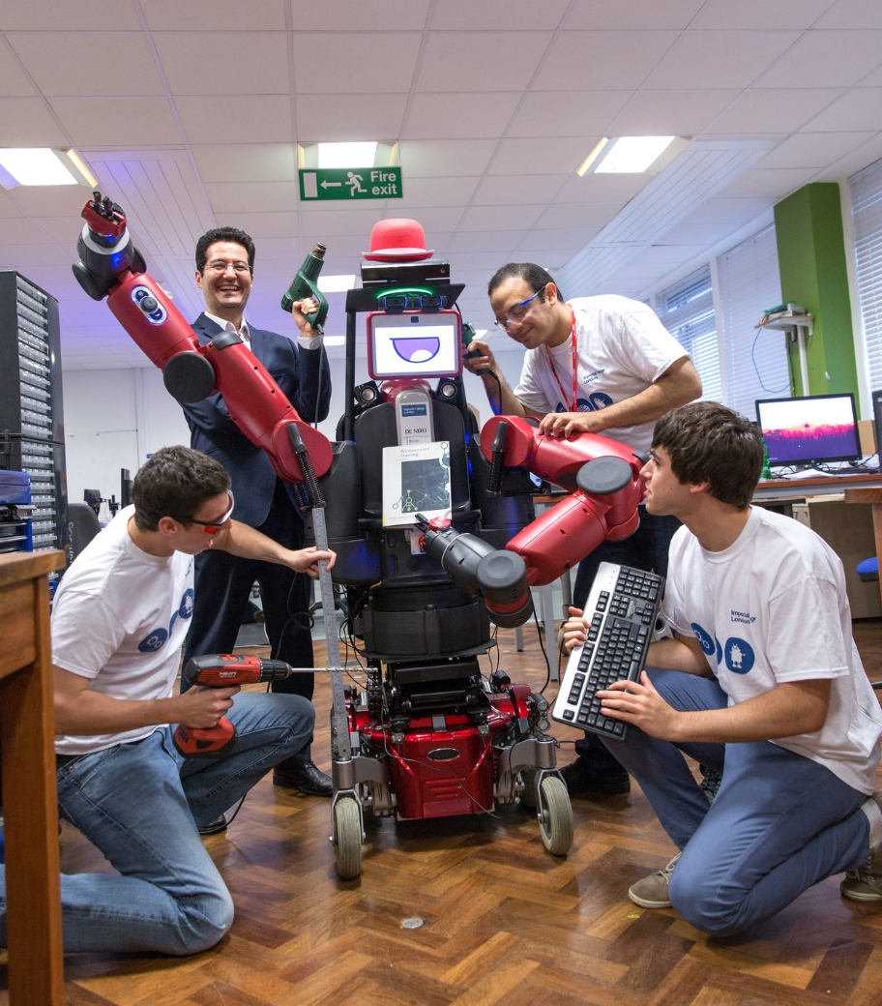
Education and the Student Experience
Our graduates will be equipped with the skills, knowledge and attributes they need to make an outstanding contribution to address society’s global challenges.
We will be proactive in developing the highest quality engineering education that is accessible to the widest range of potential students.
Over the next five years we will refine our curricula, enhancing our students’ core Engineering attributes and skills that are valued by employers and academia.

Slide 13
Education and the Student Experience
Educational experience
Recruitment and access
Review and implement curricula with a clear focus on ensuring the excellence of our teaching
Develop further support to enable students to gain experience in industry, enterprise, entrepreneurship or research
Enhance support in digital learning and teaching
Improve access and support for talented UK applicants from disadvantaged and underrepresented groups
Increase proportion of female and BAME students
Review international recruitment strategy to ensure applicants come from a wider range of countries than at present
Support and wellbeing
Educational infrastructure
Employer and alumni engagement
Build an inclusive and respectful community
Ensure student-facing staff are equipped with right tools & skills to support students effectively with personal challenges
Ensure all new students transition successfully to the College
Identify and work towards the optimal cohort size for each programme
Enhance our physical infrastructure
Develop core underlying digital infrastructure services for students and learning analytics
Engage actively with employers to inform development of future curricula
Strengthen alumni relations to enhance curricula, reputation and reach
Work with accrediting bodies to enhance professional skills development for students

Slide 14
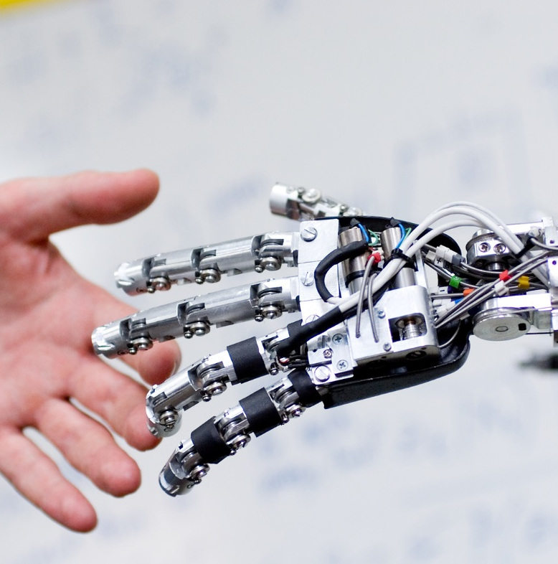
Research
All parts of the Faculty performed strongly in the last Research Excellence Framework (REF), with the newly-established “impact” measure providing an opportunity to showcase the real-world importance of the work of researchers. A clear focus for the next five year period will be to ensure that we at least match this performance in the next REF assessment.
Our research strategy focuses on maintaining world-class excellence in our core engineering disciplines, maintaining or establishing world-class facilities, hiring and developing outstanding academic staff, and attracting the best research staff and students.
We will build on our track record of multi- and trans-disciplinary research, focussing on global challenges where we are advantaged through our expertise, facilities and/or partnerships. We highlight particular opportunities in the following areas:

Slide 15
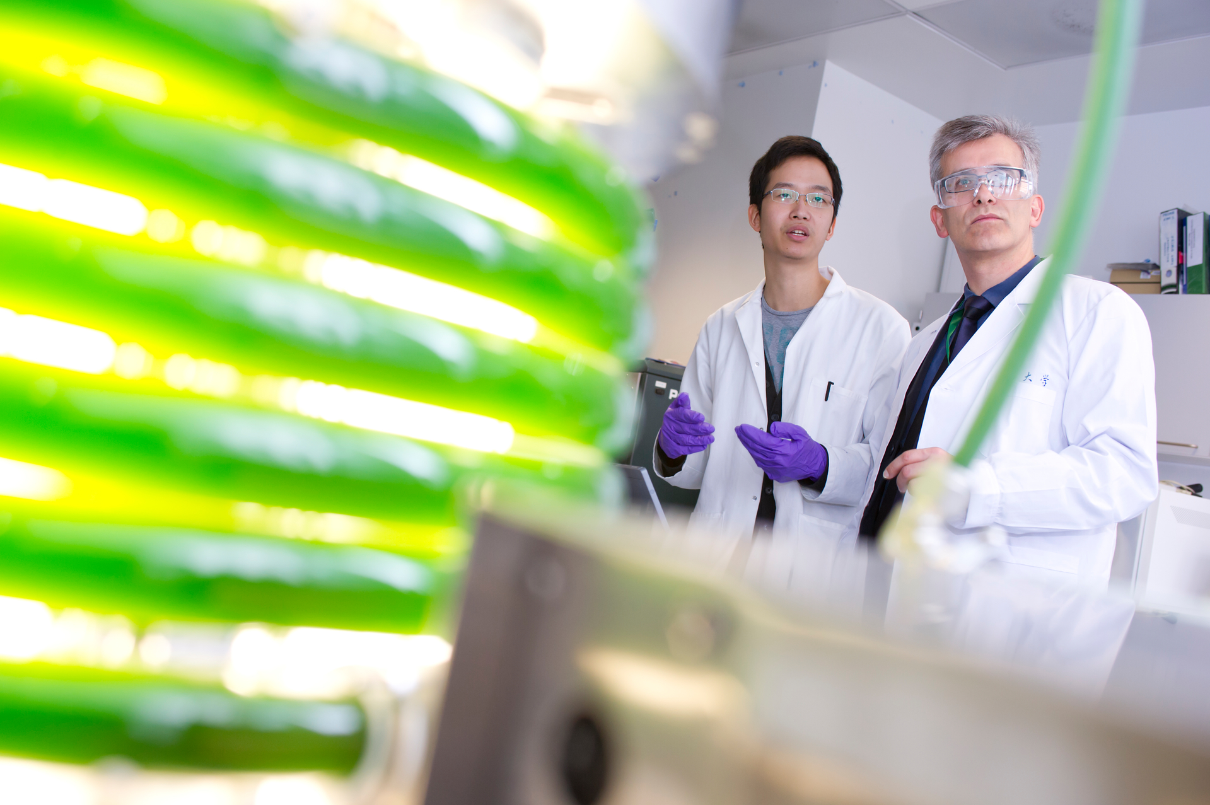
Research
Transition to a Sustainable Zero-Pollution Economy
Vision Convergence of zero-carbon and circular economy towards a zero-pollution future
Drivers
Need to transition to net-zero CO₂ emissions
World-wide plastic pollution, microplastics in the environment
Poor air quality in urban and rural societies
Academic strengths
Fossil-fuel-free transport Electric vehicles, batteries, fuel cells
Bio-economy Engineering Biology biomass for fuel and chemical feedstocks
Circular Economy systems approaches to whole life-cycle manufacture
Light weighting vehicle structures both aluminium forming and composites
Engine downsizing important for hybrid technologies
Decarbonisation technologies CCS, heat and transport decarbonisation
Global optimisation of industrial processes
New business models Blockchain, fintech
Positioning & Partners Energy Futures Lab, Faraday,
Imperial-Tsinghua Research Centre, plus a range of industrial and end user partners…
New opportunities
Machine learning for bioprocess modelling and intensification
Integrated approaches to water-food-energy nexus embracing ecosystems services research
Design and implementation at scale of robust, high-performance biosystems employing Engineering Biology
Transition to zero pollution economy
New technologies and business models for a zero-pollution economy

Slide 16
Research
Engineering Resilient and Secure Infrastructure
Vision Global Centre of Excellence in Resilient & Secure Infrastructure
Drivers
Today 55% world's population lives in urban areas; by 2050 it will be 68%
Cities with 1- 5 million inhabitants projected to grow to 559 by 2030
To limit global warming to 1.5ºC CO₂ emissions must reach net zero by 2050 (IPCC)
The OECD estimates that globally US$53 trillion of infrastructure investment will be needed by 2030
Academic strengths
The low carbon energy transition Whole-system analysis, System integration, Regulation and policy…
Sustainable Power Energy storage, fuel cells, solar, wind…
Transport technology & transport systems Intelligent transport systems, vehicle powertrains, future fuels…
Energy efficiency and decarbonisation Low carbon heat, poly-generation, new conversions/reactions, smart grid…
Future Cities Smart urban infrastructure, Digital energy systems…
Water & Air quality Sustainable water management systems; air quality measurement, sensor networks and modelling…
Security/verification Cyber-Physical, IoT, Data Science, Privacy & Trust
Positioning & Partners Energy Futures Lab, Grantham Institute, Faraday, UKCRIC, ISST, DSI, CPSEI, CEP, plus an extensive range of industrial partners…
New opportunities
Re-imagining transport for sustainable decarbonisation
Transport as a systems-level demand-responsive service addressing needs for movement of people and goods, incorporating novel power and transport technologies, enabled by AI
Infrastructure security and safety
Infrastructure resilience: understanding digital and human characteristics of systems, IoT environments, and ability to continue operating when partially compromised
Decarbonising heating/cooling

Slide 17
Research
AI and Machine Learning for Engineering Applications
Vision Advancing artificial intelligence (AI) & machine learning (ML) to solve real-world challenges
Drivers
Exponential growth in availability of data & hardware infrastructure
Developments in ML, AI, data science and systems offer potential of transformative leaps forward (‘digital disruptors’)
Commercial applications through disruptive impact on technology companies and vigorous start-up ecosystem
(AI in the UK, HoL report, Made Smarter report)
Ethical implications including dual-use technologies, trust & privacy in AI systems, legislative implications
Academic Strengths
Machine Learning Explainable ML, geometric ML, foundations of ML, statistics
Automated Reasoning: Argumentation, negotiation, coordination, multi-agent systems
Trustworthy AI/ML Verification, testing, model checking, program analysis
Secure AI/ML Privacy, cybersecurity, threat detection & mitigation
Systems for AI/ML Distributed systems, data centres, scalability, data management
Hardware for AI/ML Hardware/software codesign, FPGAs/GPUs, compilers
AI/ML for robotics Planning, control, robot manipulation, autonomy
AI/ML for vision 2D/3D vision, VR, audio & natural language understanding
Cyber-physical AI/ML Sensing, control, self-organisation, Internet-of-Things
Data science & data-centric engineering Data mining, optimisation, process optimisation
Positioning & Partners DSI, AI for Healthcare CDT, Turing, RAEng, plus an extensive
range of international and academic business partners…
New Opportunities
AI for Future Healthcare
Clinical support, medical image computing
AI for Scientific Discovery
AI-enhanced creativity and discovery in chemistry, drug discovery, new materials
Digitisation of Manufacturing Life-cycles from discovery, product design, development and testing
Sustainable Smart Mobility
AI for managing urban infrastructure and transport systems, infrastructure for autonomous transport
Safe & Predictable Future AI Systems
AI for critical infrastructure, safety-critical applications, autonomous control

Slide 18
Research
Affordable Technologies for an Ageing Society
Vision Enhanced quality of life for ageing populations enabled by novel Engineering
Drivers
Ageing population – need to reduce societal burden of chronic disease
Spiraling cost of healthcare: 9.7% of GDP in UK (£2,892 per person) & 17.2% of GDP in US (£7,617 per person - 2016 figures)
Age-related diseases, such as dementia, musculoskeletal conditions and hearing/vision loss, represent a huge burden to the NHS
Academic strengths
Biomedical Engineering/Biomechanics Arthritis, cardiovascular disease…
Medical devices Sensing and imaging technologies, Nanotechnology, Novel Biomaterials…
Medicines manufacturing/vaccines Bio-process systems engineering, Synthetic Biology, Molecular engineering…
Neurotech Dementia, mental health, hearing loss…
Positioning & Partners World-leading Engineering and Medical Faculties, BME Research Hub, RBL Centre for blast injury studies, Dementia Research Institute, Hamlyn Medical Robotics Centre, plus an extensive range of healthcare and industry partners
New opportunities
Creating generalisable AI to deliver personalised and more affordable healthcare
Smart combinations of personalised big data and clinical technology AI to improve health outcomes and patient quality of life
Engineering novel medicines
Reducing time to market and cost of manufacture
Customised replacement tissues and organs by Engineering Biology with additive manufacture
Global Health
Engineering health solutions for the developing world

Slide 19
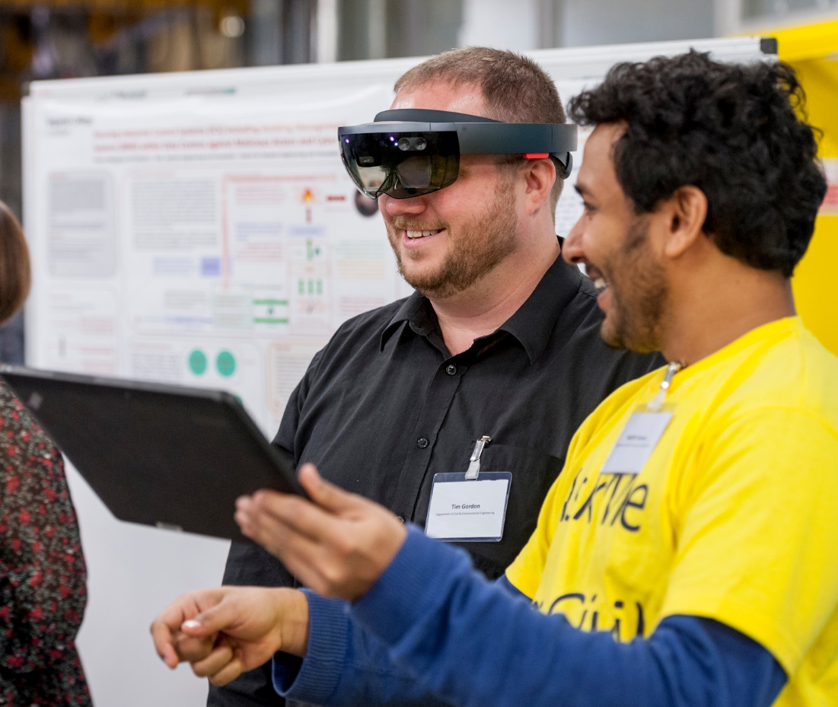
Impact and Translation
We will continue to increase all forms of impact from our research and to deliver an enterprise culture.
We have done this by bringing together staff responsible for handling invention disclosures, patenting and licensing with the industry partnerships and commercialisation staff responsible for securing research income from industry, promoting our research capabilities and available technologies to existing and prospective partners and supporting the Faculty’s interactions with industry.

Slide 20



Impact and Translation
Translation from research to practice can be achieved through:
Publication in open literature and findings made available for free use e.g. via open access software
Direct take-up via corporate partners, typically by securing access to potential arising IP upfront as part of the contract at a fee
Proof of concept studies via translational funds or industry funding, patenting and subsequent licensing
Licence to spinout
Over the next 5 years, we aim to:
  Double the number of licences and spinouts
  Increase the volume of direct industrial research funding by 50% (to around £45M per annum)
  See at least 75% of the current industrial research centres renewed
We will work to evaluate the most appropriate route for each technology and then seek to actively manage the process of translation to increase the probability of success.
Different industry sectors have very different cultures and promoting technology take-up requires experience in that particular sector. We will therefore engage experts from among our alumni and research contacts base to be involved with each technology and assist the Imperial team in taking it to market.

Slide 21















Impact and Translation
2017-18: Benchmarking industry partnerships and commercialisation activity
(Below data is for the whole of Imperial College London, not just the Faculty)
2022-2023: The Faculty in 5 years’ time
 | MIT | Imperial | Oxford | Cambridge
Total research volume (£m) | 567 | 361 | 553 | 462
IP income (£m) (licensing and realisations) | 41.1 | 2.9 | 7.4 | 15.4
IP income as % of total research volume | 7.24% | 0.80% | 1.34% | 3.33%
Spin-off companies | 25 | 10 | 19 | 10
Research volume (£m) required per spin-off | 29.6 | 36.1 | 29.1 | 46.2
Patents (granted) | 298 | 49 | 233 | 136
Research volume (£m) per patent | 2.48 | 7.37 | 2.37 | 3.40
Industrial research volume (£m) | 148 | 61.12 | 68.1 | 50.9
Industrial research volume as % of total | 21% | 17% | 12% | 11%
FoE
130
4
3.08%
4*
32.5
30
4.33
45
35%
*total of 20 over the 5-year plan period

Slide 22
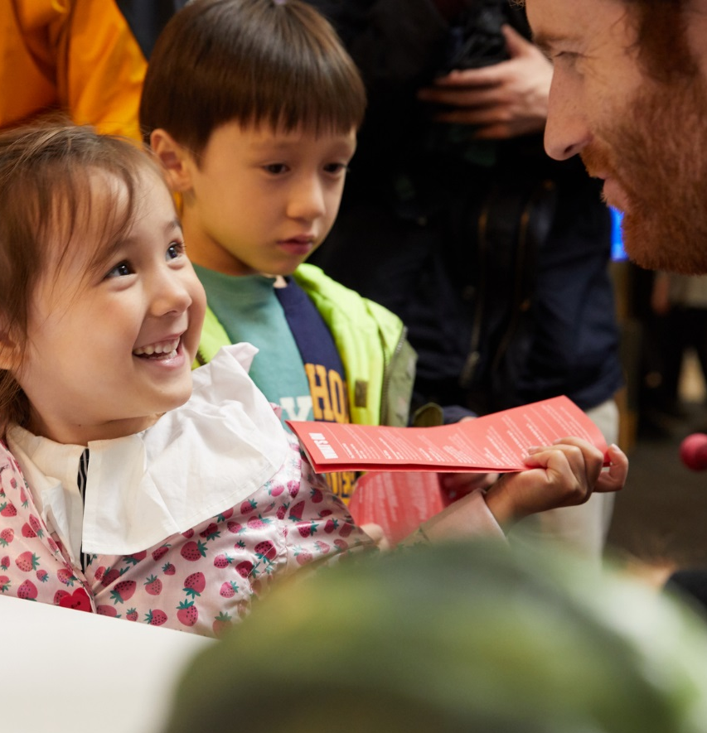



Public Engagement
Public engagement is a two-way communication about engineering and the implications of our work, as well as its need for society. We will actively encourage and equip our staff and students to engage in public discourse around their research, teaching and translation activities:
in person
in print
online

Slide 23
Public Engagement
Existing College routes, e.g.
Seek to create new opportunities for engagement by
Imperial Festival
Engaging with other key organisations such as the South Kensington cultural institutions, learned societies and professional bodies
Schools engagement programmes
Giving our students the opportunity to undertake these activities
Creating new digital content
Recognising the efforts that staff make in engaging the public in the work of the College
+
Working with the College’s societal engagement and communications teams, we will make more of our location in London, one of the most active and well-known international centres for public engagement, through promoting events such as our flagship lectures more widely to the public.

Slide 24
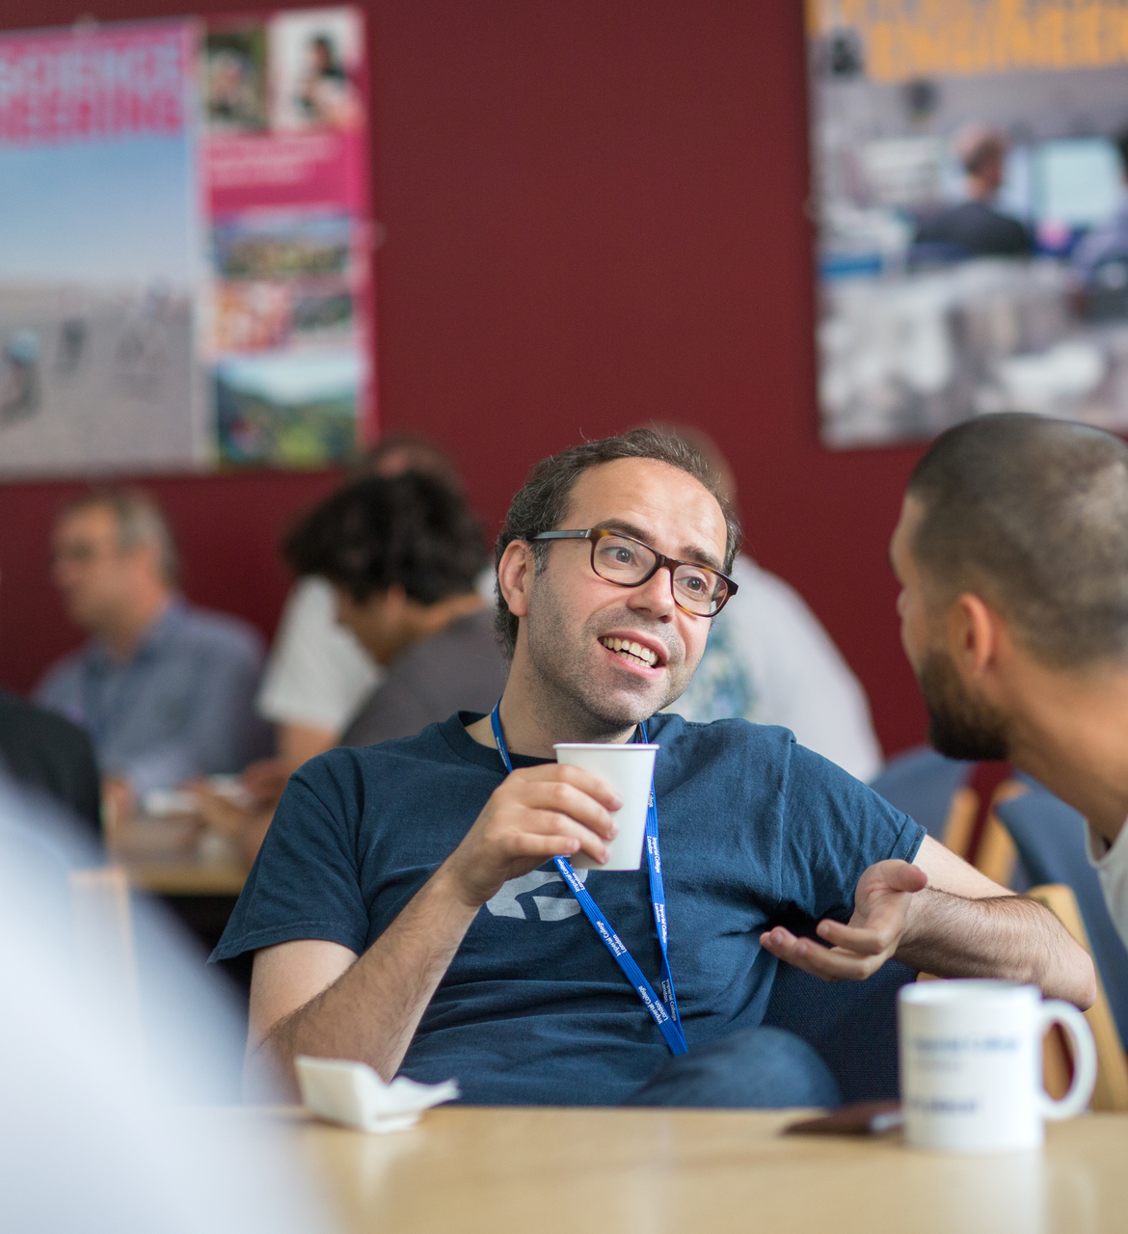
Operations
Professional and technical staff across the Faculty are committed to providing excellent support to research and teaching. In seeking to provide support to staff and students in a more efficient and cost-effective manner, we will work to align support processes across the Faculty and ensure that staff are provided with the training that they need to undertake their roles.
Our staff will be empowered so that decision making and responsibility rest at the appropriate levels. We will be proactive in identifying and enabling secondments and other mechanisms for staff to develop through gaining experience in working in other departments.
To increase integration and sharing of best practice, we will develop roles that enable staff to work at both the Department and Faculty level.
Notes:
Change to HR picture

Slide 25
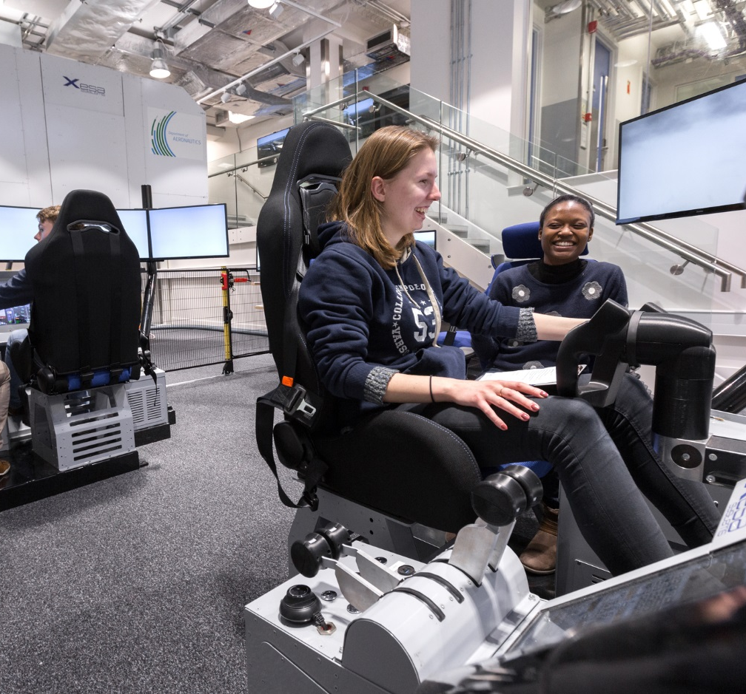
Space and Facilities
There has been substantial investment in many parts of the Faculty’s infrastructure in recent years, with world-class research and teaching facilities developed across the City and Guilds, Dyson, Skempton and Uren Buildings. However, creating and maintaining suitable quality space for engineering education and research in all parts of the Faculty still requires further action.

Slide 26
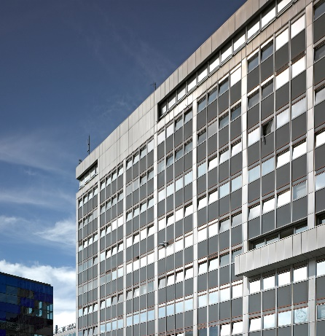
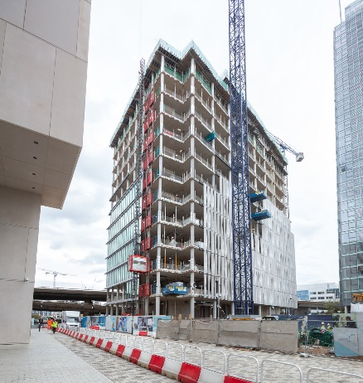
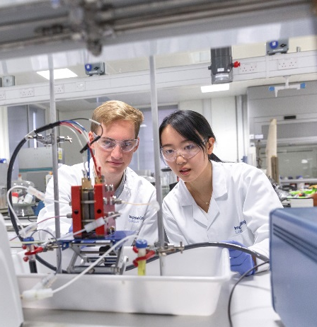
Space and Facilities
SOUTH KENSINGTON
Teaching facilities in Computing and Electrical Engineering need updating
Our space in Huxley Building for Computing needs improvement overall, especially in view of the demand for teaching and research in that sector
WHITE CITY
Some staff will be moving to the Michael Uren Biomedical Engineering Research Hub in 2020 in partnership with Medicine, and to access the Royce facilities for materials fabrication and characterisation
Opportunities for joint research with Chemistry in the Molecular Sciences Research Hub
FLEXIBLE SPACE
Strategic need for flexible space to be developed capable of housing multi-disciplinary research teams in response to specific challenges & funding opportunities → new research initiatives currently constrained by space concerns + linked opportunities for both UG & PG research projects

Slide 27
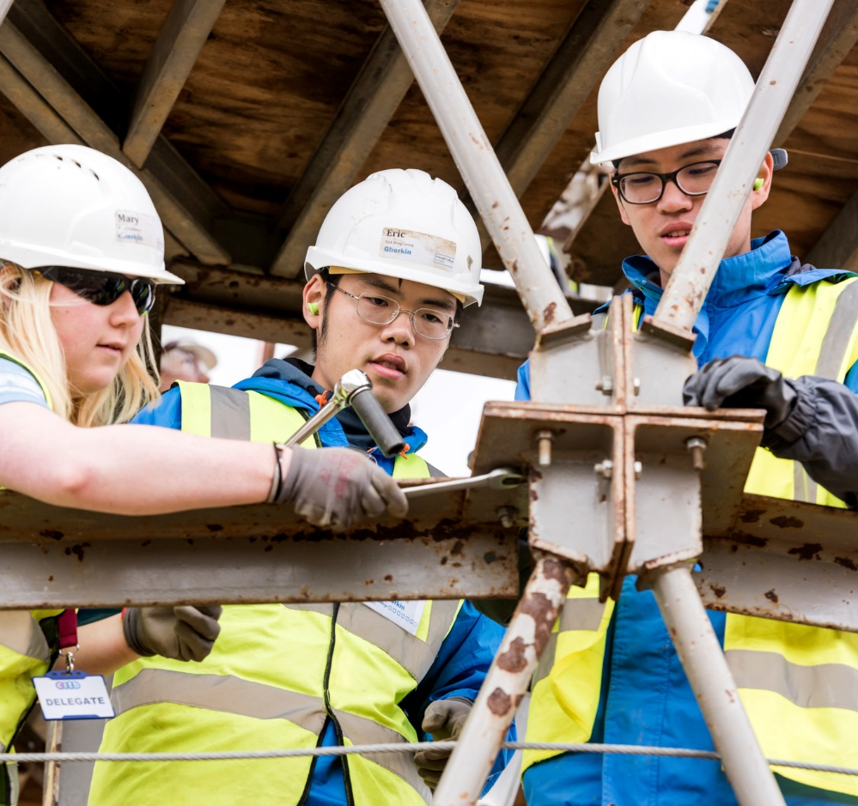
Financial Sustainability
The Faculty makes a substantive net contribution to the College. We will continue to place emphasis on secure financial management and control to ensure that this remains the case over the next five year period.
This requires a careful balance between our educational programmes, with a focus on ensuring we continue to attract excellent students from all over the world, and our research.
Continuing to move up the academic league tables is important to ensure we remain an attractive destination for the very best students who have choice around their place of study, and to ensure that we remain attractive to global industry players who also have choices around their research investments.

Slide 28
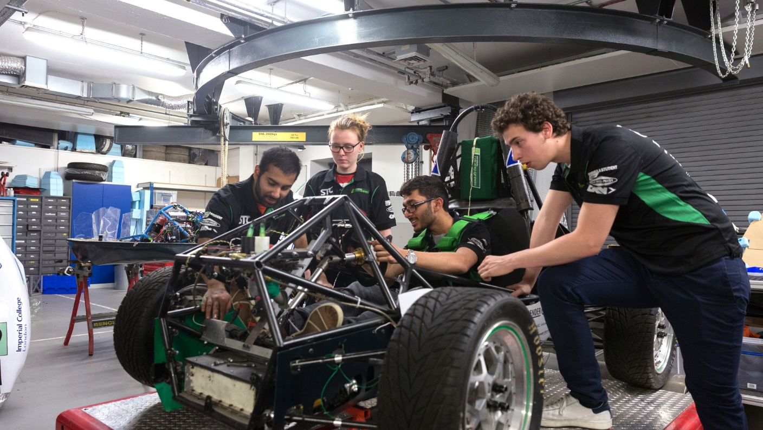
Summary
What will the Faculty of Engineering look like in 2023?

Slide 29














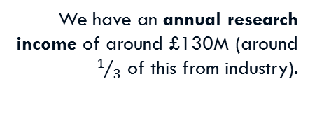
We are ranked as one of the world’s top 8 engineering and technology schools.
One in four of our academic, teaching and research staff is female.
One in three of our students is female.
~450 academic staff
All departments hold a Bronze Athena SWAN Award.
20% of UK students entering our UG programmes will meet our widening participation requirements.
~50 learning and teaching staff
The Faculty of Engineering in 5 years’ time
~4,800
UG students
We have an annual research income of around £130M (around $1/3$ of this from industry).
75% of our UG students have an opportunity to experience a summer placement over the course of their studies.
We have a combined annual licencing and realisation income of around £4M.
~1,500
PGT students
~1,600
PhD students
30 patents are granted per annum.
~50
MRes students
Seven of our departments score in the top quartile of the National Student Survey.
20 new spin outs have been created over the period.

