Slide 1
Savanna Burning Emissions Abatement (SBEA) Schemes in East and Southern African Savanna-Protected Areas
Abigail Croker
arc20@ic.ac.uk

Slide 2
My Research – An Overview
Dynamic African savanna ecosystems
Complex colonial history
Indigenous peoples and local communities
Wildfire paradox
Ecosystem degradation and social inequality
Does CBFiM provide an alternative and realisable, equitable, effective, and sustainable ‘bottom-up’ fire management framework? What are the colonial implications in an East and Southern African savanna-PA context?
Does the effectiveness of CBFiM in savanna-PAs across East and Southern Africa differ conditionally on type of governance system?
Can equitable and adaptive governance, policy, and management solutions, based on knowledge sharing and collaborative networks, be realised for approaching challenges associated with the dominant fire regime in dynamic social-ecological savanna-PAs?
Establishment
Participation
CBFiM
Sponsorship
Decision-making

Slide 3
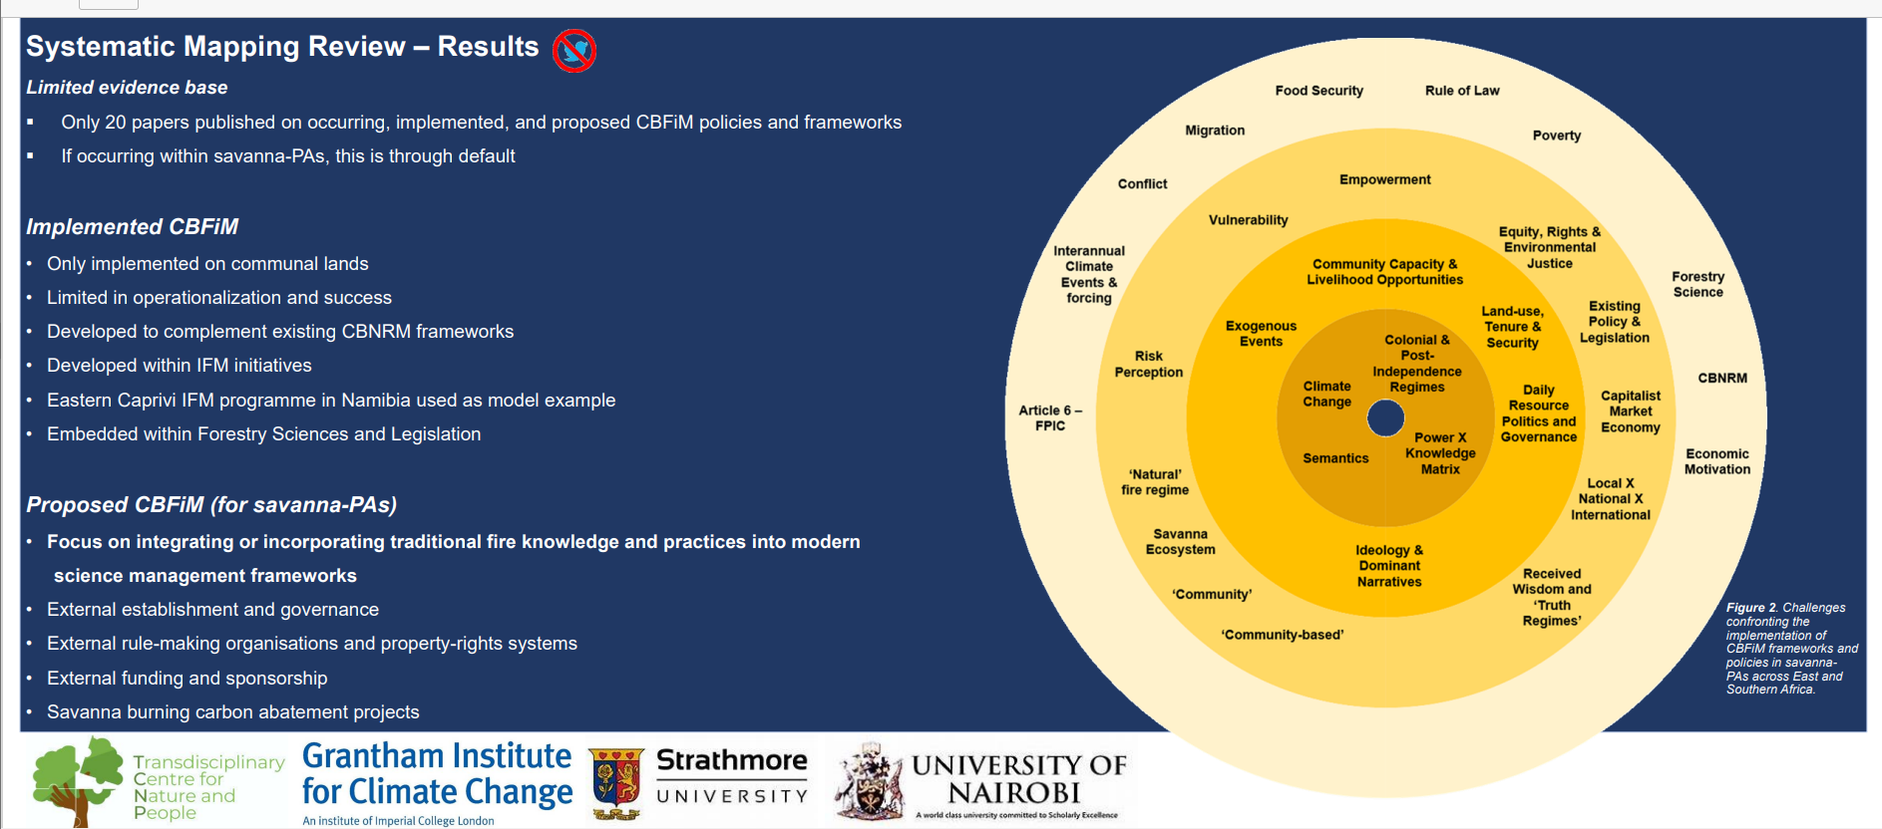
Governance Systems: “Community-Based Fire Management” Frameworks in East and Southern African Savanna Protected Areas

Slide 4
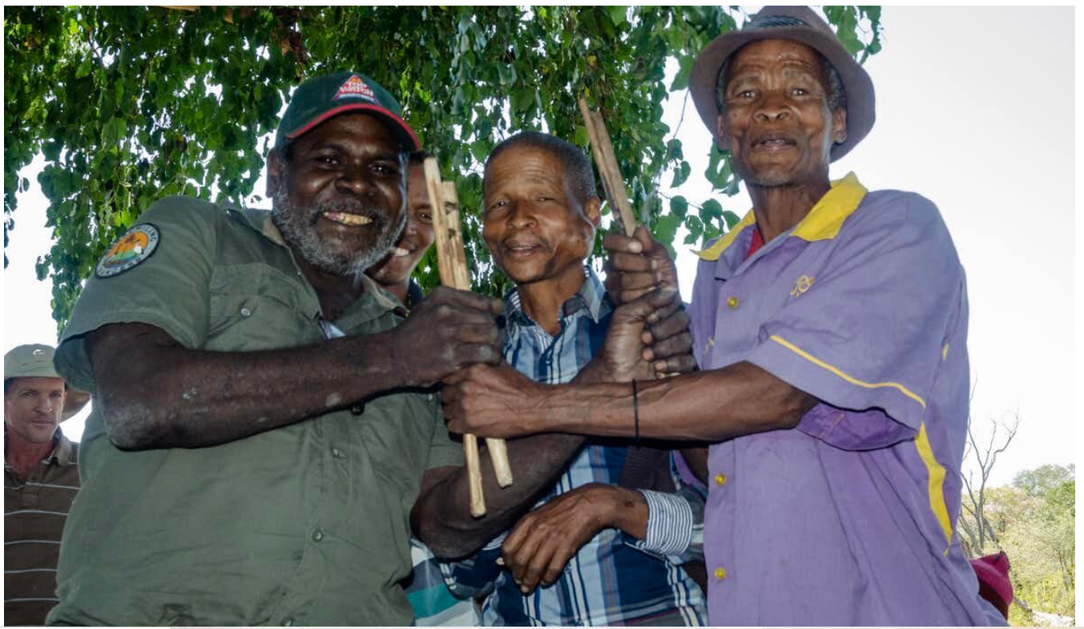
Savanna Burning Emissions Abatement
West Arnhem Land Fire Abatement Project (WALFA), Northern Australia
Reduce overall frequency, intensity, and extent of savanna fires (CO_{2,} CH_{4,} and N₂O emissions) through a seasonal shift in fire occurrence from the late (LDS) to the early dry season (EDS).
Prescribed EDS burning policies to generate revenue from carbon offsetting.
National accreditation for trading offsets in regulatory carbon markets.
Local income generation.
Proposed SBEA projects, East and Southern Africa
Transferability of the Australian SBEA model.
Emissions mitigation opportunities in African fire-prone savannas:
20 “Least Developed Countries” (LDCs) in Africa account for approx. 74% of total savanna emissions mitigation potential.
Identification of 17 potential pilot sites across these 20 LDCs which have a combined total of 192 savanna-dominated PAs, each larger than 1000km2.
17 potential pilot sites are projected to abate 37% of global savanna burning emissions.
“Indigenous-led savanna projects” or “community-based savanna fire management”
Source: ISFMI - https://www.isfmi.org/isfmi-publications-1/mqj07k6t6clxv8yrmbqfhdgb70g5x3

Slide 5
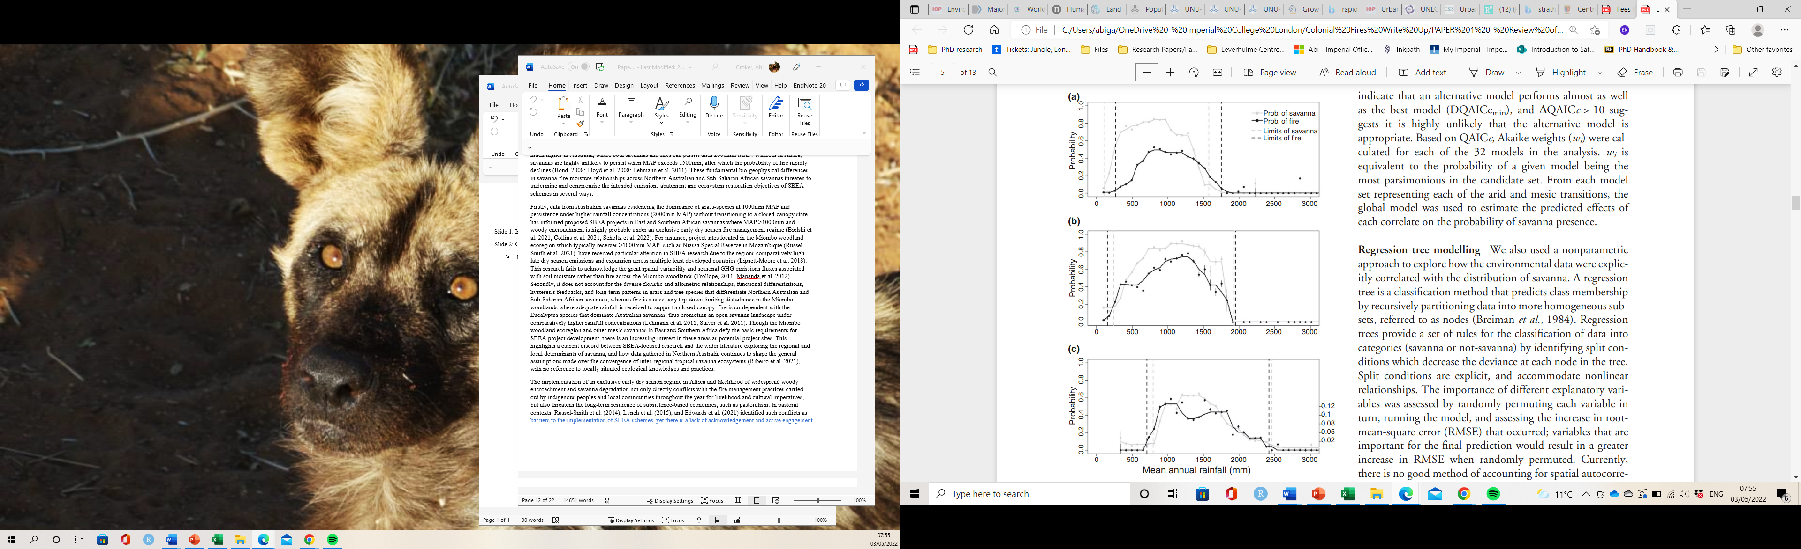
Challenges: framing SBEA schemes as “Community-Based Fire Management” in East and Southern African-PAs
Challenges: framing SBEA schemes as “Community-Based Fire Management” in East and Southern African-PAs
Diverse and spatially and temporally distinct pastoralist groups and fire use
Communal lands vs Protected Areas
Complex colonial history and persisting (neo)colonial influences
Unprecedented population growth and urbanisation
Ratification, National GHG Inventory, Emissions Registry, and Authority
Human Environment
“New Frontiers”
Green conditionalities and “aid”
Land and resource ownership, access, and rights
Globally highest urban growth rate
SSA: 90% of world’s population growth (2050-2100)
Kyoto Protocol: centralised objectives
Australian SBEA model
Physical Environment
Arid and mesic limits
Anti-fire wisdom
Contextual
Strict and scientifically robust accounting protocols informed by technical and acceptable data sources
Privatisation and marketisation of public goods: commodification and commensuration of GHG emissions
Extreme climatic change – regional vulnerability
“Carbon Capitalist” Accumulation
F-IPC or state and market sovereignty?
Emissions framing: market-based approach
Complex and dynamic feedbacks: precipitation and evaporation, CO2 fertilisation, ENSO teleconnections, Indian Ocean Dipole, rising SSTs over Indian and Pacific Oceans, heat extremes, droughts, and extreme pluvial flooding
Challenges
Decadal variability
“Pyro-diversity begets biodiversity”
Applied
Biodiversity or “bio-perversity”
Limited data and confounding variables: poaching, disease, weather events, density dependence
Physical discrepancy: focus on semi-arid and mesic savannas & “incompatibility” of savanna ecosystems prone to woody thickening
Assumed premise of Traditional fire practices
Externalised conservation-development objectives
Early dry season (EDS) patch mosaic burning
Merited on mitigation potential, actual remissions reductions, and national wealth accumulation
Emissions discrepancies
Confounding variables: mega-herbivores and apex predators

Slide 6
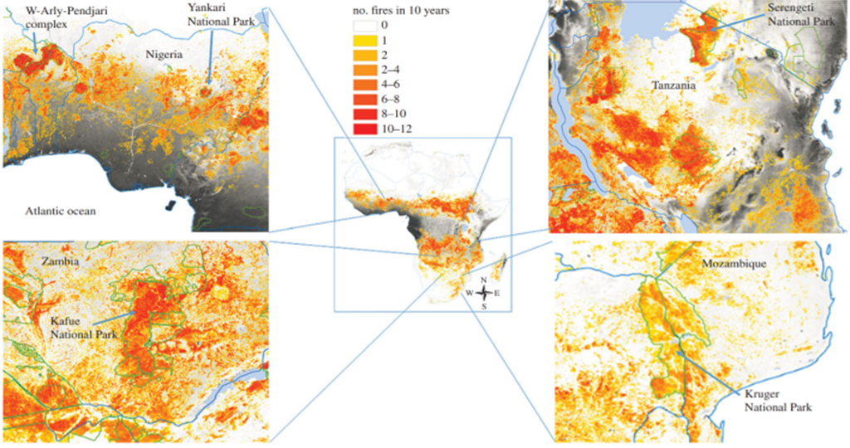
Contextual Challenges
2 Main Generalisations for model transfer: (I) similarities between nutrient poor mesic savannas with distinct wet and dry seasons, (II) presence of extensive savanna networks with low human and livestock populations and high wildfire frequency.
Complex recent colonial history
- Construction and constitution of savanna-protected areas
- Fire suppression policies
- Globalised conservation-development agenda and green conditionalities
- Political-economy and territorialisation
- Exclusion rights
2. Unprecedented population growth
- Sub-Saharan African population projected to increase by 99% and over 300% by 2050 and 2100, respectively
- Increased pressure on declining resources and available land
- State and market dominance in common-pool resource management
3. Extreme climatic changes
- Extreme wet and dry seasons – prolonged drought periods interspersed with pluvial flooding events
- Increase in fire prone weather and extension of the fire season
Notes:
WHY SOUTHERN/EASTERN AFRICA IS CONTEXTUALLY DIFFERENT TO AUSTRALIA.

Slide 7
Implementation Challenge – Focus 1
Physical Environment
Requirements:
Rainfall (over >600 mm MAP)
Not prone to woody thickening
Challenges:
Convergence of inter-tropical savanna ecosystems:
Variation in savanna and fire limits (arid and mesic limit)
Precipitation gradient
Vegetational differences (e.g., eucalyptus species)
Confounding variables determining Africa’s savanna limits – megafauna
Emissions (CO2, N20, CH4)
Notes:
CO-EVOLUTION OF EUCLYPTUS AND FIRE: Many are excellent post-fire epicormic resprouters from the stems and branches after high-intensity fires^{8,9,10,11}. In most investigated angiosperm trees, dormant epicormic buds are situated in the outer bark^{8,12}, where they are likely killed by fire, but in eucalypts, the epicormic bud-forming structures are located deeply, where they are protected by the full thickness of the bark and can sprout even after high-intensity fires. In Australia, RAINFALL LIMITS FIRE AND SAVANNA AT THE MESIC END (where savanna species are co-adapted to fire for resprouting). In Africa, RAINFALL INCREASES TREES AND PREVENTS FIRE FROM MOVING THROUGH THE LANDSCAPE.

Slide 8
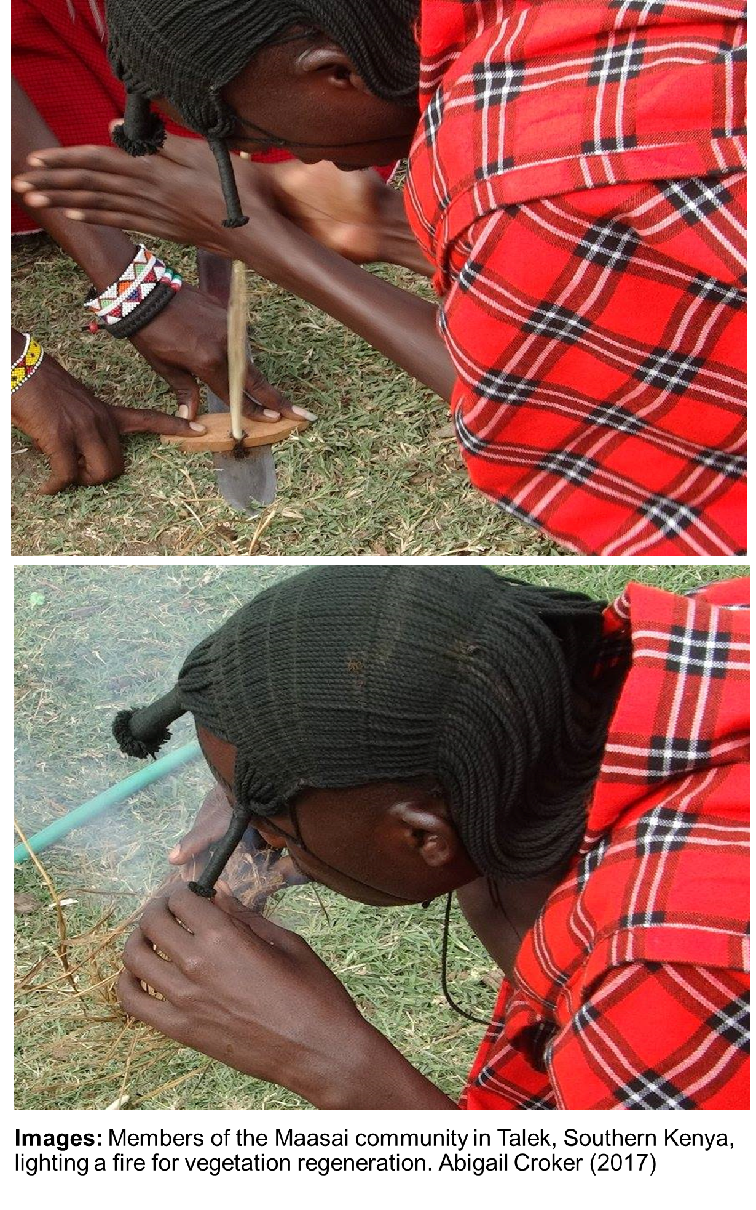
Implementation Challenge – Focus 2
Human Environment
Requirements:
Strict national accounting methodologies for global carbon markets
Landowners and pastoralist communities and globally aligned pastoral burning practices
Early dry season patch mosaic burns
Low human population densities
Challenges:
Centralised objectives – success measured on actual emissions mitigation
Daily resource politics and decision-making: levels of social organisation and economies
No formal recognition of the role of IPLCs in decision-making processes or guidelines for the distribution of carbon benefits
Land ownership (freehold, leasehold, and Native Title arrangements in Northern Australia vs excludable and subtractable savanna-protected areas in Africa)
Diverse pastoral communities and burning practices
Complex and changing state-society relations and re-territorialisation in ‘New Frontiers’

Slide 9
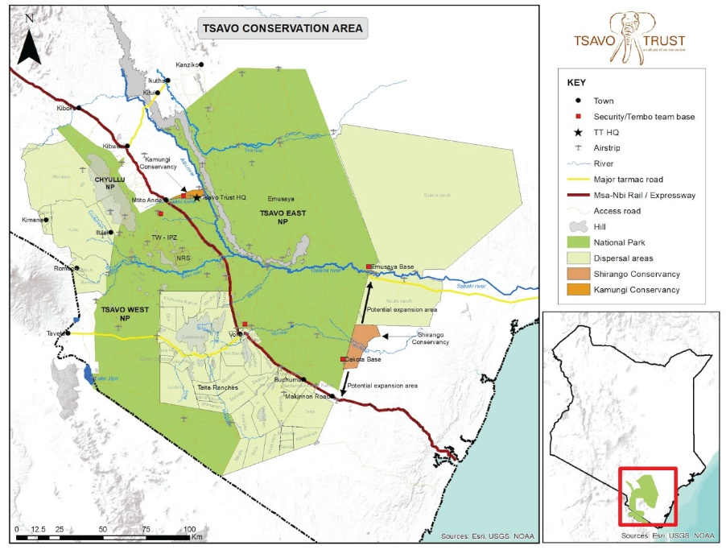
Next Steps
Multi-group Collaboration and Knowledge Sharing for Developing Equitable, Effective, and Sustainable Fire Management and Policy in Savanna-Protected Areas
Fieldwork: Tsavo Conservation Area, including Tsavo East NP, Tsavo West NP, Chyulu Hills National Park, Kasigau Corridor, and surrounding ranches and conservancies.
In collaboration with researchers from Strathmore University, Kenyatta University, the University of Nairobi, and the Kenya Wildlife Service.
Notes:
Also ways of communicating knowledge > pictures, workshop etc.

Slide 10
Thank you!
Any Questions?

