Slide 1

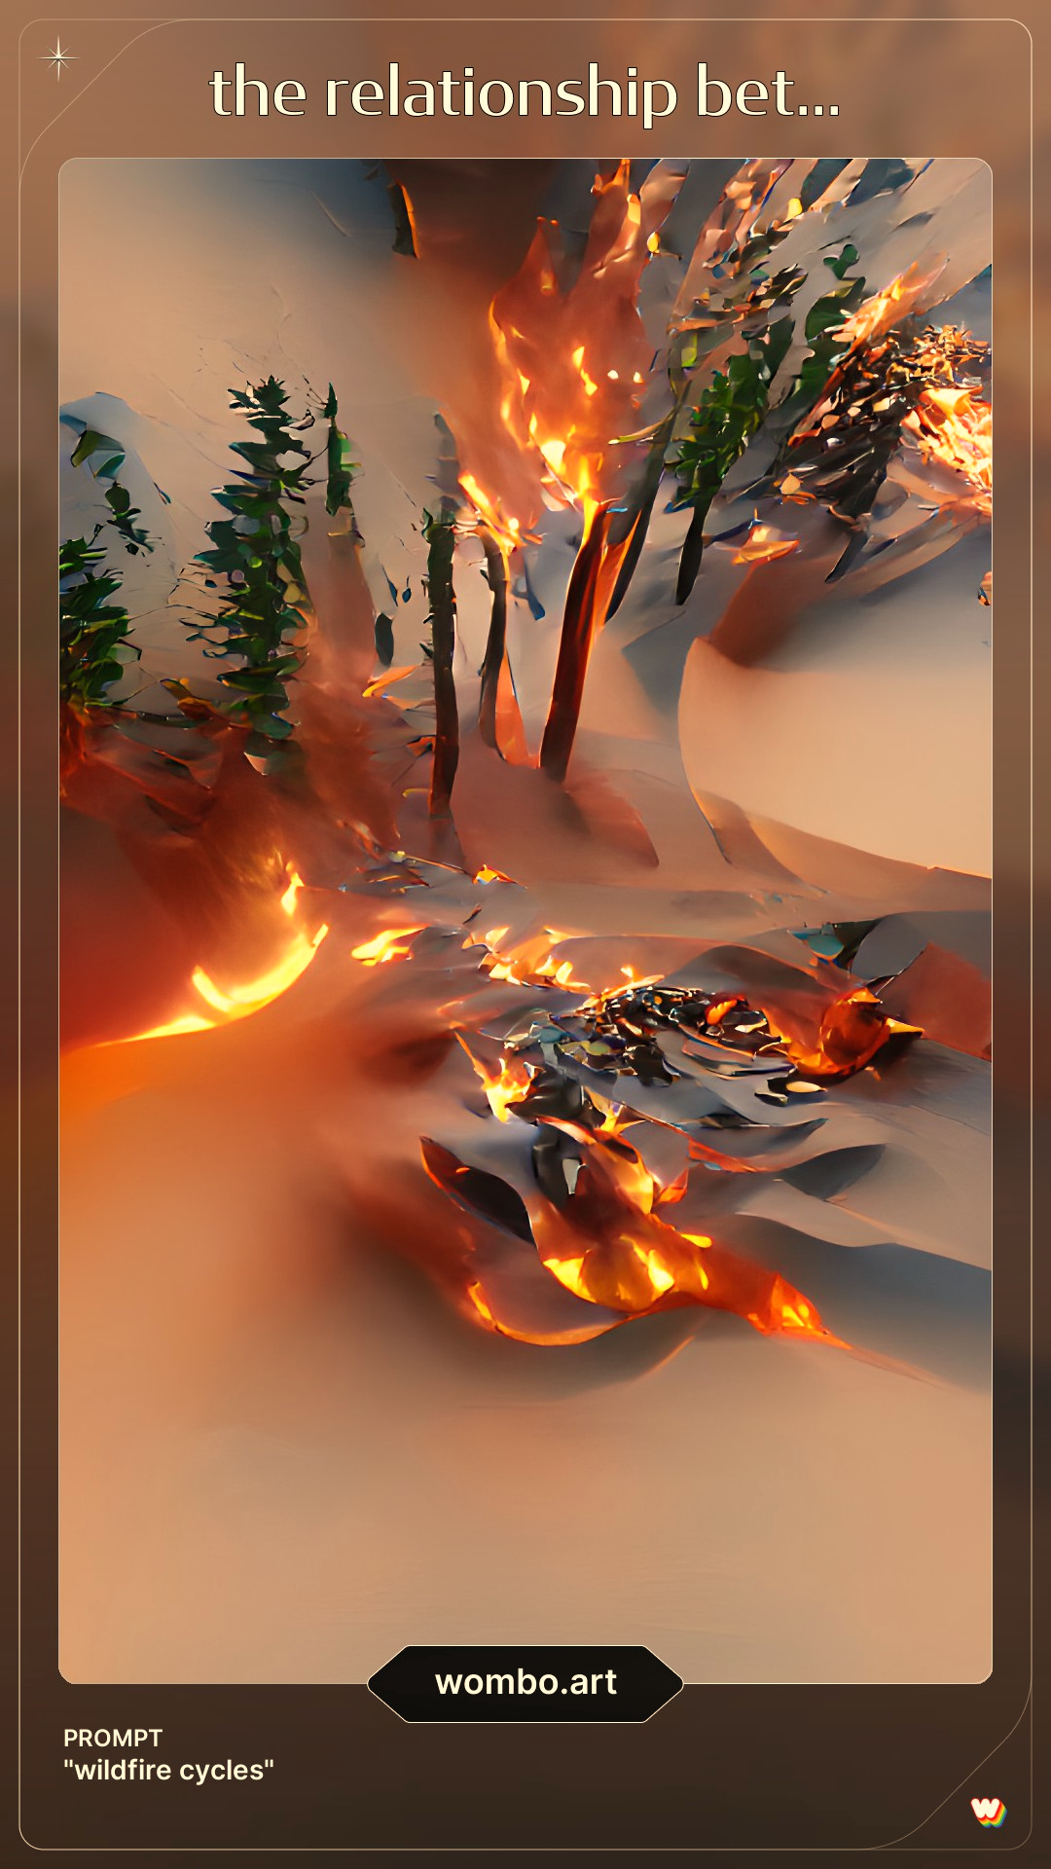
Is it all about climate change? Understanding the relationships between anthropogenic factors, politicians’ incentives and wildfire outcomes
Ms Erika Piroli
Supervisor: Dr Ioannis Kountouris
Centre for Environmental Policy, Imperial College London
e-mail address: e.piroli20@imperial.ac.uk

Slide 2
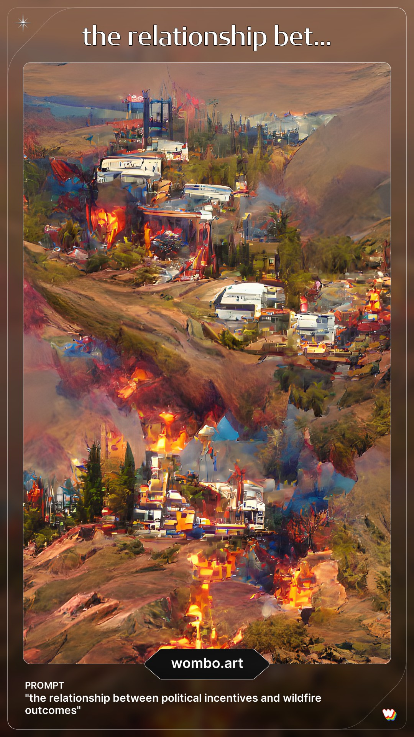
Outline
Introduction
Large wildfires and extreme weather conditions
The socio-ecological damages and future trend
Wildfires as a socio-ecological problem
Myths against reality: the simplification of a complex issue
The anthropogenic factors leading to wildfires
Research overview
Aim and Methods
Initial findings and discussion
Conclusions
Next steps
Notes:
This presentation starts with an overview of the recent large wildfire events and how these are becoming more frequent. I will then present why wildfire are a socio-ecological problem, what is the role of climate change and the anthropogenic factors. And lastly, I will focus on my research, where it stands in this context, what are the objectives, and methods I am applying and I will conclude showing some preliminary results.

Slide 3
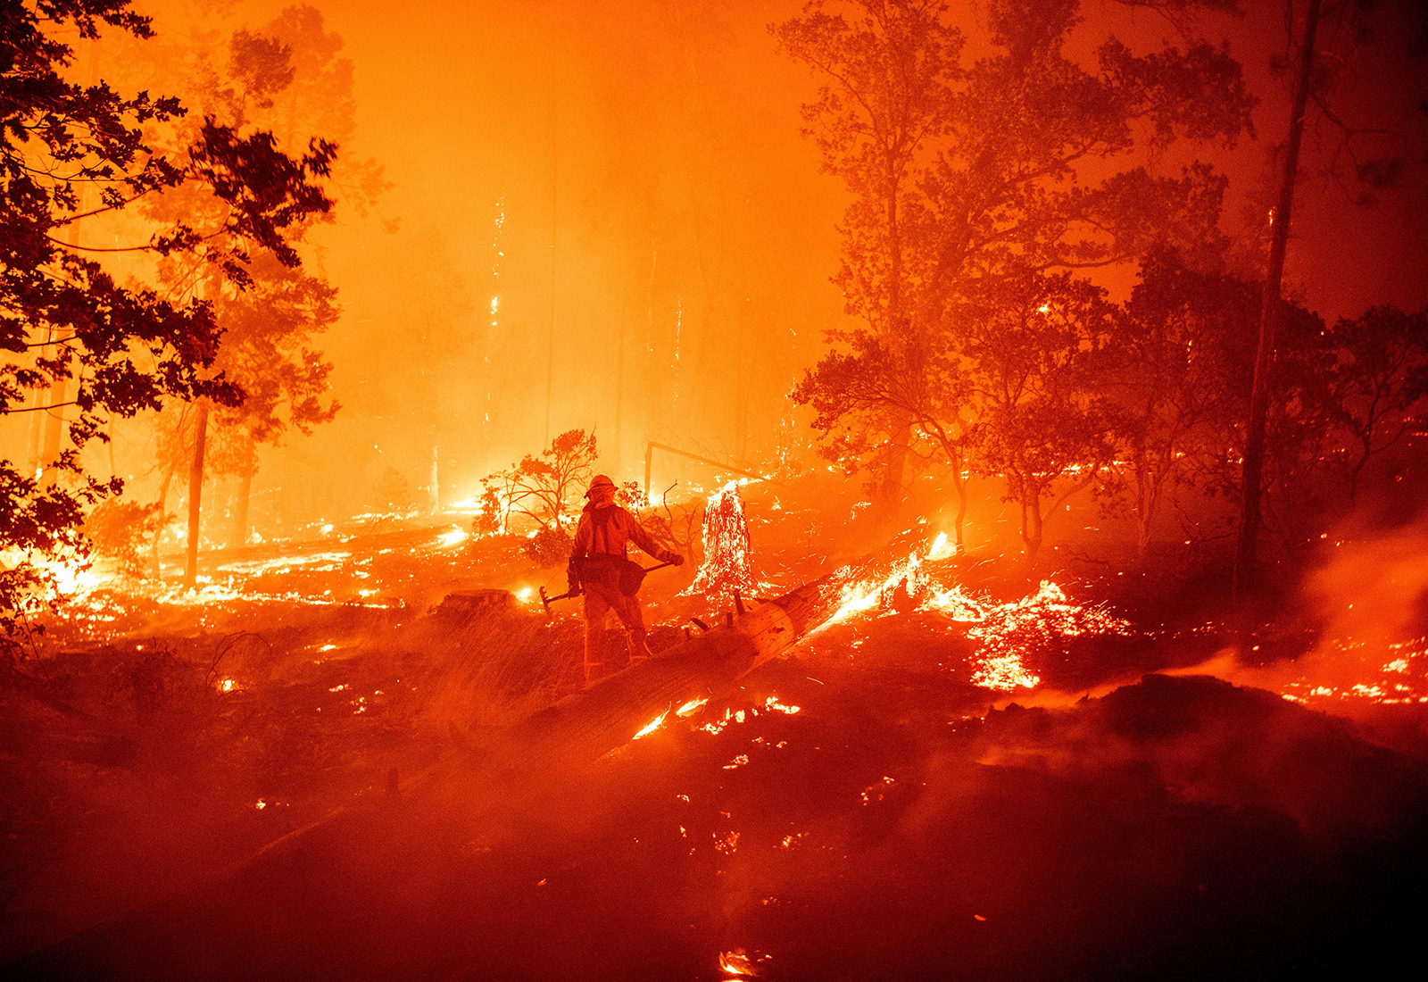
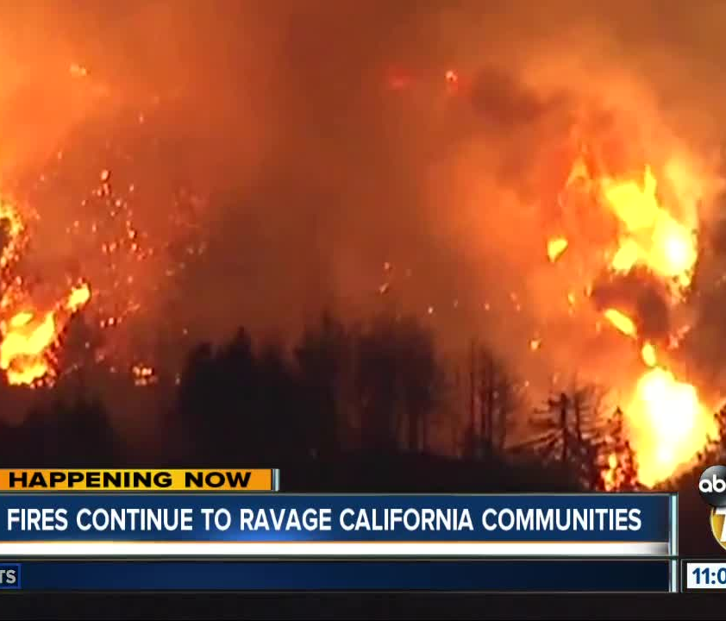
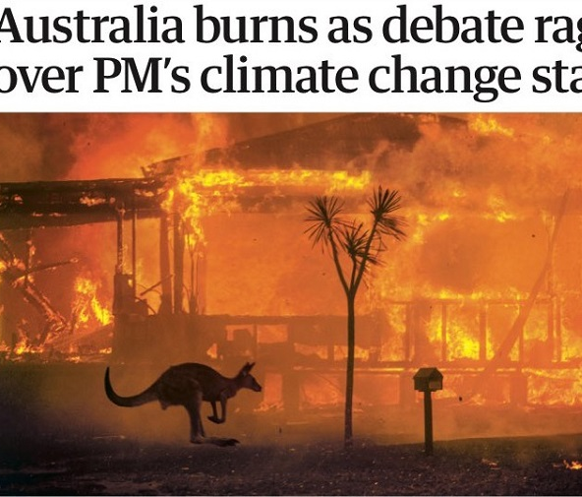
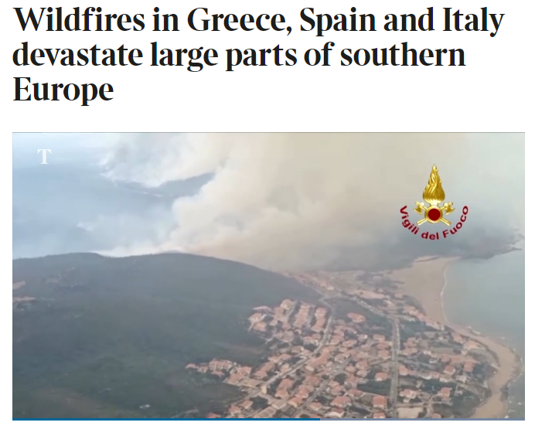
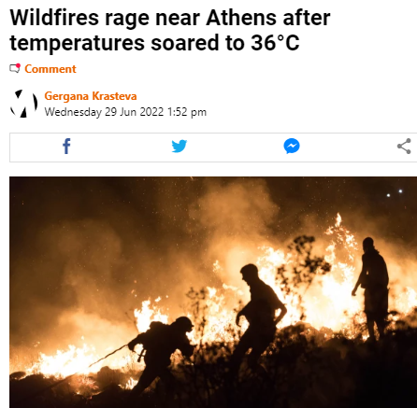
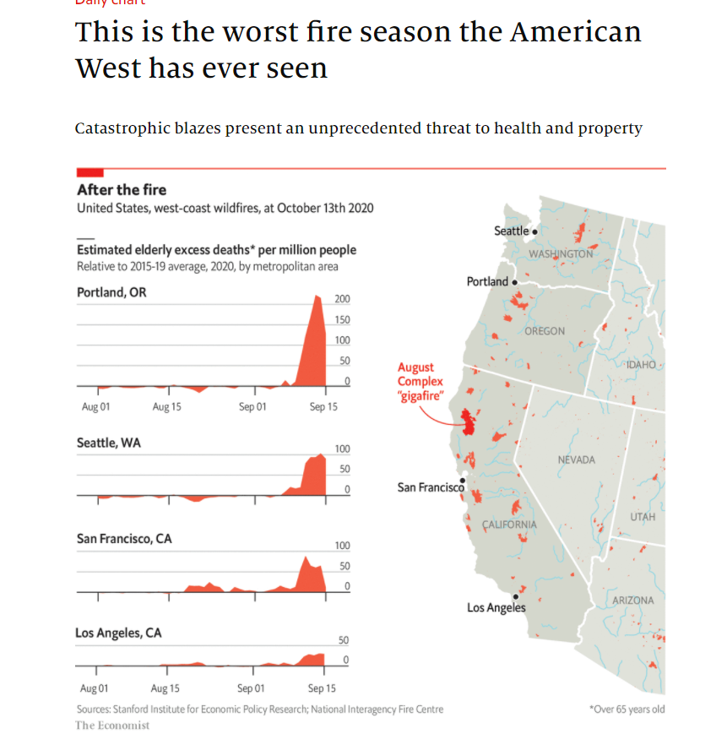
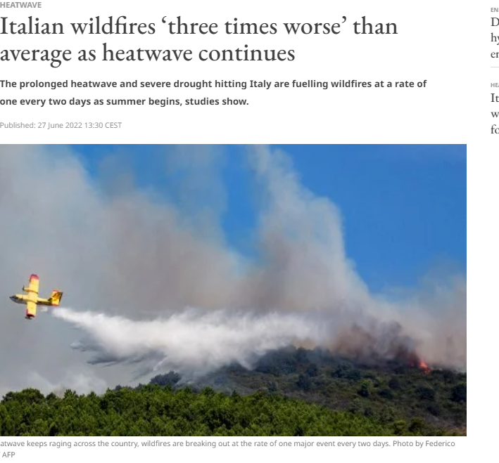
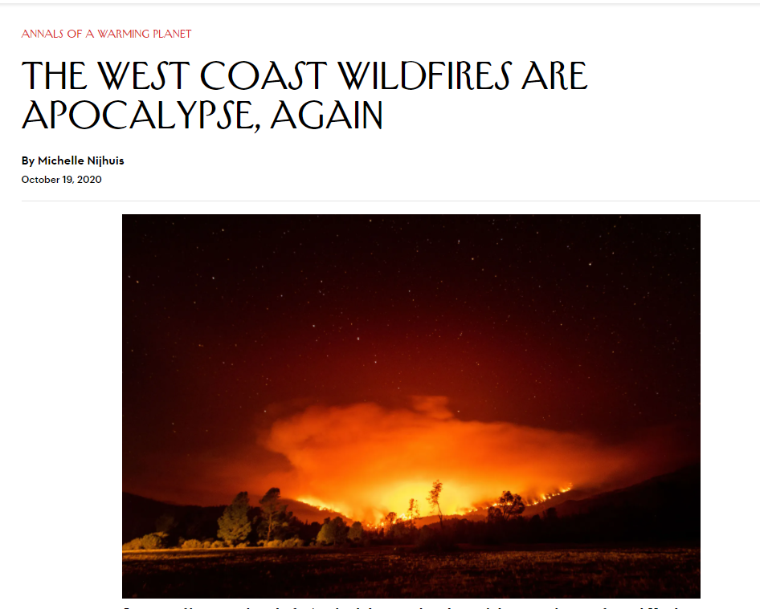
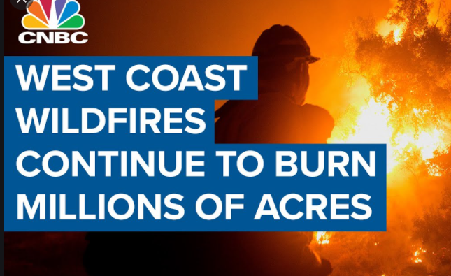
Notes:
In the last decades, we have assisted to many exceptionally large fires events in different parts of the world, from the amazon to the artic, from tropical to boreal areas. Indeed, 2020 was not only traumatizing for many of us but also for trees, especially in the western US, where they experienced a record-breaking number of large fires.

Slide 4
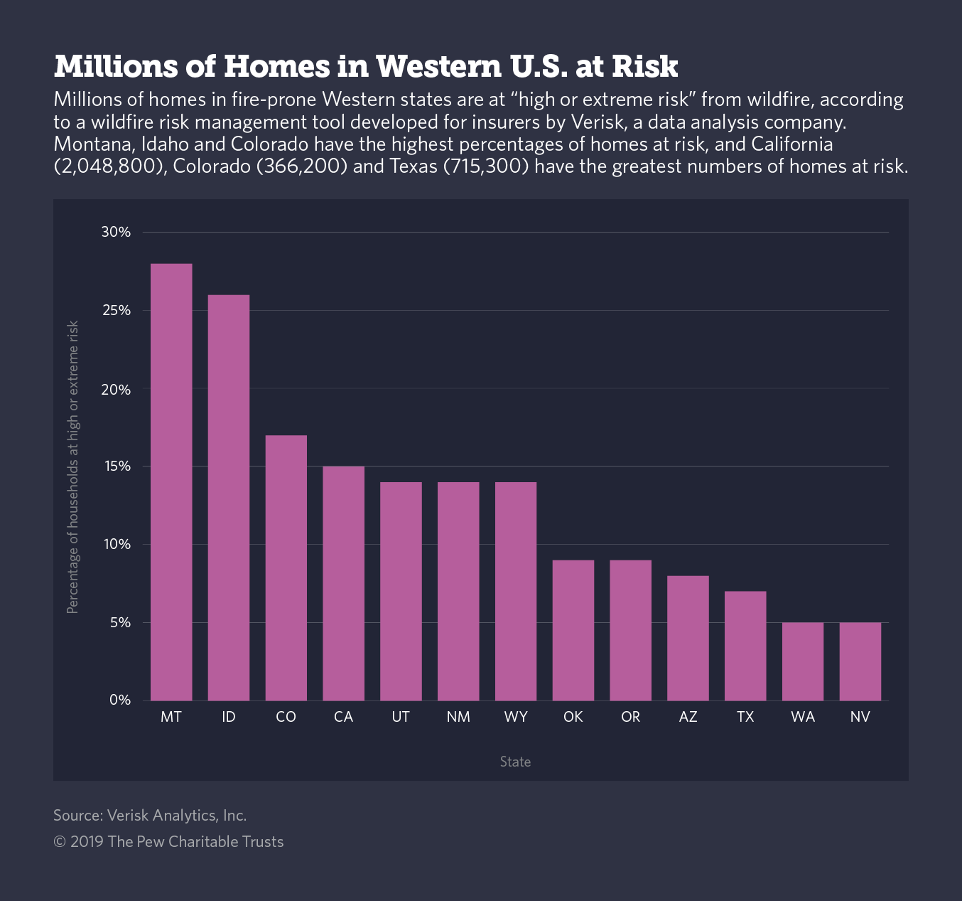
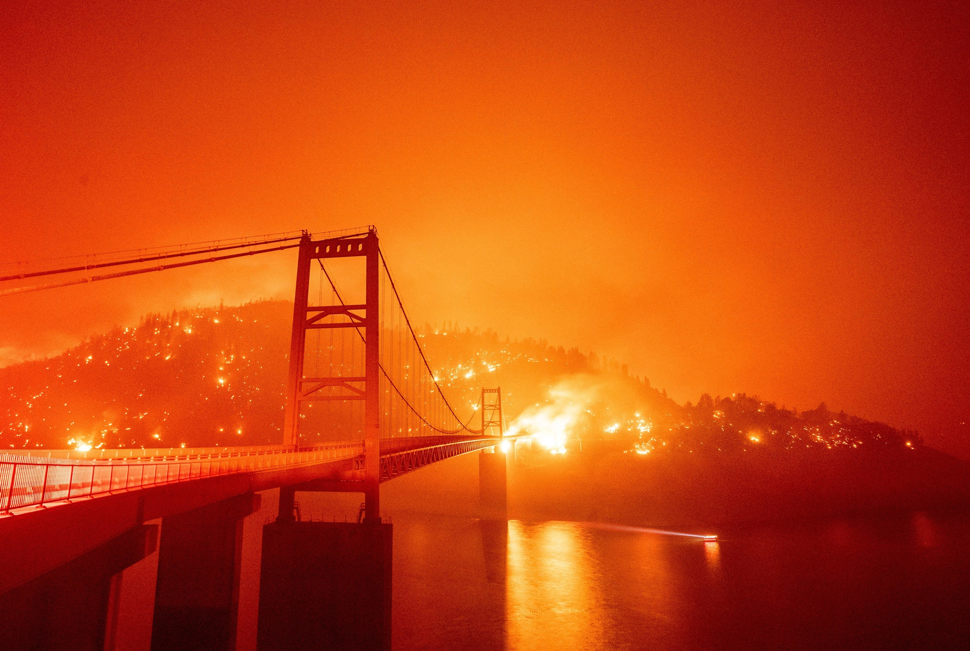
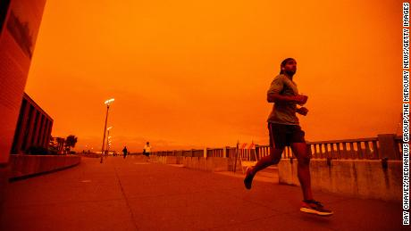
Notes:
When the newspapers covered the 2020 wildfires, they focused on the description of the apocalyptic red-orange colour in the sky and the threat this situation impose for millions of homes in wildfire prone areas.

Slide 5
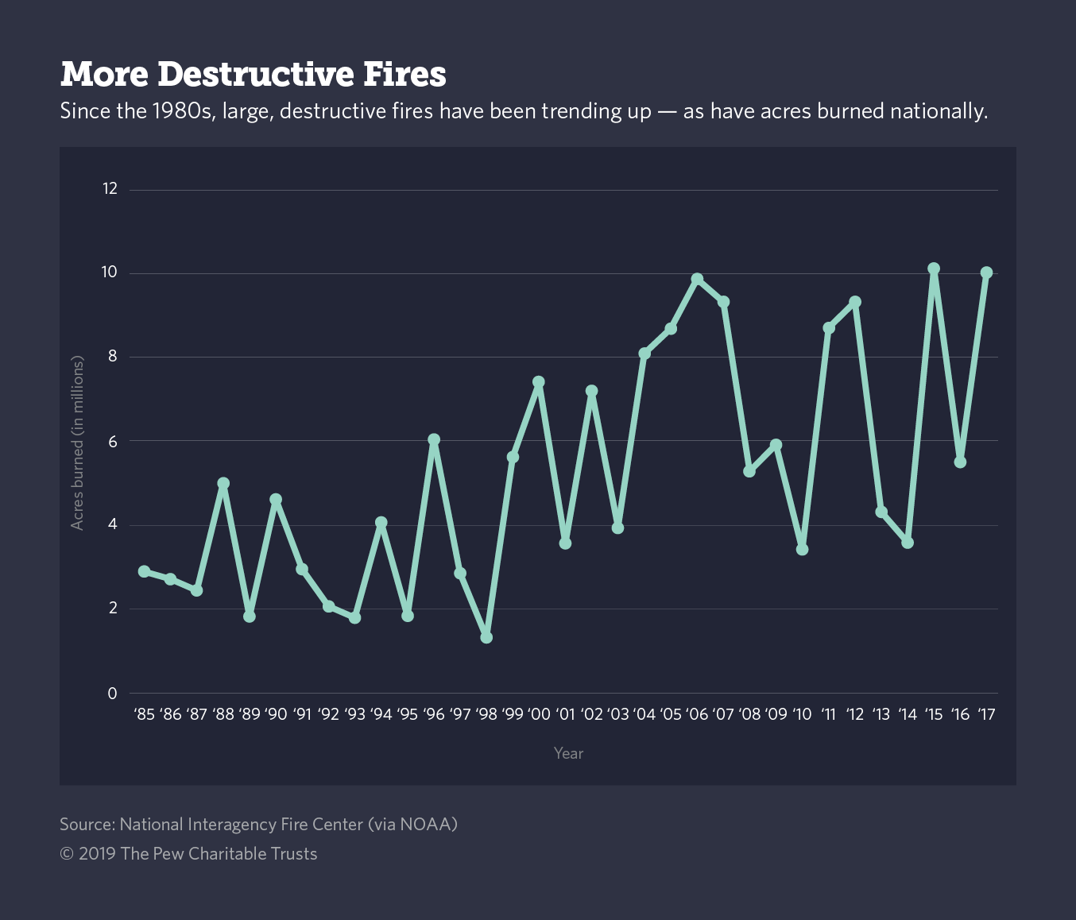
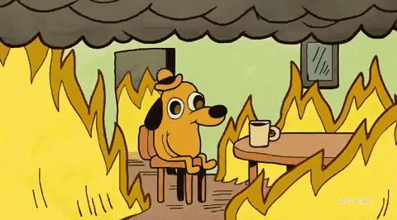
“Is this the new normal?”
“No, it is going to get worse.”
P. Duffy, Applied Physics PhD and Climate Science Advisor, White House OSTP, interviewed by T. Fuller and C. Flavelle, New York Times
Notes:
Research often associates drought and extreme heat periods with large fire events, forecasting a trend where the increasing fuel aridity and temperature will bring to more extensive burned areas and stronger fire severity.

Slide 6
Can we blame it all on climate change?
Notes:
However, this is not only a problem driven by climate change and first and foremost, wildfires need to be acknowledged as a socio-ecological problem.

Slide 7
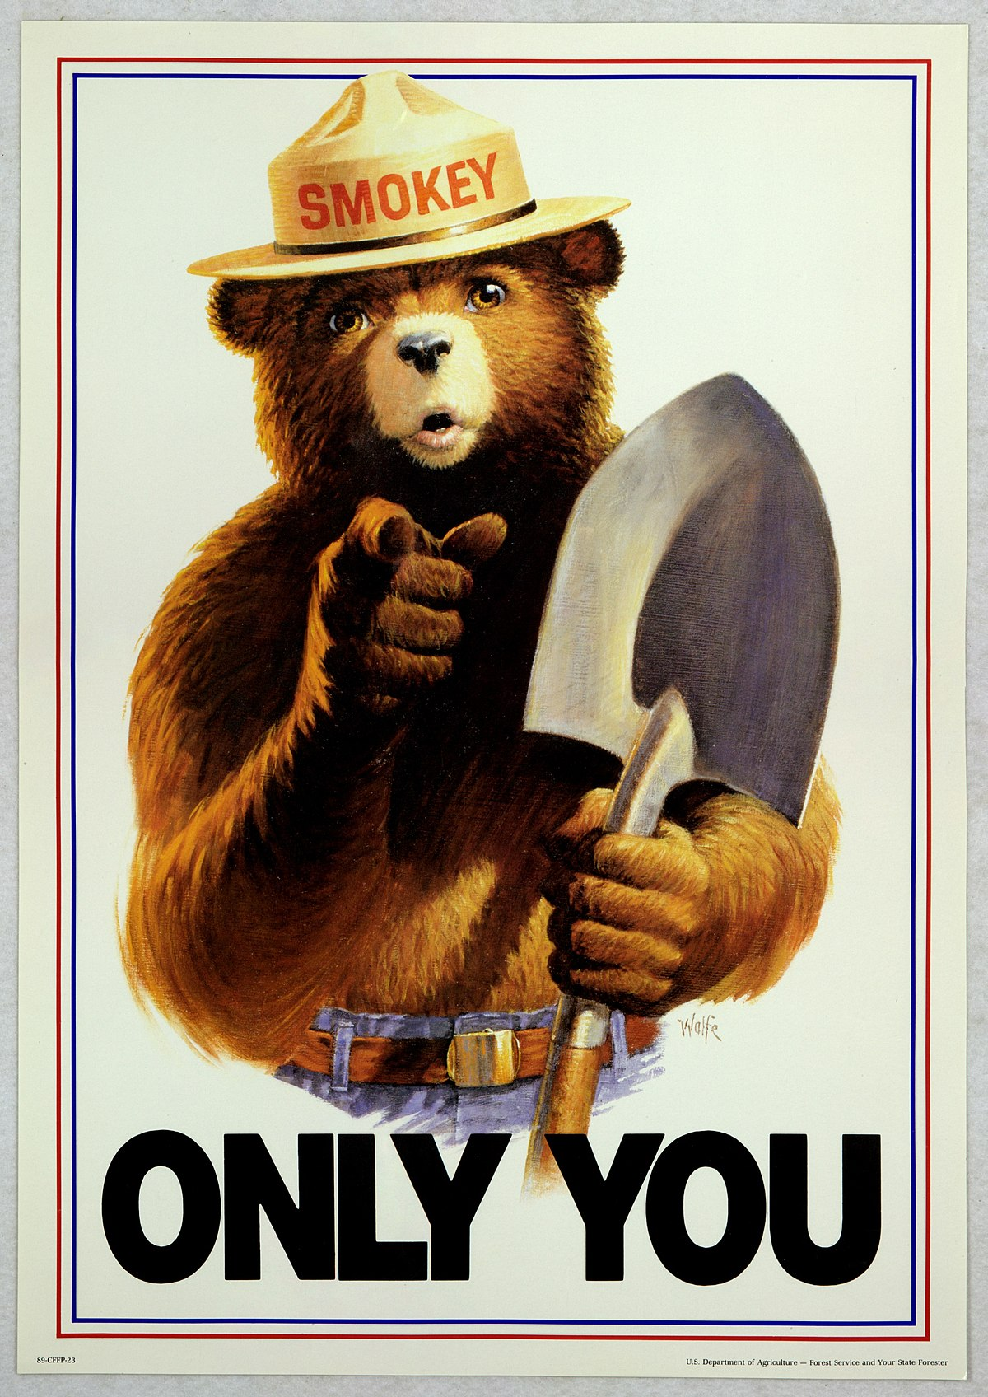
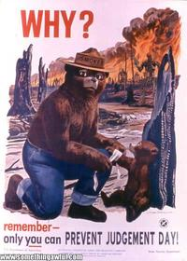

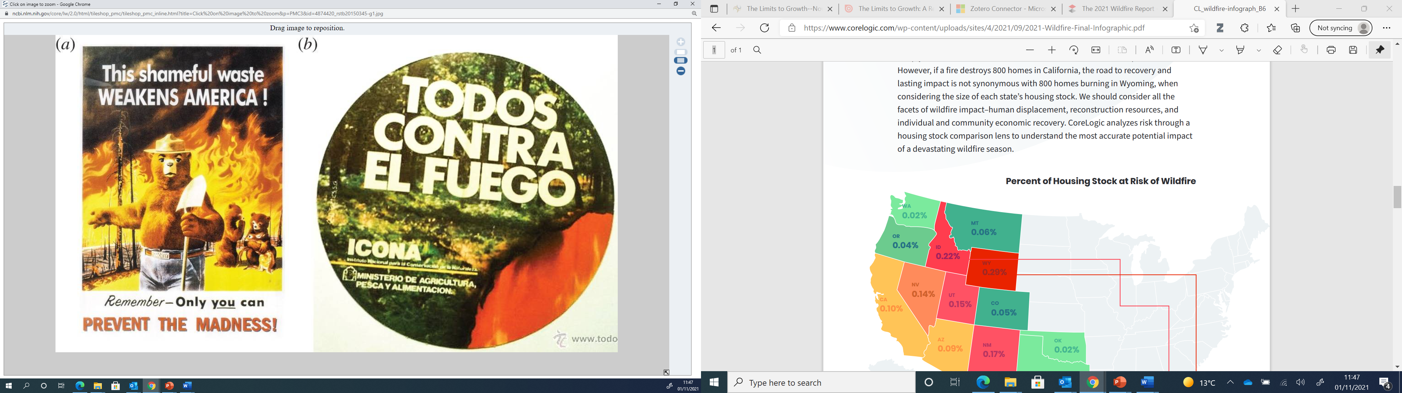
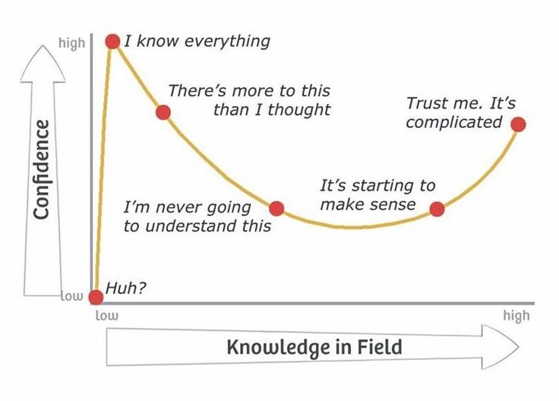

The knowledge about our knowledge
Here I am.
Vegetation
Weather
Landuse
Topography
Temperature
Fuel
Oxygen
Fuel
Climate
(Graphical conceptualization of Bowman et al., 2009)
(Graphical conceptualization of Dunning and Kruger 1999 and Sanchez and Dunning, D., 2018)
Notes:
This figure on the left is the representation of how the geophysical, climatic and human dimensions influences fires at the local, landscape, regional and global levels. At the landscape scale, fire responds to variation in fuel types, topographic features, and weather conditions. At regional and global scales, the interaction of climate with vegetation types and human land use results in characteristic fire regimes.
Although truthful, this representation is only the tip of the iceberg, since it simplifies the various interactions that humans have with nature, which are not necessarily linked to land-use, and that might lead to wildfires. Models of human-fire interactions range from conceptual and managerial local models to numerical global models. And the overly simplistic explanation of the causes behind wildfires conveyed to the public is not only misleading but also dangerous cause it had encouraged decision makers in the last decades to adopt fire suppression as the main solution to harmful fires.

Slide 8
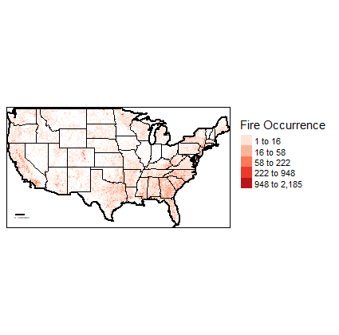
Myth against Reality
“Wildfires are always caused by extreme weather”
“All fires need to be prevented or extinguished”
“The extreme fire events seen in the last years are unprecedented”
“Wildfires are periodical events to be better tackled when they occur”
Active human-ignited fires in the United States from 1997 to 2018, collected in the FPA FOD
Notes:
Much of the social conceptions around fires are fuelled by these simplifications. Research now has recognised that some of these believes are not supported by scientific evidence. Wildfires are not only caused by extreme weather. Scientists generally agree that not all fires are harmful, and not all fires need to be prevented or extinguished. As well, The extreme fire events seen in the last years are not unprecedented and definitely wildfires are not periodical events to be better dealt with when they occur.

Slide 9


Myth against Reality
“Wildfires are always caused by extreme weather”
“All fires need to be prevented or extinguished”
“The extreme fire events seen in the last years are not unprecedented”
“Wildfires are periodically event to be better tackled when they occur”
Notes:
However, research has not yet completely unfolded the complex interactions between humans and fires, which still remain imperfectly understood also because constantly evolving.

Slide 10









Notes:
Recreational activities, forestland managers and owners, farmers, fire management practices, estate agencies, the wildland-urban interface expansion and insurance companies have different and sometimes opposite direct and indirect effects on wildfire incidence.
Models involving locals like firefighters, farms and forest managers are often agent-based, using data from ethnographic observation, interviews, questionnaires or participatory research methodologies. Studies related to Real estates and insurance agencies concern how policies regulating their activity have changed after a large wildfire event or while the one related to wildland urban interface usually focus on the risk of propagation of wildfires to building from an ignition point.
However, given the high selectivity on the aspects analysed, the insights gained from these models are often limited which can make them a poor basis for developing fire-related policy and management practices.

Slide 11


Notes:
On top of that, political systems can play a significant role in influencing wildfire occurrences, given the public nature of environment.
some literature explores the policies directly affecting the role of these players and factors, but politicians’ behaviour might also have some effects on wildfire outcomes. However, research has given less attention to this aspect and the link btw politicians’ incentives and behaviour and wildfire outcomes remain invisible. So, my research generally aim to try to unveil the anthropogenic factors related to wildfires, with a special attention on the political systems.

Slide 12
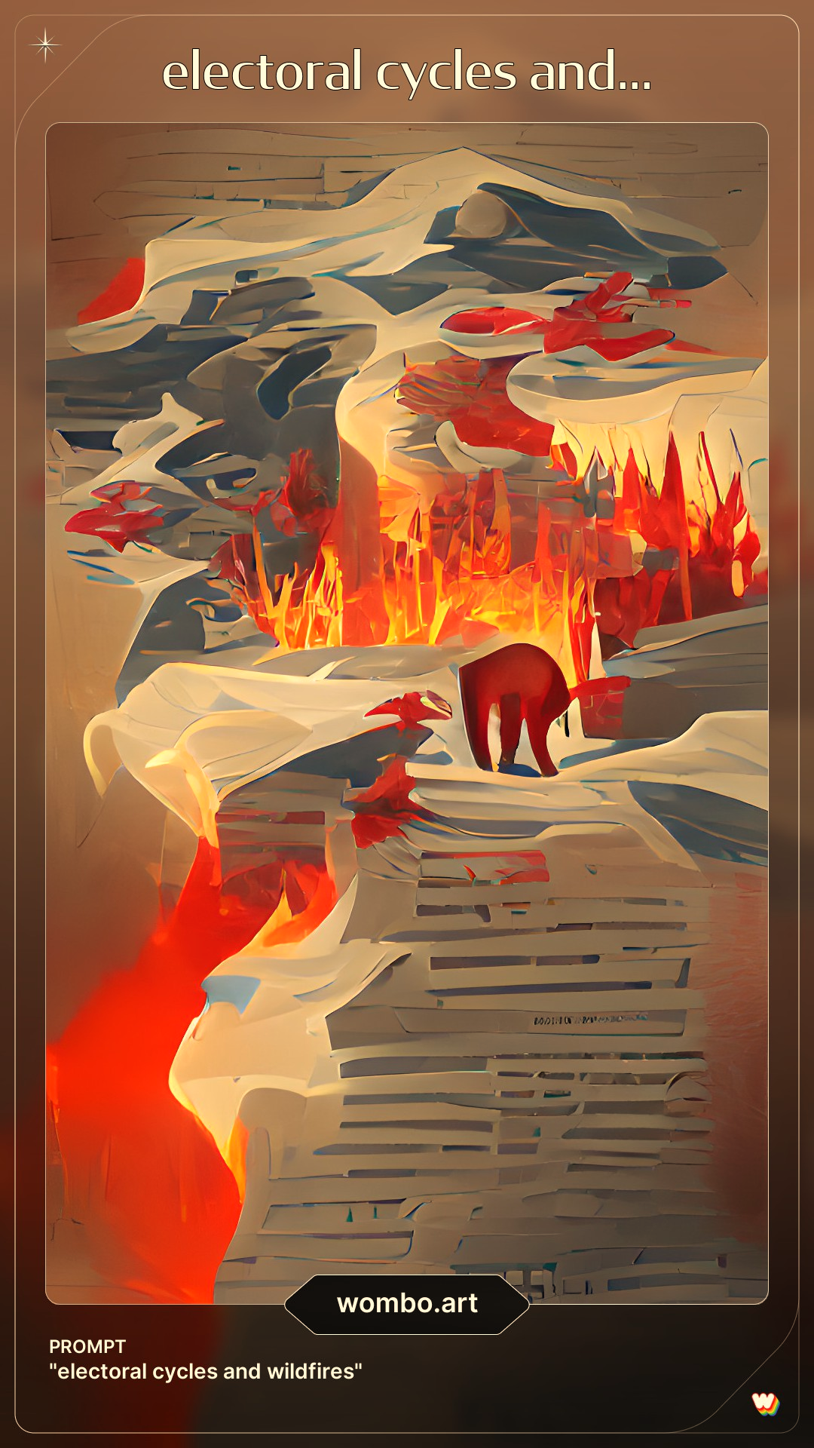


Objectives and methods
(1) Investigating if partisanships or election period play a role in shifting political systems’ commitments in managing lands and influencing wildfire occurrences.
Quasi Maximum Likelihood Poisson regression on electoral cycles
Regression Discontinuity Design on partisan effect
Notes:
The first objective is to understand if factors related to politicians like partisanships, election period or simply their opportunistic behaviour can play a role in shifting political systems’ commitments in the management of forestlands and ultimately influencing wildfire occurrences. To estimate the impact of election periods on wildfire I estimate a quasi maximum likelihood poisson regression, while I apply a regression discontinuity design analysis to investigate on the potential partisan effect.

Slide 13


Electoral Cycles in a nutshell
Electoral cycles describe the fluctuations of economic outcomes resulting from an external intervention of political actors.
Applied on environmental outcomes like green tax (Ashworth et al., 2006), deforestation rates (Burgess et al., 2011 and Pailler, 2018)
Related to wildfires, compatible patterns with the presence of electoral cycle in Greece and Spain (Christodoulakis and Skouras, 2014; Álvarez-Díaz et al., 2015).
Pre-election period
Election Period
Legislature
Notes:
Politicians had incentives to implement expansionary monetary policies before the election period to gain popularity. This has been also applied to environmental outcomes confirming that these dynamic can have an effect on these too, examples are green taxes not approved before election periods or deforestation rate increasing.
Few previous studies in Greece and Spain confirmed the presence of wildfires influenced by electoral cycles.

Slide 14
Regression Discontinuity in a nutshell
Regression discontinuity is a quasi-experimental design determining the effect that a treatment variable has on an outcome.
Several papers have used it to analyse the discontinuity in close election to detect many socioeconomic outcomes. (Ferreira and Gyourko 2009, Cellini et al. 2010, Gagliarducci and Paserman 2010).
Notes:
We would only to be able to study the real effect of government’s partisan affiliation if we could just randomly assign it like in a field experimental work. Since we cannot do that for multiple reasons which can be summarized in the concept of democracy where it is the population that decide about it, we can use a quasi-experimental model like the regression discontinuity design, which assign the treatment variable of partisanship to a given state following close election results.

Slide 15

Objectives and methods
(2) Understanding the role the different actors as potential drivers of wildfires.
A scoping review of policy content, stakeholders’ harmful incentives, and factors related to wildfires
Notes:
The second objective is to understand the role of the different actors as potential drivers of wildfires through a scoping review of policy contents, stakeholders’ harmful incentives, and other related business factors. To my knowledge, a scoping review has never been applied to map the links between wildfires and the human dimensions, providing a qualitative model that highlights relationships for further investigation.

Slide 16
Preliminary results in the Western US
Notes:
The table reports preliminary results from estimating the poisson regression. It seems to confirm some positive correlation between election years and fire occurrences at State level in the Western US.

Slide 17
Preliminary results in the Western US
Notes:
Specifically, there seems to be a 25 % increase in wildfire incidents in the year after the gubernatorial elections.

Slide 18
Preliminary results in the Western US
Notes:
This second table shows how the results change with the introduction of another variable: the incumbent governor running for re-election. The positive relationship between election years and its lag and lead effect seems not to be significant anymore.

Slide 19
Preliminary results in the Western US
Notes:
However, when the incumbent runs for re-election there is about a 20% increase in wildfire incidents. This preliminary results seem to show that when incumbent politicians seek the second term re-election, they have weaker incentives to promote a sustainable wildland management.

Slide 20
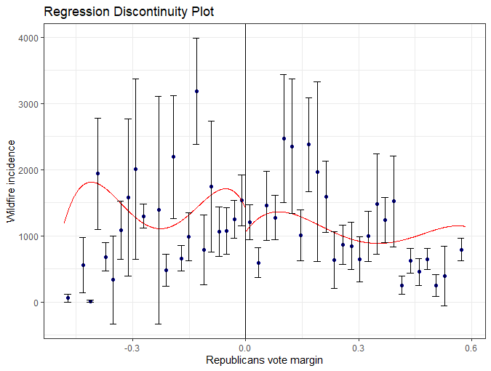
Preliminary results in the US
$$FI_{ts}=α+β1\left({Republican}_{ts}\right)+B2\left({RepublicanVoteMargin}_{ts}\right)+β3\left({RepublicanXRepublicanVotemargin}_{ts}\right)+ε$$
$$ε$$
Notes:
I also investigated whether this is only given by the opportunistic behaviour of politicians or if it is somehow related to the partisanships. The table on the left show the results from a parametric and non-parametric regression discontinuity design which seem to agree that when a republican barely won the election against a democrat, there had been less active wildfires in the period that goes from 1997 to 2018. The plot on the left in fact portrays this negative gap of wildfires when the republicans barely won.

Slide 21
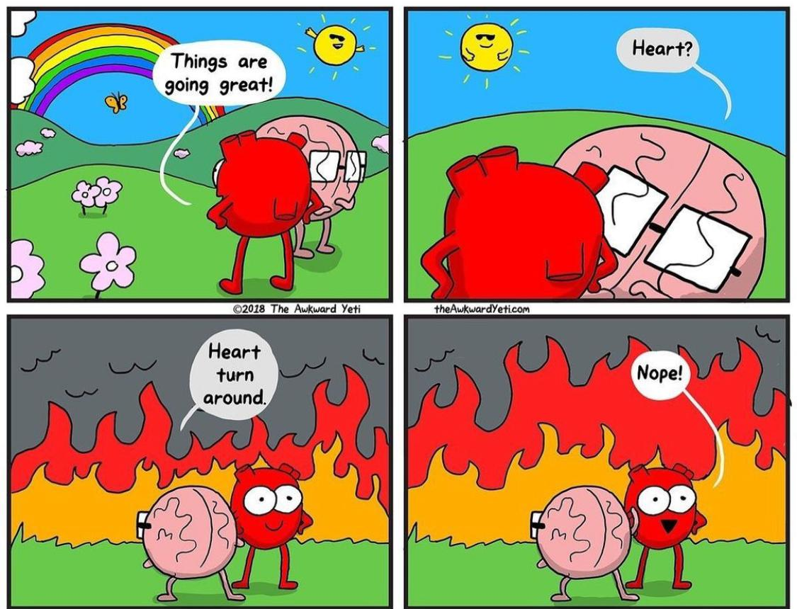
In conclusion…
Results suggest a relationship between electoral cycles and wildfires incidence when incumbent governors run for the second term in the Western US.
When a republican governor barely wins against a democratic candidate in the US, there are significantly less wildfires in the State.

Slide 22
Next steps
Enlarge the wildfire cycle analysis to all the US
Include property rights of lands (e.g., private, state, federal) in the regression discontinuity
Include lame duck vs re-electable governor in the regression discontinuity
Apply the same methods to European contexts
Scoping review of human drivers to wildfires

Slide 23
Thank you!

