Slide 1
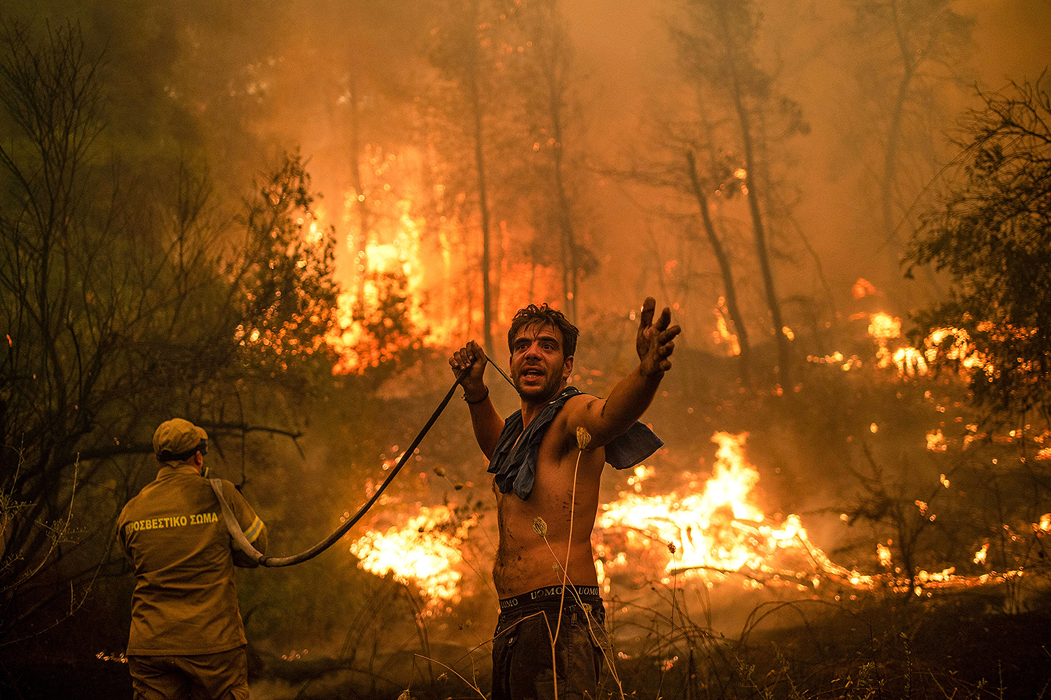


Assessing preferences for wildfire mitigation in Crete
Haleema Misal, Ioannis Kountouris, Apostolos Voulgarakis

Slide 2
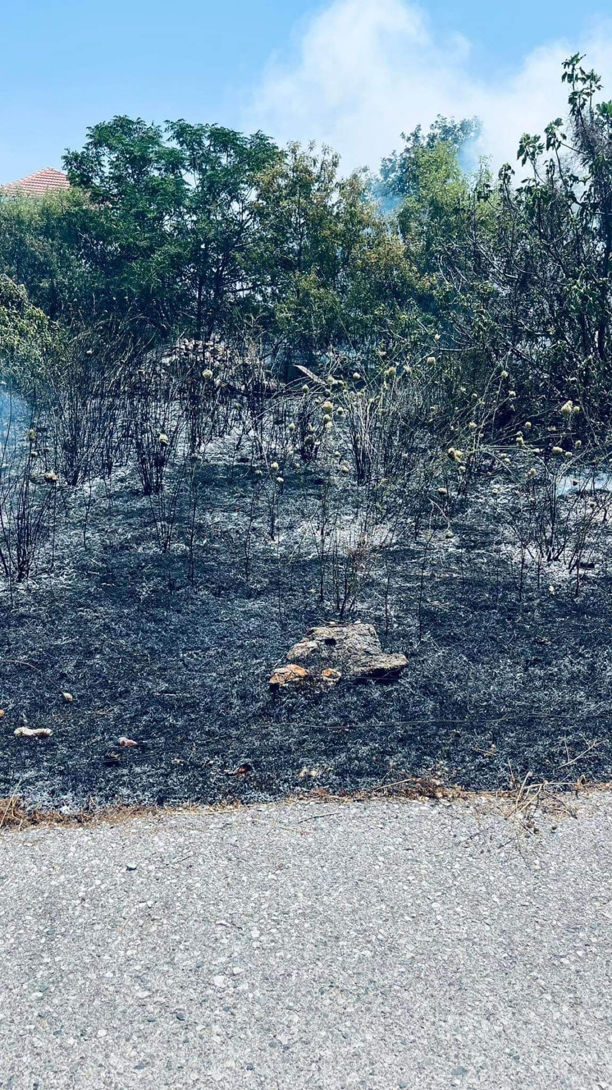
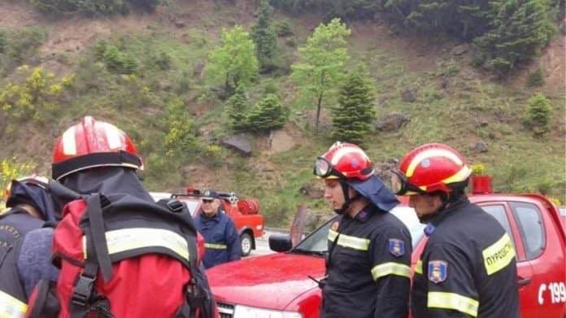
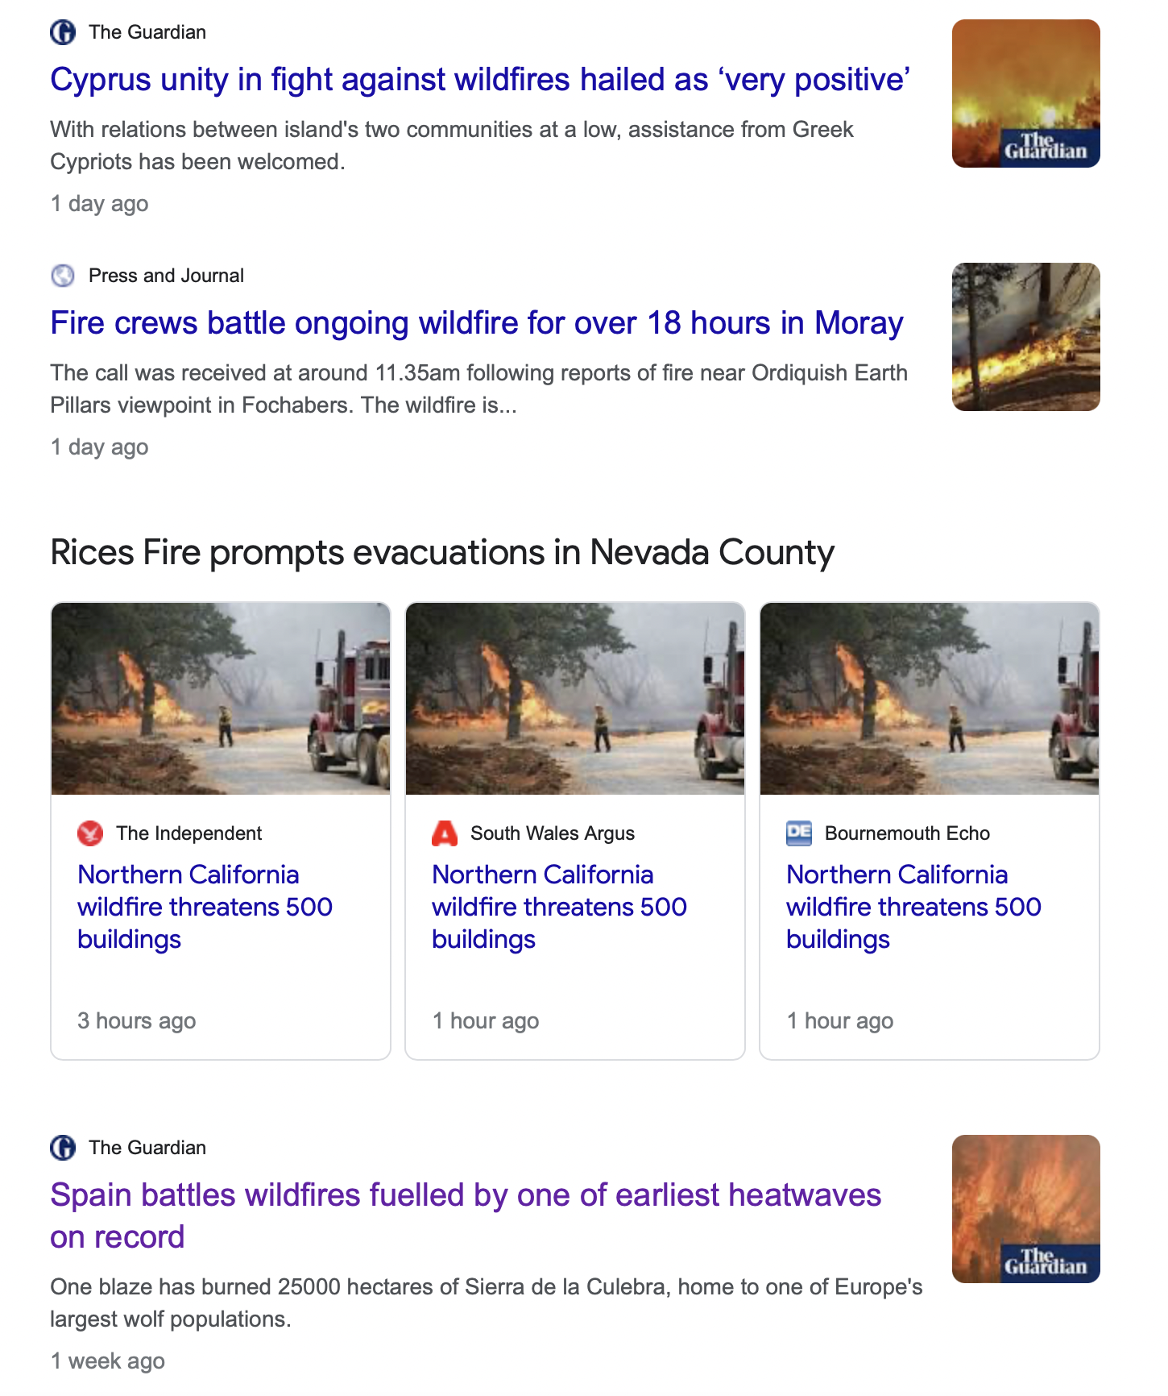
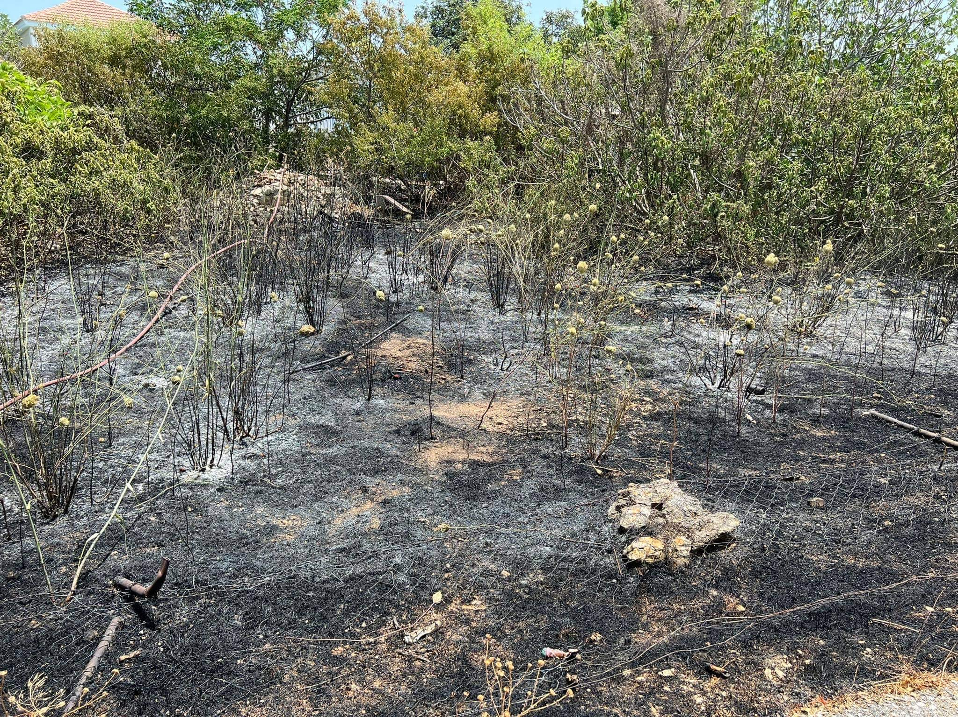
Fire danger forecast
Figure 1: Burnt forest in Chania Source: Chief of Fire Service Chania, June 2022

Slide 3

This paper
Employs non-market valuation to assess Cretan public preferences for a wildfire mitigation programme
Estimate their willingness to pay (WTP) for a wildfire management programme attributes
Examine the heterogeneity of preferences across consumers
Environment
Economics
Policy
Degradation
Externalities
Ecosystem Services
Quantify damages
Communicate + Inform
Figure 2. Interdisciplinary link

Slide 4
Rationale
1. ES are integral to human wellbeing → wildfires damages threaten these
2. Methods such as choice experiments can be utilised for this- they are also a good indicator of public preferences for wildfire management
3. Communicate the damages
Ecosystem services provide human wellbeing
Human wellbeing is compromised during a wildfire event
Quantification of ES through valuation : information of wildfire damages
Choice experiment
Management policies to mitigate wildfire damages
Figure 3. Conceptual framework

Slide 5
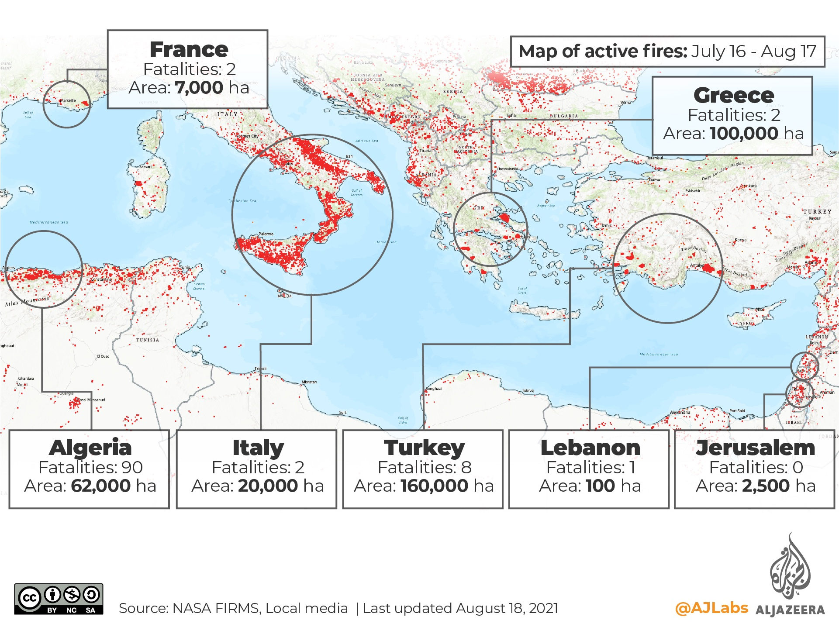
Background
Figure 4. Elevation map of Crete Data Source: Copernicus, (2018)
Figure 5. Mediterranean wildfires 2021
Hot/dry summer med climate with mild and wet winters = Vegetation growth in winter with high fuel availability during summer fire seasons
The landscape is naturally heterogeneous but also anthropogenically influenced through millennia's of agricultural activities and pastoralism

Slide 6








Issues of wildfire in Crete
Climate
Higher temperatures and drought: increase the potential for wildfire by creating perfect fire conditions / longer fire seasons
Humans
Human ignited wildfires: cigarettes, equipment failure, fireworks, arson, unattended campfires (over 95% of the fires in Europe are human-induced (EFFIS, 2012)
Unregulated urban expansion
Fire regimes change as human populations expand into wildlands. People provide a new source of ignition that can increase the occurrence of fires.
Land abandonment
-Rural depopulation has led to altered fire dynamics within ecosystems that are sensitive to perturbations and therefore vulnerable to extreme wildfires.
-Increased levels of fuel due to abandonment of agro-pastoral activities.
-CAP: Intensification of olive cultivation, traditionally managed terrace olive groves at higher altitudes abandoned
Fire Management Practices:
Fire suppression is a direct anthropogenic activity that alters fire regimes. Focusing on fighting fires diverts attention away from preventing fires in the first place and often fails to reflect the diversity of fire regimes and ecology of the region
Notes:
(Ursino and Romano, 2014).

Slide 7
Management of wildfires
Challenging due to the non-market nature of many of wildfire impacts
There are myriad of competing incentives across institutions and government (Forest service vs Fire service)
Legal/institutional framework is lacking e.g. no forest cadastre
Designing effective wildfire policy needs to account for public preferences – Lack of public participation in policy making
Notes:
The Greek Forest Service was responsible for all three aspects of wildfire management (i.e. prevention, abatement and ecosystem restoration) until the year 1997.

Slide 8
Overview of the literature
Similar studies on public preferences-specific to the Mediterranean include:
(Alló and Loureiro, 2020) to understand citizen preferences for fire prevention in Spain with a focus on perceived risk of megafires
(Varela et al., 2014a) look at preferences for fuel break programmes that differ with respect to cleaning techniques
(Soliño et al., 2010) design a forest-energy policy to reduce forest fires in Galicia, Spain

Slide 9
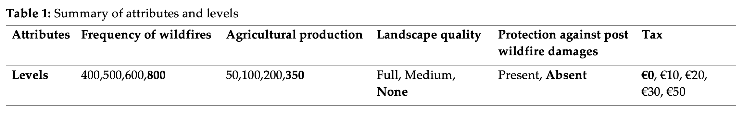
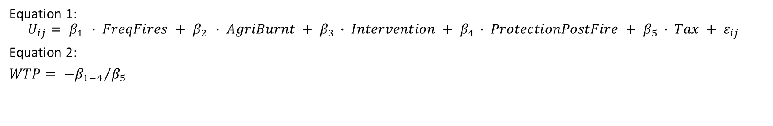
Theory of DCE
Choice experiments can be used to measure the strength and direction of preferences by asking respondents to trade‐off between alternatives on the basis of different attributes and levels
Lancaster's theory: “all goods possess characteristics or attributes that are demanded by the consumers, not the goods themselves” (Lancaster,1966)
Equation 1:
$$U_{ij}= β_{1 }∙ FreqFires + β_{2 }∙ AgriBurnt + β_{3 }∙ Intervention + β_{4 }∙ ProtectionPostFire + β_{5 }∙ Tax + ε_{ij }$$
Equation 2:
$WTP= {{−β}_{1−4}}/{β_{5}}$

Slide 10
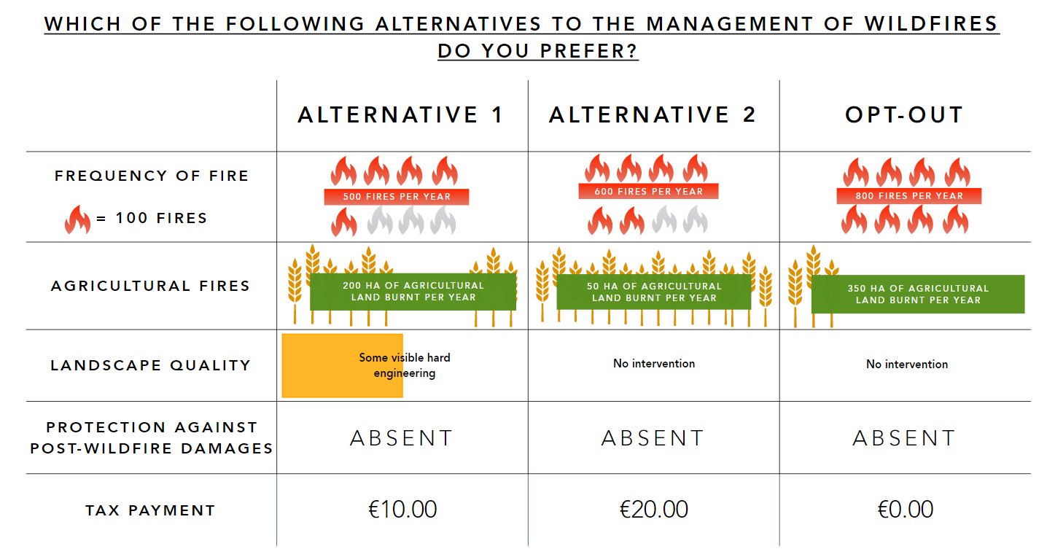
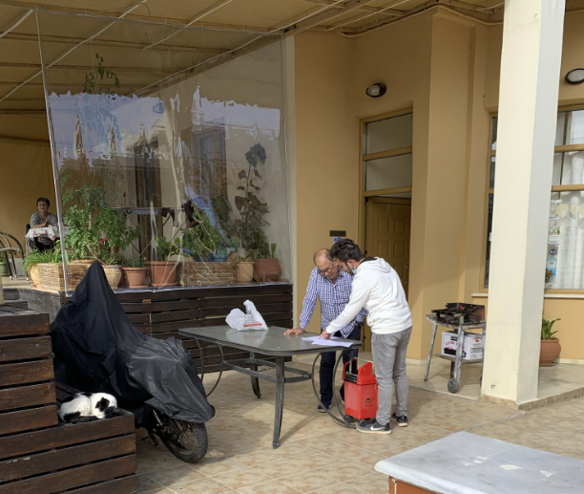
Survey design + Data Collection
Figure 6. Tasos deploying the first survey
Figure 7. An example of a choice set

Slide 11
Results: Estimated coefficients
Conditional Logit Model |  |  |  |  | Latent Class Analysis
 | Estimates |  | Standard Error |  | Class 1 |  | std. error | Class 2 |  | std. error | Class 3 |  | std. error
Status Quo | 0.72 | ** | 0.23 |  | 2.26 | * | 1.07 | 1.84 | *** | 0.34 | 1.57 |  | 20.07
Fire Frequency | 0.11 | * | 0.04 |  | 0.04 | * | 0.21 | 0.12 | * | 0.05 | 4.51 |  | 7.71
Agricultural land | 0.23 | *** | 0.06 |  | 2.43 | ** | 0.86 | 0.2 | * | 0.08 | 0.32 |  | 3.58
Landscape quality: Full | 0.26 | * | 0.11 |  | 0.26 |  | 0.85 | 0.41 | ** | 0.13 | 8.76 |  | 14.15
Landscape quality: Medium | 0.17 |  | 0.11 |  | 5.66 | * | 2.55 | 0.57 | ** | 0.18 | -0.8 |  | 74.31
Protection Post-Fire | 0.59 | *** | 0.09 |  | 5.11 | * | 2.54 | 0.62 | *** | 0.12 | 13.15 |  | 23.12
Tax | -0.01 | *** | 0 |  | -0.19 | * | 0.08 | -0.01 | ** | 0.04 | -0.41 |  | 0.75
Gender |  |  |  |  | -1.21 | *** | 0.11 | 0.95 | *** | 0.10
Education |  |  |  |  | 0.69 | *** | 0.13 | -0.46 | *** | 0.12 | 0.40 | *** | 0.17
Children |  |  |  |  | -1.13 | *** | 0.11 | 0.39 | *** | 0.11 | 1.01 | *** | 0.16
Farming |  |  |  |  | -0.21 | *** | 0.13 | -0.20 | *** | 0.12 | 0.20 | *** | 0.16
Tourism |  |  |  |  | -0.12 | ** | 0.15 | 0.31 | *** | 0.13 | -0.74 | ** | 0.18
Working Age |  |  |  |  | 0.51 | *** | 0.16 | -0.3 | *** | 0.14 | -0.26 | *** | 0.19
Class share |  |  |  |  | 16% |  |  | 76% |  |  | 8%
Num of Observation | 942 |  |  |  | 942
Log Likelihood |  |  |  |  | -714.61
Men- Working age
Women- Approaching retirement
No children
Children
University level educated
Engaged in Tourism
Not educated to university level

Slide 12
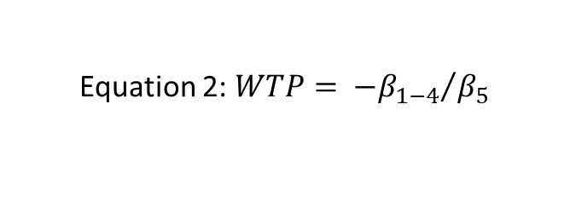
Results: WTP
 | Conditional logit |  | std. error | Class 1 |  | std. error | Class 2 |  | std. error | Class 3 | std. error
Status quo | 41.97 | *** | 14.16 | 11.47 | ** | 4.61 | 135.56 | *** | 48.57 | 3.77 | 53.38
Fire frequency (€ per 100 fires) | 6.41 | ** | 2.97 | 2.28 | ** | 1.04 | 9.53 | * | 5.32 | 10.79 | 13.39
Agricultural land (€/10ha) | 13.87 | *** | 4.39 | 12.37 | *** | 1.99 | 15.15 | ** | 7.25 | 0.77 | 8.21
Landscape intervention: Full | 15.58 | ** | 7.07 | 1.37 |  | 4.02 | 30.30 | ** | 13.7 | 20.92 | 13.76
Landscape intervention: Medium | 9.95 |  | 6.91 | 28.75 | *** | 6.53 | 42.42 | ** | 21.25 | -1.92 | 178.12
Protection post-wildfire | 34.56 | *** | 8.67 | 25.92 | *** | 5.16 | 46.03 | *** | 16.15 | 31.39 | 59.58
Class share |  |  |  | 16% |  |  | 76% |  |  | 8%
Total number of observations | 942 |  |  | 942
Final Log-likelihood | -885.57 |  |  | -714.61
Equation 2: $WTP= {{−β}_{1−4}}/{β_{5}}$
Notes:
WTP to avoid more fire frequency
Remove – signs

Slide 13
Discussion
Overall strong preference for wildfire management
LCA reveals that certain socio-demographic characteristics e.g women are more likely to want to want to mitigate the damages from wildfires
Protecting agricultural land was the highest valued attribute, then fire frequency, protection against post wildfire damages with Landscape quality coming in at the end
Notes:
Pecuniary effects of wildfires seem to be more important as people care about livelihood, landscape quality comes later but relatvive to attributes that realte directly to financial contributes matter more as they come first.

Slide 14
Next Steps
Understand causes and drivers of wildfires (Q- Method)
'Q' is a semi-quantitative methodology that seeks to systematically quantify an individuals self-perception by categorising beliefs, opinions and attitudes. The aim is to identify these preferences and reveal consensus and disagreements amongst participants
Notes:
Preferences of general public and then now were expanding to look at the opinions of the experts and stakeholders.

Slide 15
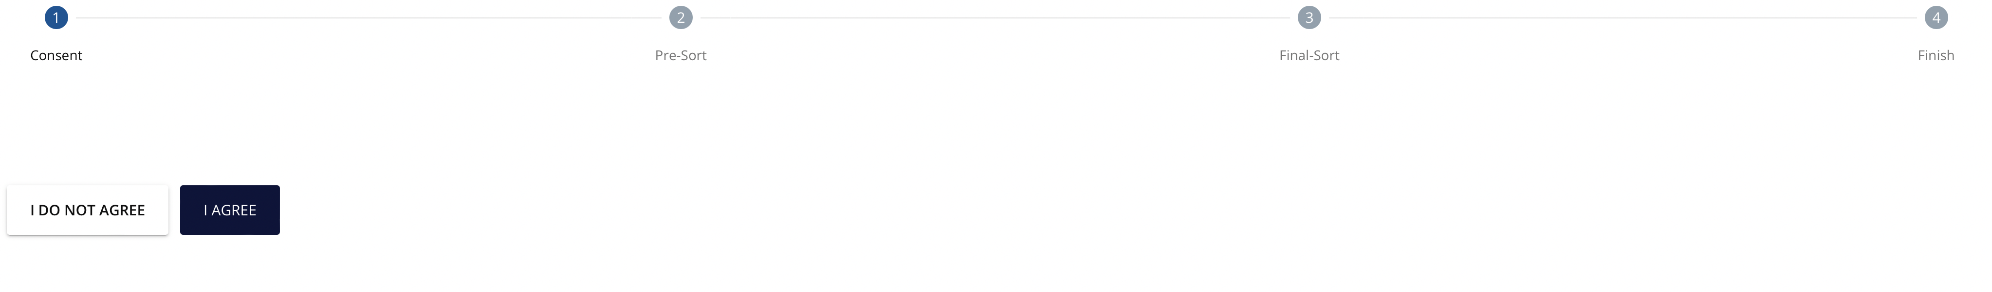
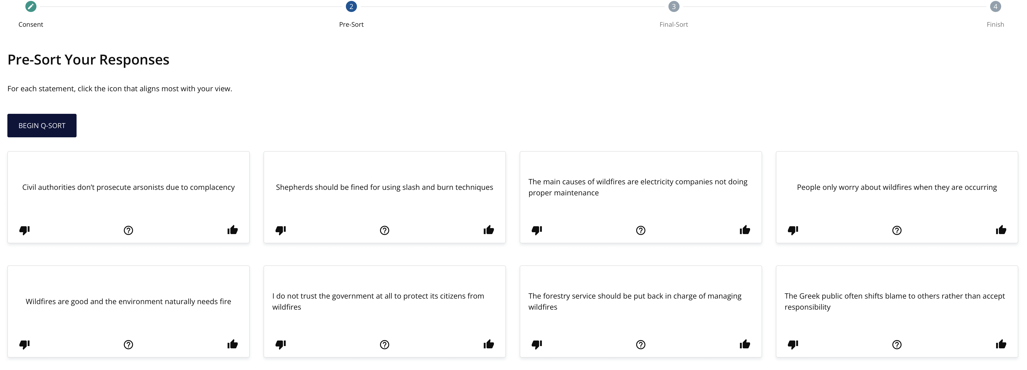

Slide 16
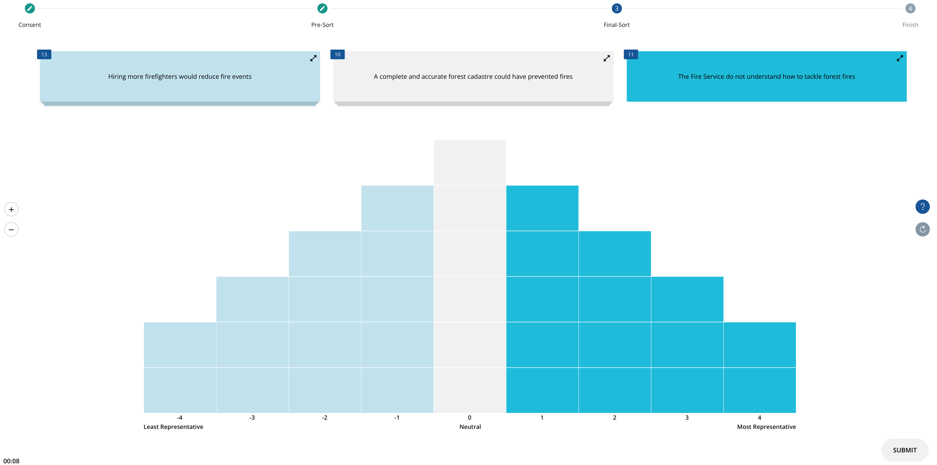

Slide 17
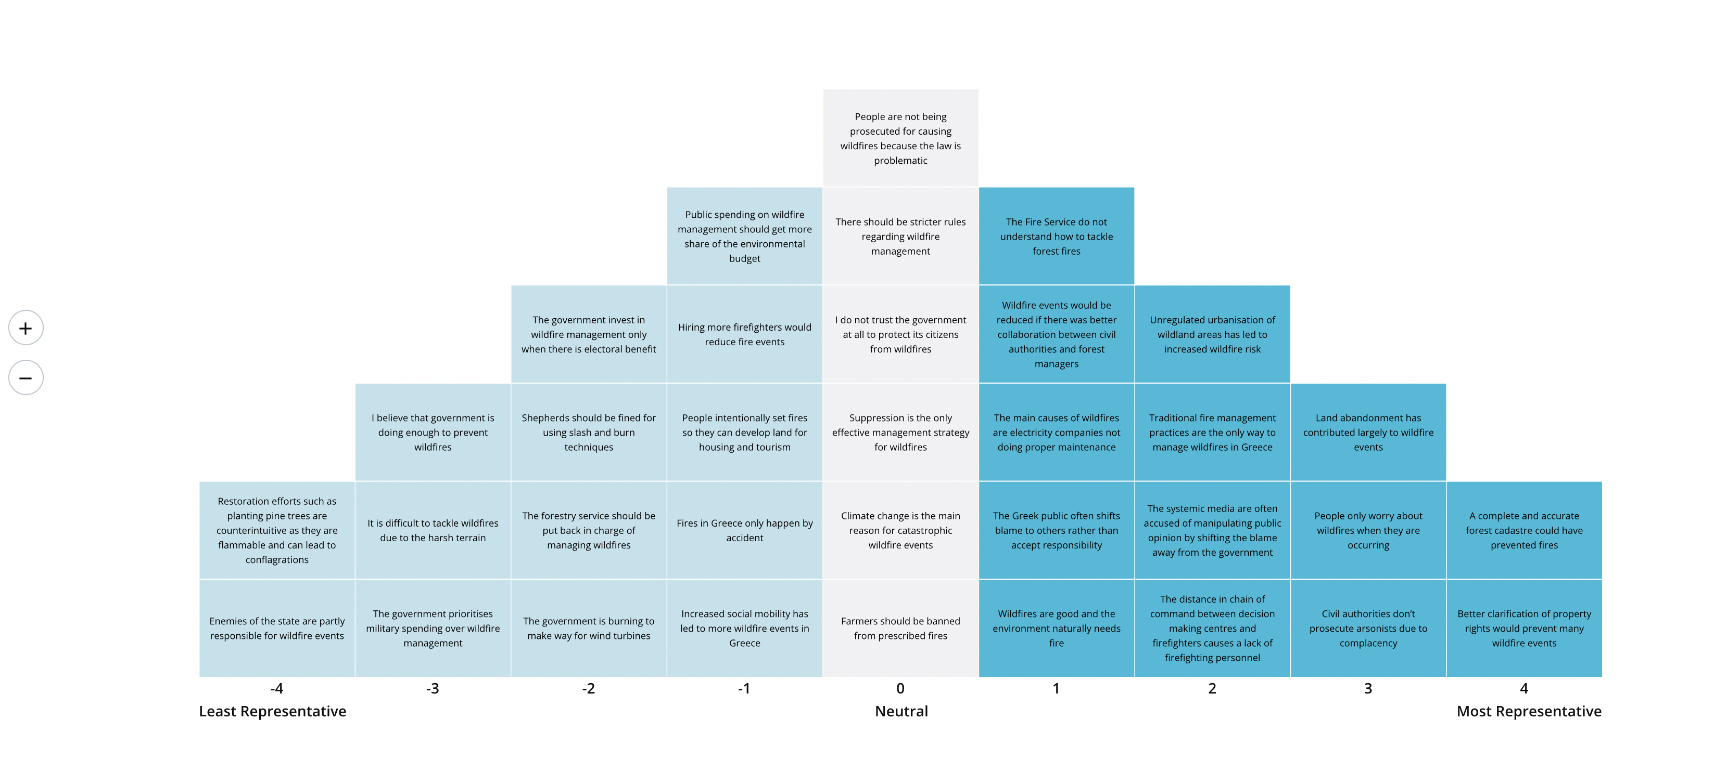

Slide 18
