Slide 1



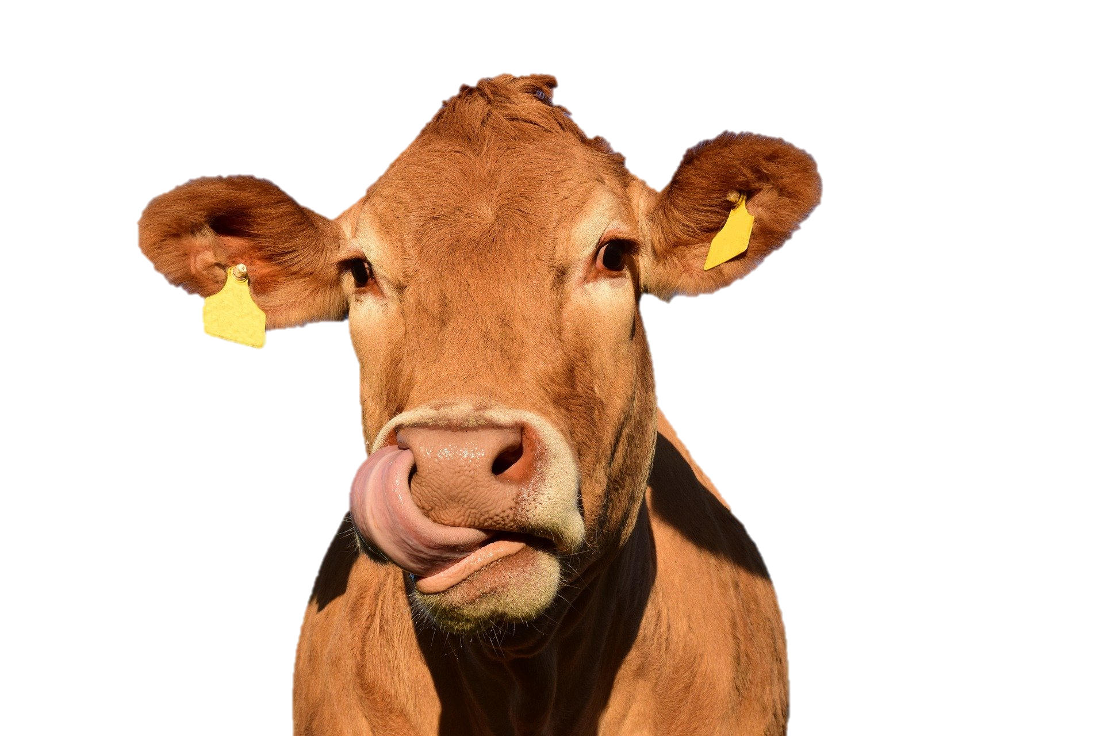


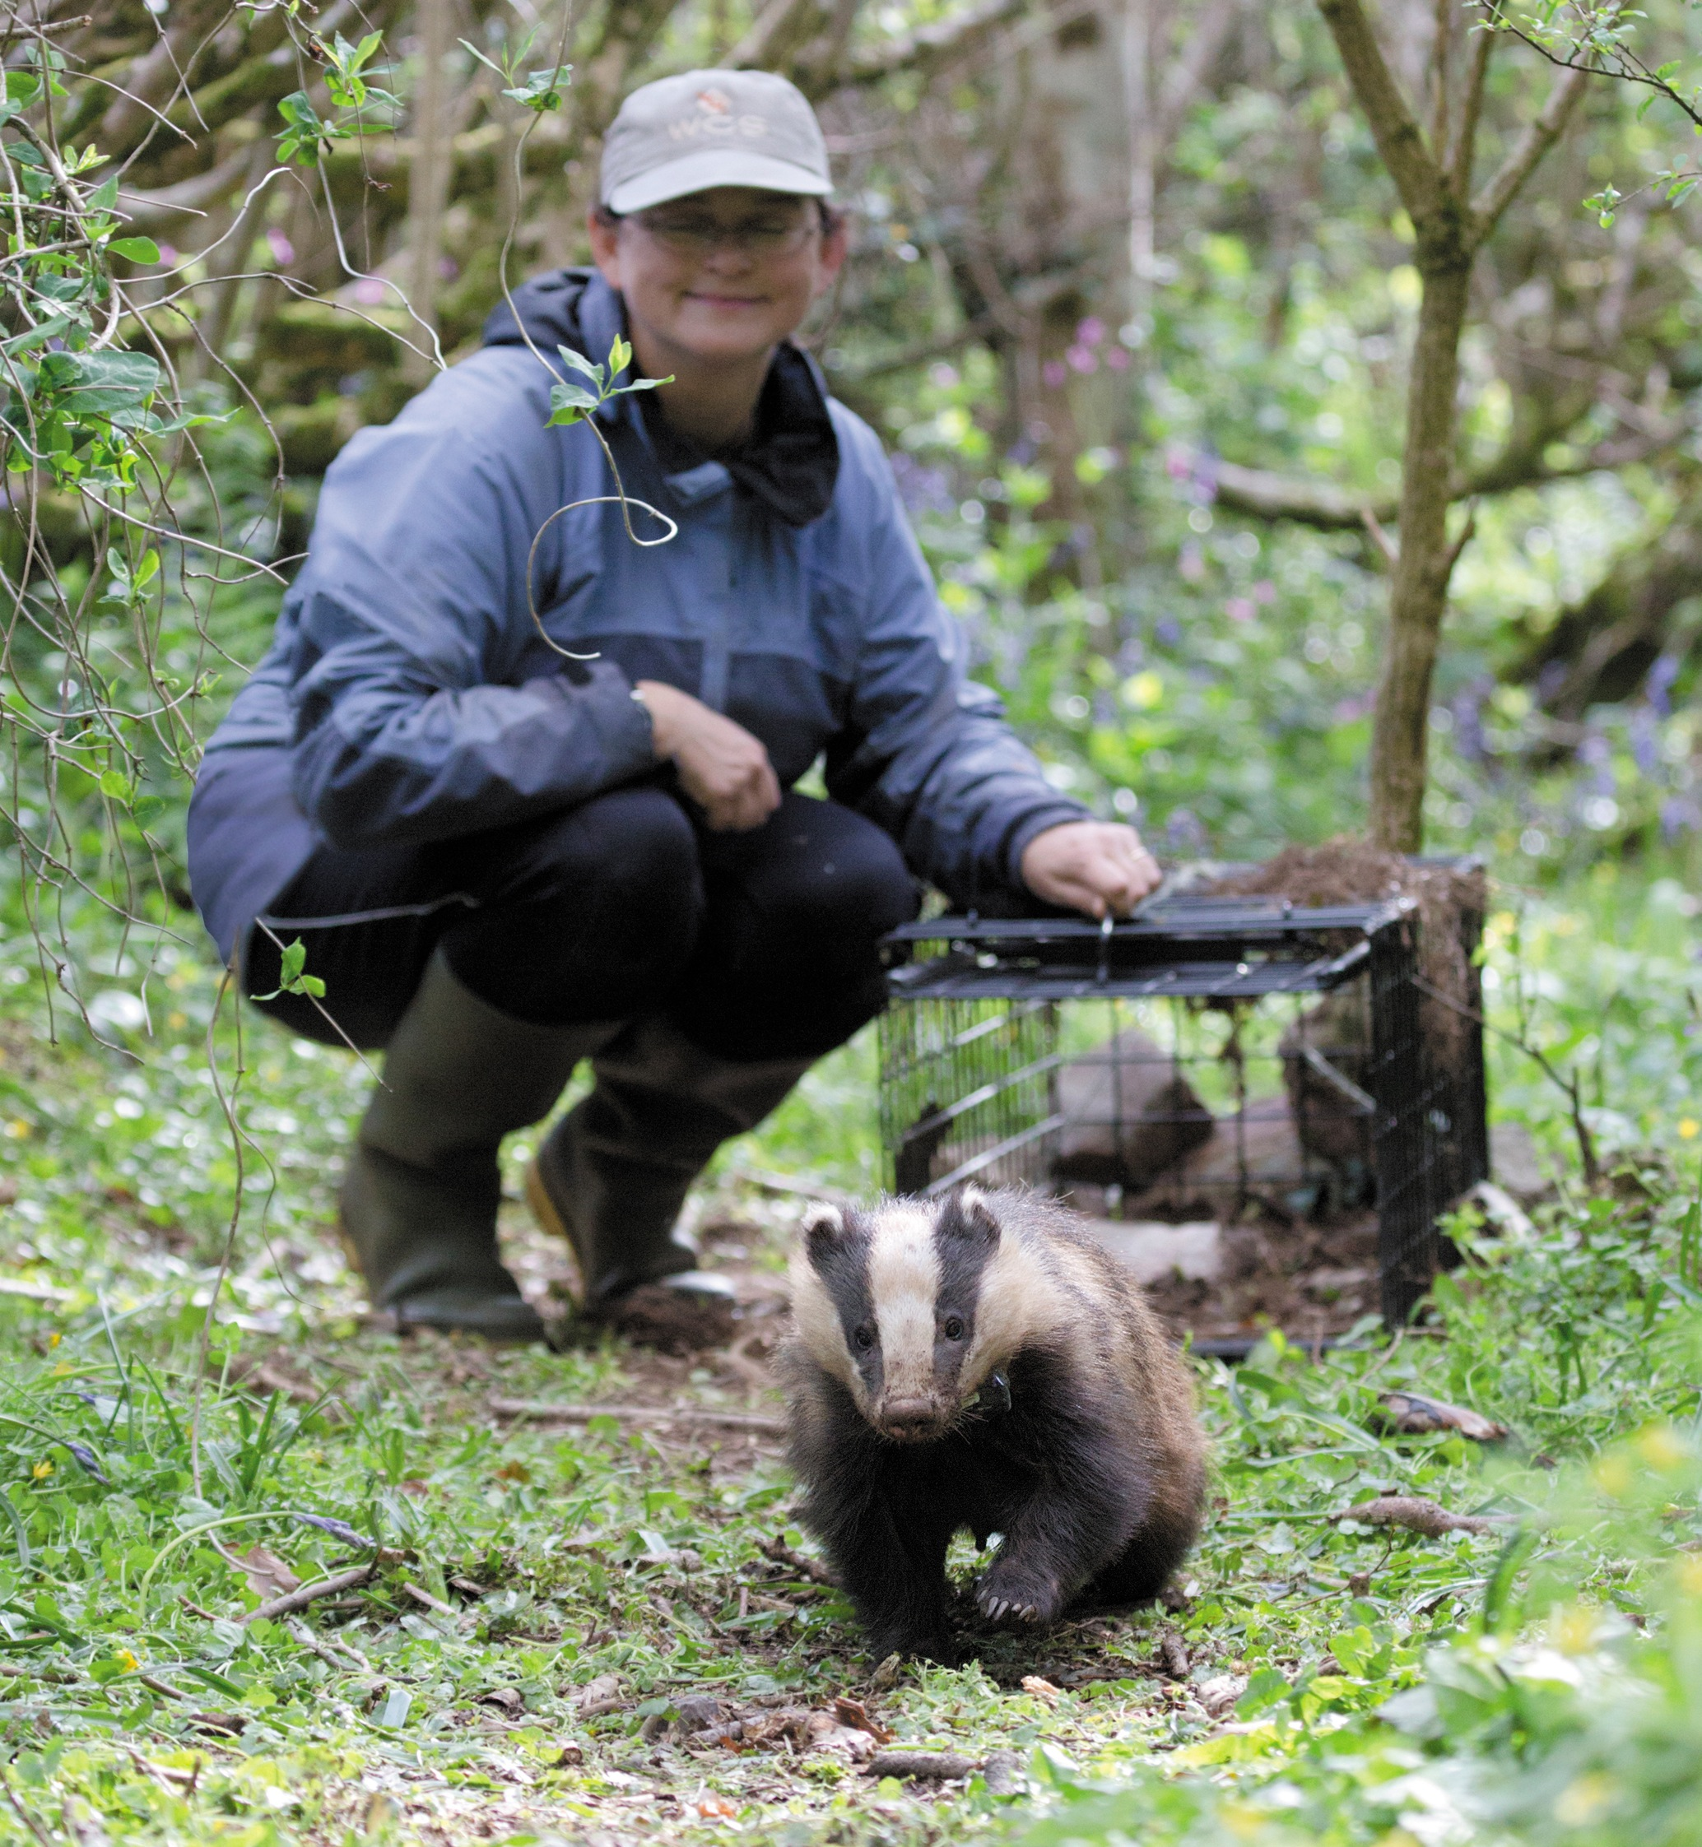

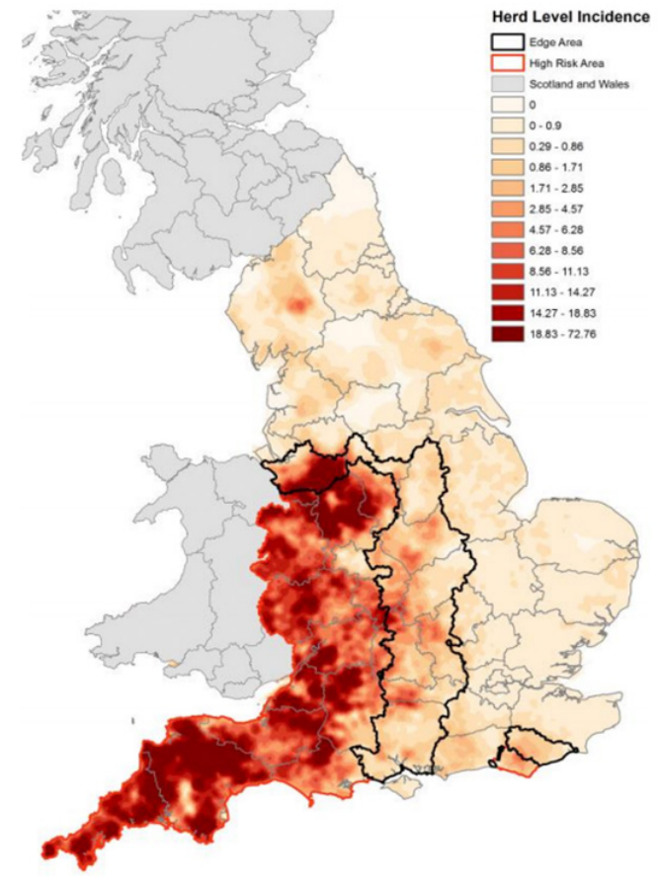
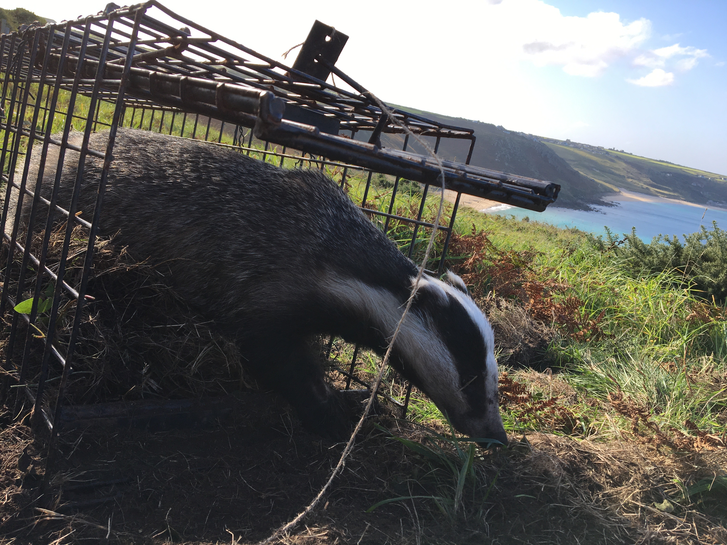
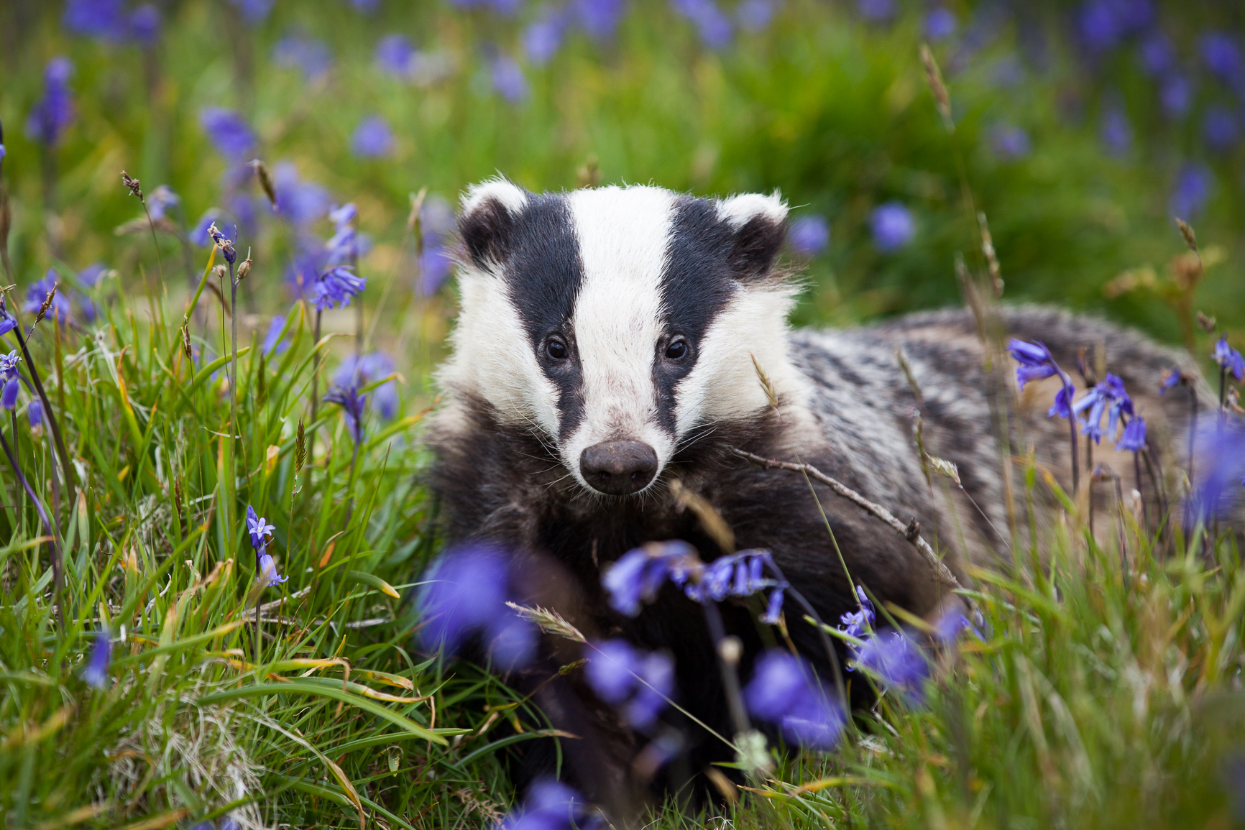










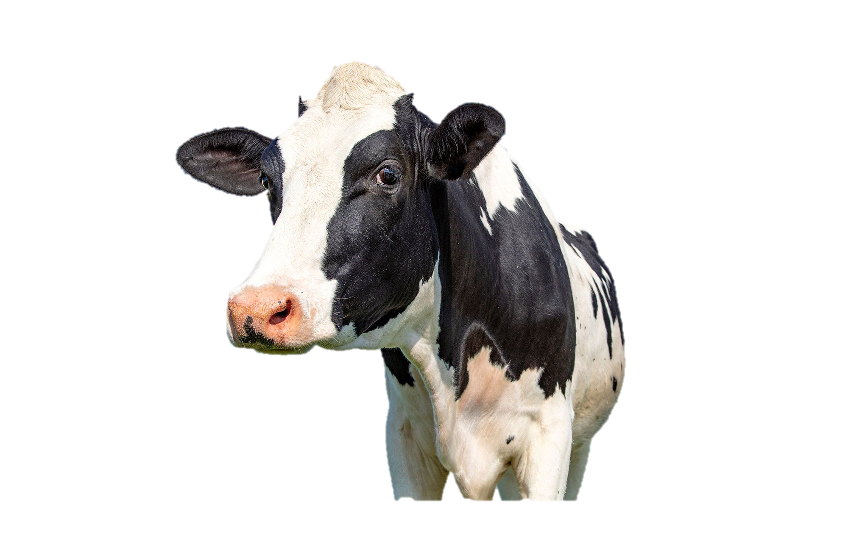
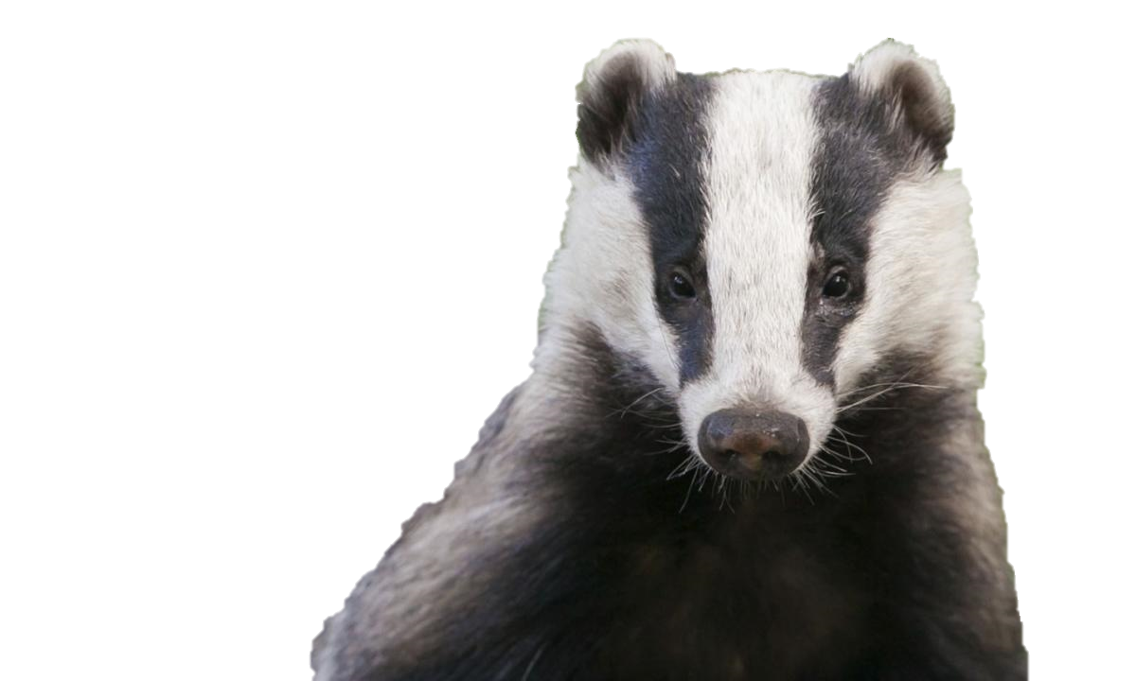
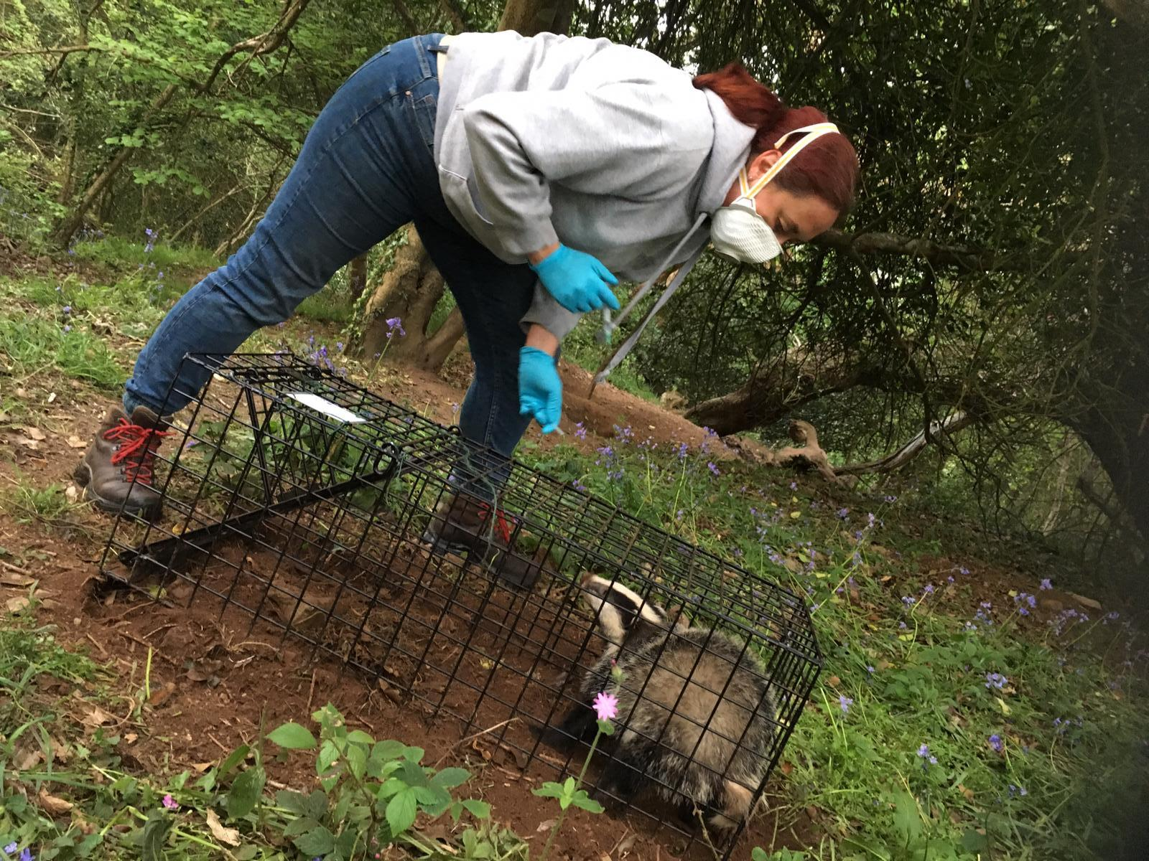
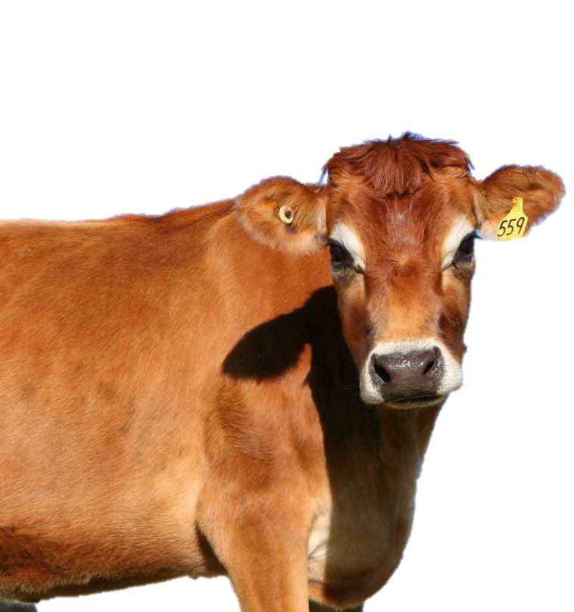
Bovine tuberculosis: a social-ecological systems approach to the latest chapter in Britain's long-running countryside saga
Henry M.J. Grub^{1,2}, Caroline Howe¹, Rosie Woodroffe²
¹Centre for Environmental Policy, Imperial College London; ²Institute of Zoology, Zoological Society of London
Research funded by NERC through the Science Solutions for a Changing Planet Doctoral Training Programme (SSCP DTP) at the Grantham Institute, ICL
1. Introduction & Framing
Bovine tuberculosis (bTB) disease leads to the mandatory slaughter of 30,000 UK cattle each year¹. Badgers are also a prominent host of the disease, known to infect cattle (and vice versa). We propose that the disease and its management exist in a social-ecological system (SES), where policy, farming practices, and ecology interact to shape the epidemiological trajectory of the disease.
This research aims to assess the efficacy of control options within the context of a novel SES for a livestock disease, aiding understanding of system-wide decision consequences. We are currently at a point of policy change: the Government has announced the end of general badger culling, to be replaced with badger vaccination².
2. Policy History & Timeline
bTB case numbers significantly rose after the 2001 foot and mouth outbreak¹, to make bTB the UK’s prominent livestock disease issue. In England, the Government introduced licensed culling of badgers, which are a protected species in the UK, to reduce badger population numbers in high-risk areas for bTB and thus reduce transmission to cattle. However, badger culling is highly controversial, and in 2020 the Government announced a huge strategy shake-up that is currently being planned out – phasing out badger culling and bringing in badger vaccination and industry-based practice changes.
1998
Government-funded Randomised Badger Culling Trial (RBCT) begins following Krebs Report
2007
Bourne Report
Submits the findings of the RBCT, showing that badger culling can reduce bTB in certain cases
2013
Government issues the first licenses to ‘cull companies’ to carry out badger culls paid for by farmers
2017
Brunton et al. publish first statistical analysis of industry culls, results are very mixed across the three study counties³
2019
Johnson becomes Prime Minister with a renewed focus in government on animal welfare
2021
Government outlines new strategy, which includes ending widespread culling and replacing with vaccination
2025
Target date for having developed a deployable vaccine for cattle
3. Research Stages
We will undertake a mixed-methods approach, with sub-projects centring around one of four core research aims. This is social-science research, with the underlying data being collected centring on what key stakeholders think, examples of what has worked in the past, and analysis of who stakeholders interact with and how.
1997
Krebs Report
Formally identifies badgers as a wildlife host
2001
Foot and mouth outbreak, nearly 800,000 cattle slaughtered
2010
General Election
Conservatives campaign backing the roll-out of culls as a control measure; go into coalition government
2014
Munro Report
Assesses cull practices, concludes culls were not meeting required welfare or coverage requirements
2018
Godfray Report
Assesses the options for the ‘evolution’ of Government strategy to eradicate bTB (alternatives to culling)
2020
Government responds to Godfray report, indicating desire to phase out culling, pivot to vaccination, launches major consultation
2022
Final culling licenses granted this year, with all current licenses due to expire by 2026 at the latest
2038
End-date for the strategy; eradication of bTB, ending a 40-year saga
Key informant interviews (KIIs): one-to-one with farmers, vets, conservationists, industry leaders and civil servants; thematic analysis (up to 200 people)
Aim 1: ‘The How’: examine what are the barriers to uptake of badger vaccination schemes on English farms
Map of England showing bTB incidence on a heat map scale. Case study sites are numbered:
1 = Cornwall, 2 = Derbyshire,
3 = Sussex
4. Unmatched Count Technique
A method used in conservation science to make estimates of the prevalence of illegal behaviour when it is not possible to ask participants directly⁴. It is known that some farmers illegally lay poison for badgers, but prevalence has never been quantified, so it is unknown whether this will change when culling ends.
5. Social Network Analysis
This social-science technique aims to map connections between stakeholders and assess the structure of networks⁵. In rural farming communities, we will investigate how farmers share information, especially scientific info about vaccination, with each other and seek advice from non-farmers, like vets. By establishing if there are ‘brokers’ or ‘connectors’ that link and leverage networks, Government can target messaging to ensure key network members are correctly informed about policy changes.
Large-scale questionnaire: to farmers throughout England assessing attitudes towards badger vaccination and underlying causes of hesitancy (1000 people)
Aim 2: ‘The Why’: investigate what predisposes farmers to participating with badger vaccination programmes, and how this is influenced
Social network analysis (SNA): how information passes through local rural communities, who major ‘influencers’ are; discover if certain prevailing views stem from certain individuals
Participants approached at agricultural fairs & showgrounds
Aim 3: Explore areas of conflict and synergy between stakeholders on general badger management and broader conservation targets
2
Half are randomly shown activity set A, half shown set B
Unmatched count technique: to estimate the prevalence of illegally laying poison for badgers, i.e. extrajudicial cullings
Set A lists five farming activities, ranging from common to rare
Set B lists the same, plus a sixth option of laying poison
Focus groups: local communities (incl. farmers and vets) simulate negotiating consensus forming to vaccinate an area’s badgers, and what incentives would work
Aim 4: Investigate strategies for policy design aimed at integrating a variety of linked desired outcomes for nature, badgers, conservation and bTB
3
Participant asked simply ‘how many of these have you done in the last month?’
Case studies: compiling examples of how communities have undertaken vaccination projects in three areas of different stages and techniques – Cornwall, Derbyshire & Sussex (see map)
1
Difference in average number of activities undertaken by sets A & B can be interpreted into prevalence
↑ Above: a flow diagram outlining the process for carrying out an unmatched count technique study
Credits & References:
¹Godfray et al. (2013) A Restatement of the Natural Science Evidence Base Relevant to the Control of Bovine Tuberculosis in Great Britain. Proceedings of the Royal Society B, 280 (1768), 20131634.
²DEFRA (2020) Next Steps for the Strategy for Achieving Bovine Tuberculosis Free Status for England. Published on gov.uk.
³Brunton et al. (2017) Assessing the Effects of the First 2 Years of Industry‐led Badger Culling in England on the Incidence of Bovine Tuberculosis in Cattle in 2013–2015. Ecology and Evolution, 7(18), 7213–30.
⁴Hinsley et al. (2019) Asking sensitive questions using the unmatched count technique: Applications and guidelines for conservation. Methods in Ecology and Evolution, 10(3), 308-319.
⁵de Lange, Milner-Gulland & Keane (2019) Improving Environmental Interventions by Understanding Information Flow. Trends in Ecology and Evolution, 34(11), 1034-1047.
Photo credits: Steve McKendrick, Steve Race, Clara Bastian, Keith Broomfield, Rosie Woodroffe
Map credit: Godfray et al. (2018) Bovine TB Strategy Review. Published on gov.uk.
6. Conclusions & Outputs:
This project aims to make multiple recommendations for policy-makers and stakeholders about how best to design the roll-out of new vaccination policy, drawing on SNA, direct feedback and case study examples. A novel SES framing of this area will help with understanding knock-on effects of decisions.

