Slide 1
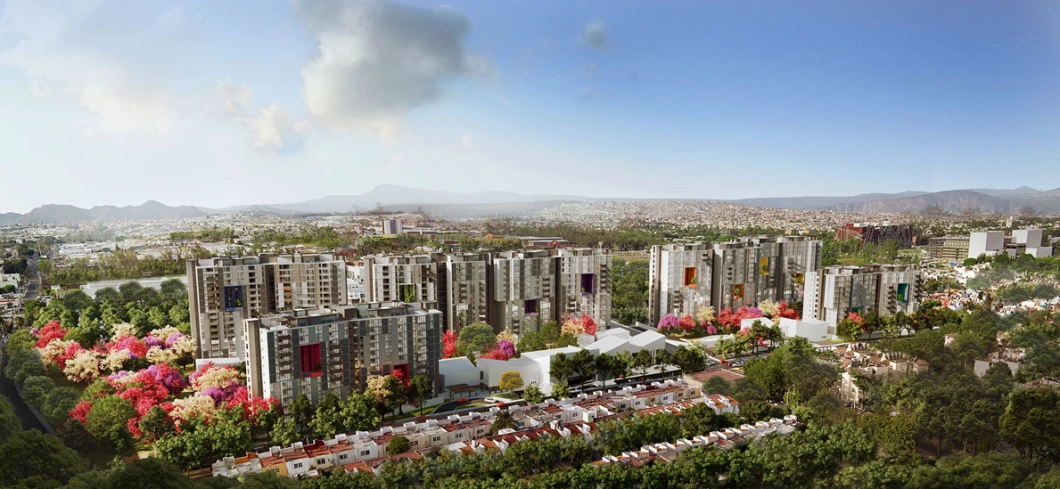
Healthy Low-carbon transitions in cities:
The role of stakeholders in the delivery of regulatory frameworks in Guadalajara, Mexico.
Leonardo Zea Reyes
Supervisors: Audrey de Nazelle,
Clive Potter

Slide 2
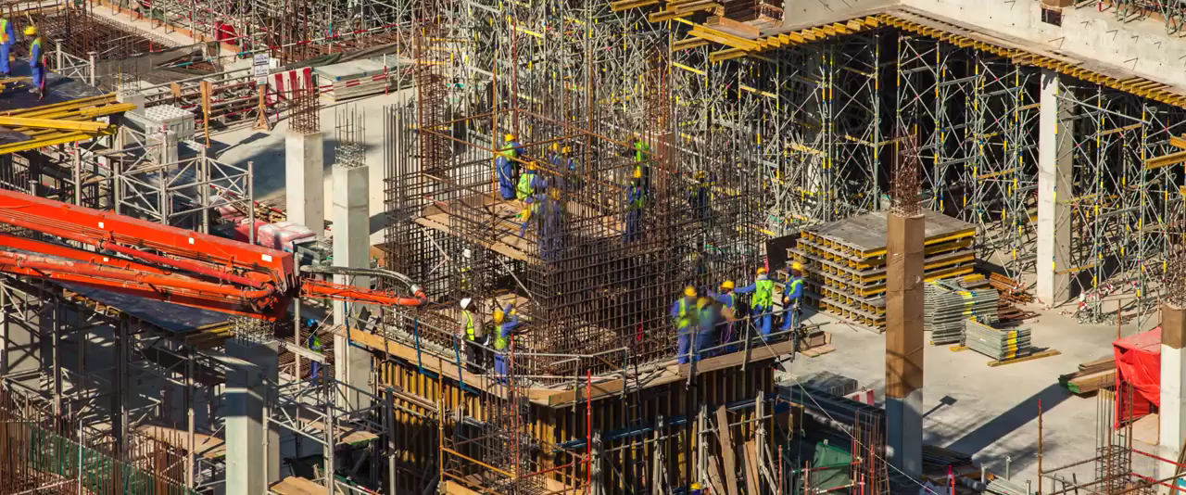
Jobs
Massive transport
Leisure
Health services
Education

Slide 3
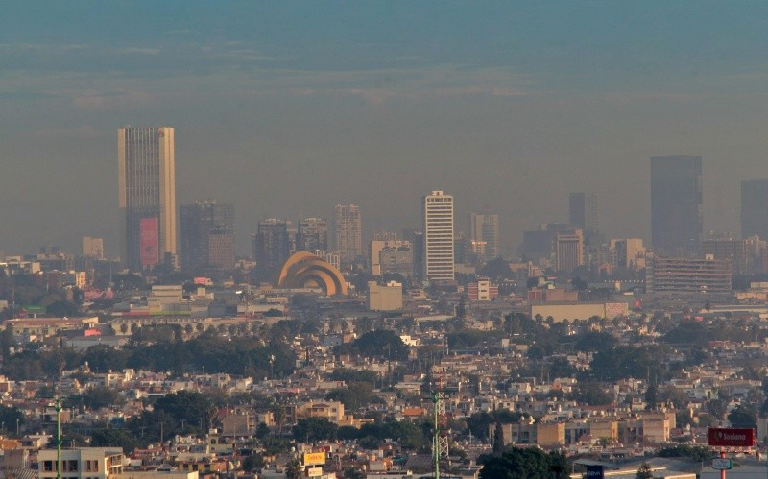
Cities generate 70% of CO2 emissions.
This has high impacts on our health and wellbeing!
UN-Habitat, 2016
(photo of Guadalajara, Mexico)
The building sector consumes 40 % of the energy.
(Energy information administration, 2006; Hossaini, Hewage and Sadiq, 2015)

Slide 4
Low carbon buildings (to reduce GHG emissions) are an opportunity to promote physical and mental health

Slide 5
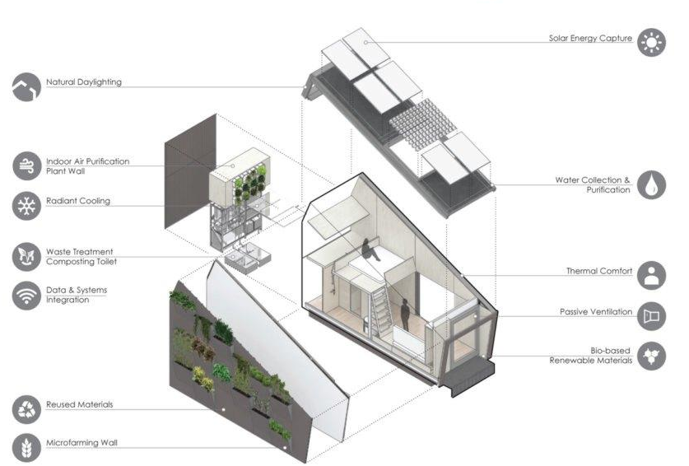
Human health strategies
Environmental health strategies…

Slide 6
…but not enough has been done!
Reframing climate change as a public health issue may be useful in enhancing public engagement and robust acceptance of low carbon policies
(Maibach et al., 2010; Myers et al., 2012; Workman et al., 2016)

Slide 7
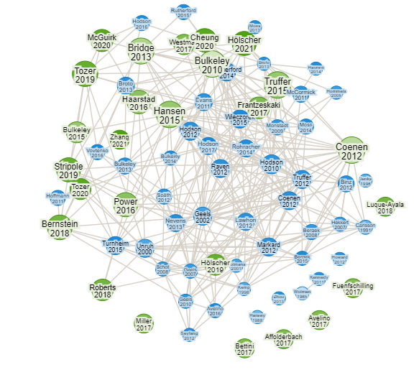
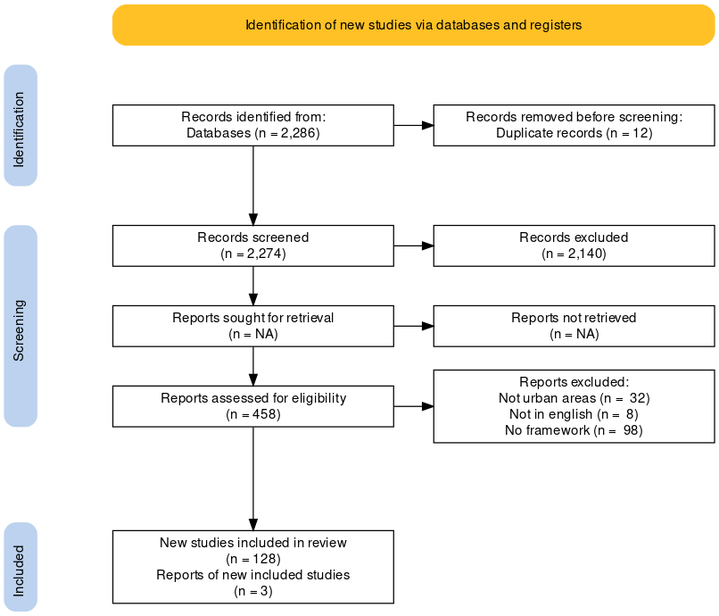
So, as part of my research…Conducted an Overview review to summarize where the LCT stands, describe its characteristics, and find gaps!
Why? There is little knowledge on how the LCT is put into practice.
How has the governance/politics of the low carbon transition been broadly conceptualised?
(1) Research Rabbit
(2) Systematic review process (PubMed, Scopus, Web of Science) helped by Covidence

Slide 8
Overview review: Key points - Models
What
Who
How
Where
Ideal governance conditions favorable to facilitate transitions
Identification of actor constellations and relationships
Focus on the big picture - process to make transitions happen
-grounded approaches to power relationships among stakeholders
Acknowledge the materiality as one more element in conceptualisations
-More pragmatic, connect the what, who, how to the where
- Focus on material implementation (then see what happens)
Characteristics / focus
Frameworks difficult to operationalise
Studies tend to only identify actors rather than studying in depth through which mechanisms actors promote or block decarbonisation
Perhaps too general
- Space is seen as something that will change as a consequence of an energy transition
- Surprising lack of visual frameworks
Critic
GAP
The health dimension hasn’t been integrated in the LCT literature, let alone in LCT in buildings
What promotes/deters the transition?
So…

Slide 9
Aim & Objectives
Analise the extent to which health & wellbeing policy agendas act as catalysts for transitions to low carbon buildings.
Define the role of building regulations in helping to deliver low carbon transitions
Analyse how actors have used health arguments to further promote low carbon transitions.
Analyse the role of stakeholders in shaping/determining the regulatory environment for new constructions

Slide 10
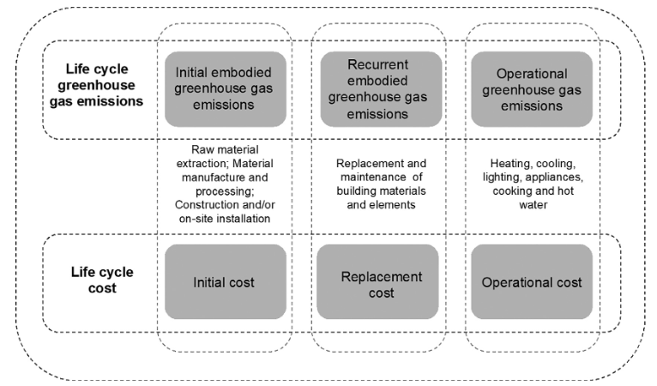
Scoping
Design that reduces GHG during the operation of buildings – Ongoing emissions (residential sector: from small houses to big high-rise developments)
CapEx VS OpEx
Source: Schmidt, 2018. A framework for the integrated optimisation of the life cycle greenhouse gas emissions and cost of buildings

Slide 11
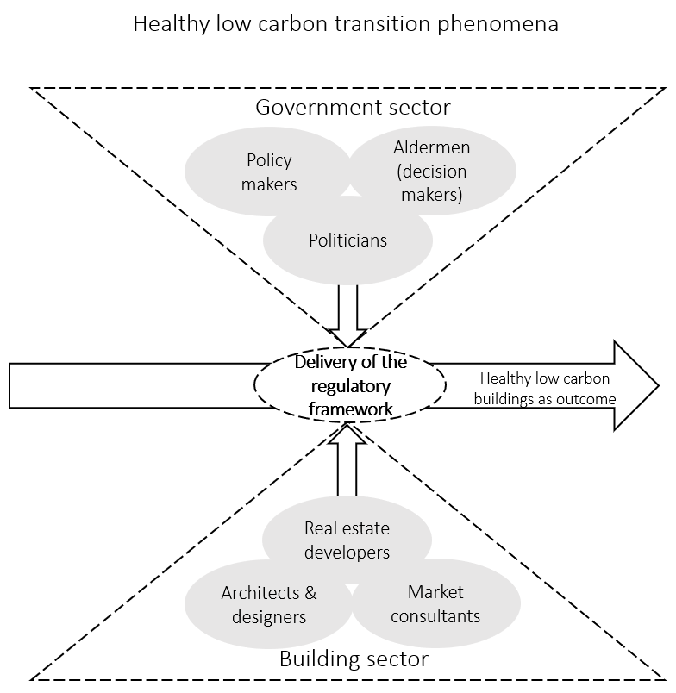
Analytical framework
Focus of AF is on the delivery of the regulatory framework (how effective regulations are, how good or bad is the RF implemented?)
AF will inform the survey design for data collection
Source: Author

Slide 12
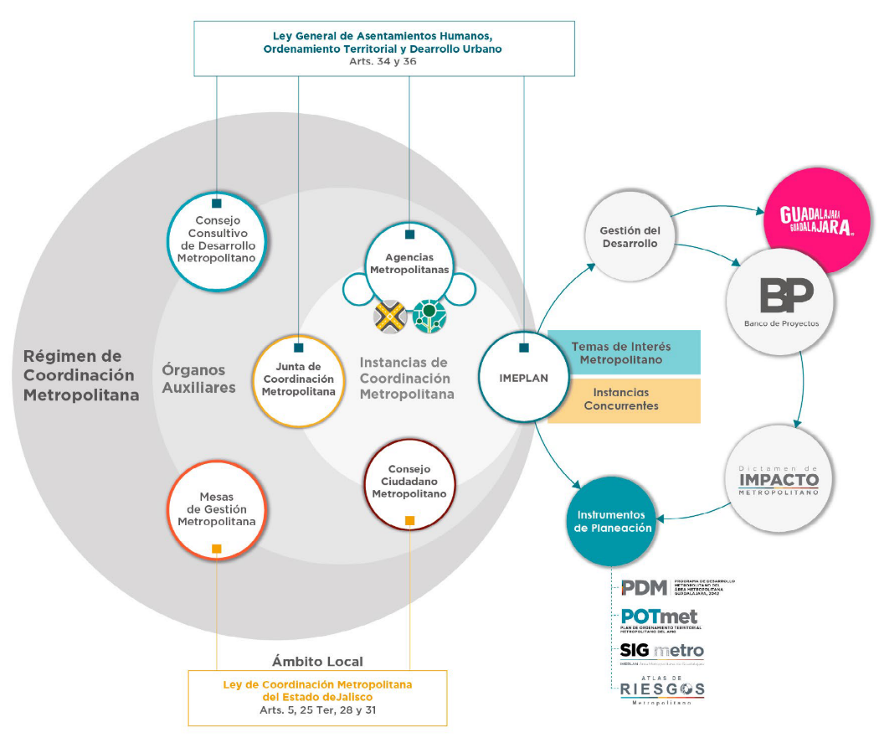
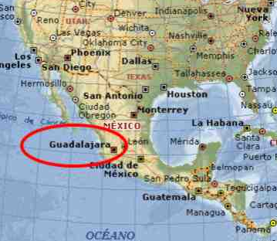
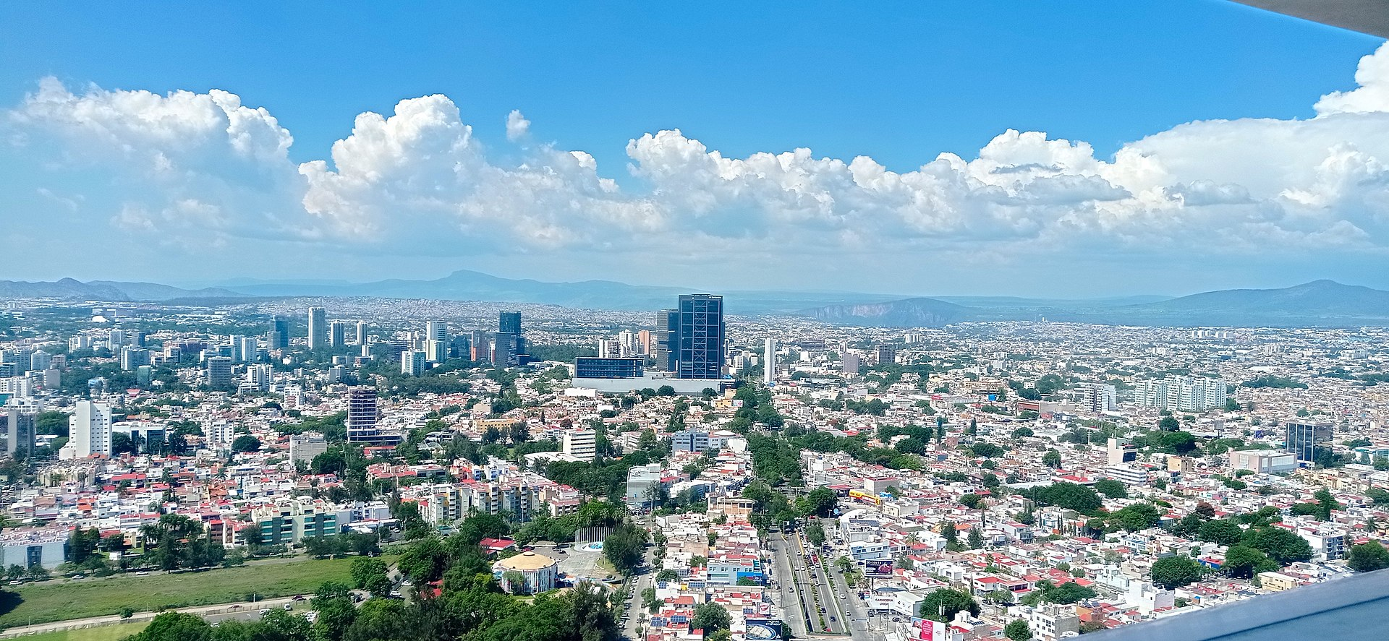
Will apply framework to the Metropolitan Area of Guadalajara: a cutting-edge city in Mexico
It is the only metropolis that has a governance and coordination mechanism that integrates the three levels of government that works to plan, manage, and administer metropolitan public policies

Slide 13
Institutionalisation process of a climate plan in Mexico (building-focused)
Translation issues in the regulatory framework =/ Catalysts
Metropolitan Climate Change Action Plan
Who: Multiple local actors and institutions led by IMEPLAN
Where: IMEPLAN office, metropolitan level
Municipal Program for Climate Action
Who: Municipal climate change unit (office within the environmental department)
Program public consultation
Who: Civil society
Where: In person and online
Program approbation and publication
Who: Aldermen
Where: State Congress, Official State newspaper
Embed program across government departments, not only environmental department (mainstreaming)
Who: General coordination of comprehensive management of the city?
Where: ?
Translate program into new and existing regulations and bylaws
Who: ?
Where: Across government departments
Request new and existing buildings to comply with new regulations and bylaws
Who: Department of Licenses and Permits
Where: across government departments
Metropolitan Development Plan
Who: State Governor
Where: State level
Will apply framework to this process: Regulations are good but final result may not match original plans!
There may be translation issues. MLG Identifies where and why these occur and hence facilitates a better understanding of barriers and enablers to influence the transition process
Data will be analysed to assess how regulations are being implemented in different case study contexts and to offer explanations for any differences
Source: Author

Slide 14
Methods:
Comparative case analysis of municipalities
Pilot survey and/or interviews
Surveys and/or Semi-structured interviews with stakeholders
Thematic analysis

Slide 15


Thanks
Contact: l.zea-reyes20@imperial.ac.uk
June 2022

Slide 16
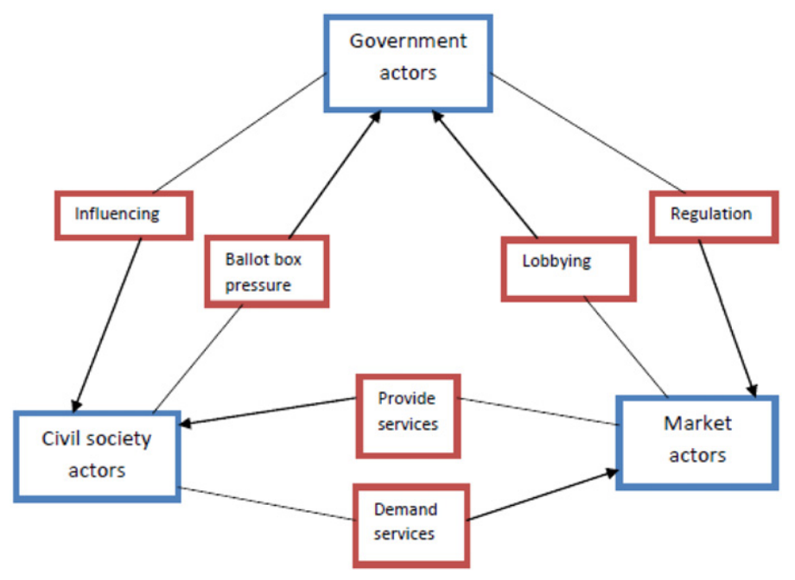
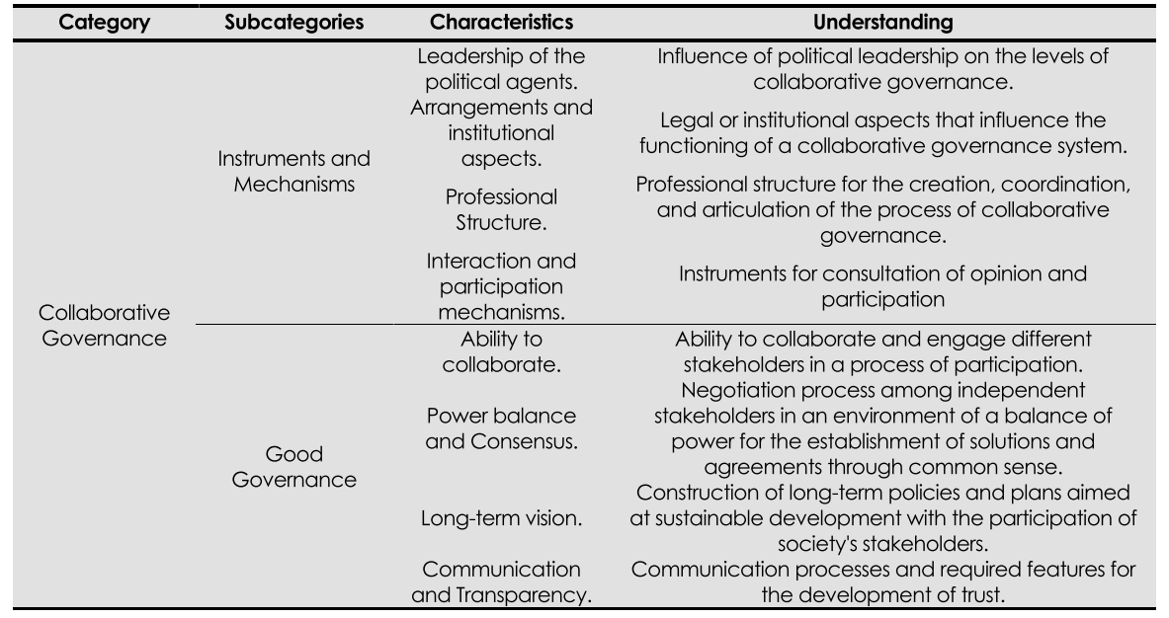
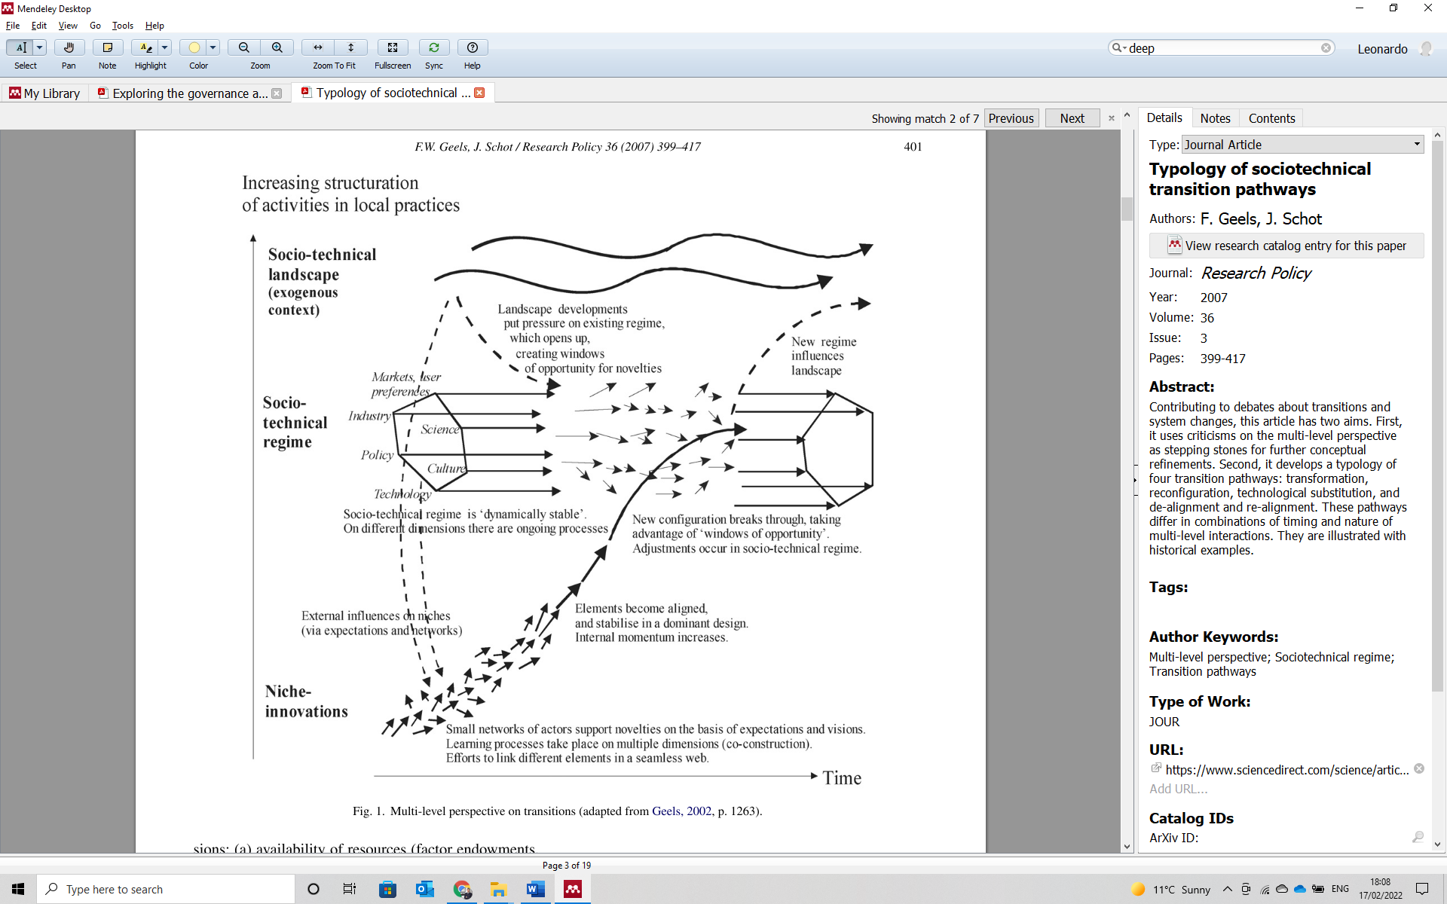
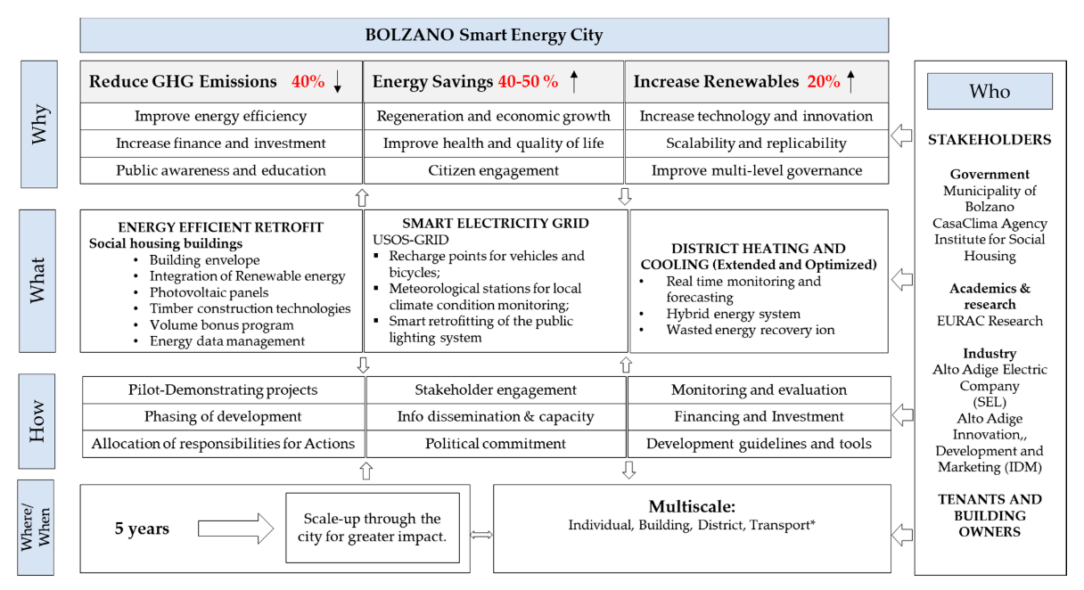
Source: Conti et al (2019)
What model example
Who model example
Source: Hughes, Strachan and Gross’ (2013)
How model example
Where model example
Source: Geels and Schot (2007)
Source: Hunter, Vettorato and Sagoe (2018).

