Slide 1
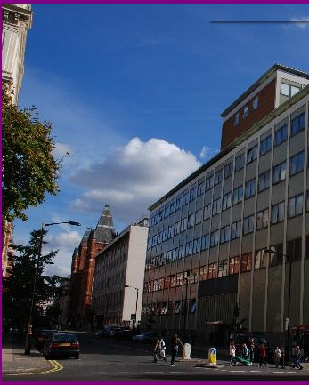




Welcome to the Blackett Laboratory
Ben Sauer, Director of Postgraduate Studies

Slide 2
Being a postgraduate
You are professionally qualified!
You have standing in the physics community
You are students in that you are still studying
so
You should expect to be treated with professional respect
You should treat others with professional respect

Slide 3
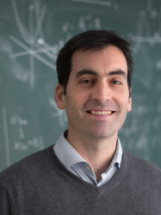
Department of Physics
Light
Matter
Particles
High Energy Physics
Space, Plasma and Climate
Space and Atmospheric Physics
Plasma Physics
Universe
Astrophysics
Theoretical Physics
Professor Stefan Söldner-Rembold Head of Department
Professor Carlo Contaldi
Deputy Head of Education
Staff
100 Academic Staff
150 Research Staff
Students
900 Undergraduates
200 Taught PG (masters students)
330 Research PG

Slide 4
Now meet some more wonderful people
Horacio Septien-Gonzalez & Guhesh Kumaran (Dep Reps)
Jerry Chittenden (PGR Tutor)
Nico Henry (Imperial College Union)
Amaya Calvo Sanchez (Women and Non-binary individuals in Physics)
Yasmin Andrew (LGBTQ+)
Elias Fink (Physoc)
Jake Durrant – ICAH
Paul Seldon, MARS

Slide 5
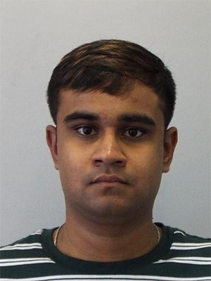
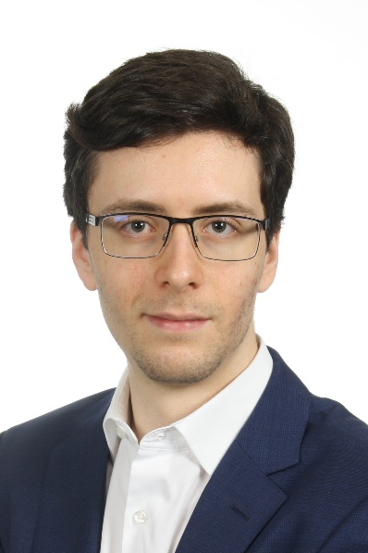
Postgrad Student Reps
Our role
Point of contact between PG students and the department, together with the Community reps
Available to confidentially discuss any potential issues you might have
Organising PG socials and events
FAQs
Don’t hesitate to come to us or your community reps if you have further questions!
Contact us
physics-pg-student-representative@imperial.ac.uk
horacio.septien-gonzalez22@imperial.ac.uk guhesh.kumaran18@imperial.ac.uk
Horacio Septien-Gonzalez
Guhesh Kumaran

Slide 6


OUR
MISSION?
TO BE A HIGH PERFORMING
STUDENTS' UNION RUN BY STUDENTS, FOR STUDENTS.

Slide 7
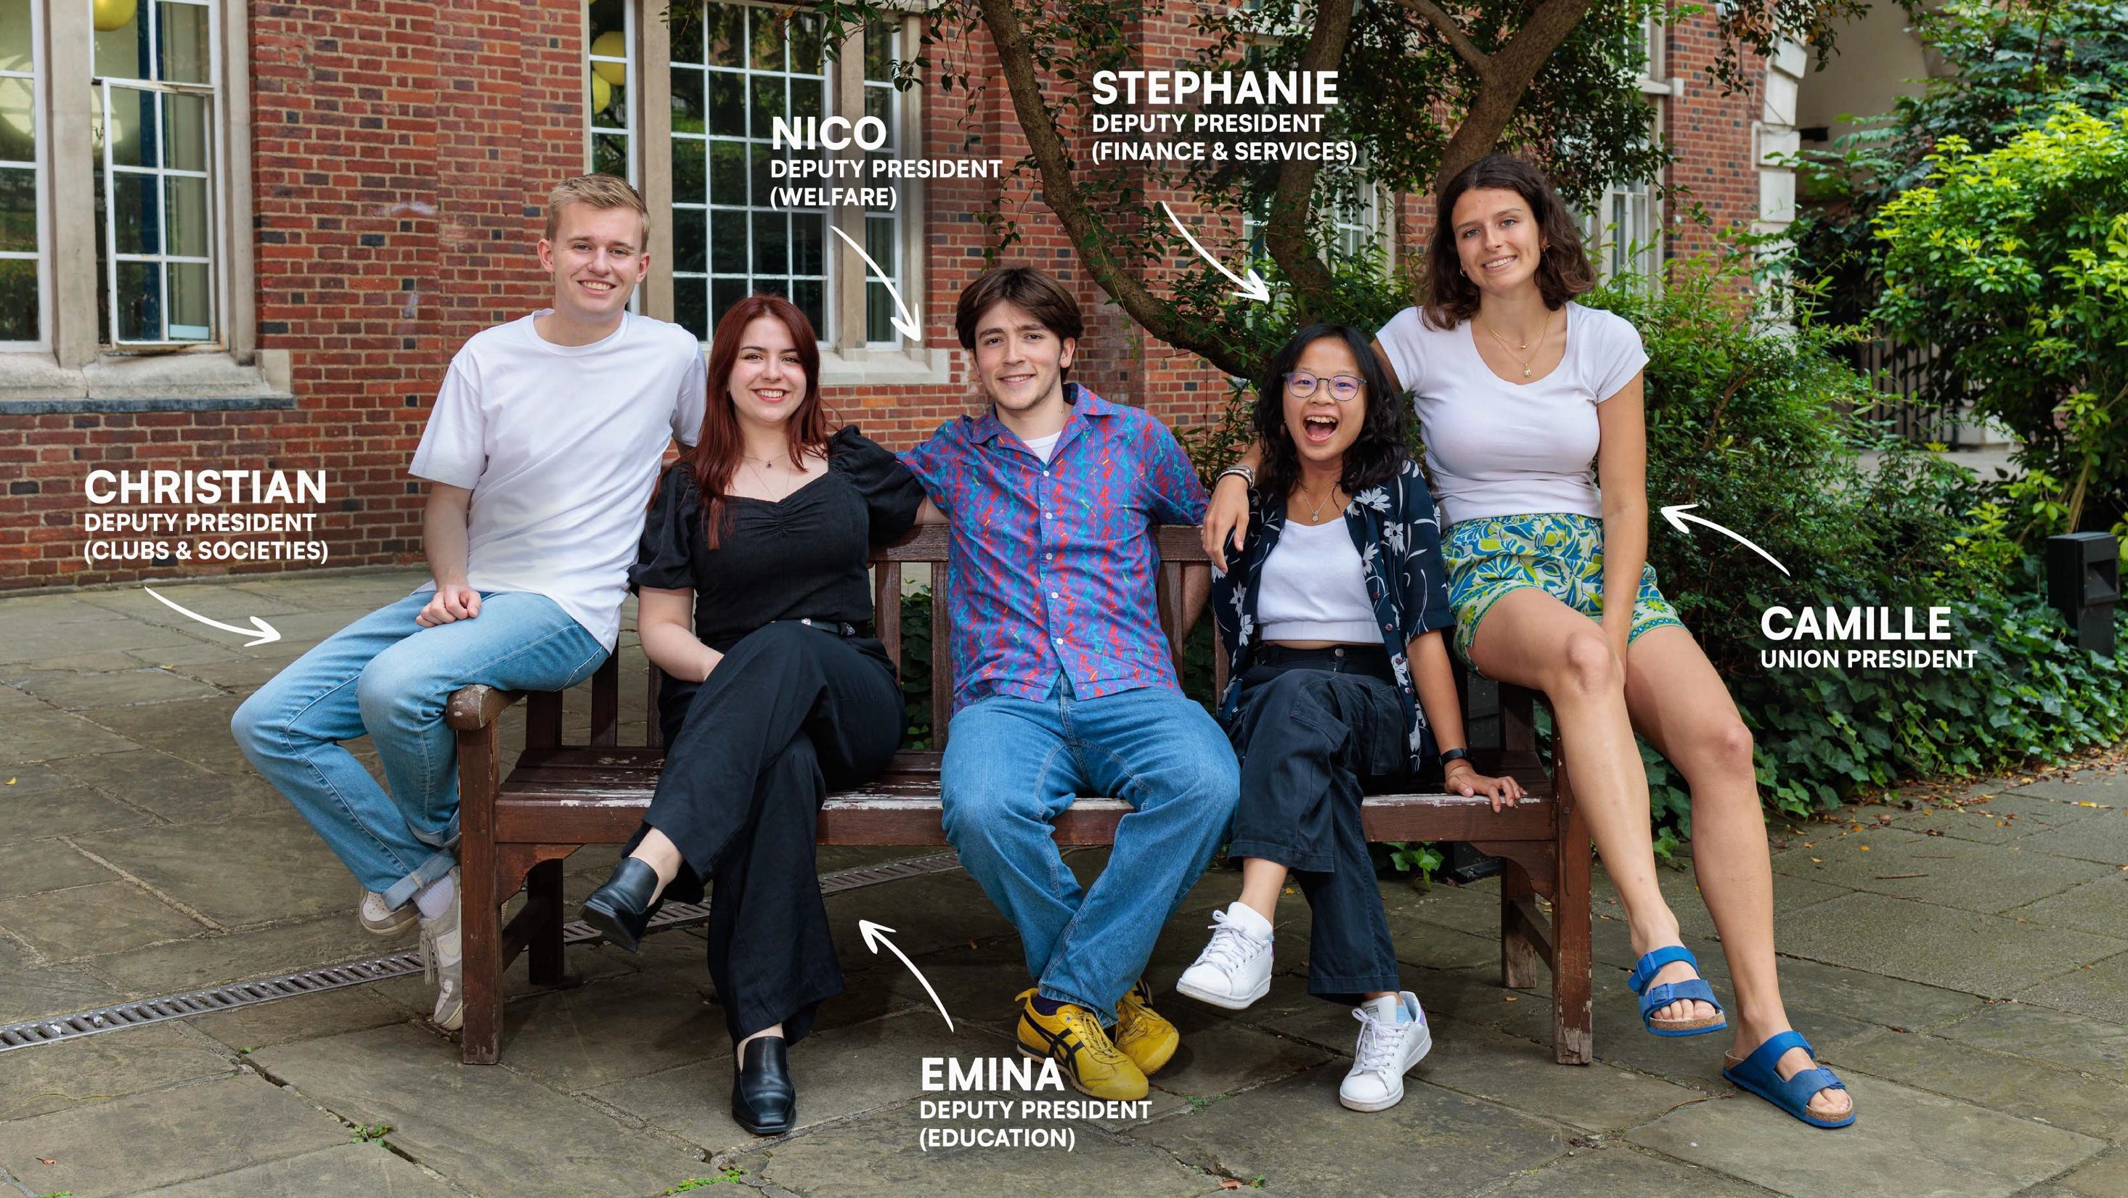

Slide 8

imperial
••• college
union

Slide 9


300+
Academic & Wellbeing Representatives - elected by you
You are represented at multiple levels - year, department and faculty

Slide 10

HOW CAN YOU REPRESENT YOUR PEERS?
Year Level
Reps
Academic & Welfare Officers
(One per Faculty)
Department Level Reps
(One per department)
Rep Chair
(One to represent ALL of you!)
(One per course group)
PGT / PGR

Slide 11
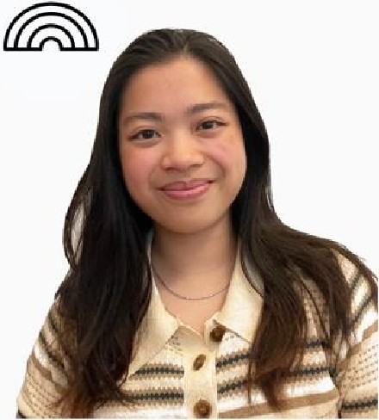
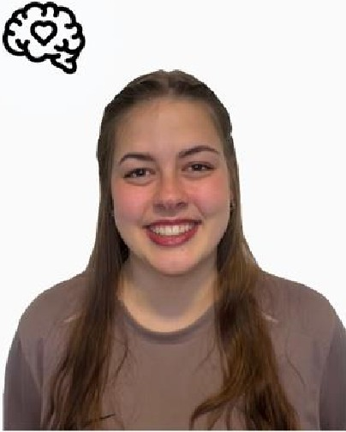
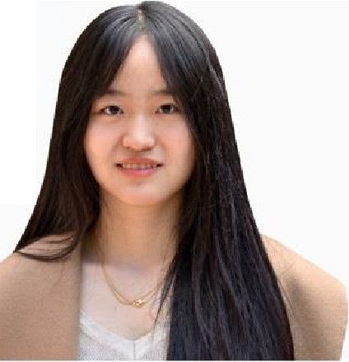
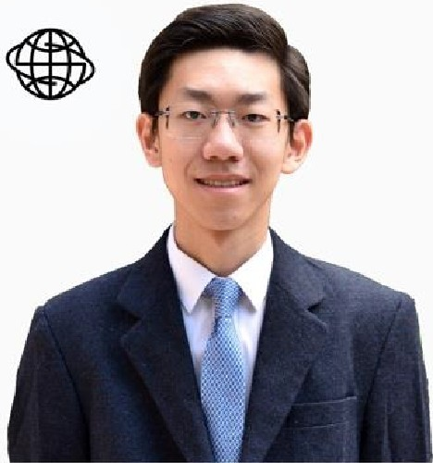
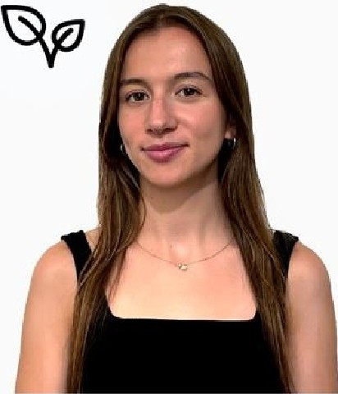
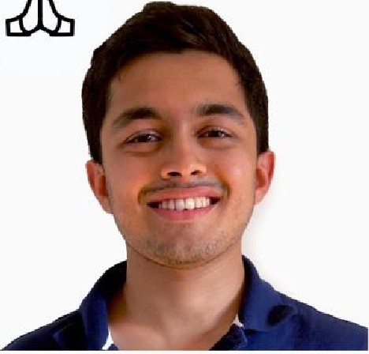

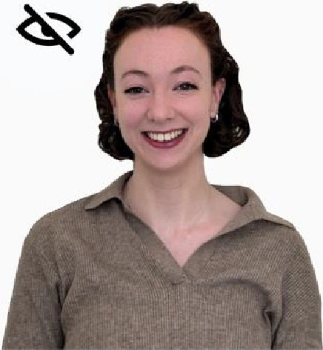
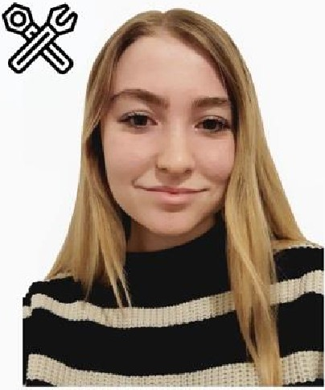

e
ANSON TO
LGBTQ+ Officer
MIRIAM FOULKES
Mental Health Officer
WENDY SONG
Gender Equality Officer
YUANZE XIA
InternationaI Officer
ASHAY DIVEKAR
Interfaith Officer
HOLLIE MEYERS
Ethics & Environment Officer
MAEGAN SPITERI
Disabilities Officer
SCARLETT KILFORD
Working Class Officer
COMFORT OLUWAKOYA
Black & Minority Ethnic Officer

Slide 12
P O S I T I O N S A V A I L A B L E
Campaigns Officer | Welfare Officer | Community Engagement Officer
Join the network committees!

Slide 13





Nominations open
Monday 7th - Tuesday 15 October 2024
Voting opens
Monday 21st - Thursday 24th October 2024

Slide 14
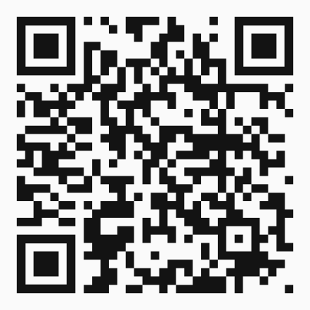
FR E E, N ON - J UD G M E N TA L, CO N F I DE N T IA L A N D I N D E PEN D E N T SER VI C E

Slide 15
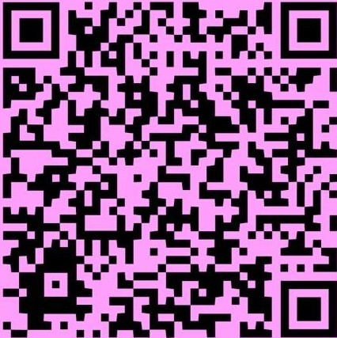


t1
THE
STUDENT CHECKLIST
SCAN ME
The union has developed a checklist to ensure you have everything ready for the year ahead.
Completing it sends you a guide plus enters you into a draw to win up to £500 worth of prizes!
ADVICE SERVICE

Slide 16


ESTABLISHED IN 1949
STORIES AFFECTING YOU
STUDENT RUN
NEWS, PUZZLES, MUSIC, FILM JOIN AS A WRITER!
FELIX: IMPERIAL'S STUDENT NE SPAPER

Slide 17


Slide 18







SPORTS SOCIETIES
RECREATION SOCIETIES
CULTURE SOCIETIES
+
Clubs, Societies and Projects at Imperial College Union - there's something for everyone!
ARTS & ENTERTAINMENT SOCIETIES
KNOWLEDGE SOCIETIES
COMMUNITY SOCIETIES

Slide 19


The Student Experience Fund (SEF) is currently available to lmperial's bursary students.
Increase financial accessibility for students to take part in activities and events at Imperial College Union.
£36k was utilised from SEF last year alone!
STUDENt EXPERI NCE FUND

Slide 20
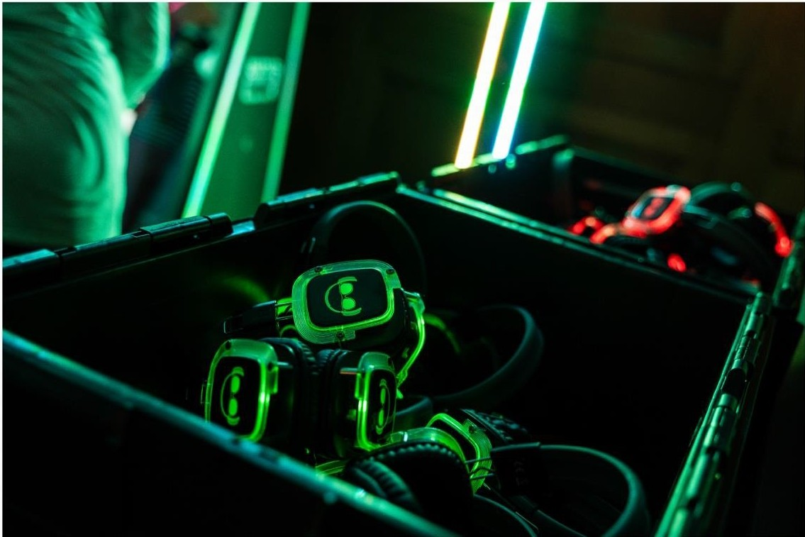
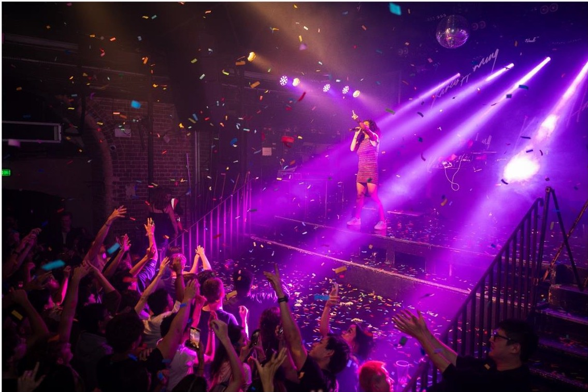
OUR
VENUES
4 bars// Event space// Theatre// Cinema
OUR
EVENTS
Welcome Week // Weekly student events // Annual Summer celebration with over 2,500 attendees

Slide 21









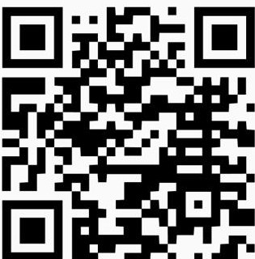


WELC.ME
FAI R
RUN' ;: i
CLUB | \' I GI/
4 OCTOBER (
12:00 | •• ,, .•.
\
WELCeME
WEEK<,..,-,
•· imperial WELC.ME
••tJ₁ eg e W EE K@'-'
Flower Power
40CTOBER
22:00 - 03:00
:J TI a₉
WELCe
WEEK ^{ME}
union
....
INTERNATIONAe,
GATHERING
WELCOME WEEK EVENTS
27 SEPT - 5 OCT
2 0 CT
OBER
12:00

Slide 22
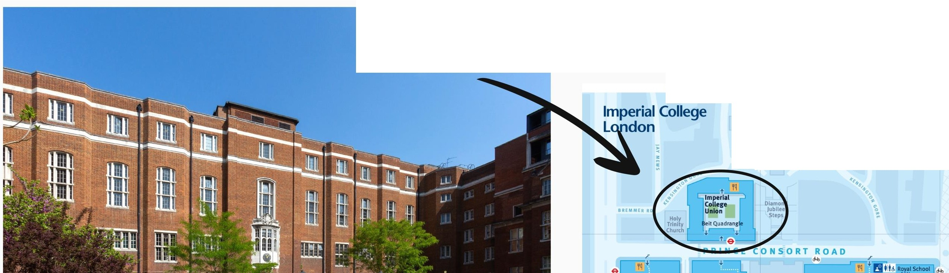


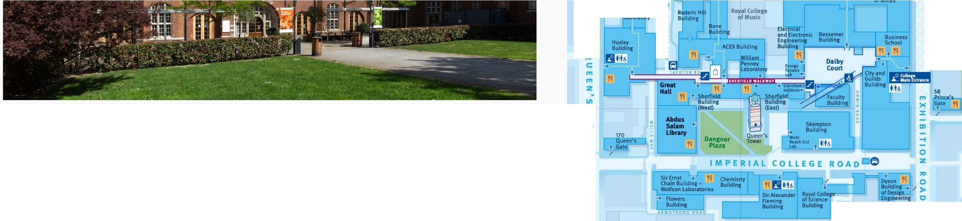


WE'RE HERE!
A
B
C
Roya l Geographical Society
Royal
"''
l v Mt..,,_
Albert Hall •' ,.,
\
150m I
e
>
t
52 ,
,-P rince:-s,
0
>
/ Gate
I)
C:
1q
..,r
f
nc e' s Gate
Prince's Gardens
"'
"_{z}'
Ill Cl
>
e -4
Pl:IH(E'S 611.Tf M(
?
Science Museum
e
-

Slide 23

·• imperial
••• union
coll
ege
imperialcollegeunion.org
{?
Imperial College Union
@icunion
@)
@icunion
er
@imperialcollegeunion
f
@icunionvenues

Slide 24


Slide 26


Designed to assist you turn your ideas into reality by providing
access to the latest prototyping equipment and support
Create prototypes, experiment and refine ideas
Join a community of innovative makers from all backgrounds
Access the latest facilities
1-1 or online support from a team of experts

Slide 27
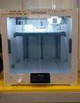
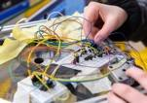
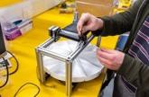
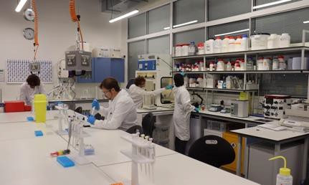
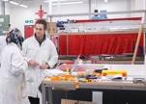
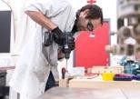
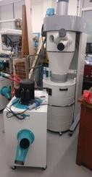
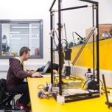
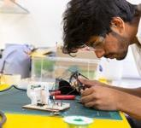

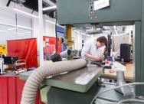
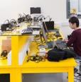
Mechanical
Digital
Biolab
3d printing Oscilloscopes Soldering Laser cutting
Microscope Cell culture lab Bioreactor Autoclave
Large CNC Welding
Milling & Turning Water jet cutting

Slide 28
www.imperialhackspace.com

Slide 29

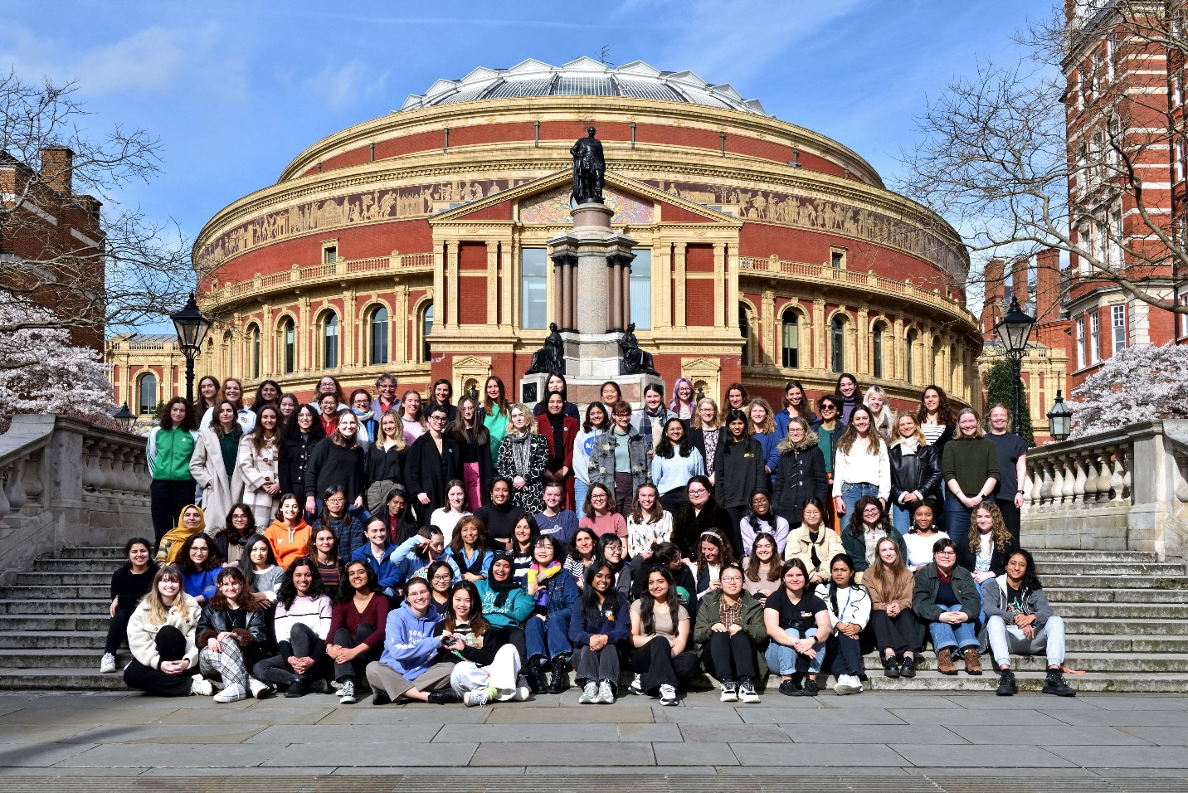
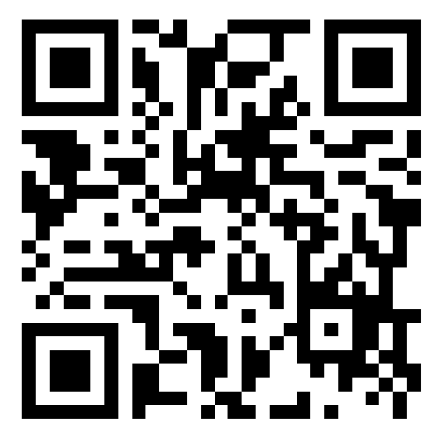
We run social and academic events aiming to create a welcoming, inclusive, and supportive network for women and non-binary people working and studying in physics.
Coming up: GirlsWhoML. Sign up here!
International Women’s Day 2024

Slide 30
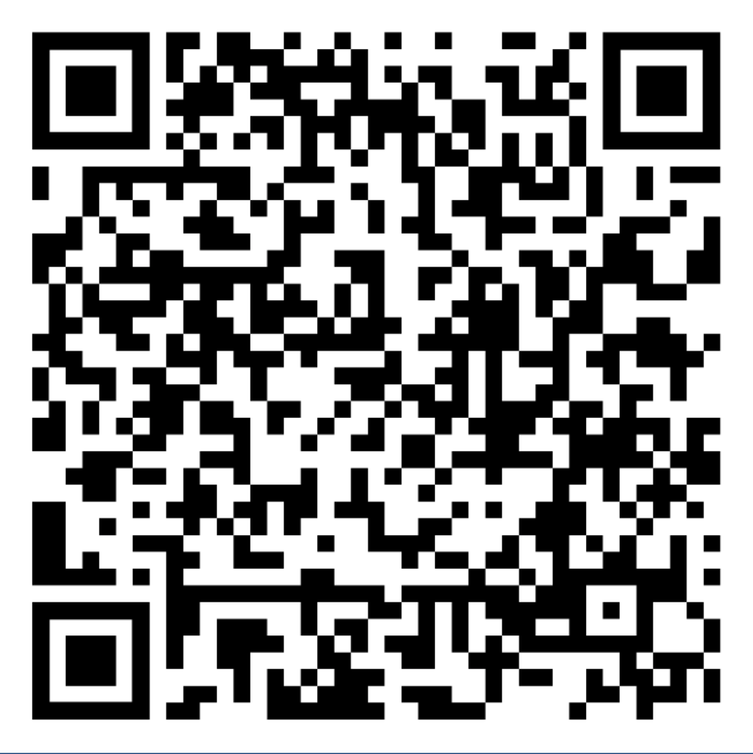
womeninphysics@imperial.ac.uk
@ic_wnbip
Becoming a member is free! Just sign up to the mailing list
International Women’s Day 2024

Slide 31


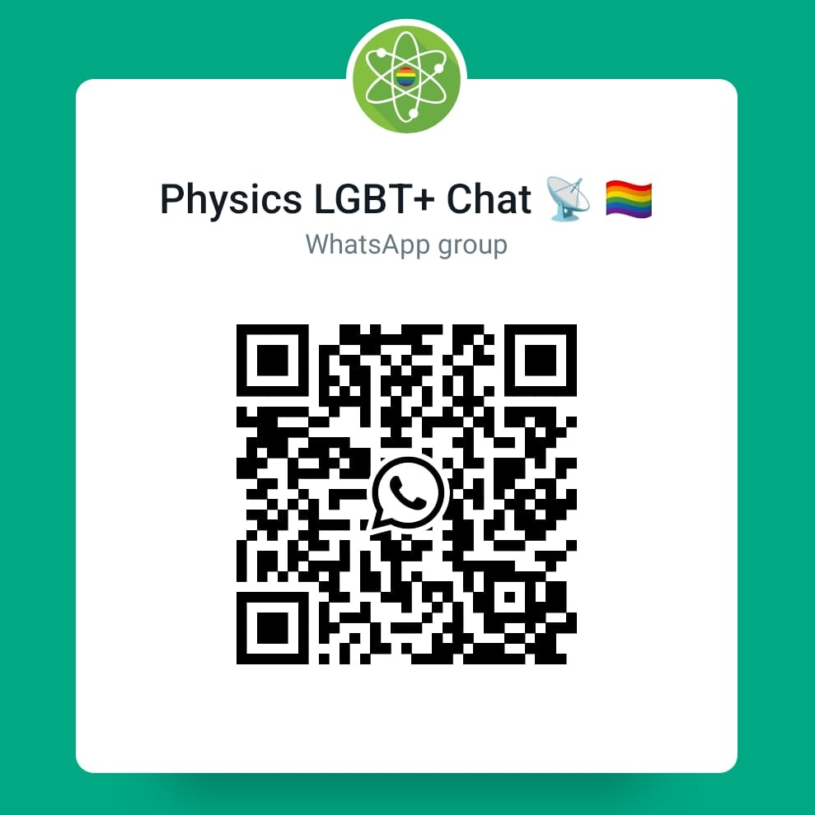
LGBTQ+ Network
A warm welcome from the Physics LGBTQ+ Network!
Regular events
Coffee catch-ups!
Casual union drinks!
An opportunity for us to network and plan events!
Most communication via our WhatsApp community. Join here ---------------------------------->
Physics LGBTQ+ welcome party: date TBC – date to be announced in our WhatsApp community!
We are recruiting students for our committee – let Yasmin Andrew know if interested!

Slide 32

From 1 October 2024
Early Career Researcher Institute ECRI
Graduate School (GS)
+
Postdoc and Fellows Development Centre (PDFC)
Notes:
They will continue hearing and reading documents with our previous names while we transition– be assured that whatever the name, we are ready to support you.

Slide 33
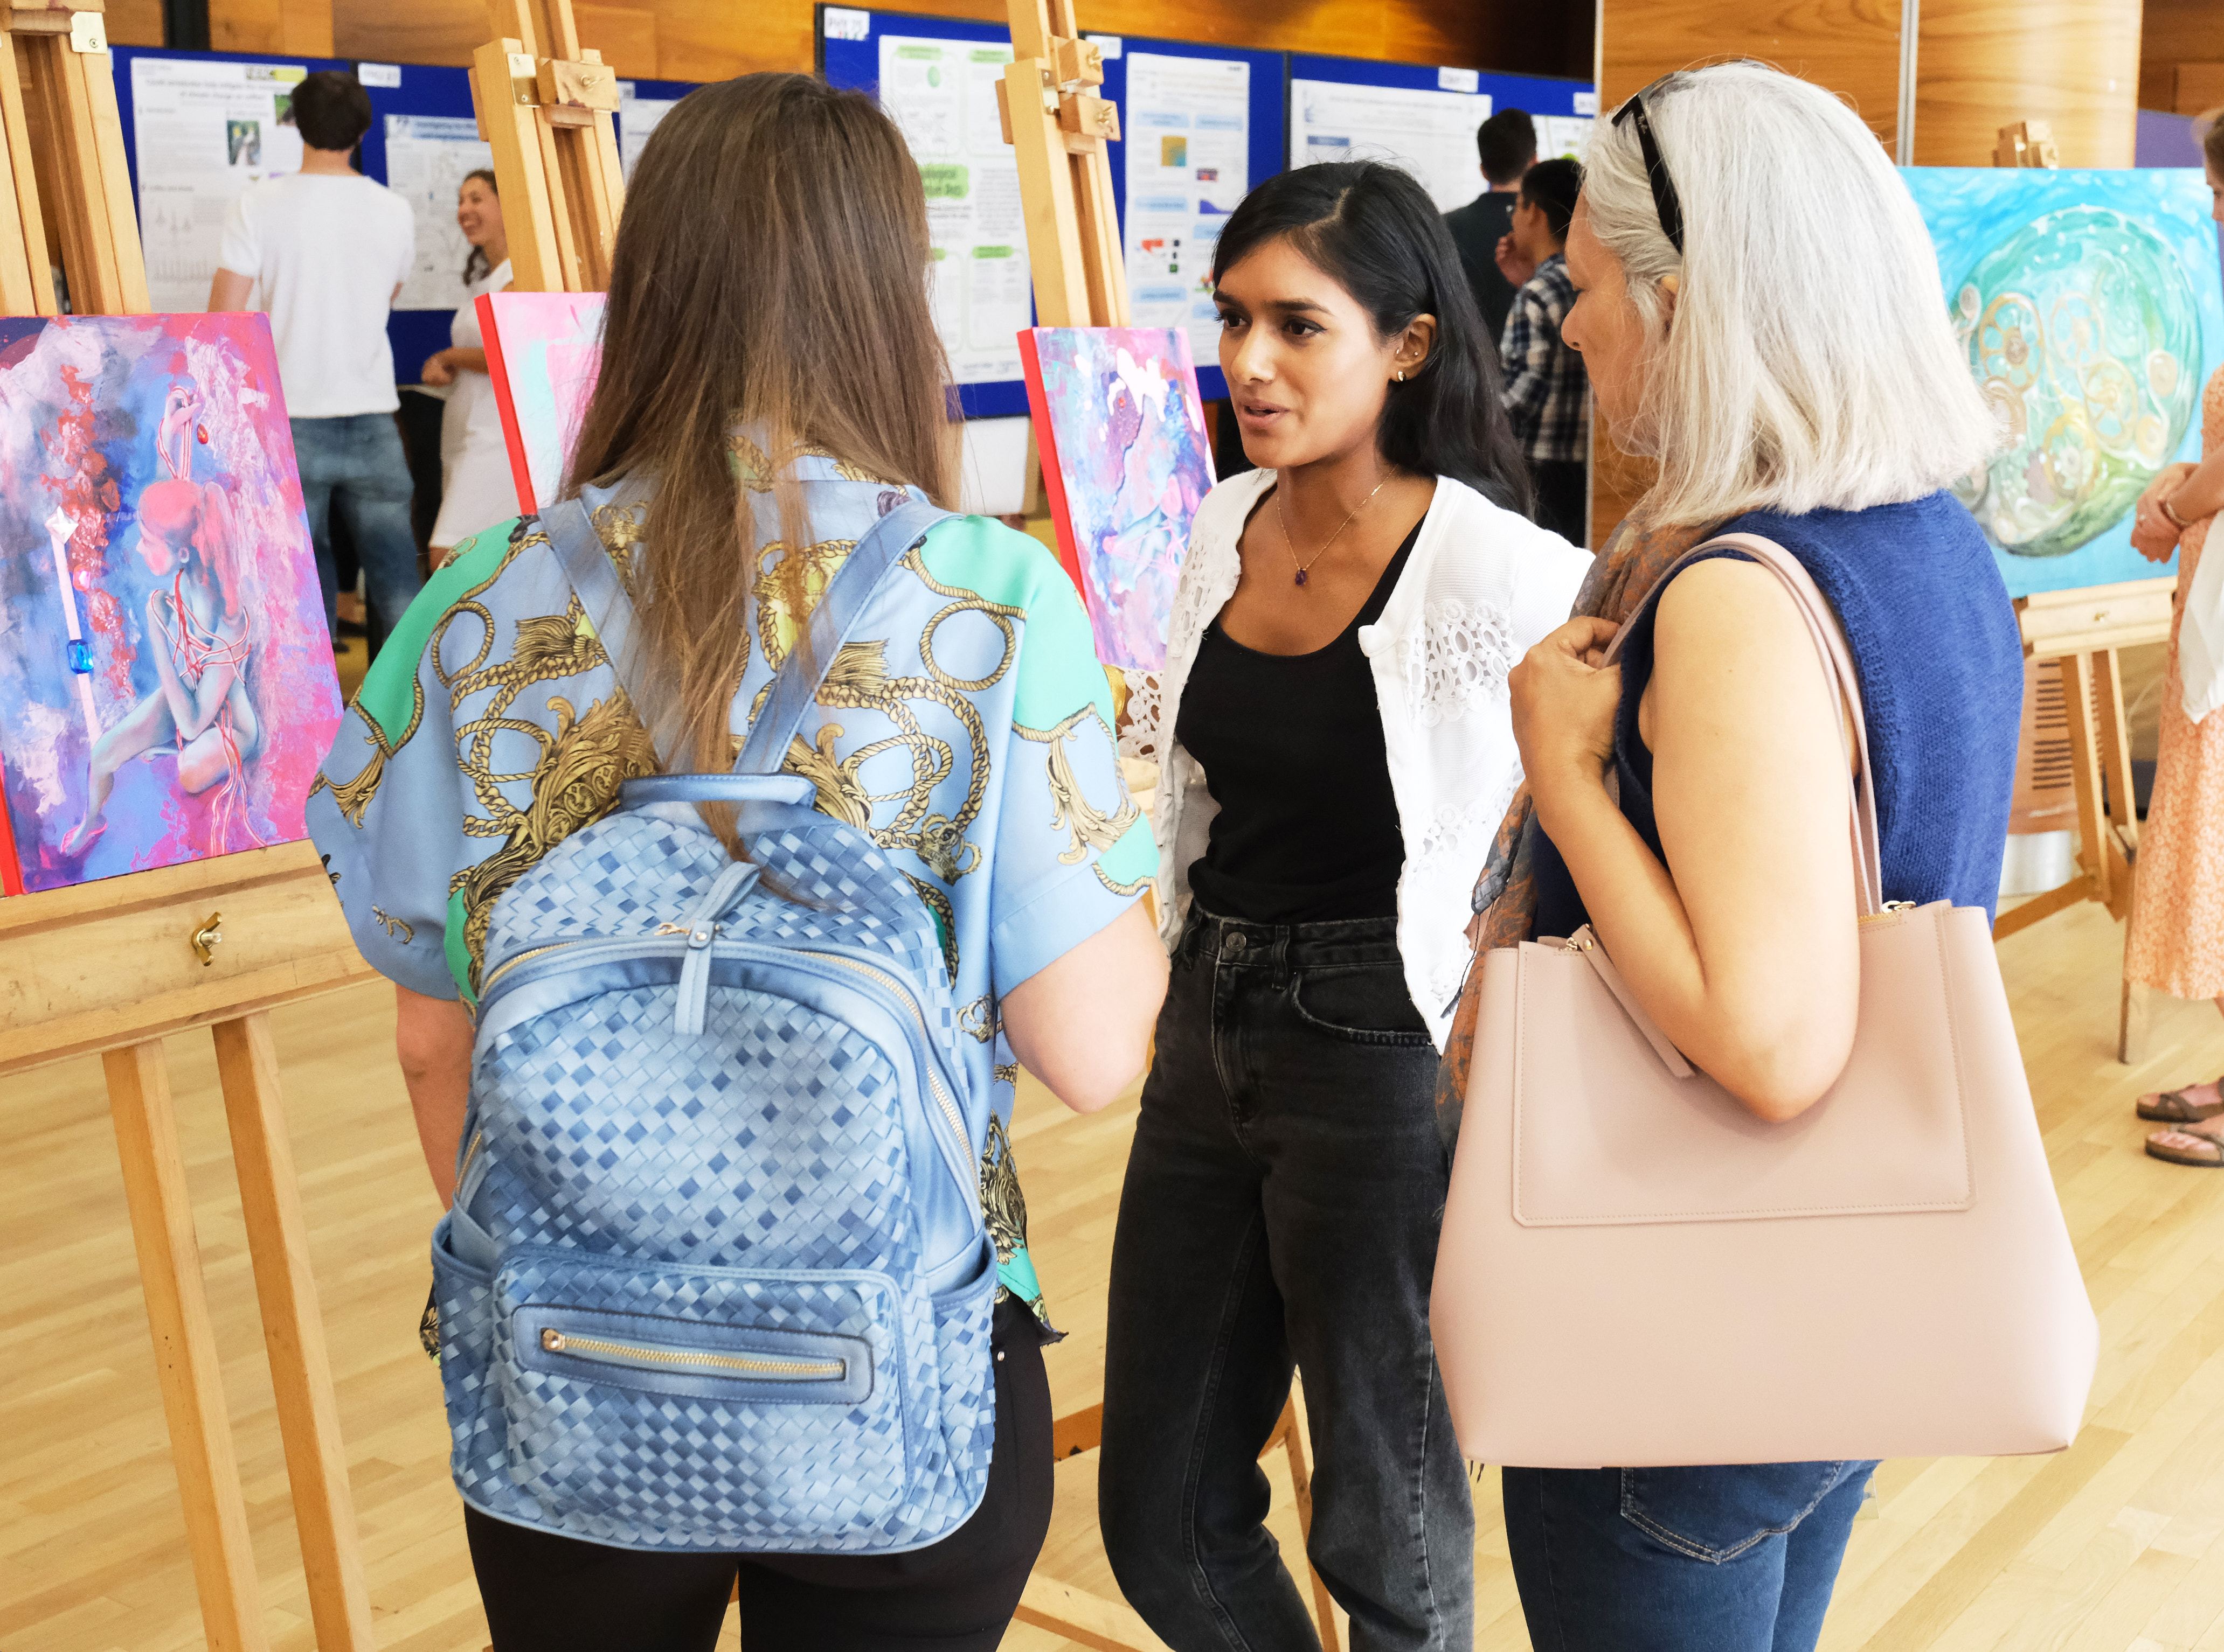
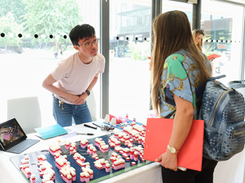
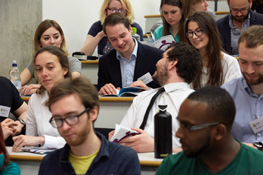
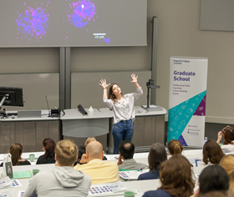
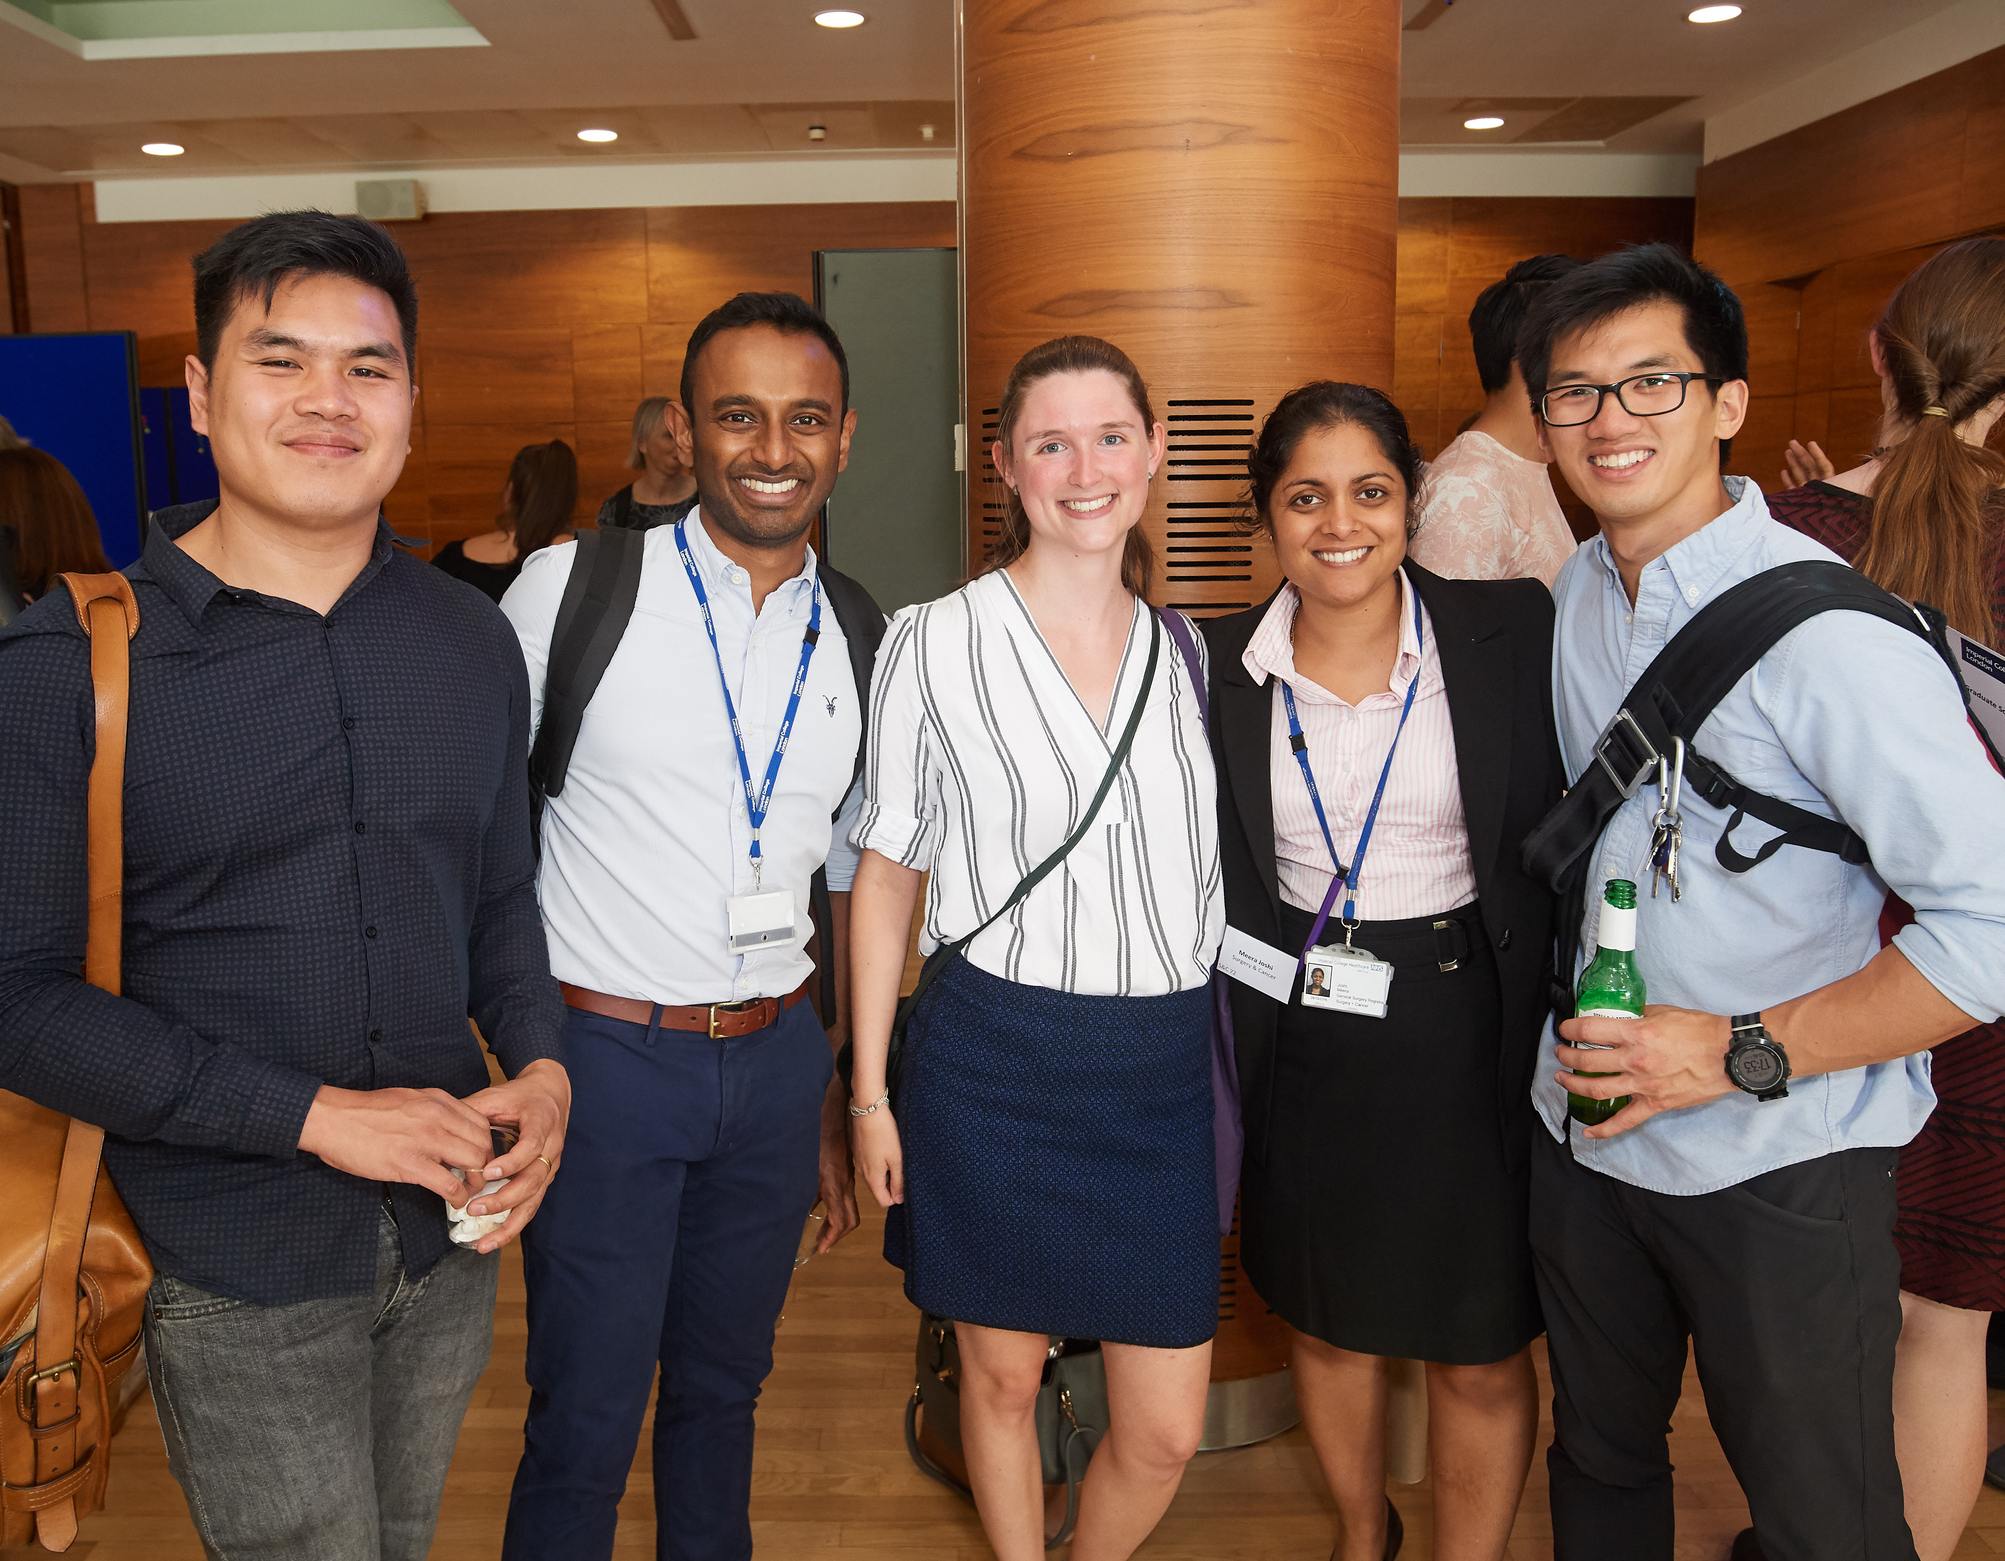

ECRI is responsible for the postgraduate experience at Imperial College London.
Professional development – dozens of courses to develop the skills you need to successfully complete your degree and prepare for your future career.
Attendance requirement : 2 cr by ESA + 2 cr by LSR
One Compulsory course: Plagiarism Awareness
Wellbeing & Support – Coaching
Events and networking opportunities – Competitions, Networks
Opportunities to feedback to the College – working with IC Union & Reps
Regular newsletters/bulletins – read our emails!

Slide 34
Boost your STEMM communication with CfAE
Scan the QR code
online self-study writing and speaking resources
live guided speaking and writing activity sessions
1:1 advice and feedback on speaking and writing online and on campus

Slide 35
Disability Advisory Service
Introduction to the service
07/10/2024

Slide 36
What we offer
How can DAS help you
Advisors – provide information, advice and guidance
Most common reasonable adjustments (extra time and computer use in exams), other adjustments may also include ergonomic equipment, and lab assistant.
SpLD tutors - study skill tutorials and study efficiency sessions.
Study mentors – problem-solving, strategies, life/study balance.
And finally, we also offer screenings for autism and SpLDs (specific learning differences/difficulties).​

Slide 37
Screenings and assessments​
Specific learning difficulties (SpLDs) and autism
We can screen for autism – if you are finding it difficult to communicate in social situations, develop friendships, cope with unexpected changes to routine…. then come for a screening.
We can screen for SpLDs (dyslexia, dyspraxia – DCD, ADHD as an SpLD) – if you are finding it difficult to retain what you’ve read, concentrate and stay focused, time management.… then come for a screening.​
If indicators are present, we refer you for a full diagnostic assessment.​

Slide 38
Support at Imperial via DAS
How can DAS help you
Long and short-term support​
Knowledgeable team members and a wealth of experience and expertise​
Efficient service and in-house support
Multiple services are ready to support disabled students: careers, library, mental health mentors, student union - we all work in unison to provide support
In your own time, watch our video to hear what students have said about us!​

Slide 39
Visit our appointments page for information on securing an appointment with DAS.

Slide 40
We look forward to meeting you
07/10/2024

Slide 41

Departmental Career Support
I have office hours usually Mondays or Wednesdays 12-2pm. To make an appointment (virtually or in person) please email PH CAREERS <ph.careers@imperial.ac.uk>
Please check the Physics Career Website for info on internships and international research placements (for Undergraduates)
https://www.imperial.ac.uk/physics/students/current-students/careers-information/
For all students - please sign up to jobslive for regular College Career Event updates
https://www.imperial.ac.uk/careers/services/jobslive/
Prof Lesley Cohen
Member of Matter Community
Research interests:
-Superconductivity
-Magnetism
-Functional Materials
-Energy Efficient ICT
-Caloric cooling

Slide 42

MARS Membership Accreditation & Recognition Scheme
Membership & Chartered status of professional bodies are a key recognition in industry.
Postgraduate students can register on MARS to:
Become Registered Scientist (RSci)
Progressing towards Chartered status (Cphys)
Benefits of joining this scheme
Your development at Early Careers Research Institute is recognised by the IOP
You can apply for Chartered status earlier in your career
Full details at MARS membership webpage - Contacts p.seldon@ic.ac.uk or ph.careers@imperial.ac.uk
Attend MARS Q&A session – see Inkpath to book.
MS Teams: 17th October (12.00 - 13.00); 16th January (12.30-13.30)
In Person: 15th November (13.00-14.00) & 18th February (13.00-14.00)

Slide 43

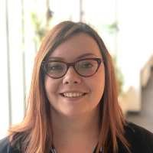
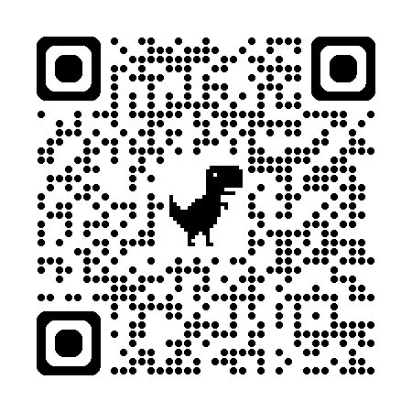
Your Careers Consultant: Jess Popplewell
j.popplewell@imperial.ac.uk
1-1 appointments available in-person and online​
Careers fairs and employer events​
Workshops throughout the year
Check over application documents​
Practice presentations​
Mock interview support​
Sign up to JobsLive
Ask an Alum (new feature!) >>>
Imperial.ac.uk/careers/about/jobslive/

Slide 45
Library Services for Physics PhD students
Abdus Salam library building on campus
Physics librarian – Ann Brew
Physics subject page, for journals, books and search tools
Research support specialists (RDM, Open Access, copyright)
Workshops, including Grad School sessions
Physics PhD library induction:
Thursday 10th Oct, 11.30 – 12.30
Includes talk from Scholarly Comms team
Abdus Salam library, Training Room 1

Slide 46
ICT
https://www.imperial.ac.uk/admin-services/ict/new-to-imperial/students/
Information Communication Technologies

Slide 47
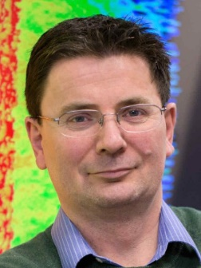
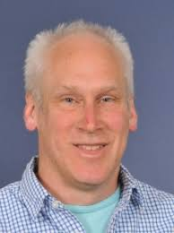
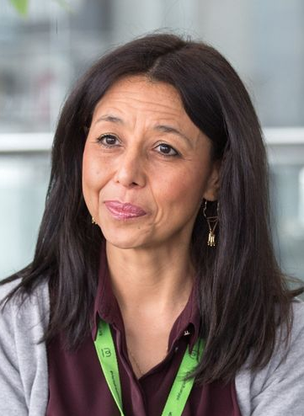
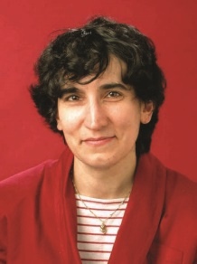
PG welfare in Physics: PhD
Community PG Mentors | https://www.imperial.ac.uk/physics/students/current-students/postgraduate-research/contacts-and-mentors/academic-staff-contacts/ |  | Safety, academic and personal issues
Research community PG committee representatives | https://www.imperial.ac.uk/physics/students/current-students/postgraduate-research/contacts-and-mentors/research-group-committee-reps-and-coordinators/ |  | PG feedback to department, common issues, social events.
PGR Senior Tutor | Jerry Chittenden j.chittenden@ic.ac.uk Blackett 744 020 7594 7654 |  | Pastoral care of students, supervisor/student issues, mental health issues
Director of PG studies | Ben Sauer ph.dps@imperial.ac.uk Blackett 212 |  | Administrative aspects, progression, issues related to the wider college.
Disabilities Officer | Mery Fajardo m.fajardo@imperial.ac.uk Blackett 306 |  | Disabilities
PG Administrator | Loli Sanchez Rey l.sanchez@imperial.ac.uk Blackett 315 |  | Postgraduate liaison and administration; progression, deadlines, etc.
Physics PG Helpdesk For both MSc and PhD students |  | First Wednesday of each month (12-1pm, advertised by email regularly)
(Profs Lesley Cohen, Ji-Seon Kim or Dr Yvonne Unruh if you’d prefer to talk to a female member of staff)

Slide 48
Faculty Student Wellbeing Advice Team Ella Robson, Student Wellbeing Advisers
The team are here to support all students within the Faculty of Natural Sciences.
Our service is here to complement the support available in your Department and College support services.
The support we offer is tailored to your individual circumstances.
We can help provide you with general guidance on managing your wellbeing.
Students can self-refer or be referred.

Slide 49
Working with us
The Student Wellbeing Advice Team is available for one-to-one guidance meetings, either in-person or online via Teams.
We can offer a confidential appointment to discuss your query. We will meet with you to talk through any initial concerns and explore next steps.
Support is tailored to your circumstances and might include:
Receiving relevant information to assist with your query
Accessing support with setting wellbeing-related goals
Information about wellbeing self-help resources
Options for further support

Slide 50
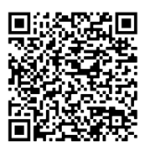
How to contact us
If you’re a student in the Faculty of Natural Sciences and would like to speak to someone about your wellbeing, we are here to help.
To find out more about the support we offer and/or to arrange a chat, please visit our website, or scan the QR code: https://www.imperial.ac.uk/natural-sciences/education-and-teaching/wellbeing-support/resources-for-students/advice-team/
All you’ll need to do is complete a quick referral and we’ll be in touch.

Slide 51
Highlights
Jerry Chittenden - PGR Senior Tutor
Student-supervisor agreement: https://www.imperial.ac.uk/physics/students/current-students/postgraduate-research/postgraduate-student-handbook/guidance-for-students/
Student well being advice team (SWAT) & Student mental health intervention officers (concernedaboutastudent@imperial.ac.uk)

Slide 52
Welfare
Be honest with yourself & your supervisor.
And act:
1st port of call is/are your supervisor(s)
PGR mentor
Contact PGR Senior Tutor: Jerry Chittenden (j.chittenden@imperial.ac.uk)
Contact PGR Office: Roxanne Ray and Loli Sanchez
Contact Director Post-Grad Studies: Ben Sauer (dps@imperial.ac.uk)
IN EMERGENCY - ANY ONE OF THE ABOVE or MENTAL HEALTH FIRST AIDER

Slide 53
Postgraduate Milestones
We will discuss the milestones in our meeting on Dec. 4
3M- you write one page about your research topic, identify safety training, bottlenecks, etc.
12M (early stage assessment) – you write a substantial literature review and have a viva to demonstrate familiarity with the area and a thesis strategy.
24M (late stage review) – you a substantial report on your research results and have a viva to demonstrate that you are on track for your PhD

Slide 54
Important starting information
1. You are in the Dept of Physics (which community?)
2. Who is/are your supervisor(s)?
3. Who is your community PGR mentor?
4. Who is your community administrator?
5. Who is funding you?
6. How long is the funding for?
These are the six most important things you need to know / find out – soon…….

Slide 55

Keep up to date:
Check your e-mail Visit the website for general activities/ information including welcome information: https://www.imperial.ac.uk/physics/students/current-students/postgraduate-research/

Slide 56


PGR Welcome Social Event
PGR Social welcome event with Refreshments
Date: 9th October 2024
Place: Level 2 Foyer, Blackett Lab
Time: 3:00 – 4:30
PGR 2nd Induction event
Date: 4th December 2024
Place: LT2, Blackett Lab
Time: 2:00 – 3:00

