Slide 1
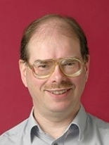
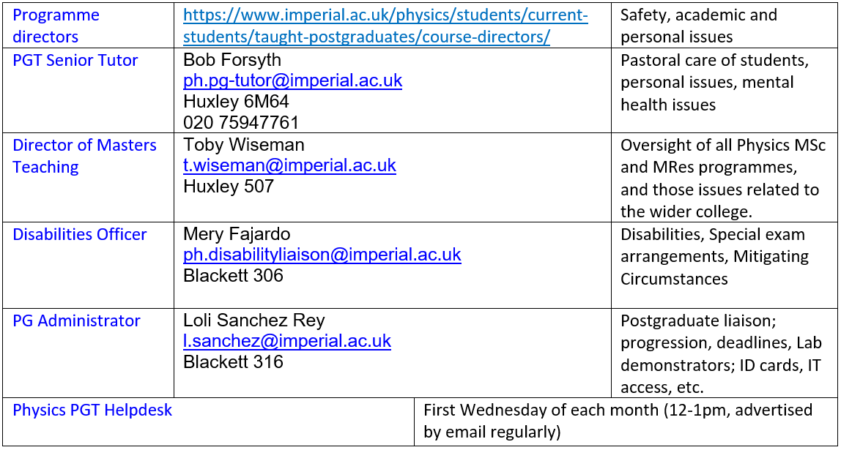
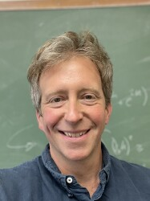
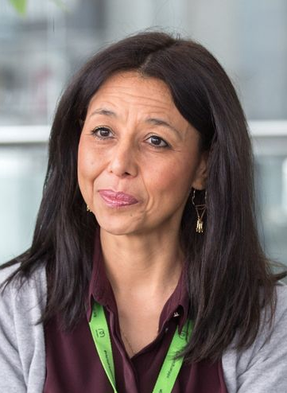
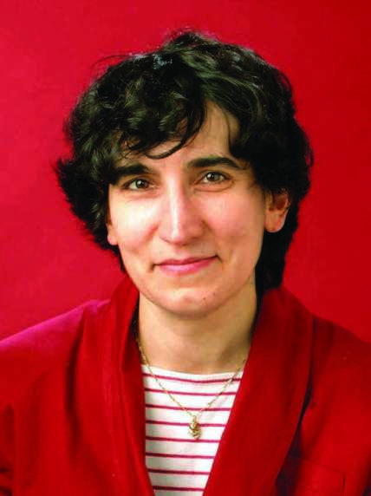
PG welfare in Physics: MSc & MRes
(Profs Lesley Cohen, Ji-Seon Kim or Dr Yvonne Unruh if you’d prefer to talk to a female member of staff)

Slide 2
Highlights
Helpdesk: co-run with Jess Popplewell from career office and current RAs. First Wednesday of every month 12-1pm.
Student well being advice team (SWAT) & Student mental health intervention officers (concernedaboutastudent@imperial.ac.uk)

