Slide 1
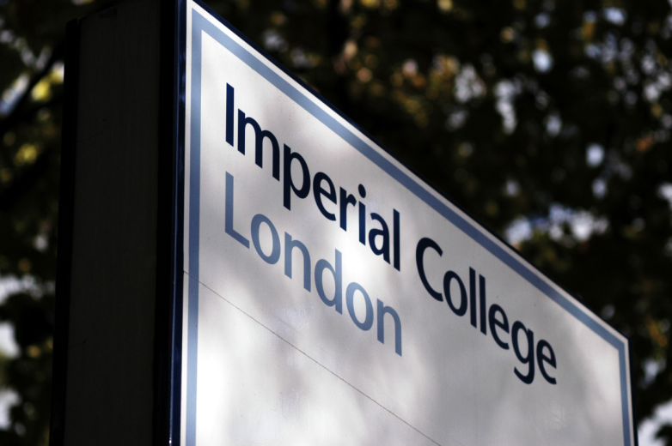
Introduction to Safety
Heather Combe, Campus Safety Manager

Slide 2
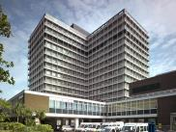
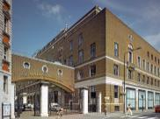
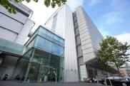
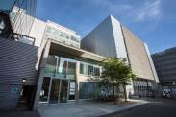
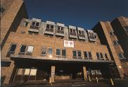
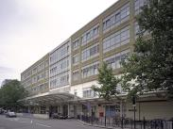
Faculty of Medicine Campus Safety Managers
Heather Combe
Hammersmith (CWB & BD) and Charing Cross
Helga Koch
South Kensington, Chelsea & Westminster, Royal Brompton & Harefield
Sukwinder Singh
Hammersmith (ICTEM, IRDB, Francis Fraser, Wolfson, CRB)
Diane Thomason
St. Mary’s and Northwick Park
Your Campus Safety Managers are: Heather Combe & Sukwinder Singh

Slide 3
Lines of Responsibility
Rector
Campus Safety Managers
Dean and Vice Deans
Heads of Division/Department/Institute
Support Services
Heads of Section/Group
Principal Investigators
Individuals
Safety Department

Slide 4
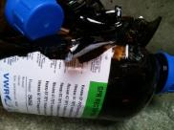
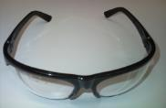
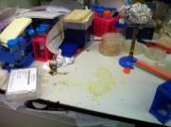
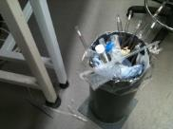
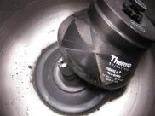
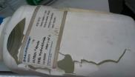
College Safety Department
The role of the Safety Department is to ensure that:
the College provides a safe working environment for all staff, students and visitors
all College activities are undertaken in a safe manner, and
the College complies with the requirements of the Health and Safety at Work Act and other relevant legislation
In undertaking this role, the Safety Department:
provides expert advice on safety matters to the College
develops policies on safety issues and prepares codes of practice and guidance notes as appropriate
audits compliance with College safety policies & national standards
investigates accidents and near misses
liases with statutory authorities
runs a safety training programme and provides advice on specialist needs
advises on environmental monitoring.

Slide 5
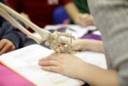
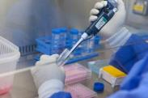
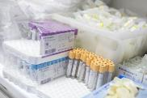
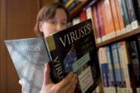
Individual safety responsibilities
All staff/students must:
Comply with all local and College policies, procedures and codes of practice etc.
Ensure that their activities do not present unnecessary or uncontrolled risks to themselves or to others.
Attend appropriate induction and training.
Report any accidents, unsafe circumstances or work-related ill health.
Not interfere with any equipment provided for Health and Safety.
Inform their line manager if they are not confident that they can carry out a work activity safely, rather than compromising their own safety or the safety of others.

Slide 6
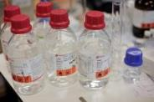
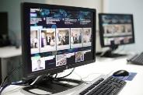
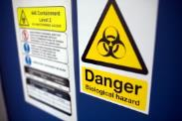

Main responsibilities of the Principal Investigator
Ensuring that effective local arrangements are in place for the implementation of College health and safety policies, procedures and codes of practice.
Ensuring that they are aware of the principal hazards and risks present in their area, that appropriate risk assessments have been undertaken.
Ensuring that all staff, students and others working under their control comply with College health and safety policies, procedures and codes of practice.
Ensuring that arrangements are in place for the regular monitoring, auditing and review of health and safety performance and risk assessments.
Ensuring that there is proper coordination, cooperation and communication with other users of shared and/ or adjacent space.
Suspending activities where health and safety is being, or is likely to be compromised.
Taking appropriate disciplinary action where staff have breached the College's Health and Safety Policies and Procedures.
Ensuring that individuals are properly supervised until they have received the necessary instruction, information and training.
Promoting a positive health and safety culture.

Slide 7
Main responsibilities of the Principal Investigator
Ensuring that effective local arrangements are in place for the implementation of College health and safety policies, procedures and codes of practice.
Ensuring that they are aware of the principal hazards and risks present in their area, that appropriate risk assessments have been undertaken.
Ensuring that all staff, students and others working under their control comply with College health and safety policies, procedures and codes of practice.
Ensuring that arrangements are in place for the regular monitoring, auditing and review of health and safety performance and risk assessments.
Ensuring that there is proper coordination, cooperation and communication with other users of shared and/ or adjacent space.
Suspending activities where health and safety is being, or is likely to be compromised.
Taking appropriate disciplinary action where staff have breached the College's Health and Safety Policies and Procedures.
Ensuring that individuals are properly supervised until they have received the necessary instruction, information and training.
Promoting a positive health and safety culture.

Slide 8
Main responsibilities of the Principal Investigator
Ensuring that effective local arrangements are in place for the implementation of College health and safety policies, procedures and codes of practice.
Ensuring that they are aware of the principal hazards and risks present in their area, that appropriate risk assessments have been undertaken.
Ensuring that all staff, students and others working under their control comply with College health and safety policies, procedures and codes of practice.
Ensuring that arrangements are in place for the regular monitoring, auditing and review of health and safety performance and risk assessments.
Ensuring that there is proper coordination, cooperation and communication with other users of shared and/ or adjacent space.
Suspending activities where health and safety is being, or is likely to be compromised.
Taking appropriate disciplinary action where staff have breached the College's Health and Safety Policies and Procedures.
Ensuring that individuals are properly supervised until they have received the necessary instruction, information and training.
Promoting a positive health and safety culture.

Slide 9
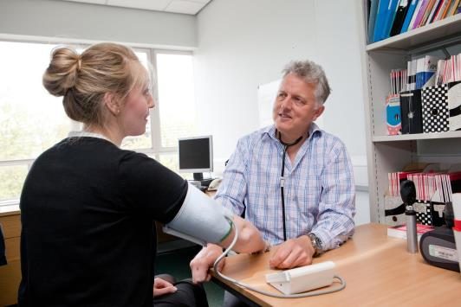
Occupational Health
Health clearance before commencing work is required for:
All deliberate work with pathogens in Hazard Groups 2 and 3
All class 2 or 3 genetic modification projects
Work with unfixed tissues, blood or serum that may contain Hazard Group 2 or 3 pathogens
The assessment must be completed before a person can begin laboratory work with these biological agents.
Anyone working with live laboratory animals or insects
Anyone who may be exposed to allergens
generated by work with animals
An appointment with Occupational Health will be required
before any work can start.
Alert your supervisor or course administrator if you have disability or existing medical condition that might impact on your safety.

Slide 10
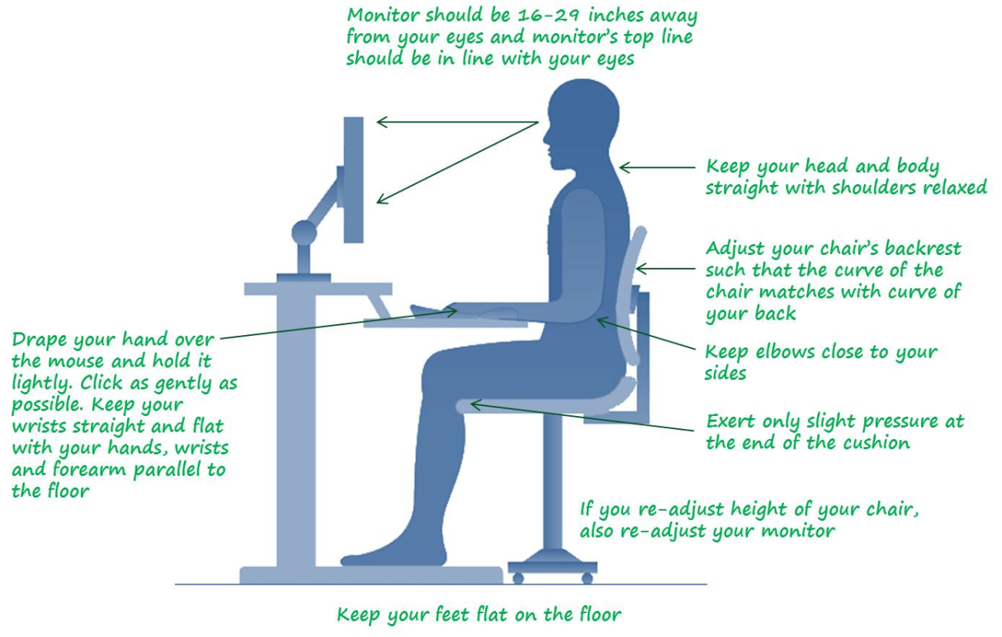
Computer Safety
Take regular breaks
Adjust chair to suit you
Look away from screen frequently
If necessary, speak to your DSE assessor

Slide 11

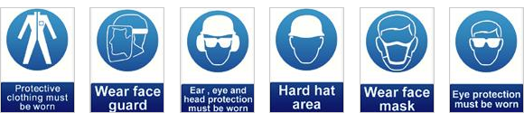
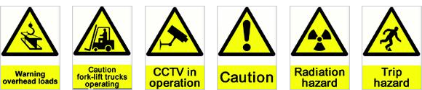



Safety Signs
Prohibited
Mandatory
Hazard

Slide 12
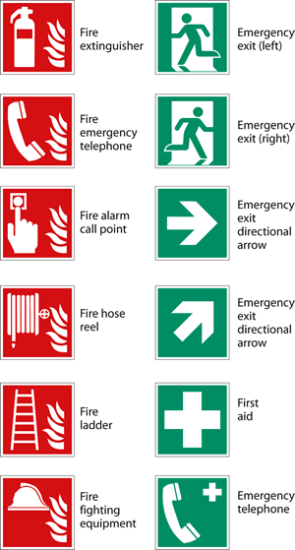
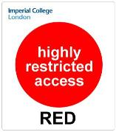


Safety Signs
Emergencies
Imperial Access Control

Slide 13
Lone Working
Lone working is where a person works by themselves without close or direct supervision or contact with others, for example:
Where only one person is working in an area and there is no one to provide immediate assistance in the event of an emergency
Workers working by themselves away from their fixed base
Working with a patient, student or client in a segregated area
This can be dictated by the type of work undertaken e.g. time of courses or length of experiments or availability of samples or equipment. It can also occur because of deadlines for papers, conferences or thesis submission.
For the purpose of the Faculty of Medicine policy, out of hours working is considered equivalent to lone working in both risk and procedural requirements.
All work outside 7am-7pm is considered to be lone work.

Slide 14
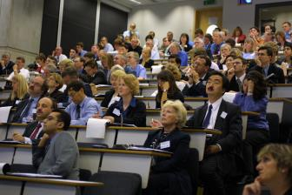
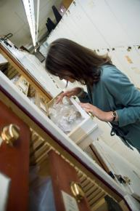
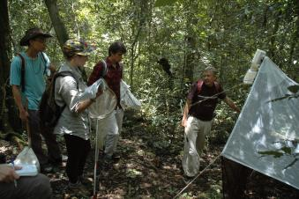
Off Site Working
Conferences:
Emergency contact information
Report accidents to College
Health clearance (if tropical country)
Travel advice
Hosted Research:
Emergency contact information
Report accidents to College (and host)
Health clearance
Risk assessment (can be from host)
Travel advice
Fieldwork:
Report accidents to College
Health clearance
Risk assessment form FW1/FW2
Emergency contact information (held by department, from FW1/2)
Travel advice

Slide 15
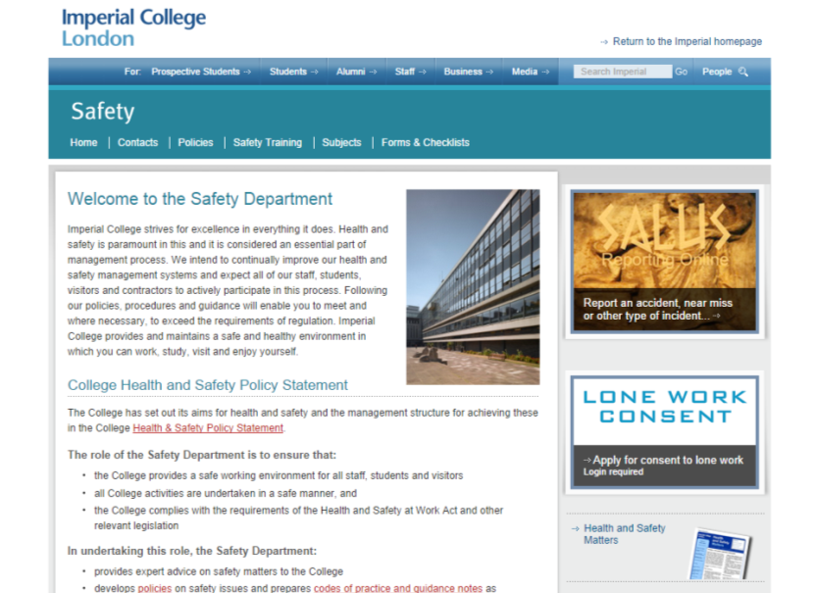
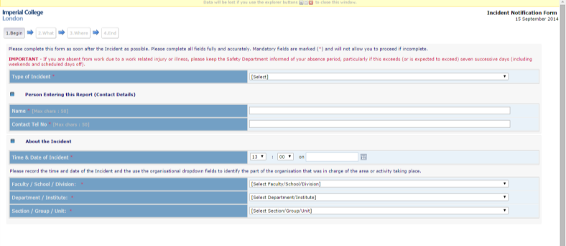
Reporting an Accident
Online reporting system located on the Safety Department website (www.imperial.ac.uk/safety)
Select type of incident and fill in details to generate a report

Slide 16
Safety Contacts
Safety Department | www.imperial.ac.uk/safety
Occupational Health | http://www.imperial.ac.uk/occhealth
Faculty of Medicine safety pages | http://www.imperial.ac.uk/medicine/staff/healthandsafety/
Learning and Development Centre | http://www.imperial.ac.uk/staffdevelopment/ldc
Staff website | http://www.imperial.ac.uk/staff

