Slide 1
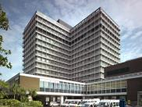
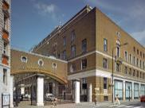
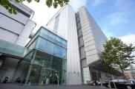
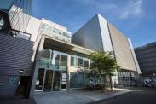
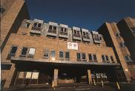
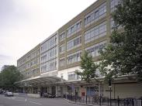
Faculty of Medicine Safety Advisors
Heather Combe
Hammersmith (CWB & BD), White City & Charing Cross
h.combe@imperial.ac.uk
Helga Koch
South Kensington, Chelsea & Westminster, Royal Brompton & Harefield
helga.koch@imperial.ac.uk
Sukwinder Singh
Hammersmith (ICTEM, IRDB, Francis Fraser, Wolfson, CRB)
sukwinder.singh@imperial.ac.uk
Diane Thomason
St. Mary’s and Northwick Park
diane.thomason@imperial.ac.uk

