Slide 1
DoID Grant Writing & Research Manager support
Version 1.0
28 April 2022
Paula Kirby, Research Manager
e-mail: p.kirby@imperial.ac.uk
Research Committee | Faculty of Medicine | Imperial College London

Slide 2
Need / want grant funding?
Identify schemes
Funder
Idox search
Ask colleagues
Ask Research Mgr
Is the scheme right for me?
Financial or in-kind
commitments?
Check eligibility - guidance / with funder
Check with academic mentor / supervisor
Ask HoD & Dept Mgr or budget holder
for support & approval
No
Yes
Yes
No
Want to go for it?
Contact Section Mgr:
Costs
Contact Research Mgr:
See slide 1
You:
Write application!

Slide 3
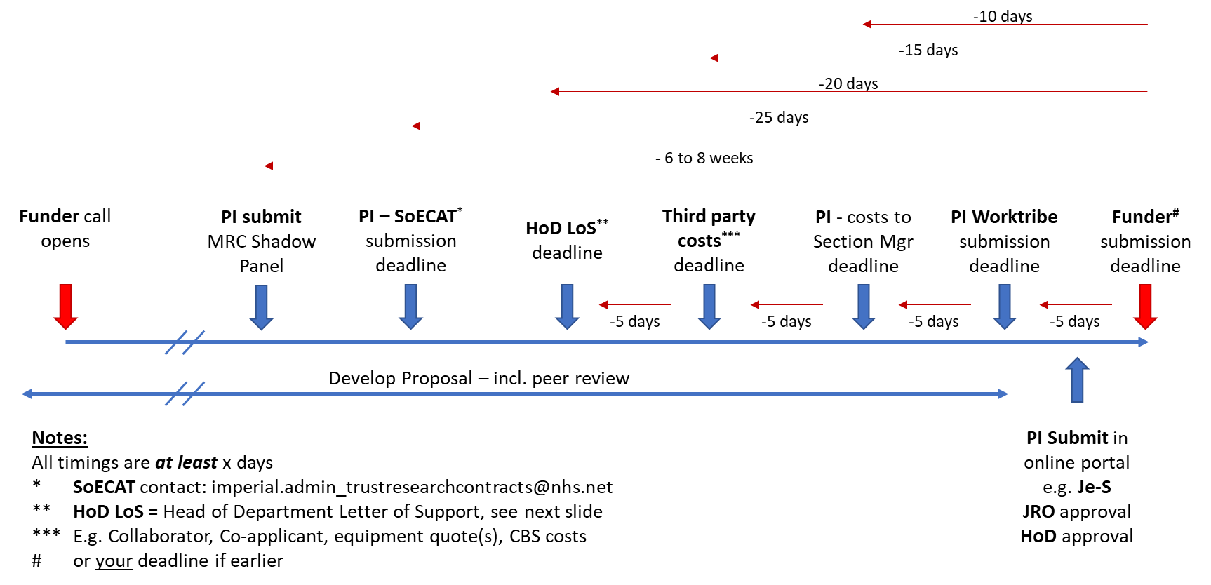
Example timeline:

Slide 4
Research Manager support (pre-award)
Advice on funding schemes
Help plan an application
  Timings
  Requirements
  Connect to previous awardees and panel members
Review of grant applications (non-scientific sections e.g. lay summary)
Arrange technical peer review of applications
Facilitate Head of Department (HoD) support for applications (letters of support, HoD support statements, HoD sign-off)
Arrange technical mock interviews

Slide 5
Head of Department (HoD) support
Letters of Support (LoS) or support statements are a critical element for fellowship applications and other proposals
These typically provide evidence of commitment or contributions from the host institution, e.g.
  space, access to facilities, technical or administrative staff, equipment, financial contributions, and studentships
Your Research Manager can help draft a letter of support or support statement on behalf of the Head of Department
You need to notify the Research Manager at least 4 weeks before the funder deadline if a HoD support statement or LoS is required
Final, signed, HoD LoS / support statements will be provided once the Worktribe costs are approved by the Department

Slide 6
What support others can provide (1)
Postdoc and Fellows Development Centre (PFDC)
Clinical Academic Training Office (CATO) – clinical postdocs and clinical PhD fellows
Patient Experience and Research Centre (PERC) - public involvement
Societal Engagement – schools, communities, public involvement
Support for Staff:
  Joint Research Office (JRO) / Preparing-and-costing-a-proposal
  Statistical Advisory Service (SAS)
  Research Project Management (EU and large programmes) and Imperial Projects (Commercial)
SoECAT – NHS Trust costs / resources
Library Services (research data management, open access)
Research Culture Toolkit – how research is done at Imperial
Graduate School (PhD studentships)

Slide 7
What support others can provide (2)
Faculty of Medicine Information Governance team (GDPR, data management – including Data Protection Impact Assessments)
Research Governance and Integrity team (RGIT; healthcare research - ethics)
Clinical Data Systems Team – electronic data capture for clinical studies
Animal research: website, and Animal Welfare and ethical research body
Replacement, Refinement and Reduction (3Rs)
EU Office and International Relations Office
Enterprise – including Industrial Partnerships and Commercialisation plus Technology Transfer
Safety – contact Section / Department Representative
Centre for Academic English – can provide feedback on grant application text

Slide 8
Other useful links:
DoID Fellowship advice:
Fellowship advice | Faculty of Medicine | Imperial College London
DoID Research Committee:
Research Committee | Faculty of Medicine | Imperial College London
Idox ResearchConnect:
Welcome | ResearchConnect (myresearchconnect.com) (Log in via my institution)
Guide to working with industry and commercialising your research | Administration and support services | Imperial College London

