Slide 1
Equipment & Facilities
The difference in costing between DI & DA
Clinical Data Systems
(formerly InForm)
CBS (Central Biomedical Services)

Slide 2
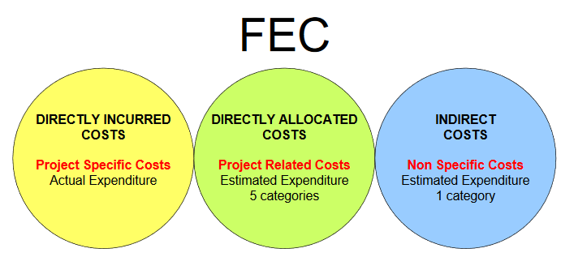
Full Economic Cost (FEC) Categories
The costs of a research project are classified under three headings:
Directly Incurred
Directly Allocated
Indirect Costs
FEC Full Guidance
FEC Quick Guidance

Slide 3
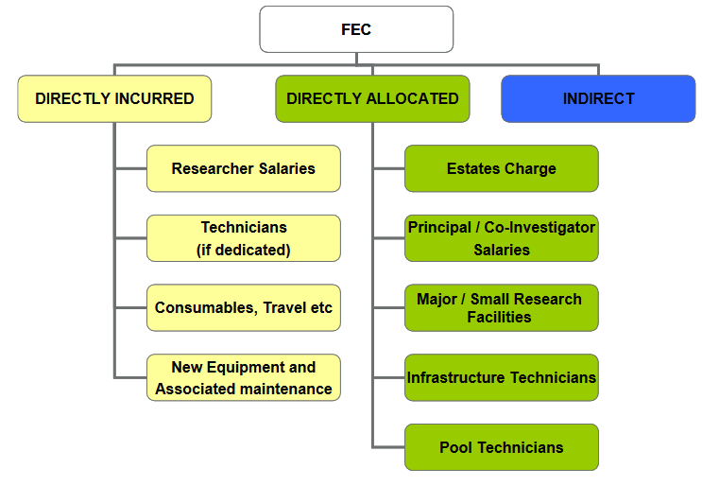

Slide 4
JRO and Research Office webpages
JRO webpage & Pre-Application Checklist
JRO Guidance documents
Expand CBS; Equipment & Facilities Process & Clinical Data Systems
Preparing and Costing a proposal – Costing Section
Expand Directly Allocated Research Facilities section

Slide 5
Directly Allocated – Equipment and Facilities
Under FEC, the costs of most items of equipment and facilities already owned by the institution will have been automatically included in the calculation of the estates rate, and are therefore included in the FEC of a research project within the estates charge.
Estates rates can be found on Page 61 of the Full FEC Guidance
Equipment and Facilities which have been extracted from the Estates Costs are included on the Charge-Out List .
FEC rates have been calculated for each Facility (per hour) and usage is based on charge out rates for a limited number of facilities.
Different rates depending on which funder is being applied to:
Partial FEC rate - Use for Research Councils, UK Govt depts, other funders not meeting full FEC rate (e.g. most charities)
Full FEC rate - Use for funders who pay the full FEC rate, e.g. industry funders
Horizon 2020 rate - Use for European Commission Horizon 2020 only

Slide 6
Directly Allocated – Equipment and Facilities
It is the responsibility of the person who is completing the proposal to include the “Number of Units (Hours)” and “Rate per Hour” in the proposal.
Example: Film Confocals on a NIH proposal - £37 x 200 hours = £7,400
NOT shown on InfoEd as 1 x £7,400
Auditors look out for costs correctly attributed to proposals based on the charge-out rates for TRAC year effective from Feb each year.

Slide 7
Directly Allocated – Equipment and Facilities
Charge-out research facilities are categorised as directly allocated and can comprise of:
A single piece of major equipment
A collective suite of equipment
A research service, e.g. statistical advisory service

Slide 8
Directly Incurred - Equipment and Facilities
Multi-user and PI-led equipment & facilities (included within estates costs)
Multi-user and PI-led access charges cannot be included on research proposals submitted to funders who pay FEC (e.g. Research Councils, Other Government Departments). However, they may be included in proposals to other funders such as Charities and Industry.
New and external equipment and facilities
The following costs are not directly allocated – they should be classified as directly incurred:
New equipment to be purchased for a specific project
Access costs for external equipment and facilities (categorised as ‘professional fees’)

Slide 9
Directly Incurred - Equipment and Facilities
Research facilities directory via Costing webpage
It is the responsibility of the person who is completing the proposal to contact the Facility Manager for the rates to include the “Number of Units (Hours)” and “Rate per Hour” in the proposal.
Example: Ion Torrent PGM on a NIH proposal - £35 x 150 hours = £5,250
NOT shown on InfoEd as 1 x £5,250
Each facility has a facility manager and potential users should contact them at the earliest opportunity so they may provide further advice about the availability of their Facility and its usage costs to ensure a correct costing rate is applied during the grant application process.

Slide 10
Clinical Data Systems (formerly InForm)
The Clinical Data Systems team aims to provide Investigators and Clinical Trial Teams across Imperial College with a comprehensive service to support the collection, management and analysis of data from clinical trials.
Clinical Data Systems link (Head of section - Amanda Bravery)
JRO Guidance Docs – expand Clinical Data Systems section for
Charge-out facility - must be added for the dept using the facility and not as a subproject for ICTU, as the under-recovery should be borne by the department using Clinical Data Systems.
Exception being H2020 - every cost incurred needs to have an auditable trail and back-up documentation; not all costs can be recovered.

Slide 11
CBS - Central Biomedical Services
Prices, costing and projects
The Costing Tool has been designed to assist researchers in completing their applications that involve in vivo procedures. It is important that the researcher liaises with the relevant CBS site manager regarding their requirements, at least 10 working days before the deadline, and it is the site manager’s responsibility to approve the Costing Tool and submit it to Section Admin and JRO.
CBS Costing Tool Guidance Notes (PDF)
CBS costs must be attached to InfoEd. Check Recovery screen has correct figures for specific funder.
If there will be any animal work outside of CBS - costing added and attached to InfoEd

Slide 12
Additional Resources and useful links:
Charge Outs List / Framework for Managing Research Facilities Guidance / Applying for Access Funding
Five-day-submission rule & Pre-Application Checklist
Preparing and costing a proposal
FEC Quick Guidance
FEC Full Guidance

