Slide 1
PI Time
The difference in costing between DI & DA
&
Clinical Staff
Fixed salary is for Clinical Consultant and Doctors in Training

Slide 2
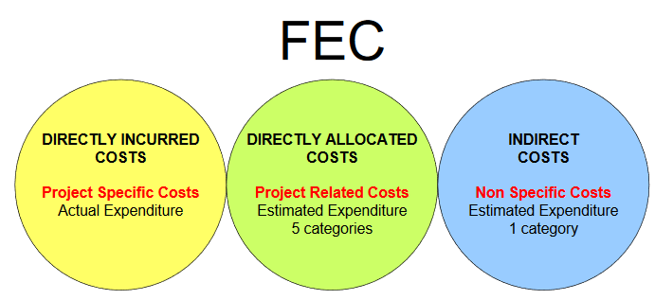
Full Economic Cost (FEC) Categories
The costs of a research project are classified under three headings:
Directly Incurred
Directly Allocated
Indirect Costs

Slide 3
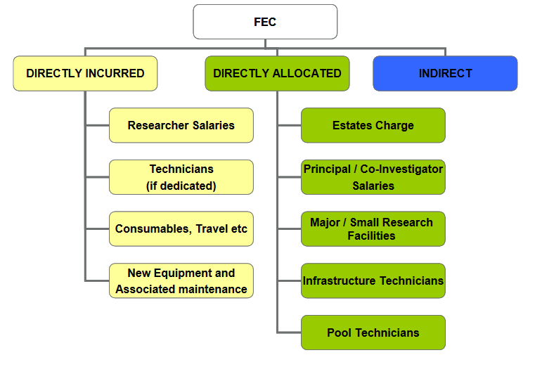

Slide 4
Directly Allocated Academic Time (PI/Co-I)
All investigators’ time should be considered in an application, whether or not the funder will pay for their salary.
Directly Allocated costs – PI and Co-I Time are estimates should include the time required to manage, undertake and supervise the research project, this should be calculated in hours per week or a percentage of their time. Generally Pay Bands.
Effectively they are an overhead to cover the costs of the academic’s time working on the project, which has been paid for from within the dept.
Guidance can be found on this link - FEC Estimating PI and Co-I Time [pdf]

Slide 5
Directly Incurred Academic Time (PI/Co-I): charged as actuals at post award
However, PI/Co-I Time should not be estimated in certain circumstances, and should be based on actual costs under DIRECTLY INCURRED:
  Namely when the funder requires actual costs to be reported and/or timesheets are required to verify time on the project.
  Examples: Professorship; Fellowship; CEC & some US Federal Agencies (Dept of Health and Human Services)
PI/Co-I added to InfoEd/WorkTribe as Directly Allocated with zero time and cost.
PI/Co-I added as Directly Incurred Costs with costs and time based on their FIXED SALARY.

Slide 6
Funders and Schemes which require Directly Incurred Costs (Actuals)
Funders which offer Professorships & Fellowships should be costed as Directly Incurred on InfoEd/WorkTribe.
Professorships will be costed as FIXED SALARY, as they are likely to be on a fixed salary on the HR module.
Fellowships maybe either Fixed Salary or interfaced from HR module based on their spine points.
CEC – funders which fall under this pillar are: EDCTP; EIT; EUROMET; IMI
Some US Federal Agencies – for the Dept of Health and Human Services we need to include all the sub-divisions, which currently include:
  National Institutes of Health (NIH);
  United States Agency for International Development (USAID);
  U.S. Food and Drug Administration (U.S. FDA);
  Centers for Disease Control and Prevention (CDC);
  National Cancer Institute (NCI)
  But there are many more, as per link above.

Slide 7
Explanation of why this is important
Paybands are costed based on an average of an academic’s salary and include basic salary, London allowance, honorarium, special allowance, salary enhancements.
(Page 62 of the Full FEC Guidance)
Paybands are not a true reflection of an academic’s salary at the point of application/costing required by the funder.
  An academic with an actual salary at the lower end of the payband will be over costing on the proposal if using the average for the payband;
  An academic with an actual salary at the higher end of the payband will be under costing if using the average for the payband, hence there will not enough budget when charging actual costs at post award.
Timesheets are required for these funders and must be based on actual costs. Timesheet hours
are recorded on E85s to calculate the true cost to be charged to the award for auditing.

Slide 8
Clinical Staff – costed as Fixed Salary
Fixed Salaries should be for new Clinical Consultant Academic and Doctors in Training.
  These are often added as pay bands or added as salary and incremented each year without following a natural progression of years’ service when there’s an increase in spine point.
  These should be added as Directly Incurred costs with Researcher as position/category.

Slide 9
HR webpage - Salaries, terms and conditions
Use the following link to determine salaries:
  https://www.imperial.ac.uk/human-resources/pay-and-pensions/salaries-terms-and-conditions/
Consultant Clinical Academics - New Appointments [pdf]
Doctors in Training (Clinical Research Fellows) [pdf]

Slide 10
Additional Resources:
Five-day-submission rule & Pre-Application Checklist
Preparing and costing a proposal
Costing using FEC methodology
FEC Quick Guidance
FEC Full Guidance

