Slide 1


Optical sideband cooling of ions in a Penning trap
Richard Thompson
QOLS Group
Imperial College London
www.imperial.ac.uk/ion-trapping

Slide 2
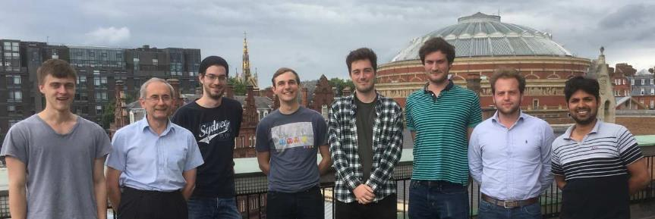
People involved in this work
PhD students: Manoj Joshi, Vincent Jarlaud, Pavel Hrmo
Postdocs: Graham Stutter (now at CERN), Joe Goodwin (now at Oxford)
Staff: RCT, Danny Segal (1960-2015)

Slide 3

Journal of Modern Optics – Special Issue
Quantum optics, cooling and collisions of ions and atoms
In memory of Professor Danny Segal, a special issue of the Journal of Modern Optics will be dedicated to his research interests and short reminiscences of him.
There was a good response to the invitation to contribute to this special issue.
Expected publication date is approximately December 2017
www.tandfonline.com/toc/tmop20/current
Danny Segal
1960-2015

Slide 4
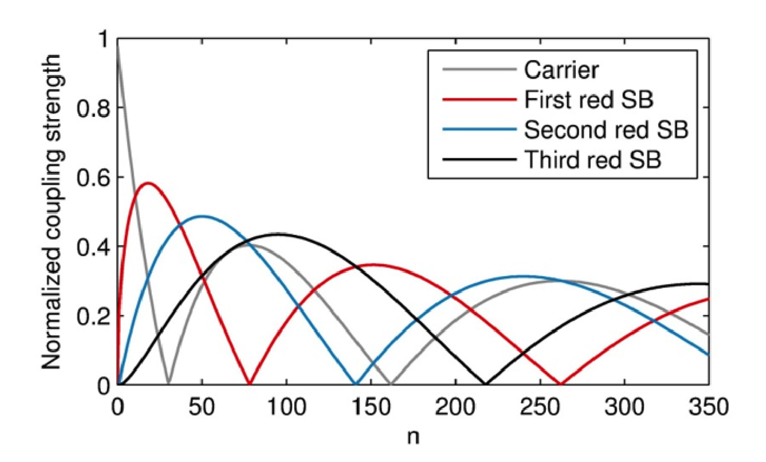
Outline of the talk
Laser cooling in the Penning trap
Effect of large Lamb-Dicke parameter
Sideband cooling of one ion
  Coherent manipulation of the motion
Sideband cooling of two-ion ‘crystals’
Sideband cooling of the radial motion
Outlook

Slide 5
Laser cooling in the Penning trap
Doppler cooling is basically the same in radiofrequency and Penning traps, but...
Zeeman splitting of levels requires multiple laser frequencies for cooling
    This is avoided in simple ions (Mg⁺ and Be⁺) by using optical pumping techniques
Magnetron motion has negative energy and is hard to cool
    Needs laser beam offset from trap centre
    Or additional fields (rotating wall, axialisation)
Oscillation frequencies are relatively low (<1MHz in our case)
²P_{3/2}
²S_{1/2}
Be⁺

Slide 6






Working with calcium in a Penning trap
In the magnetic field of the Penning trap we obtain large Zeeman splittings
We require 10 laser frequencies (4 lasers) for Doppler cooling
We can create and control 1, 2, and 3-D Coulomb crystals
Ca⁺
Low axial potential
High axial potential
B
729nm
The 729 nm transition is the qubit transition
String Zigzag Diamond Offset Square
Square

Slide 7
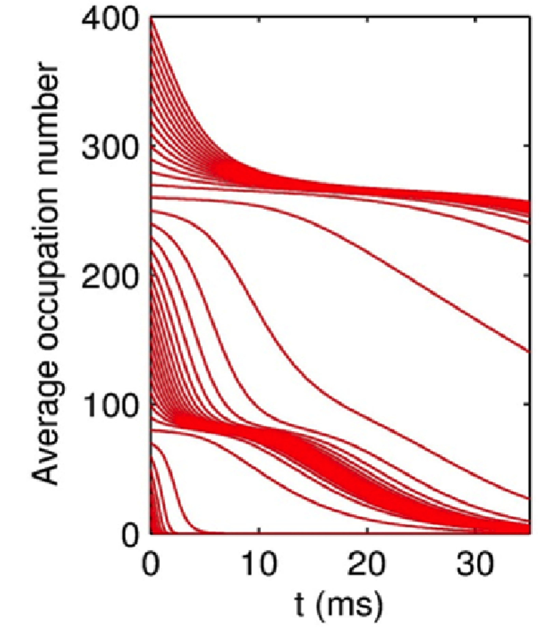
Sideband cooling: “trapped” motional states
The Lamb-Dicke parameter η determines the amplitude of the motional sidebands
  η = x₀(2π/λ) ~ 0.2 for our trap [x₀ is size of g.s. wavefunction]
The strength of each motional sideband depends on n
  Quantum equivalent to sidebands in classical frequency modulation
For our low trap frequencies we expect the first red sideband to have zero amplitude around n=80
Cooling on the first red sideband (R1) will only be effective for n<80
Around 20% of the population is at n>80 at the Doppler limit (<n>=47)

Slide 8
Spectrum showing population in trapped state
B1
Carrier
R1
After sideband cooling on the first red sideband (R1):
  much of the population is in n=0
    this gives the strong asymmetry between R1 and B1
  but some is trapped around n=80
    This gives the higher order sidebands in the spectrum

Slide 9
Clearing out the “trapped” motional states
Cooling on the first red sideband (R1) will only be effective for n<80
Around 20% of the population is at n>80 at the Doppler limit
To pump this population we need to drive the 2nd red sideband (R2) first
  R2 is strong right up to n=140 but does not give effective cooling at low n
The procedure is then
  R1 (10 ms)
  R2 (5 ms)
  R1 (5 ms) at reduced power

Slide 10
Axial sideband cooling with multiple stages
Red sideband (R1)
Blue sideband (B1)
Absence of red sideband indicates that ion is in the ground vibrational state.
Cooling sequence is R1 (10ms), R2 (5ms), R1 (5ms, reduced power)
<n> ~ (R1 amplitude) / (B1 amplitude)
Motional ground state occupation is >98%

Slide 11
Heating rate results
This heating rate was taken at an axial frequency of 200 kHz
The heating rate averages at around 0.4 phonons/second and is roughly independent of frequency
  Probably limited by technical noise
The heating rate is expected to be low because
  The trap is very large (radius 10 mm)
  The trapping fields are static and there is no micromotion
Goodwin et al. PRL 2016

Slide 12
Sideband heating on the blue sideband
Sideband cooling on R1 drives us towards n=0
After cooling to the ground state, we can also drive the ion on B1 back towards higher n states
This prepares an incoherent spread of population around the first minimum with Δn ~ 10
After sideband heating the spectrum shows a distinctive minimum for first order sidebands

Slide 13
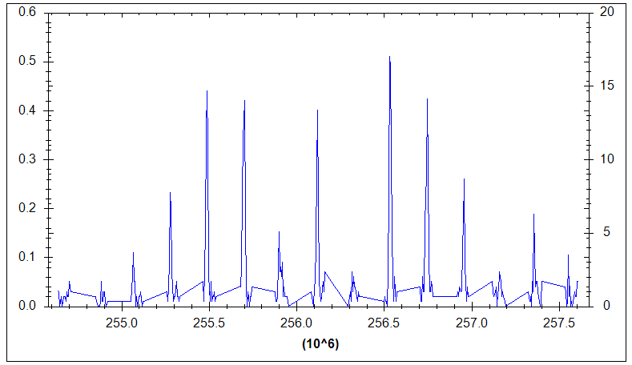
Spectrum of ions in the trapped state
Carrier
R1
B1
Frequency (MHz)
Here we have driven the ion on B1 after sideband cooling in order to drive the population into the first minimum at n=80

Slide 14
Coherence in highly excited motional states
After sideband heating the population is centred in a narrow range of n around a minimum
The strengths of the other sidebands are often fairly constant across the distribution
Therefore we see coherent behaviour
We can study the optical and motional coherence for high n states by using π/2 pulses to create coherent superpositions of states
The interference persists because the other sideband strengths are fairly constant across the range of n we populate
Rabi oscillations on 4th red sideband around n=280

Slide 15
Preparation of superposition of high-n states
|e⟩
|g⟩
n−3
n
n+3
A π/2 carrier pulse creates a coherent superposition of |g,n⟩ and |e,n⟩

Slide 16
Preparation of superposition of high-n states
|e⟩
|g⟩
n−3
n
n+3
A π/2 carrier pulse creates a coherent superposition of |g,n⟩ and |e,n⟩
A π/2 B3 pulse then creates a coherent superposition of |g,n⟩, |g,n−3⟩, |e,n⟩ and |e,n+3⟩
Period of free evolution T
Probe the coherence with a second pair of pulses on B3 and carrier (with variable phases)
Measured interference is (nearly) independent of n

Slide 17
Coherence measurements
10 μs
10 ms
At small T we see fringe visibility ~1
After 1 ms the optical coherence is lost and the visibility drops to ~0.5
Motional coherence is preserved out to ~100 ms for Δn=3

Slide 18
Sideband cooling of 2-ion crystals
Two ions can arrange themselves along the axis or in the radial plane
In each case there are two axial oscillation modes
Axial crystal:
  Centre of Mass at ω_{z}
  Breathing Mode at √3 ω_{z}
Radial crystal:
  Centre of Mass at ω_{z}
  Rocking between √(ω_{z}² – ω₁²) and ω_{z} depending on ion separation (where ω₁ = √(ω_{c}²/4– ω_{z}²/2) is the effective radial trapping frequency)
B
Axial crystal
Radial crystal
Note that the ions are imaged from the side and the radial crystal is rotating due to the magnetic field

Slide 19
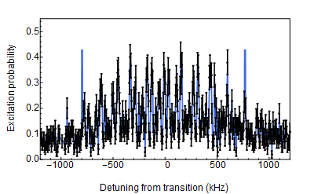
Two-ion axial crystal after Doppler cooling
The spectrum is complicated because each sideband of one motion has a complete set of sidebands due to the other motion
The overall width corresponds to the Doppler limit of ~ 0.5 mK

Slide 20
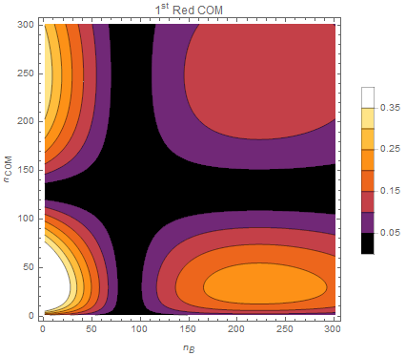
Trapped motional states in 2D
There are two independent axial modes
  The strength of each sideband depends on both quantum numbers
The sideband cooling process is therefore complicated
  It involves moving towards the origin in a two-dimensional plane with several regions where ions can get trapped
  We have to use a combination of several different sidebands of each motion
But there are still regions that are never pumped by pure centre of mass sidebands or pure breathing mode sidebands
  We have to use “sidebands of sidebands” in the cooling sequence
Amplitude of 1st Red sideband of COM
Centre of mass quantum number
Breathing mode quantum number

Slide 21
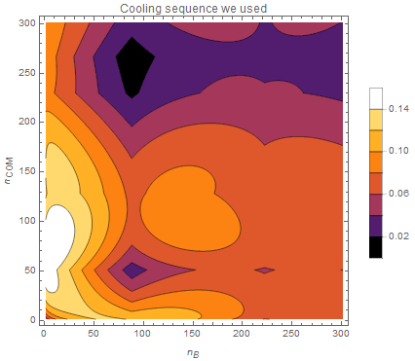
Cooling effect of the sequence of sidebands
This shows the combined effect of a sequence of 5 different sidebands including one “sideband of a sideband”
Every region of the plane is now addressed by at least one of the sidebands effectively
We cycle through this sequence of sidebands many times to complete the cooling process
Centre of mass quantum number
Breathing mode quantum number

Slide 22
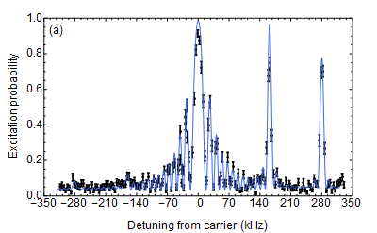
Sideband cooling of two ions in axial crystal
Carrier
COM
Breathing
Breathing
COM
We have cooled both modes of the two-ion axial crystal
  COM at ω_{z} and breathing mode at √3 ω_{z}
The final mean quantum numbers are n_{COM}=0.3 and n_{B}=0.07
  Heating rates are also low
https://arxiv.org/abs/1705.08518

Slide 23
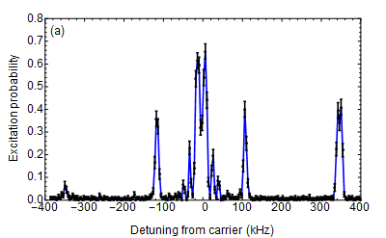
Axial sideband cooling of two-ion radial crystal
Carrier
Rotation mode
Blue sideband
Rotation mode
Red sideband
The ions are both in the radial plane
We see artifacts due to the rotational motion in the radial plane
The two axial modes frequencies cannot be resolved in this plot
  This makes the cooling process more straightforward as both cool together
We have preliminary cooling results for up to 10-ion radial crystals

Slide 24
Radial motion
The radial motion in the Penning trap is more complicated than the axial motion as there are two modes
  Cyclotron motion (fast)
  Magnetron motion (slow)
The sideband spectrum should show structure due to both motions
We can use the spectrum to measure the temperatures of the two modes directly
Radial motion in the Penning trap

Slide 25
Radial spectrum at low potential
The (fast) cyclotron motion gives rise to sidebands
The ~4 MHz FWHM corresponds to a cyclotron temperature of ~7 mK
Each cyclotron sideband has structure due to the magnetron motion
  but individual sidebands are not resolved here
The narrow width of the magnetron structure demonstrates that its “temperature” is very low (~40 μK)
See Mavadia et al
Phys. Rev. A 89, 032502

Slide 26
Problems for radial cooling
Need to cool two modes at the same time
  We have gained experience of this with ion crystals
The magnetron sidebands are unresolved
  Increase trap voltage to raise magnetron frequency
The magnetron energy is negative
  Cool on the blue sidebands of magnetron motion, not red
The initial quantum number of magnetron motion is very large (n up to 1000 in some cases after Doppler cooling)
  Use the axialisation technique to couple to cyclotron motion

Slide 27
Axialisation
This is a technique used in the mass spectrometry field to couple the magnetron motion to the cyclotron motion for cooling
We have adapted it for use with optical sideband cooling
The ion is driven by an oscillating radial quadrupole field at ω_{c}=eB/M
Classically:
The field creates a coupled oscillator system so there is a continuous transfer of energy between the two modes. Damping of both comes from the strong cyclotron cooling. Eventually r_{m}≈r_{c}
Quantum mechanically:
The field drives transitions where n_{m}=−1 and n_{c}=+1. The Doppler cooling continuously drives n_{c} to lower values. Eventually n_{m}≈n_{c}

Slide 28
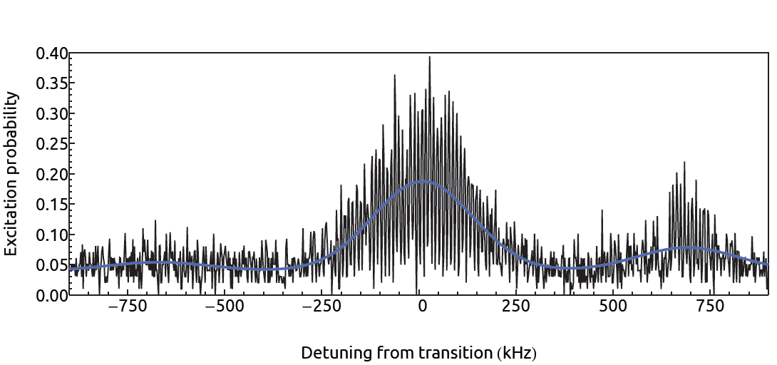
Radial cooling – first results
The cyclotron motion can be cooled by driving its first red sideband
  The spectrum shows that the cyclotron motion is close to the ground state

Slide 29
Sideband cooled radial spectrum
Carrier
B1(cycl)
R1(mag)
B1(mag)
R1(cycl)
B1R1
B1B1
The carrier is very strong to bring out the other sidebands
The asymmetry in cyclotron sidebands indicates n_{c}=0.07±0.03
The (reversed) asymmetry in the magnetron sidebands indicates n_{m}=0.40±0.06
Weak second-order sidebands can also be seen

Slide 30
Summary
Coherent processes can be observed even at high motional quantum numbers for single ions in the Penning trap
We have cooled the axial motion of small Coulomb crystals to the ground state in a Penning trap
We have performed the first sideband cooling on all the radial motion of a single ion in a Penning trap
  Both modes are cooled close to the ground state, including both radial modes
  Thank you for your attention!
  Now recruiting for postdocs :
  see jobs.ac.uk

Slide 32
Heating rate comparison
Comparison

Slide 33
Rabi oscillations
We can see Rabi oscillations for ground-state cooled ions
  The carrier Rabi frequency is up to 60 kHz and the coherence time is ~0.8 ms
Spin-echo techniques can be used to increase coherence time to a few ms

Slide 34
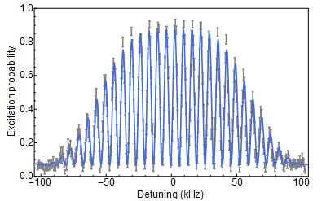
Ramsey interference with two-ion crystal
Ramsey interference pattern after 140μs delay between two π/2 pulses
The observation of Ramsey fringes confirms coherent behaviour of the system

