Slide 1

Workshop on the Research Councils and the Energy Innovation Landscape
Prof Jim Skea
Research Councils Energy Strategy Fellow

Slide 2

International Panel for the RCUK Review of Energy
Is the energy research funded by the UK government through the RCUK energy programme delivering impact in the UK and worldwide?
“Across almost all areas reviewed by us we found interesting, leading edge and world class research. The excellent international reputation of UK research is deservedly earned”.

Slide 3
Overarching conclusions and recommendation
There are, however, fundamental weaknesses …these arise because of a lack of a sustained long-term coherent energy research programme across the different funding bodies, competition between the funding bodies, a lack of transparency and poorly executed or non-existent mechanisms for moving technologies from the research stages to early demonstration, application and deployment.
The Panel therefore recommends: a fully integrated “roadmap” for UK research targets be completed and maintained to allow all to know and understand what is considered essential to meet society’s needs.

Slide 4
Research Councils response: Energy Strategy Fellow
Develop a “roadmap” of research, skills and training needs across the energy landscape to meet the UK 2050 targets:
Identify gaps and misalignments of activities with UK goals
Research needs to be evaluated, prioritised and implemented
Work closely with the Research Councils and the Department of Energy and Climate Change
Organise meetings and workshops
Act as advocate for the Energy Programme
Act impartially and independently

Slide 5
A vision for the “prospectus” not a “roadmap”
“The evidence base upon which the RCUK Energy Programme can plan its forward activities, acting in concert with Government, other RD&D funding bodies, the private sector and other relevant stakeholders.”
Key issues:
Not just climate change: security; affordability; economic opportunity
Robust against uncertainty
Training/human capital as well as research
The interface between RCEP and other RD&D activity/funders
Ensuring links with underpinning science and engineering

Slide 6
Strategic workshops
Energy Strategies and Energy Research Needs: 24 October 2012
The Role of the Environmental Sciences, Social Sciences and Economics: 13 November 2012
Research Councils and the Energy Innovation Landscape: 20 February 2013

Slide 7
Expert workshops
Six workshops January – June 2013
Fossil Fuels and CCS (Pollock Halls Edinburgh 8-9 January 2013) with UK CCS Research Centre and BGS
Energy in the Home and Workplace (Scarman House, 5-6 February 2013) with EEDO and UCL Energy Institute
Energy Infrastructure (IET Birmingham, 17-18 April 3013) with Ofgem, Smart Grid Forum and Durham University
Bioenergy (Rothamsted Research, 14-15 May 2013) with BSBEC and Biomass SUPERGEN
Transport Energy (Coventry Transport Museum, 11-12 June 2013 ) with Low Carbon Vehicle Partnership, DfT and Aberdeen University
Electrochemical Energy Technologies (St Hugh’s College Oxford, 26-27 June 2013) with Royal Society of Chemistry and IoM³

Slide 8
Light touch reviews
Nuclear fission Beddington Review due 27 February 2013
Wind, wave and tide TINAs – Technology Innovation Needs Assessments conducted through Low Carbon Innovation Coordination Group (LCICG)
Industrial energy Small number of players in the UK

Slide 9
Categories of energy research identified by US DoE
Discovery Seeks fundamental new understanding of materials or processes that may revolutionize or transform future energy technologies.
Use-inspired Pursues fundamental new understanding usually focused on scientific showstoppers, to advance energy technologies
Applied Research Conducts research to meet technical milestones, emphasizing development, performance, cost reduction and durability
+ EPSRC: Capability and Challenge

Slide 10
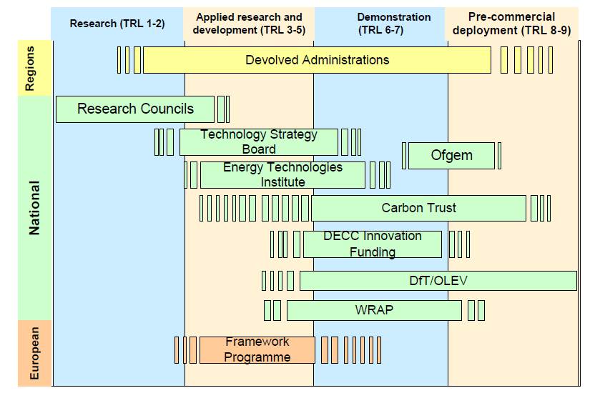
The UK Energy Innovation Landscape
Use-inspired/
applied/challenge
Discovery/
capability
Source: DECC

Slide 11
Workshop Agenda
Opening plenary:
The co-ordination of low carbon innovation in the UK
EPSRC: Challenge and capability (Energy Programme and the Physical Sciences theme)
The hand-over to applied RD&D
Case studies:
Challenge/use-inspired: marine renewables
Capability/discovery: molecular PV ……note this workshop is not about marine renewables and PV – these are exemplars!
Looking back: World Cafe session on what’s worked and what hasn’t
Lunch
Looking forward: building technology roadmaps
Pulling it all together

