Slide 1
CHALLENGE AND CAPABILITY
ENGINEERING AND PHYSICAL SCIENCES RESEARCH COUNCIL
Nigel Birch
Physical Sciences

Slide 2
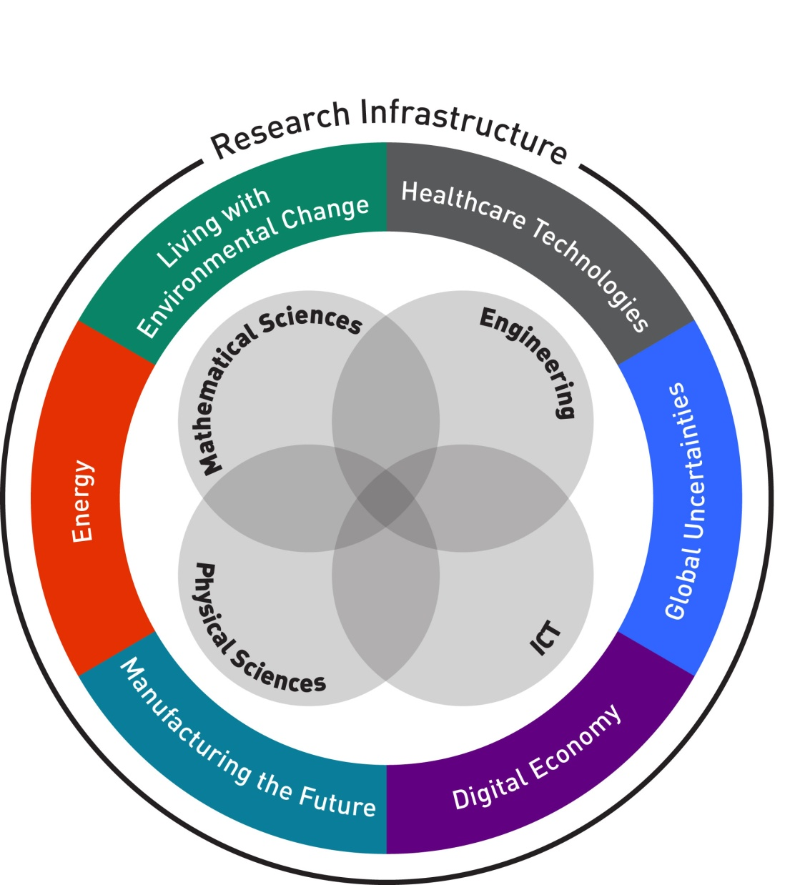
EPSRC’s portfolio
Notes:
EPSRC supports excellent, long term research and high quality postgraduate training in order to contribute to the economic competitiveness of the UK and the quality of life of its people. At any one time we are supporting a portfolio of research and training between £2-3billion.
We will have a portfolio that enables transformative impact to arise from our core national capability and from a complementary set of challenge themes. National capabilities are defined as EPSRC's support for excellent, long-term, core (and multi)-disciplinary research in mathematics, physical sciences, ICT and engineering. Our plans for Research Infrastructure will maximise the use of research equipment and guide strategic investment in large items of equipment.
These capabilities build resilience and the ability to handle unforeseen challenges which may be disruptive, drive economic growth and underpin other areas of research. We have set a balance between national capability and challenge themes of 60:40.
In order to maintain the UK’s international research standing in the face of increasing competition EPSRC must take a strategic approach to managing our portfolio. For example, to ensure we have sufficient critical mass in the areas we invest.
In future, all our investment decisions will be based on the international excellence of the research and its national importance, while continuing to encourage the free generation of ideas and curiosity-based research.

Slide 3
Key integration foci for the theme
Physical Sciences Capability
Shaping
Linking effectively to other capability & challenge themes and building on other external funding sources
Managing multiple strategies
Impact
Infrastructure
Developing a national strategy
Implementation of approach to support rather hinder science
Making impact a smarter rather than a serendipitous process
Influencing current portfolio of investments
Enhancing capability at the Cross-Council interface (the wider importance of Physical Sciences capability)
Focussing the training portfolio aligned with strategic needs
Balancing creativity with capability
Developing inspirational scientific leadership
Leaders

Slide 4
Physical Sciences – National Capability/Challenge
Strategy for the theme:
Focus on ground-breaking physical sciences research
Shape and integrate portfolio to meet societal and economic challenges that rely on fundamental science for solutions
Maintain flow of people to sustain capability at all career changes
Identify and help develop current and future research leaders

Slide 5
Materials for Energy applications
Part of Physical Sciences (Capability) portfolio
Recognises fundamental importance of materials research to meeting Energy challenges
Develops in association with Energy Programme. Eg:
Call: Encouraging physical sciences research to meet energy needs
Feedback from Energy discussions to inform strategic Theme strategy
Opening of Research Area to Fellowships

