Slide 1
Low Carbon Innovation – Coordinating UK HMG-backed Support
Dr. Paul Durrant
Head of Innovation Policy & Coordination, DECC

Slide 2
The Case for Innovation Support
The UK won’t meet its low carbon targets with current technologies at current costs.
The technology ‘push’ of direct innovation support alongside the ‘pull’ of market incentives, such as EMR, is needed
The Government’s low carbon technology innovation policies and programmes support the research, development and demonstration (RD&D) of new or enhanced low carbon technologies and their associated systems and processes.
The aim of these policies & programmes is to bring cheaper, greener, more effective technologies to the point at which they are sufficiently proven that the market (with the support of market mechanisms, such as Electricity Market Reform (EMR), if necessary) can deploy them widely.
Innovation in low carbon technologies will create business opportunities for UK companies at home and abroad and encourage the development of UK supply chains
Our investment in technology and systems development will drive down the costs of new and existing low carbon technologies

Slide 3
The LC Innovation Support Landscape
The landscape is complex say many observers – implying it shouldn’t be.
What we are trying to do is complex – develop a broad suite of technologies and systems of technologies that will transform the generation and use of energy in the next 40 years in the UK and overseas.
Government will spend over £1bn this SR period on a dozen or more technology sectors, with 100’s of projects ongoing at any given time. And innovation is an highly uncertain process.
Our approach won’t ever be simple but it can be improved.
There are wide range of public-sector backed bodies involved – coordination & collaboration is vital. Done right diversity is a strength.
Various reports in 2009/2010 were critical of the landscape.
Challenges we face:
Bodies have different objectives – risk of gaps and overlap in programmes.
Bodies have different approaches and operate at different stages – risk that projects fall into the gaps.
Innovators find the landscape hard to navigate.
Its difficult to measure impact.
Notes:
Coordination improvements,
Improved communication
Lack of overarching strategy
The LCICG – who is involved, how operates, key work packages

Slide 4
Principle UK Government Funders of LC Innovation (excluding the Devolved Administrations)
towards commercialisation
BIS
Innovators
DECC
Technology Strategy Board
Energy Technologies Institute
Research Councils
Commercial / Industry Investors

Slide 5
Principle UK Public-sector Funders of Low Carbon Innovation
DECC
towards commercialisation
BIS
Innovators
Devolved Administrations –
Scottish Government & Scottish Enterprise; Welsh Government; NI Assembly.
Carbon Trust
Energy Technologies Institute
Technology Strategy Board
Other Government Departments – Defra; DCLG; DfT; MoD.
Research Councils
Other organisations – Ofgem; The Crown Estate.
Commercial / Industry Investors

Slide 6















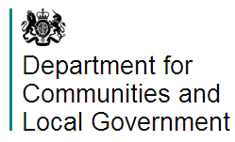

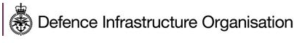
Maximise the impact of UK public sector funding for low carbon technologies.
Business
Communications
Innovators
The Low Carbon Innovation Co-ordination Group (LCICG) brings together the major public sector backed organisations that are supporting low carbon innovation in the UK.
The Group aims to maximise the impact of UK public sector funding for low carbon technologies, in order to:
Deliver affordable, secure, sustainable energy for the UK
Deliver UK economic growth
Develop the UK’s capabilities, knowledge and skills
Agreed, shared evidence base for action
Shared
intelligence
LCICG
Low Carbon Innovation Strategy
Measuring our collective impact
Coordinated,
Aligned
Programmes
Investors
HMG
http://www.lowcarboninnovation.co.uk/
Notes:
Speaker – In addition to the text on the slide you might like to refer to the following information.
The Low Carbon Innovation Coordination Group works together to maximise … [refer to slide].
We are made up of 19:
Core members (Left hand side) – are organisations that manage significant funding to support innovation in a range of low carbon technology sectors. They agree to attend all LCICG meetings and actively shape, develop and deliver the Group’s work plan. Collectively, in the period up to April 2015, core LCICG members expect to spend over £800 million of public sector funding on low carbon innovation.
Associate members (Right hand side) – are organisations with less significant funding resources, or support innovation in a smaller number of low carbon technology sectors. They can attend LCICG meetings as and when the agenda is of interest and can determine their level of engagement in shaping, developing and delivering the Group’s work plan.
PRESS RETURN
LCICG = Agreed, Shared evidence for action – Coordinated, aligned programmes – Low carbon innovation strategy
PRESS RETURN
Shared intelligence – measuring our collective impact
PRESS RETURN
Communication

Slide 7
Technology prioritisation: Technology Innovation Needs Assessments
The TINA project was launched in August 2010 with the aim of creating a robust knowledge base to guide government investment decisions.
The project highlights the innovation needs of those technologies likely to be most important in delivering our energy and climate change targets.
TINAs create a common understanding of innovation needs and the case for support, to facilitate coordinated planning between LCICG members and with developers.
11 TINAs - 9 published and further 2 to be completed by early summer 2013.
CCS
Offshore Wind
Nuclear
Heat
Bio-energy
Marine
Non-domestic buildings
Electricity networks & storage
Industrial energy efficiency
Hydrogen
Domestic buildings
7
Notes:
The TINAs in Green have been published and are available on the LCICG website. The TINAs in Orange will be published shortly.

Slide 8
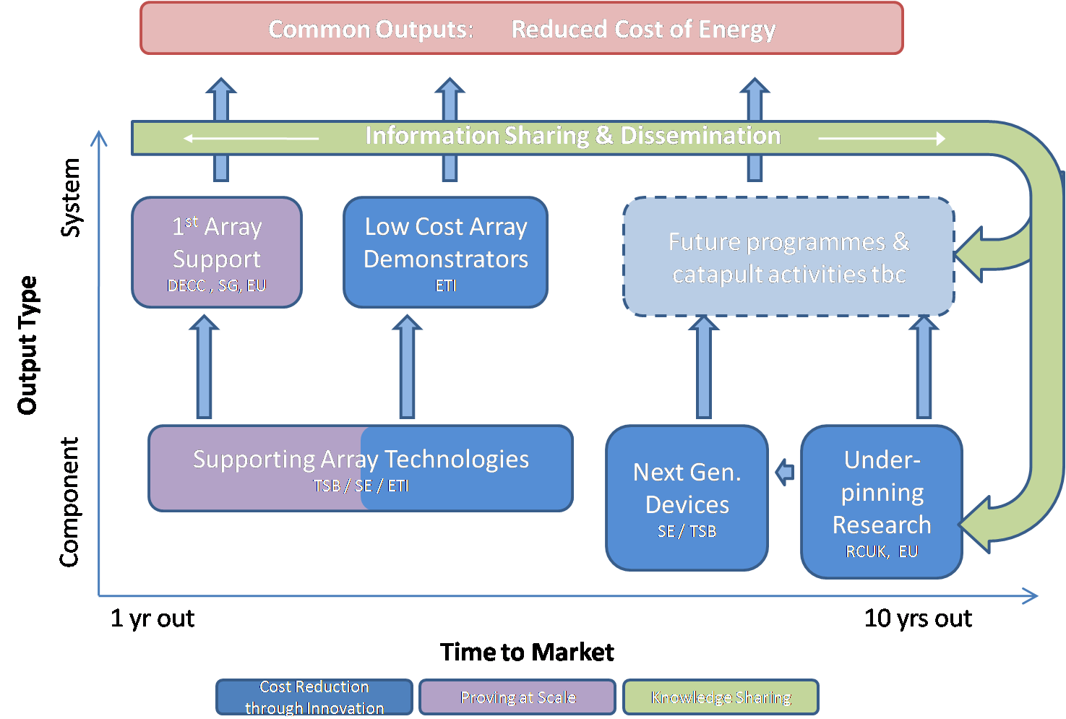
Programme Alignment – Marine Example

Slide 9
Innovation Programme Principles
The aim of the Energy Innovation Programme is to contribute to DECC’s objectives – in particular, helping to deliver our 2050 climate and renewables targets cost-effectively – by ensuring that the right energy innovation happens.
The focus of the programme is on the achievement of our long term energy targets.
Where schemes can also simultaneously deliver economic benefits that will be taken into account.
Support will be provided where:
the innovation will significantly contribute to the achievement of DECC’s energy and climate policy goals; and
there is clear evidence that the innovation need that would otherwise be unmet.
other actors (UK or international) have not, or are unlikely to, provide sufficient support; and
the potential benefits can be shown to be likely to exceed the costs.

Slide 10
£200m+ in CSR for low carbon technologies
Up to £60m for manufacturing ports infrastructure
Around £150m for innovative low carbon technologies
Up to £20m Marine Energy Array Demonstrator
Up to £35m Buildings Innovation Programme
Up to £30m for Offshore Wind Technologies
Up to £15m for Bioenergy Innovation
Up to £5m for Component Technologies (Call 1)
Up to £20m Innovative CCS Technologies
Up to £10m Non-Domestic Buildings Scheme
Up to £35m Energy Entrepreneurs’ Fund
Up to £8m ERANET Programme
Up to £5m for Component Technologies (Call 2)
Up to £3m SBRI Competition on Advanced Storage
Up to £20m for Energy Efficiency in Buildings
Up to £15m for Power Generation Technologies
Up to £19m split between Electricity Storage and Hydrogen
Up to £5m for Component Technologies (Call 3) Not announced yet and TSB will be adding more funds
Up to £Xm Nuclear Schemes
Up to £2.8m for Domestic Buildings Thermal Storage
Up to £30m for CT Legacy Programmes
£3m Contribution to TSB-led supply chain competition
Up to £5m for Polymer Fuel Cells
Up to £15m Carbon Trust Offshore Wind Accelerator
Up to £7m Carbon Trust Pyrolysis Challenge
Test facilities
Up to £3m not specified?
Note: Now slightly out of date. Some figures have changed.

